Slide 1

Building Robust and Collaborative Coded Engineering Models
J.D. Landgrebe
Data-Delve LLC
Previously Principal Engineer, Procter and Gamble Co. Inc.

Slide 2
xxx
Tutorial is at:
If you are not familiar with Github, click on Readme.md for instructions on downloading the files as a Zip archive

Slide 3
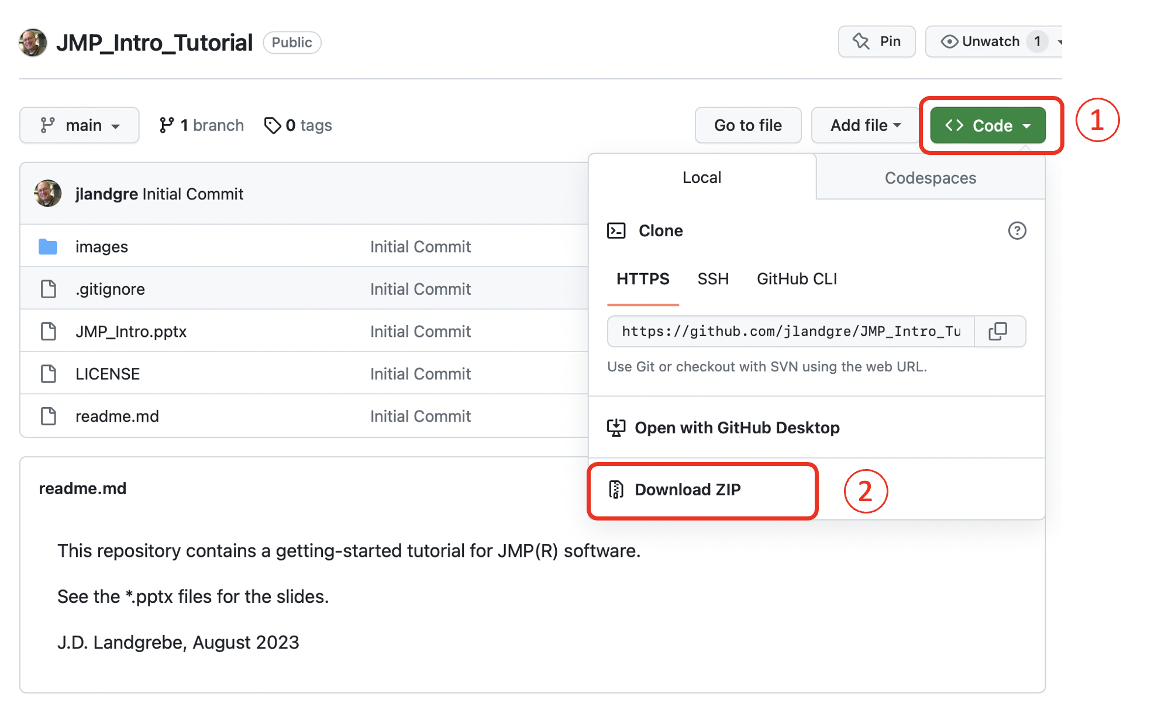
Downloading Files xxx
Download tutorial materials from Github repository: https://github.com/jlandgre/JMP_Intro_Tutorial
Github: Good for engineers to know! It’s common for sharing open-source materials like this tutorial
Github repositories can be open (like this one) or private

