Slide 1

Building Robust and Collaborative Coded Engineering Models
J.D. Landgrebe
Data-Delve LLC
Former Principal Engineer, Procter and Gamble Co. Inc.
Colloquium on occasion of Professor Sotiris Pratsinis retirement
February 26, 2025
Particle Technology Laboratory. Department of Mechanical & Process Engineering, ETH Zürich, Switzerland

Slide 2
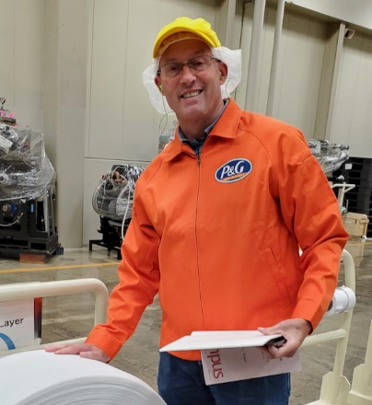


Intro
30+ years Procter and Gamble technologist/Principal Engineer – Consumer Packaged Goods R&D
BS ChE (Purdue University 1984)
MS ChE (U. of Cincinnati/Pratsinis 1989)
[xxx title xxx]
Data science and technical modeling consulting practice (datadelveengineer.com)
Adjunct Professor, University of Delaware USA Chemical Engineering

Slide 3
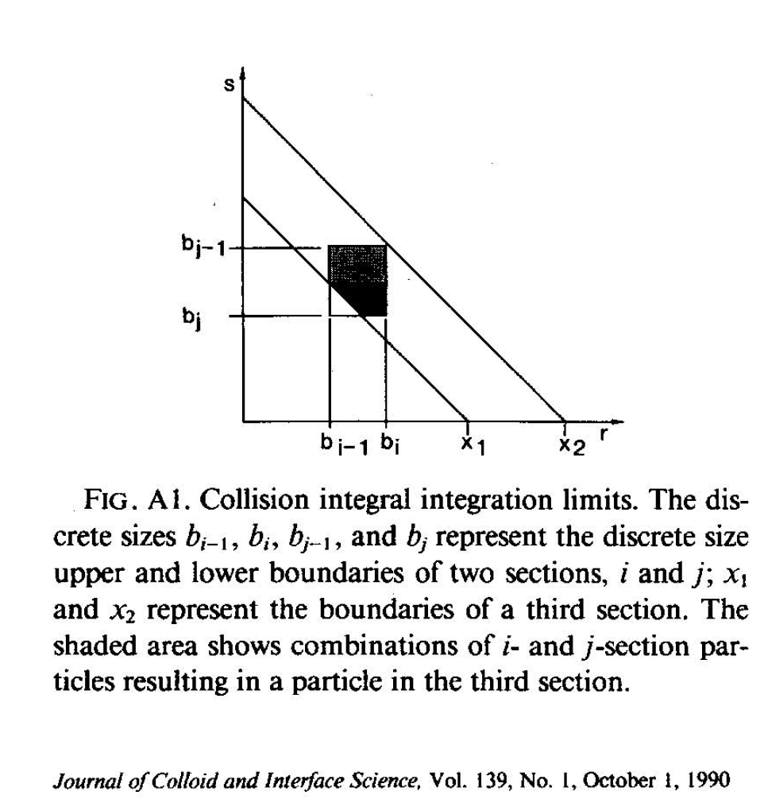
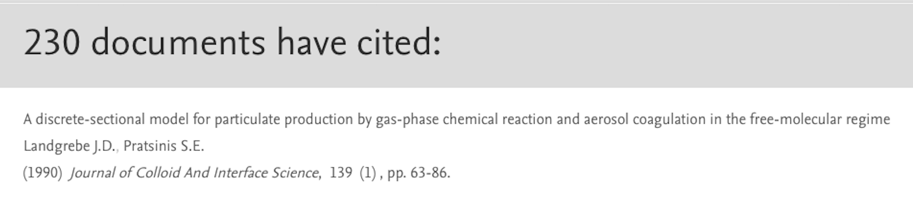
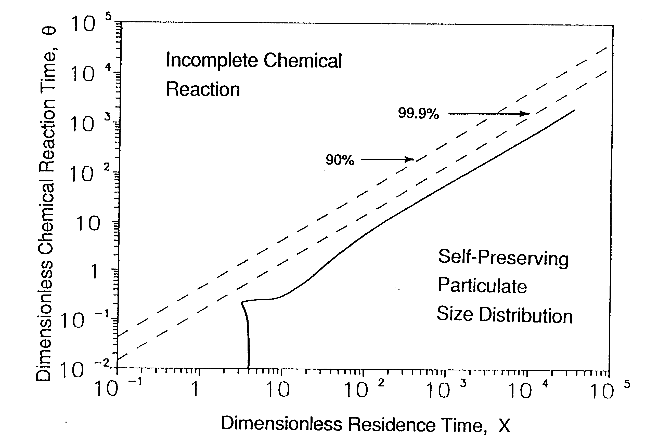
Some things I learned from “Dr. P”*
Penetrate technically to the full extent of the topic
Research is a team sport. Be friends with your colleagues wherever they may be
Great visuals rule the day (Corollary: “Say it with dimensionless numbers”)
Mentoring means giving your mentees/those under you a “seat at the table”
Conferences
Consulting
Lead a balanced life that pays full attention to our creator and to those around us
* My newlywed wife’s name for Sotiris circa 1987
Blog: What I Learned from Dr. P.
With congratulations, gratitude and warmest best wishes to Sotiris and Eleni!!
Sue and J.D. Landgrebe

Slide 4
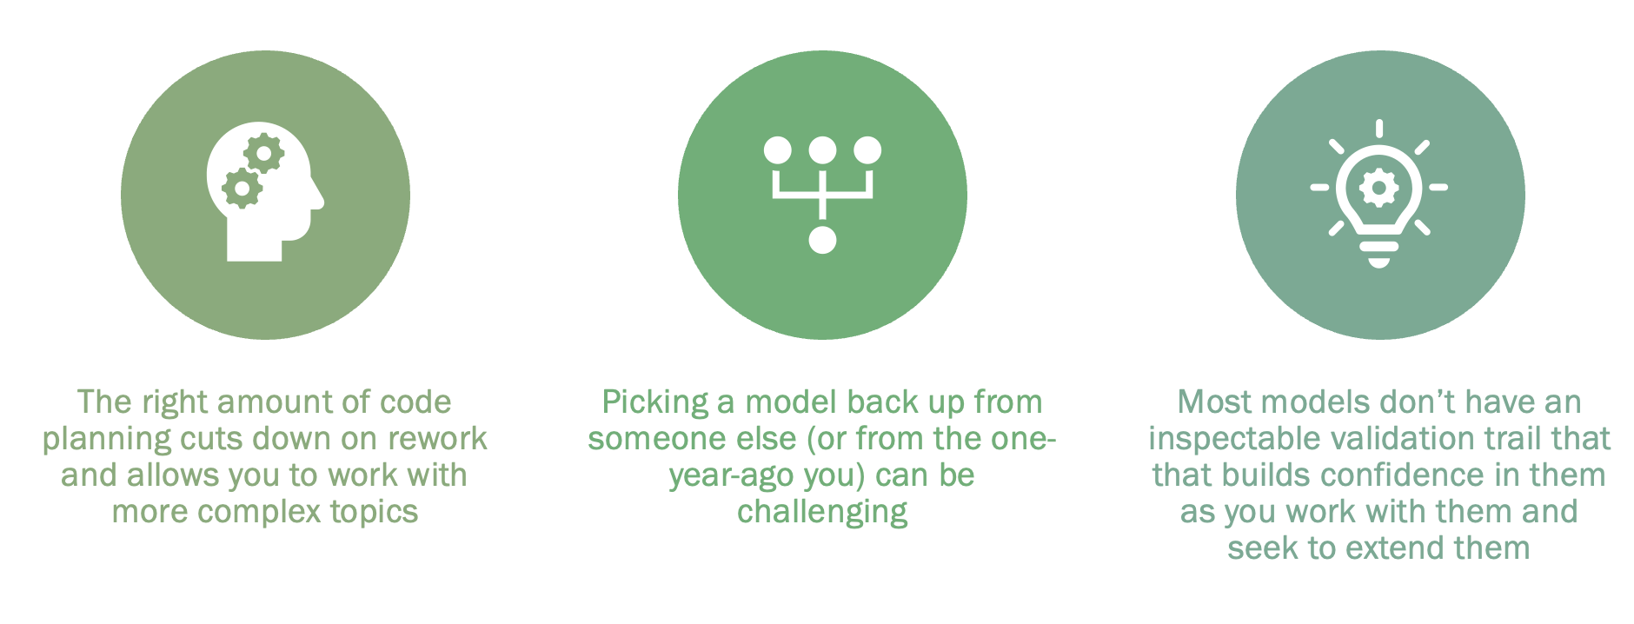
Why Best Practices for Coded Models?
Have you ever:
Picked up a colleague’s, former student’s (or your own 🤪😫) code and spent hours trying to understand it?
Been unable or had difficulty running someone’s previous model?
Had difficulty extending or scaling a previous model (your own or someone else’s?
HUGE opportunity to set best practices individually, in research groups and corporate teams –it’s a leadership job!!!
Target audience:
Leaders of groups who want to lead setting culture fpr how things are done under their watch
Individual modelers –graduate students, practicing engineers and scientists. Anyone who builds coded models but is not full-time software engineer or member of software development team

Slide 5
Why Best Practices for Coded Models?
Objectives of Implementing best practices
Gain ability to create Curated coded models personally and in your team
(see xxx, 2009)
Validate with rerunnable tests -- guard against future broken models
(see TDD for inspiration but keep it practical)
Learn to develop efficiently using AI tools to write the code (≈90%. Let’s be honest!)
Full story and tutorials are at: xxx Github repo link xxx
(If unfamiliar with Github, click on Readme.md doc for download instructions)
Best Practices for Models
“This is how we do things around here”
aka TIHWDTAH

Slide 6
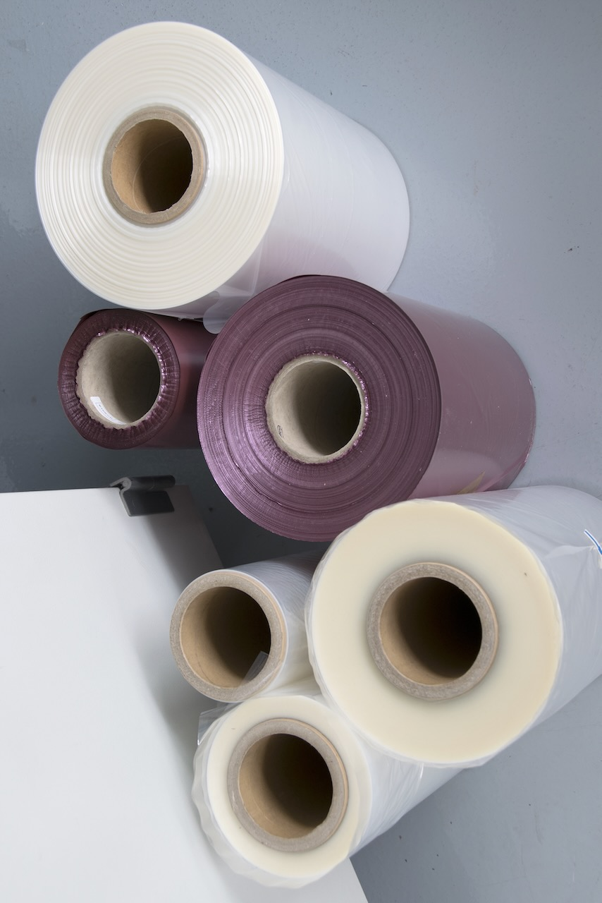
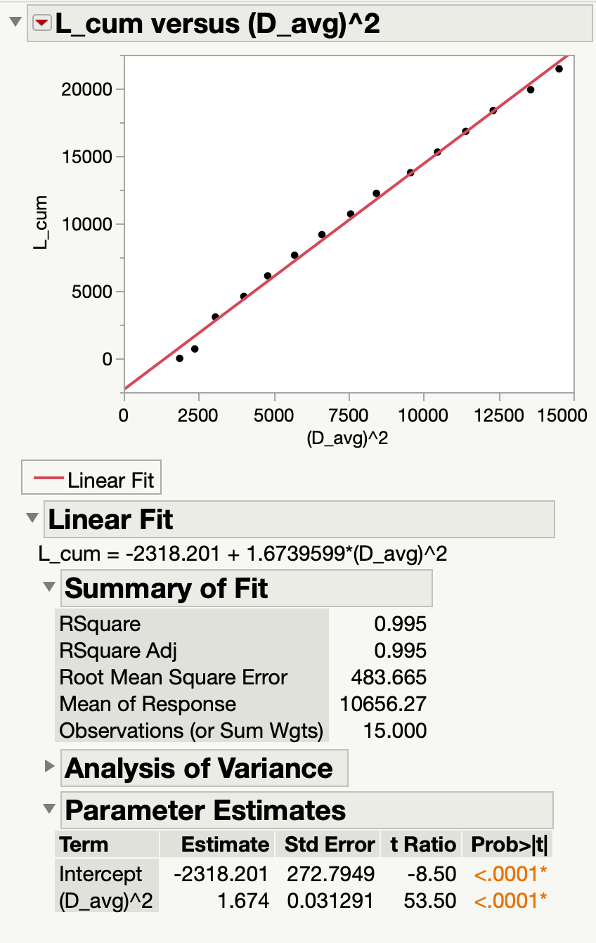
Best Practices – Python Model
Github has full tutorial to build, curate and validate an industrially useful model for calculating roll properties (Length, L vs. Diam., D)
Tutorial keeps to a simple example to teach software practices
Tutorial includes how to use AI to write the code for the model and for rerunnable Python (Pytest) tests in separate files
C = material’s caliper or thickness

Slide 7
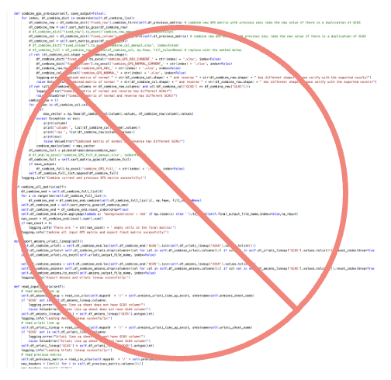
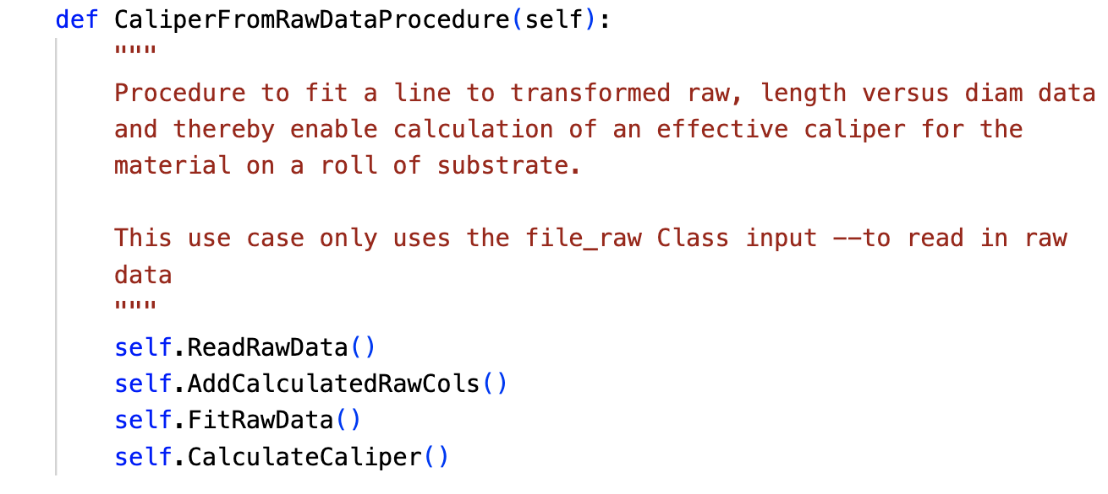
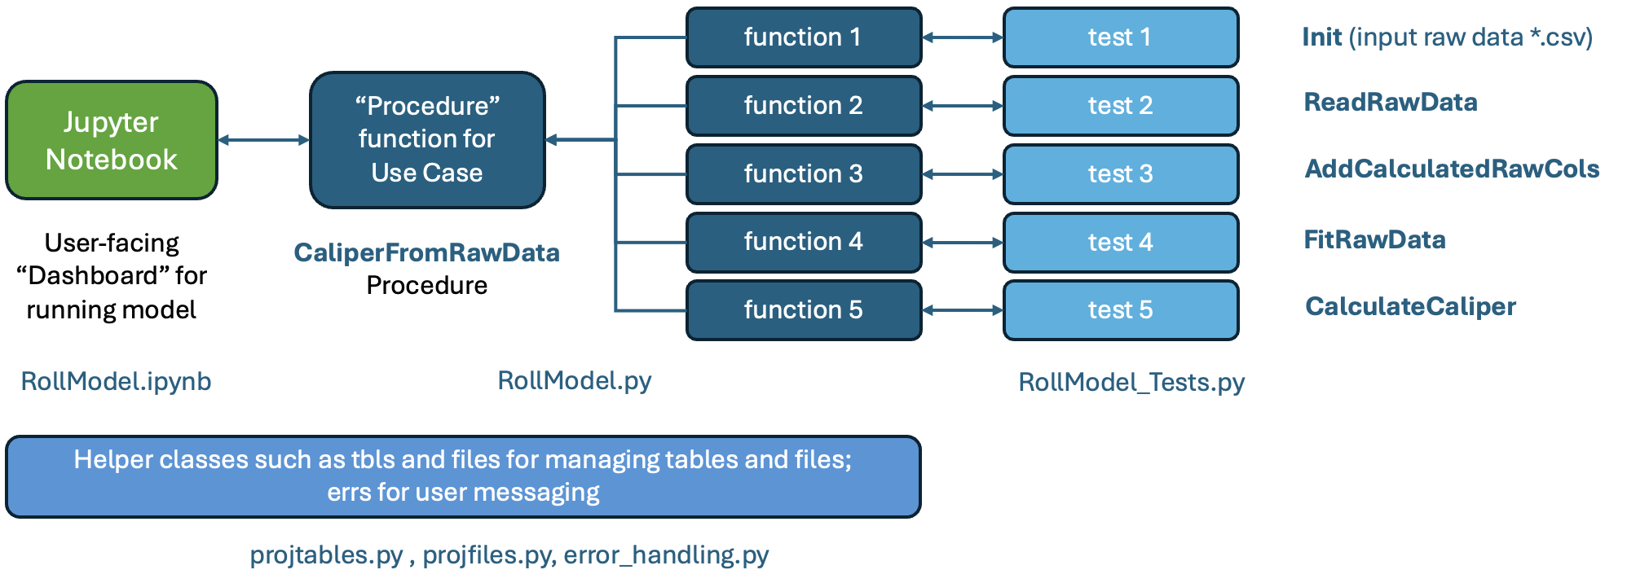
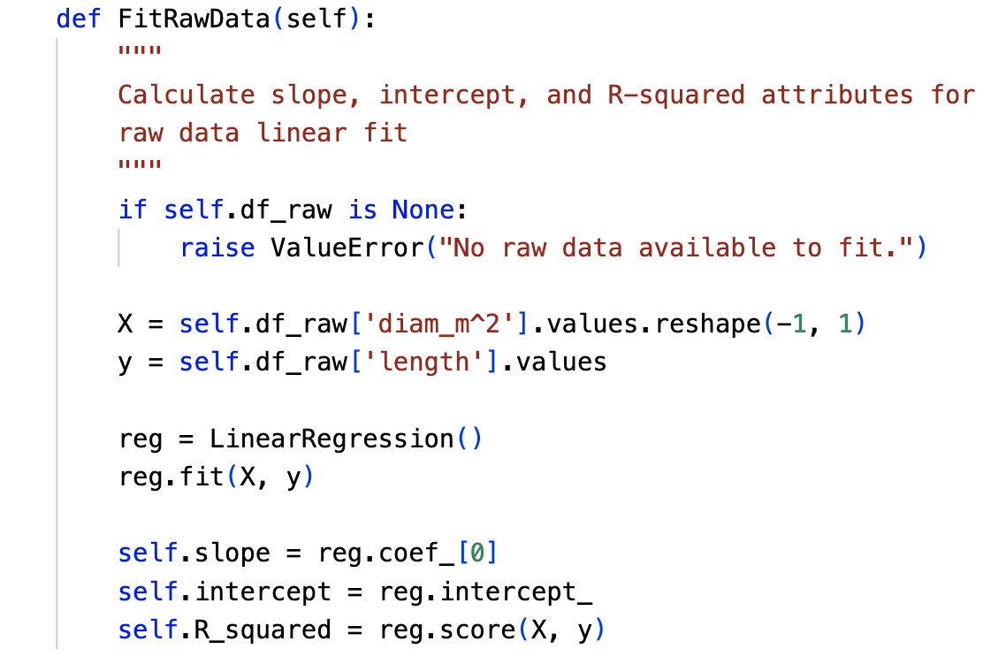
Curating – Python Model Example
Meandering, “spaghetti” code
Curating ≠ long, multi-step code with obscure names
Code should be easily inspectable by non-coding leader/manager
Macroscopic, predictable architecture helps curate
Single-action functions (Clean Code: A Handbook of Agile Software Craftsmanship”, R. Martin, 2008)
Easy to test
Easy for AI tool to write the code and write rerunnable test(s)
Object-oriented “Class-based”
Easy to bring in trusted, helper libraries for working with data etc.
Model’s instanced code objects are easy to inspect and debug
Multistep Procedure
Single-action Function
A Good Architecture for Model Code

Slide 8
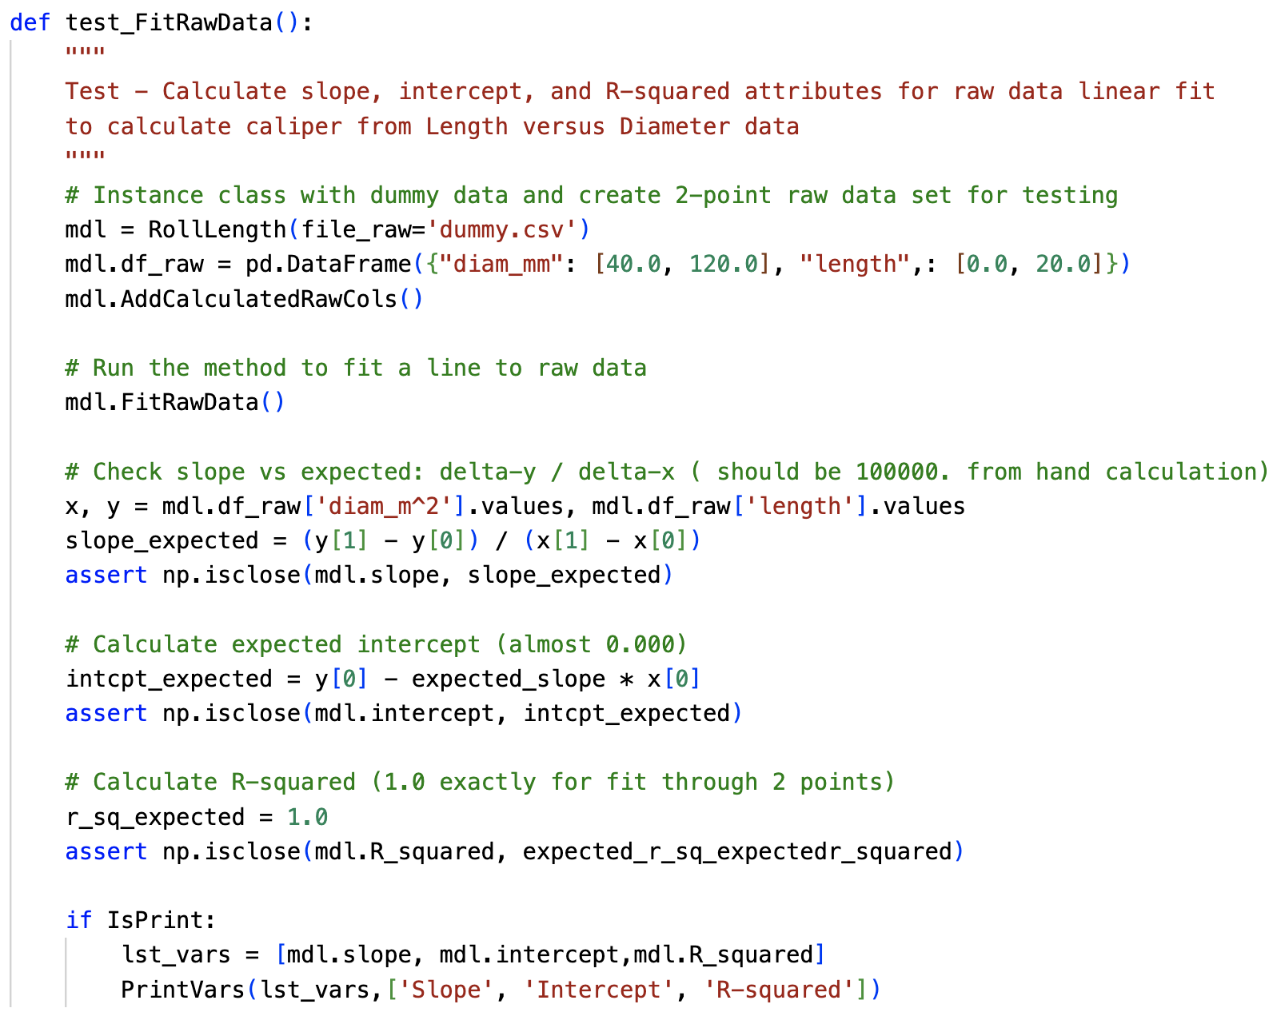
Testing/Validation
test_FitRawData Function
Testing is completely under-utilized by engineers/scientists; yet easy to learn
Standard Python Pytest library manages testing from separate file from model code
Standard should be minimum one test per model function
Tests = rerunnable proof that future changes don’t break the model
Tests are documentation that explains how each function works
Screen pic of Pytest output

Slide 9
AI Tools For Coded Models
Organization should provide subscription and not-so-subtly encourage use (“Can you send me a link to an AI chat that explains your code?”)
Github Copilot Chat + Microsoft VS Code is one, strong option
[Typical] Use Case 1 = one-time queries like “How to write a custom, Python iterator for to iterate over a range of DataFrame cells?”
[More valuable] Use Case 2 = “Write the FitRawData function and its Pytest test_FitRawData that creates mockup data…”
Previous best practices of object-oriented and modular, single-action functions + tests are an ideal fit with using current AI chat tools
Need to supply tool with background to explain “how life works.” This can be standard/pasteable text file (tutorial example)
For many modelers, requires more pre-planning than historical practices
Does not eliminate need for knowing coding –AI tools make mistakes and/or can stray from background intent

