Slide 1
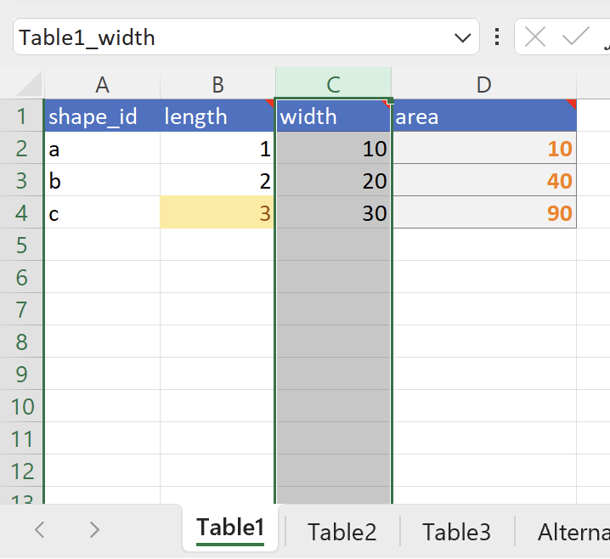
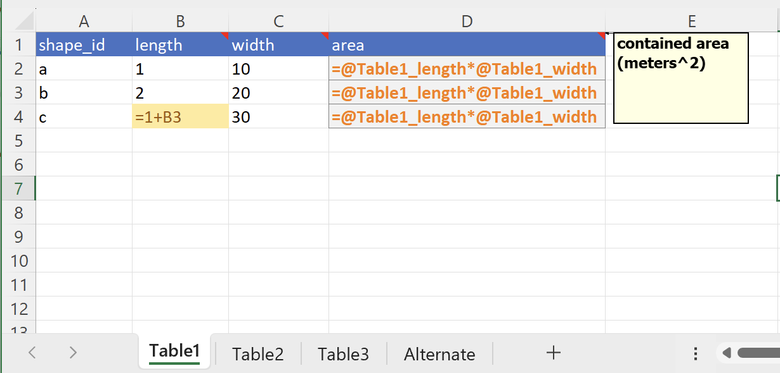
Named column ranges ($C:$C)
Named header row ($1:$1)
With formulas expanded (Control-` toggle)
Header cell Notes to curate variable names
Brown Neutral Style to highlight ad hoc (one-off) formulas
Symbolic formulas and orange Formula Style for column formulas
Named Table Range ($A:$D)

Slide 2
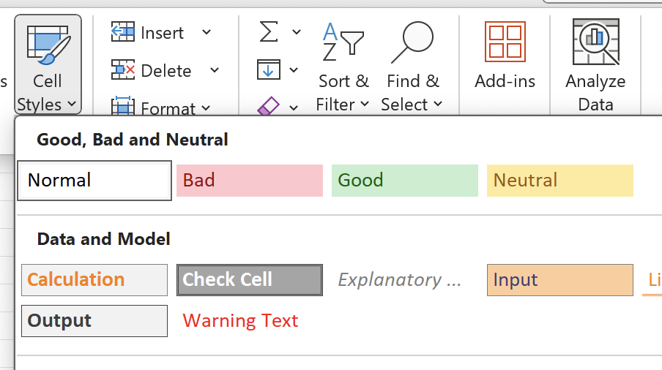
Use for ad hoc formulas
Use for table column formulas and scenario model formulas

Slide 3
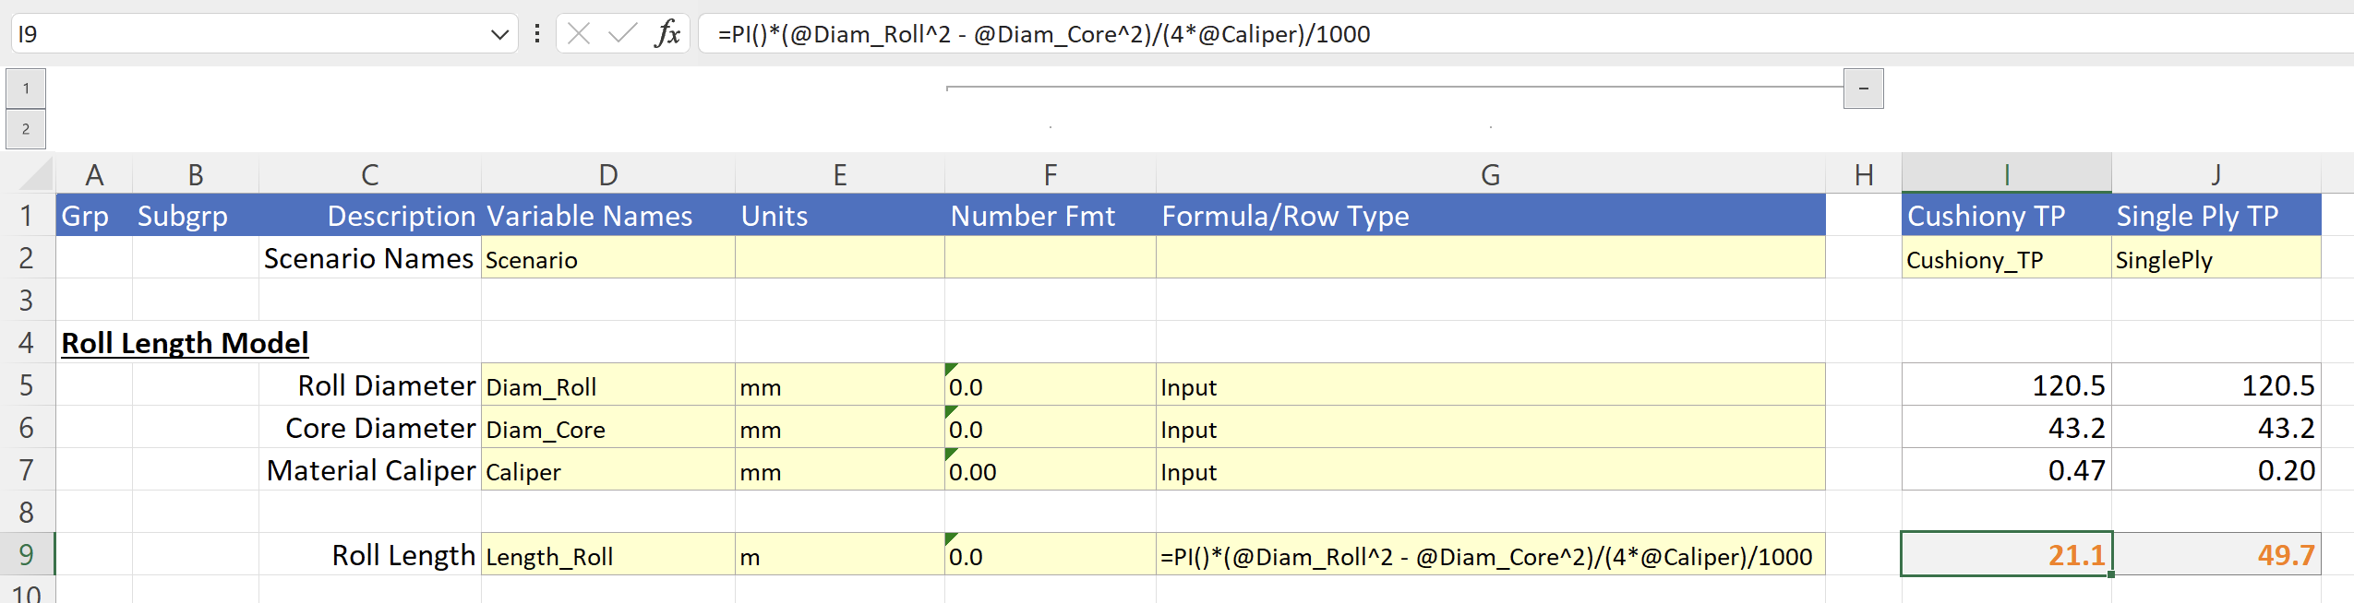
Use for naming columns
Row’s Formulas match Column G curated text
Use for naming row ranges
Text Number format for storing format strings and formulas

Slide 4
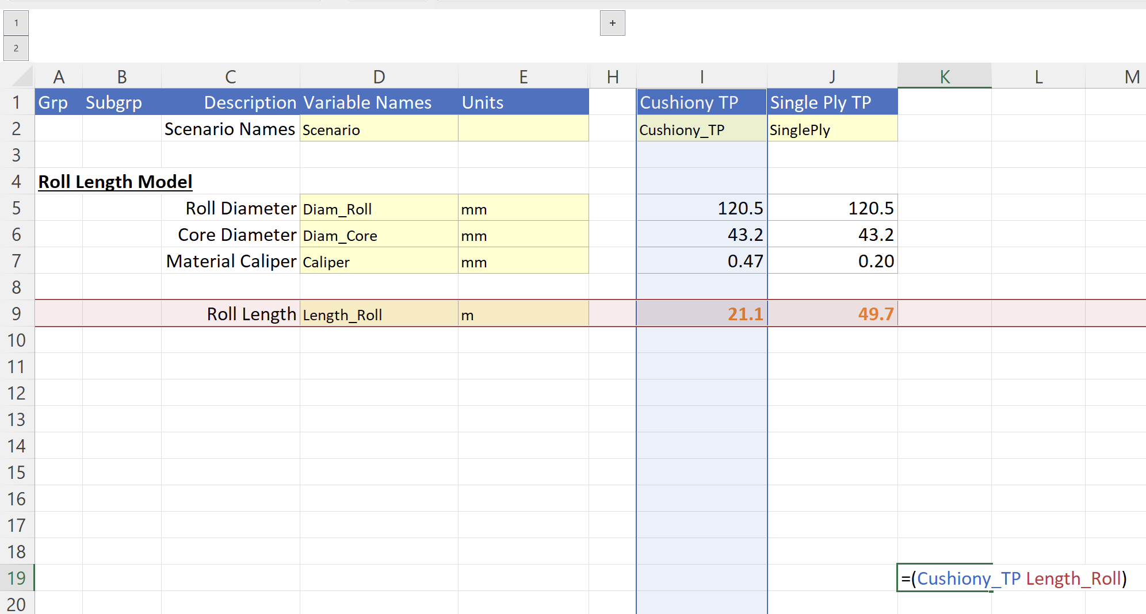
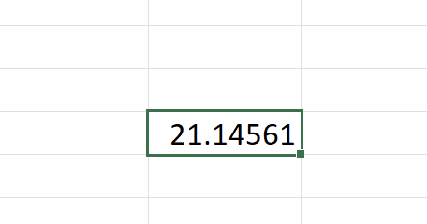
Range intersection formula:
(var1 range + space + var2 range)
Formula result (unformatted)

