Slide 1

JMP Intro For Chemical Engineers
J.D. Landgrebe
University of Delaware

Slide 2

Getting Started With JMP® Software
JMP (By a famous company, SAS Institute) is ideal for reshaping, exploring and analyzing ad hoc data
https://www.jmp.com/en_us/home.html
https://www.sas.com/en_us/software/viya.html
Widely used in industry
Recommended over Excel® and Python for exploratory analysis
Ease-of-use suited for engineers
Designed with thoughtful combo of numbers and pictures describing data
It guides to good statistical practices for non-statisticians

Slide 3
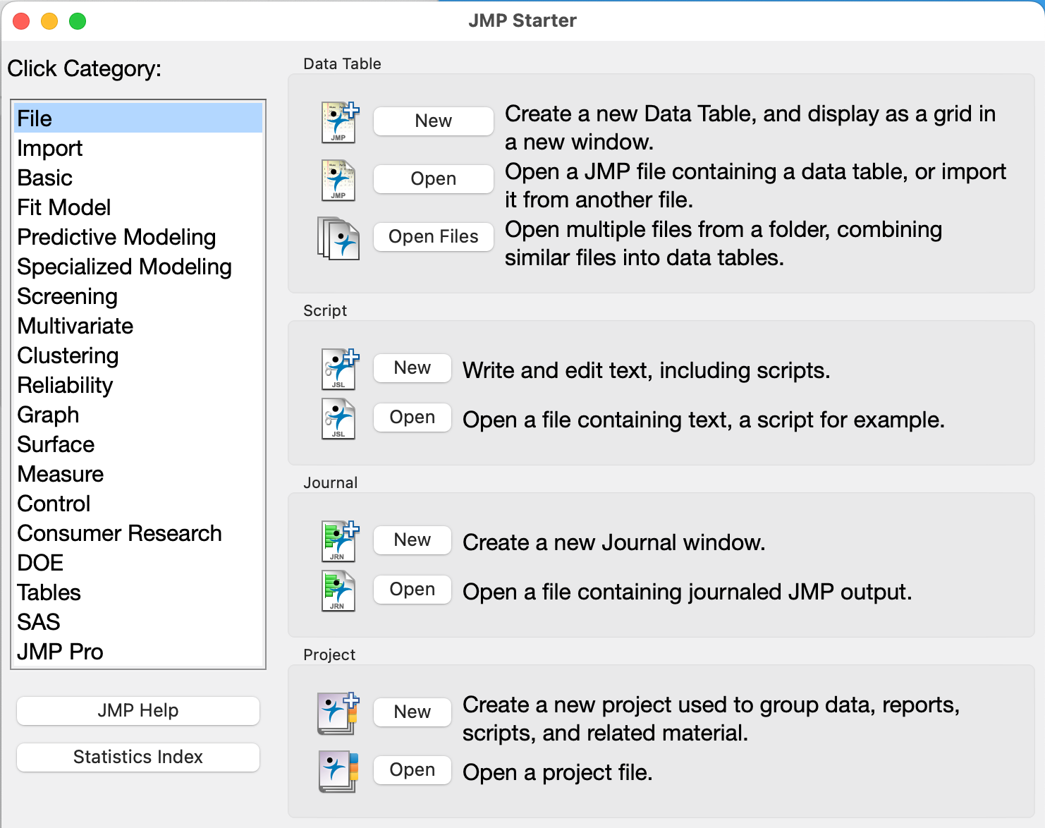
JMP Getting Started Topics
This is a customized tutorial to go with the great (and wide-ranging) tutorials that come with software install. We cover:
Installation and accessing tutorials that come with the install
Data selection, Column info and Data Types
Data table operations and reshaping data
Basic Analyses

Slide 5
Installation and accessing tutorials
Add U. of Delaware specific instructions

Slide 6
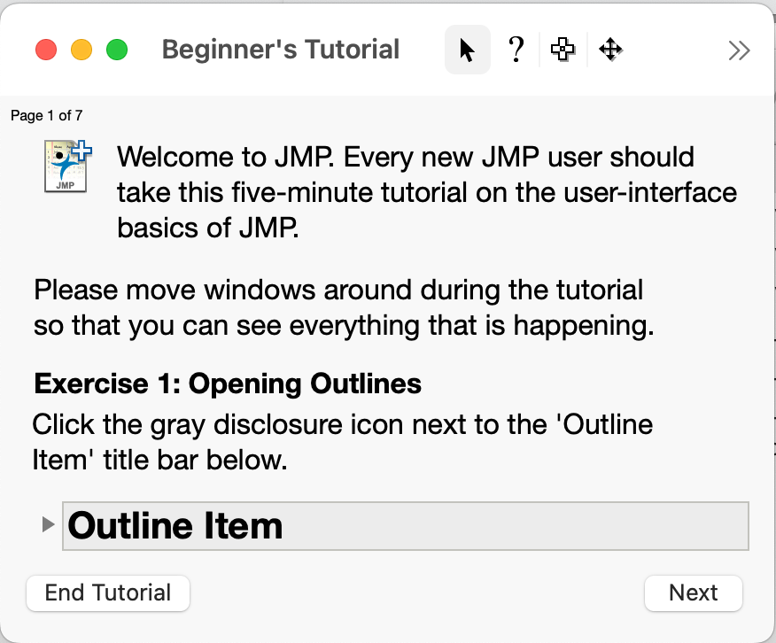
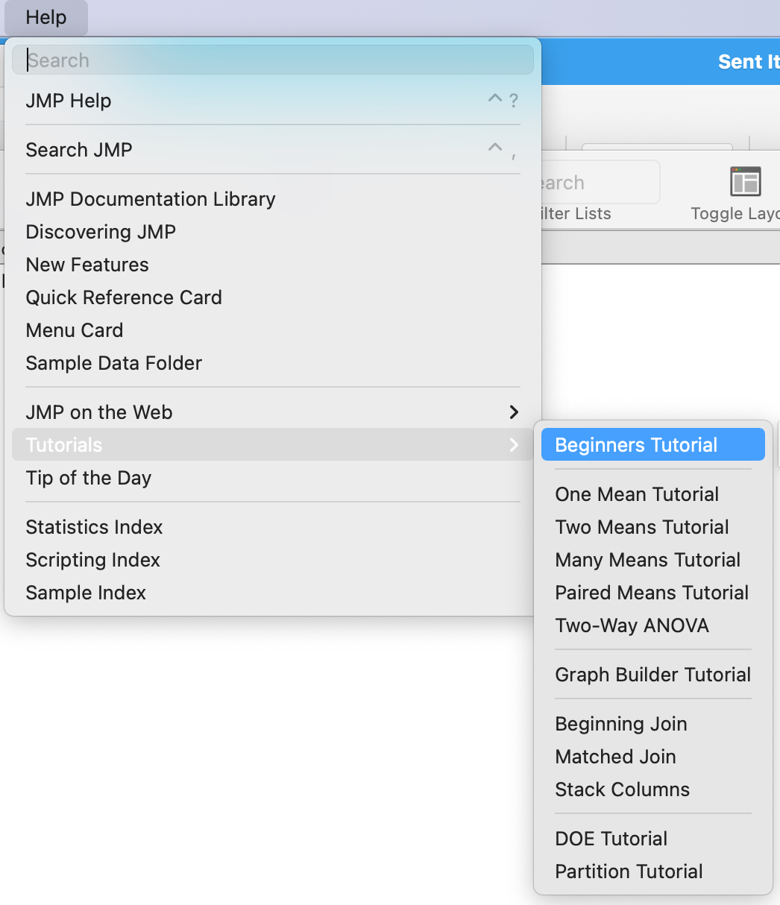
Installation and accessing tutorials
Installation also installs references and resources for learning
As an exercise, launch JMP, choose the Help menu and browse what’s there
Take the 5-minute Beginners Tutorial to get a feel for how JMP works

