Slide 1
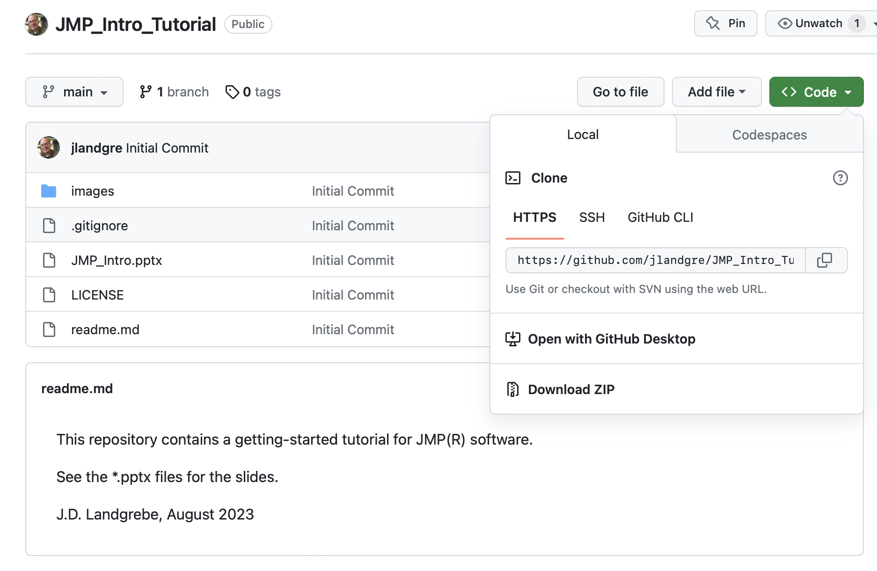
1
2

Slide 2
