Slide 1
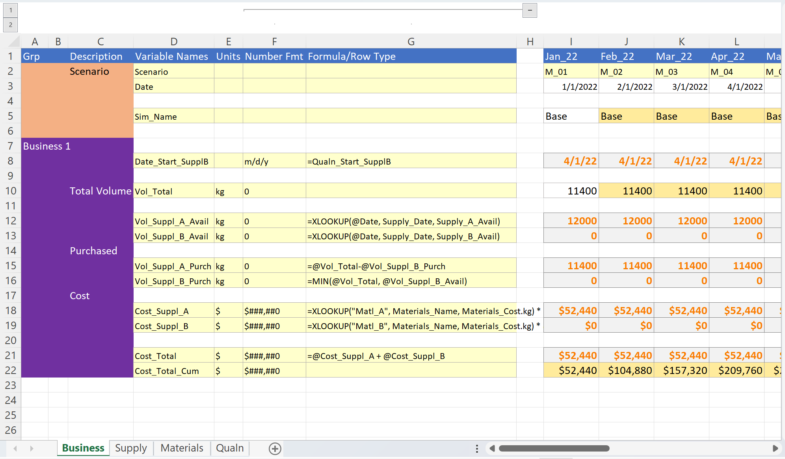
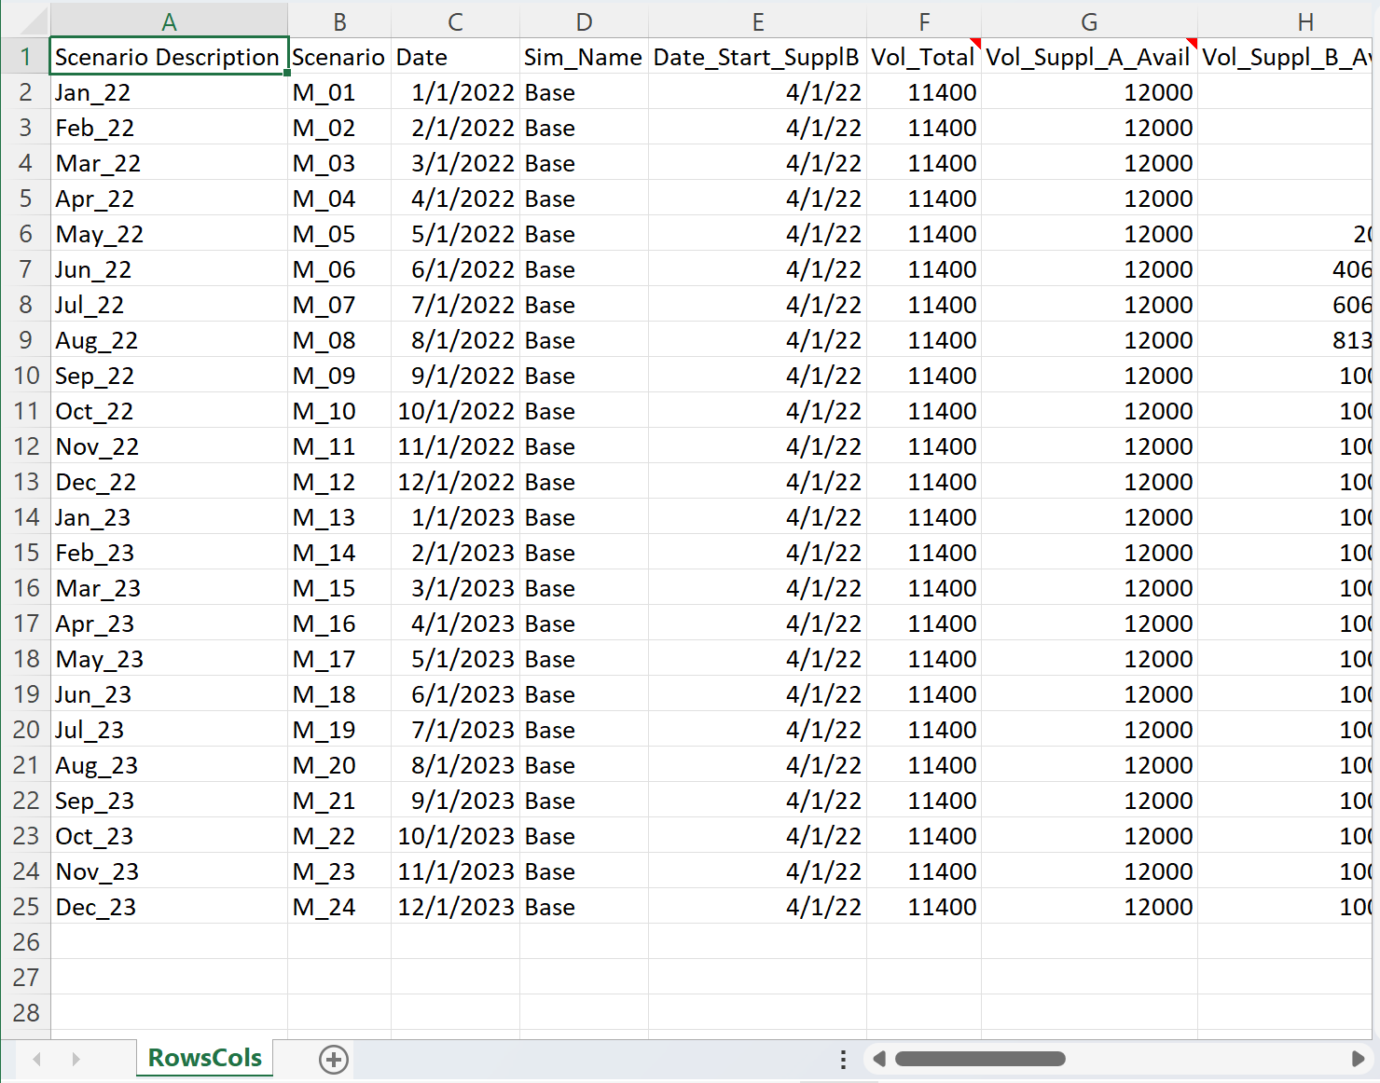
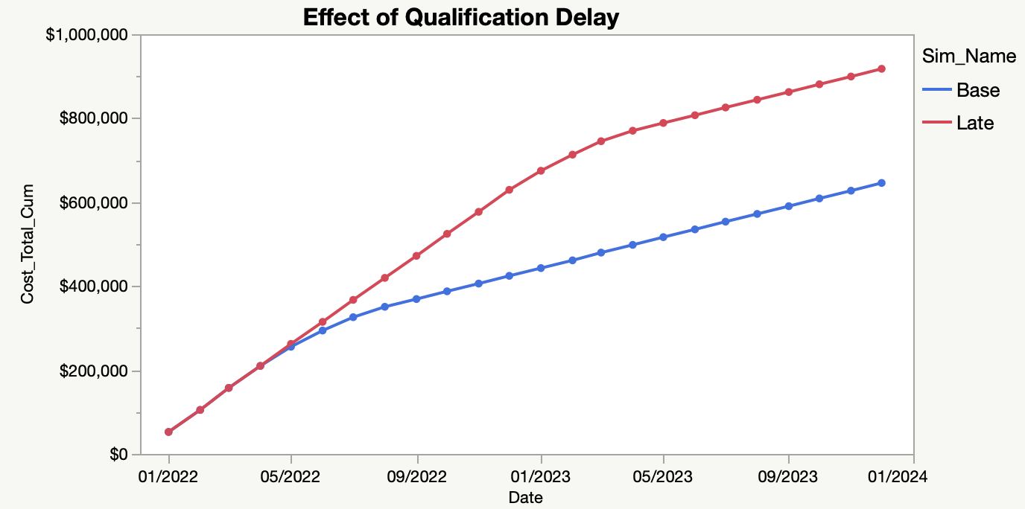
Calendar
Months
Rows/Columns Version of Simulation
Business Simulation Model

Slide 2
Time-Based simulation of New Supply Qualification Impact on Financials
Supply
Capacities and costs versus time
Time-Based
Business Simulator
(Scenario = 1 month)
Materials
Raw Material cost lookup table
“Utilities”
Unit conversions, Named Lists etc.
Qualn
Single-valued Params affecting sim
Summary
(Concatenated simulations for graphing)

