Slide 1





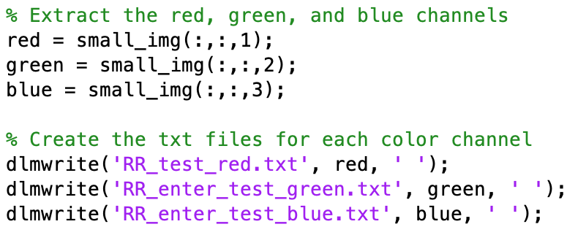
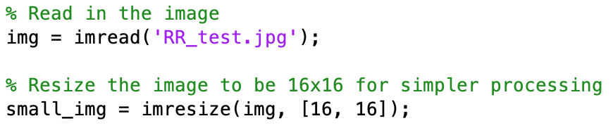
Traffic Sign Recognition
Aric Landy, John Landy, John Stefan
https://github.com/Jstefan123/214Final
Overview/Problem
Linear Algebra Concepts
Tests
This project uses linear algebra and simple but effective machine learning concepts in order to recognize traffic signs.
Using the span of several images for each sign, our project calculates the minimum error of projection onto the span of each different image in the database, and thus predicts the road sign.
Further Expansion
Least squares
Edge detection
Recognize signs from an angle
Process
Resize image to 16x16 image for more simple processing using MATLAB
Split the 16x16 image into its R, G, and B channels, then write these values to three separate text files

