Slide 1
Lab Assignment 1
Joseph Lanser

Slide 2

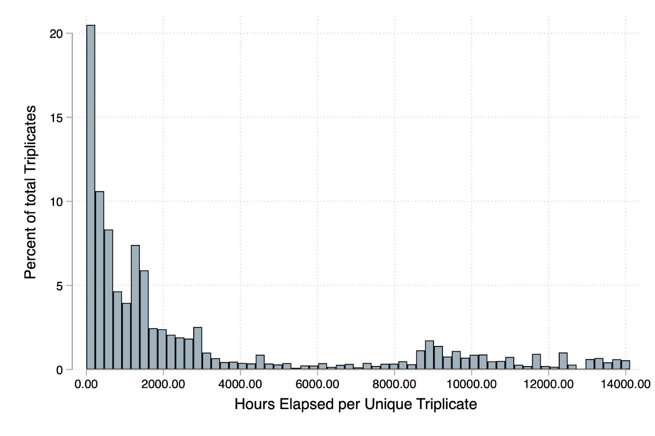
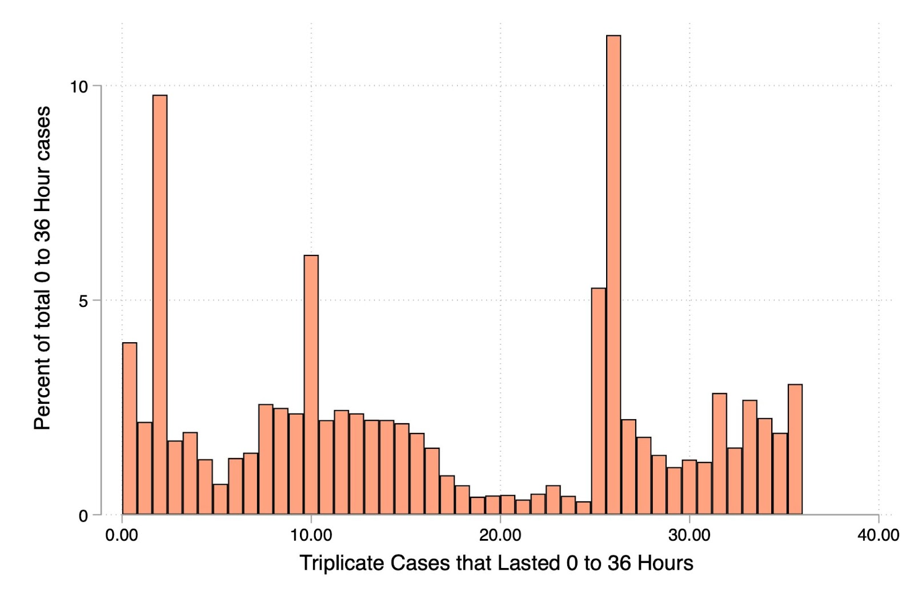
Using the 1% Random Sample:
26,037 Unique Triplicates
Earliest case OPEN date: May 24th 2023
Latest case OPEN date: June 26th 2025
Earliest case CLOSED date: January 1st 2024
Latest case CLOSED date: August 15th 2025

Slide 3
22,512 cases lasted less than 1 day.
That’s only 1.6% of cases in this sample.
239,419 cases never closed (don’t have an RI).
That’s 17.5% of cases.
I do think it is worth including cases less than a day in lifespan
1.6% of cases isn’t huge, but I think it is worth keeping them as it is a typical case type
(not uncommon just rare, want to include it in our models)

Slide 4
Metric | Balance at 30 DPB | Balance at 60 DPB
N (Obs) | 22,298 | 5,397
Mean | $2,448.90 | $1,917.07
Std. Dev. | $12,531.05 | $8,650.90
Min | $1.59 | $1.59
25th Percentile | $155.67 | $181.00
Median (50th) | $340.00 | $340.27
75th Percentile | $983.03 | $1,059.31
Max | $617,975.40 | $159,540.10
Number of cases beyond 30 DPB: 23,450 (around 1.7%)
Number of case beyond 60 DPB: 16,390 (around 1.2%)
24.2% of 30 DPB cases move to 60 DPB

Slide 5
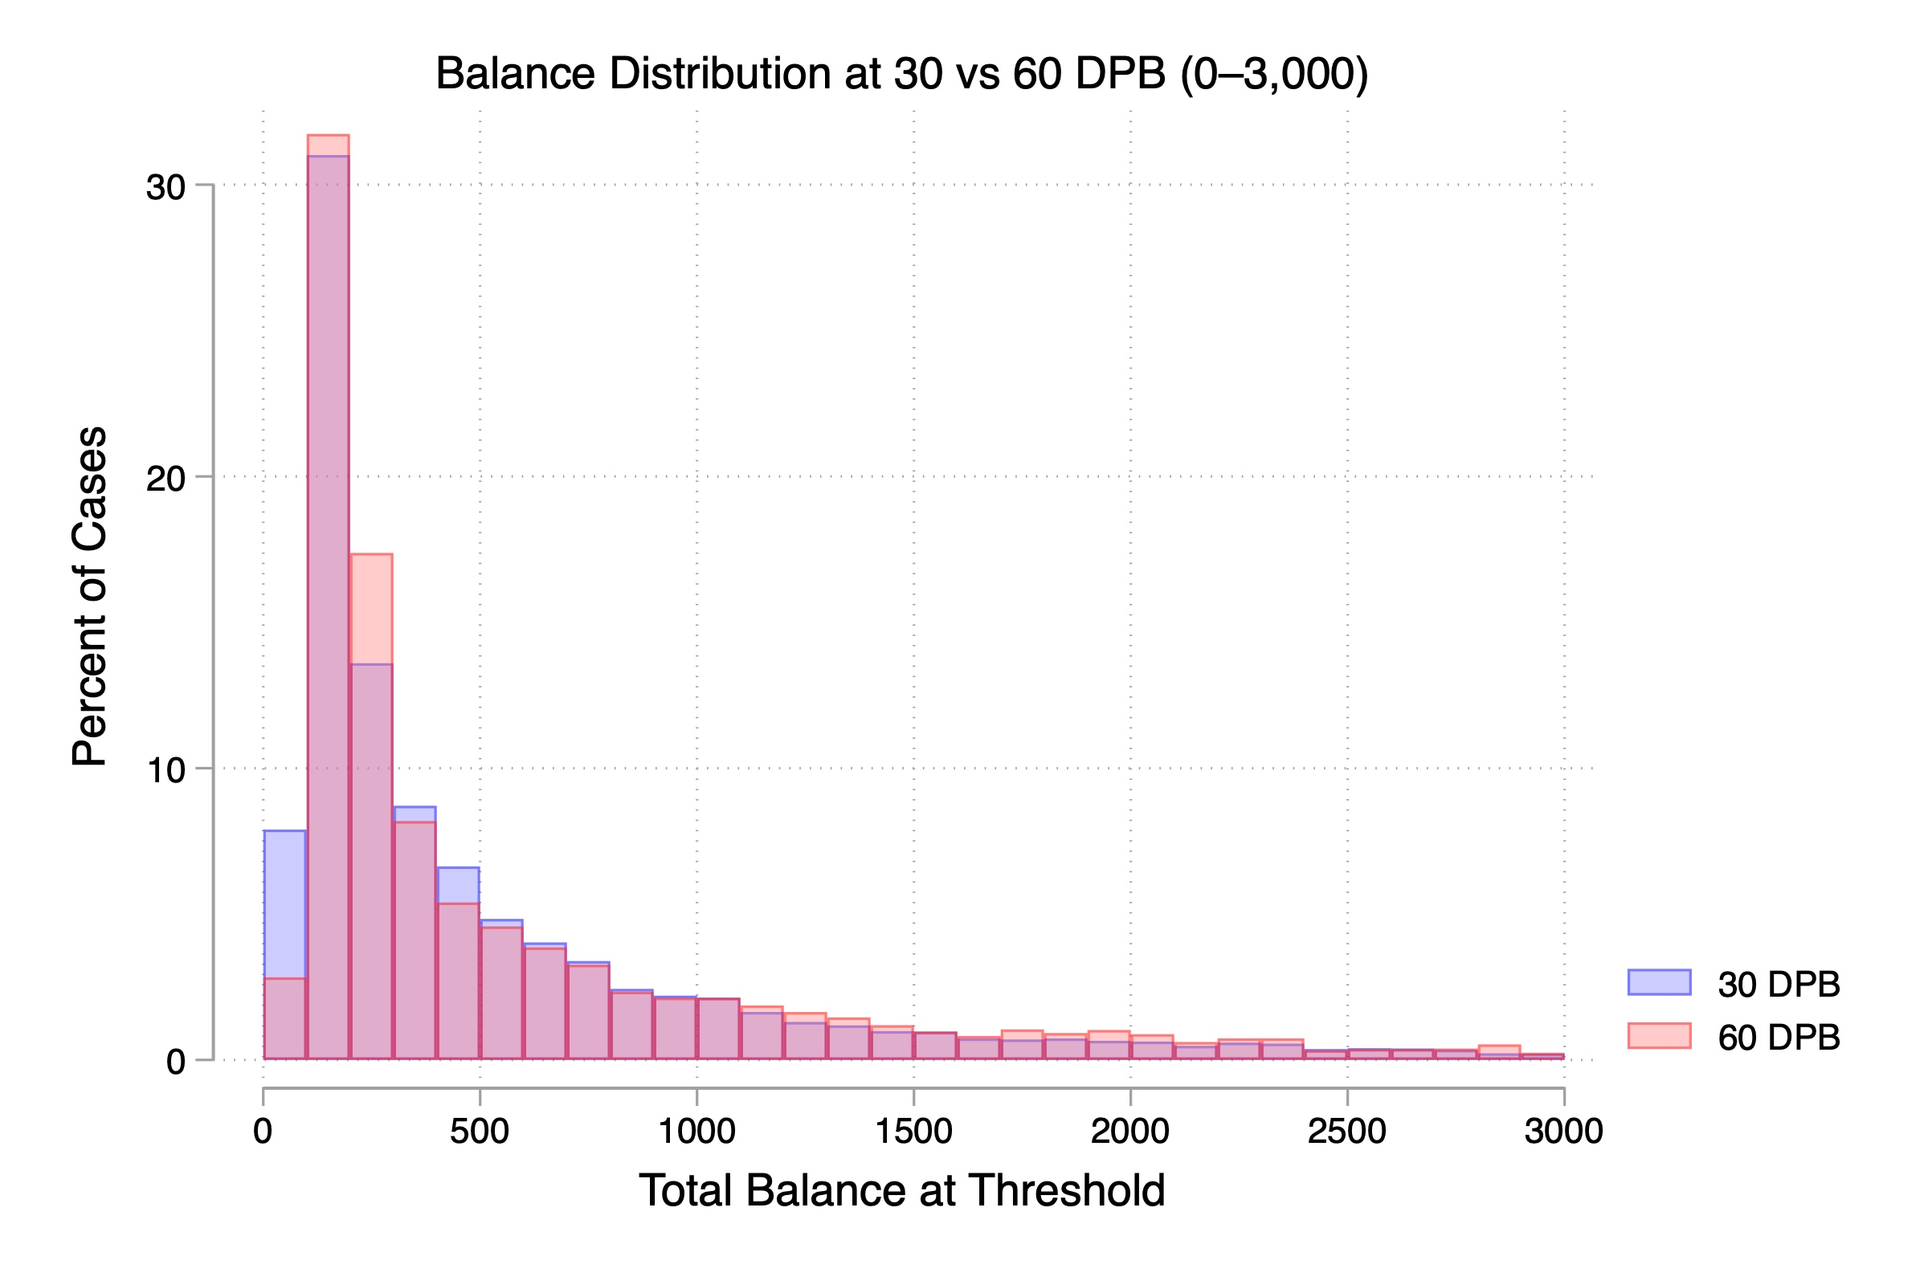

Slide 6
30 DPB: Customer Type | Consumer | Small Business | Total
Charge | 3,986 | 1,866 | 5,852
Charge+Lend | 1,378 | 431 | 1,809
Lend | 9,996 | 1,684 | 11,680
Total | 15,360 | 3,981 | 19,341
60 DPB: Customer Type | Consumer | Small Business | Total
Charge | 385 | 114 | 499
Charge+Lend | 127 | 35 | 162
Lend | 1020 | 163 | 1183
Total | 1532 | 312 | 1844

Slide 7
Customer Type | DPB | N | Mean | SD | p25 | p50 | p75 | Min | Max
Both | 30 | 2,122 | $4,007.45 | $13,319.50 | $392.46 | $959.58 | $2,676.90 | $35.98 | $241,518.41
Both | 60 | 449 | $3,769.41 | $11,147.25 | $452.64 | $1,167.36 | $2,865.00 | $39.20 | $157,665.33
Charge | 30 | 6,521 | $6,095.96 | $21,305.04 | $318.70 | $1,002.12 | $3,431.90 | $3.83 | $617,975.44
Charge | 60 | 1,440 | $4,354.08 | $14,851.27 | $311.69 | $842.73 | $2,391.42 | $3.83 | $175,888.55
Lend | 30 | 13,636 | $464.81 | $1,206.31 | $122.17 | $209.47 | $465.04 | $1.59 | $46,997.37
Lend | 60 | 3,504 | $679.46 | $2,090.23 | $155.11 | $226.65 | $556.60 | $1.59 | $56,219.84
Total | 30 | 22,279 | $2,450.46 | $12,536.25 | $155.80 | $340.00 | $983.35 | $1.59 | $617,975.44
Total | 60 | 5,393 | $1,917.89 | $8,654.04 | $181.00 | $340.00 | $1,059.31 | $1.59 | $175,888.55

