Slide 1
Descriptive Statistics and Log Results

Slide 2
Small Business
Descriptive Statistics for our key variables
Variable | Mean | SD | Min | p25 | p50 | p75 | Max | N
fico | 672.94 | 71.52 | 434 | 627 | 676 | 721 | 850 | 30,877
tsr | 0.45 | 0.32 | 0 | 0.18 | 0.39 | 0.73 | 0.999 | 30,877
cdss | 0.34 | 0.33 | 0 | 0.07 | 0.207 | 0.56 | 0.999 | 30,877
probc | 0.74 | 0.37 | 0 | 0.71 | 0.94 | 0.98 | 1 | 30,877

Slide 3
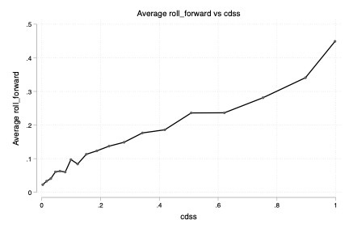
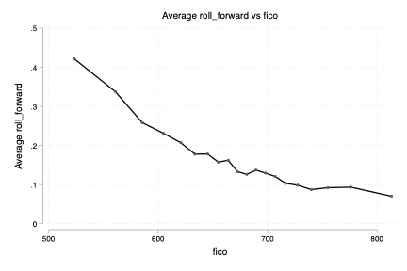
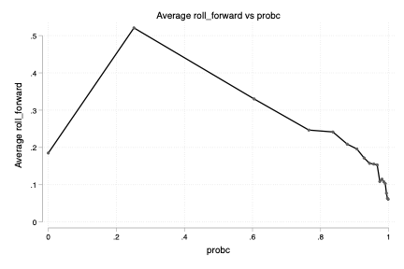
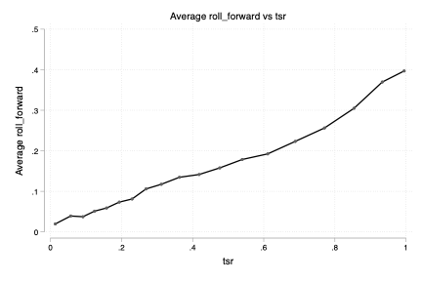

Slide 4
Log Results: Base Model
AUC = 0.7489
*Margins calculated using the Delta Method
Variable | dy/dx | Std. Err. | z | P>|z| | 95% CI Lower | 95% CI Upper
fico | 0.000 | 0.000 | 0.130 | 0.899 | 0.000 | 0.000
tsr | 0.158 | 0.014 | 11.260 | 0.000 | 0.131 | 0.186
cdss | 0.171 | 0.012 | 14.420 | 0.000 | 0.148 | 0.194
probc | -0.054 | 0.005 | -10.250 | 0.000 | -0.064 | -0.043

Slide 5
Log Results: Full Model
AUC = 0.7523
Variable | dy/dx | Std. Err. | z | P>|z| | 95% CI Lower | 95% CI Upper
fico | 0.000 | 0.000 | 0.870 | 0.385 | 0.000 | 0.000
tsr | 0.450 | 0.044 | 10.150 | 0.000 | 0.363 | 0.537
cdss | 0.125 | 0.038 | 3.260 | 0.001 | 0.050 | 0.200
probc | -0.054 | 0.005 | -10.080 | 0.000 | -0.065 | -0.044
num_products | -0.010 | 0.003 | -3.220 | 0.001 | -0.016 | -0.004
bal_due | 11.369 | 3.474 | 3.270 | 0.001 | 4.559 | 18.179
bal_over_expr | 0.002 | 0.001 | 1.730 | 0.084 | 0.000 | 0.005
tenure | 0.000 | 0.000 | 1.870 | 0.062 | 0.000 | 0.001
cs_other | -0.296 | 0.108 | -2.740 | 0.006 | -0.508 | -0.085
cs_low_balance | -0.200 | 0.114 | -1.750 | 0.080 | -0.423 | 0.024
cs_currents | -0.286 | 0.108 | -2.640 | 0.008 | -0.499 | -0.074
cs_seg_a | -0.317 | 0.109 | -2.910 | 0.004 | -0.530 | -0.103
cs_high_balance | -0.325 | 0.108 | -3.000 | 0.003 | -0.538 | -0.113
cs_cfs_team | -0.231 | 0.118 | -1.950 | 0.051 | -0.463 | 0.001
cs_arct_team | 0.000
d_chrg_lend | -0.004 | 0.007 | -0.570 | 0.570 | -0.019 | 0.010
d_chrg | 0.001 | 0.005 | 0.280 | 0.778 | -0.008 | 0.011
tsr_sq | -0.265 | 0.036 | -7.400 | 0.000 | -0.335 | -0.195
cdss_sq | 0.060 | 0.032 | 1.880 | 0.060 | -0.003 | 0.122
*Margins calculated using the Delta Method

Slide 6
Consumer
Descriptive Statistics for our key variables
Variable | Mean | SD | Min | p25 | p50 | p75 | Max | N
fico | 636.25 | 67.08 | 431 | 588 | 638 | 683 | 850 | 92,894
tsr | 0.56 | 0.34 | 0 | 0.25 | 0.53 | 0.98 | 0.999 | 92,894
cdss | 0.42 | 0.34 | 0 | 0.13 | 0.31 | 0.71 | 0.999 | 92,894
probc | 0.88 | 0.15 | 0 | 0.84 | 0.97 | 0.97 | .999 | 92,894

Slide 7
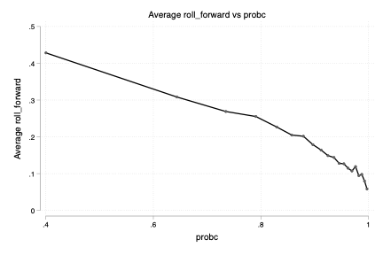
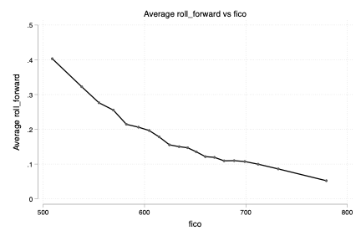
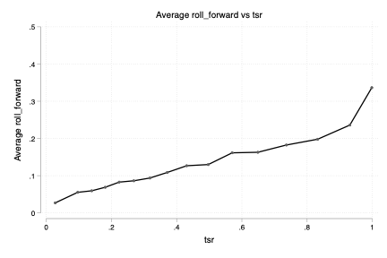
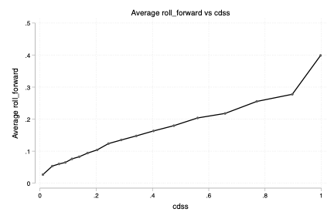

Slide 8
Log Results: Base Model
AUC = 0.7269
Variable | dy/dx | Std. Err. | z | P>|z| | 95% CI Lower | 95% CI Upper
fico | 0.000 | 0.000 | -0.630 | 0.530 | 0.000 | 0.000
tsr | 0.076 | 0.009 | 8.800 | 0.000 | 0.059 | 0.093
cdss | 0.187 | 0.008 | 24.660 | 0.000 | 0.172 | 0.202
probc | -0.175 | 0.008 | -23.100 | 0.000 | -0.189 | -0.160

Slide 9
Log Results: Full Model
AUC = 0.7288
Variable | dy/dx | Std. Err. | z | P>|z| | 95% CI Lower | 95% CI Upper
fico | 0.000 | 0.000 | 0.740 | 0.456 | 0.000 | 0.000
tsr | 0.363 | 0.030 | 12.180 | 0.000 | 0.305 | 0.422
cdss | 0.122 | 0.028 | 4.340 | 0.000 | 0.067 | 0.177
probc | -0.174 | 0.008 | -22.850 | 0.000 | -0.189 | -0.159
num_products | -0.010 | 0.002 | -5.080 | 0.000 | -0.013 | -0.006
bal_due | 6.130 | 3.109 | 1.970 | 0.049 | 0.037 | 12.223
bal_over_expr | 0.001 | 0.002 | 0.530 | 0.596 | -0.003 | 0.005
tenure | 0.000 | 0.000 | 3.230 | 0.001 | 0.000 | 0.001
cs_other | -0.198 | 0.059 | -3.360 | 0.001 | -0.314 | -0.083
cs_low_balance | -0.214 | 0.059 | -3.620 | 0.000 | -0.330 | -0.098
cs_currents | -0.241 | 0.060 | -4.050 | 0.000 | -0.358 | -0.125
cs_seg_a | -0.247 | 0.061 | -4.080 | 0.000 | -0.366 | -0.129
cs_high_balance | -0.197 | 0.059 | -3.330 | 0.001 | -0.313 | -0.081
cs_cfs_team | 0.000
cs_arct_team | 0.000
d_chrg_lend | -0.019 | 0.004 | -4.210 | 0.000 | -0.027 | -0.010
d_chrg | -0.016 | 0.004 | -4.310 | 0.000 | -0.023 | -0.009
tsr_sq | -0.241 | 0.022 | -10.870 | 0.000 | -0.284 | -0.197
cdss_sq | 0.072 | 0.021 | 3.390 | 0.001 | 0.030 | 0.113

