Slide 1
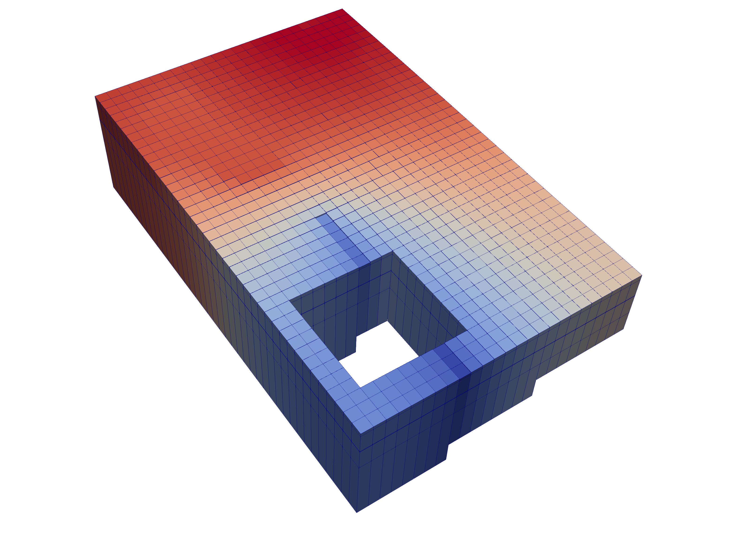
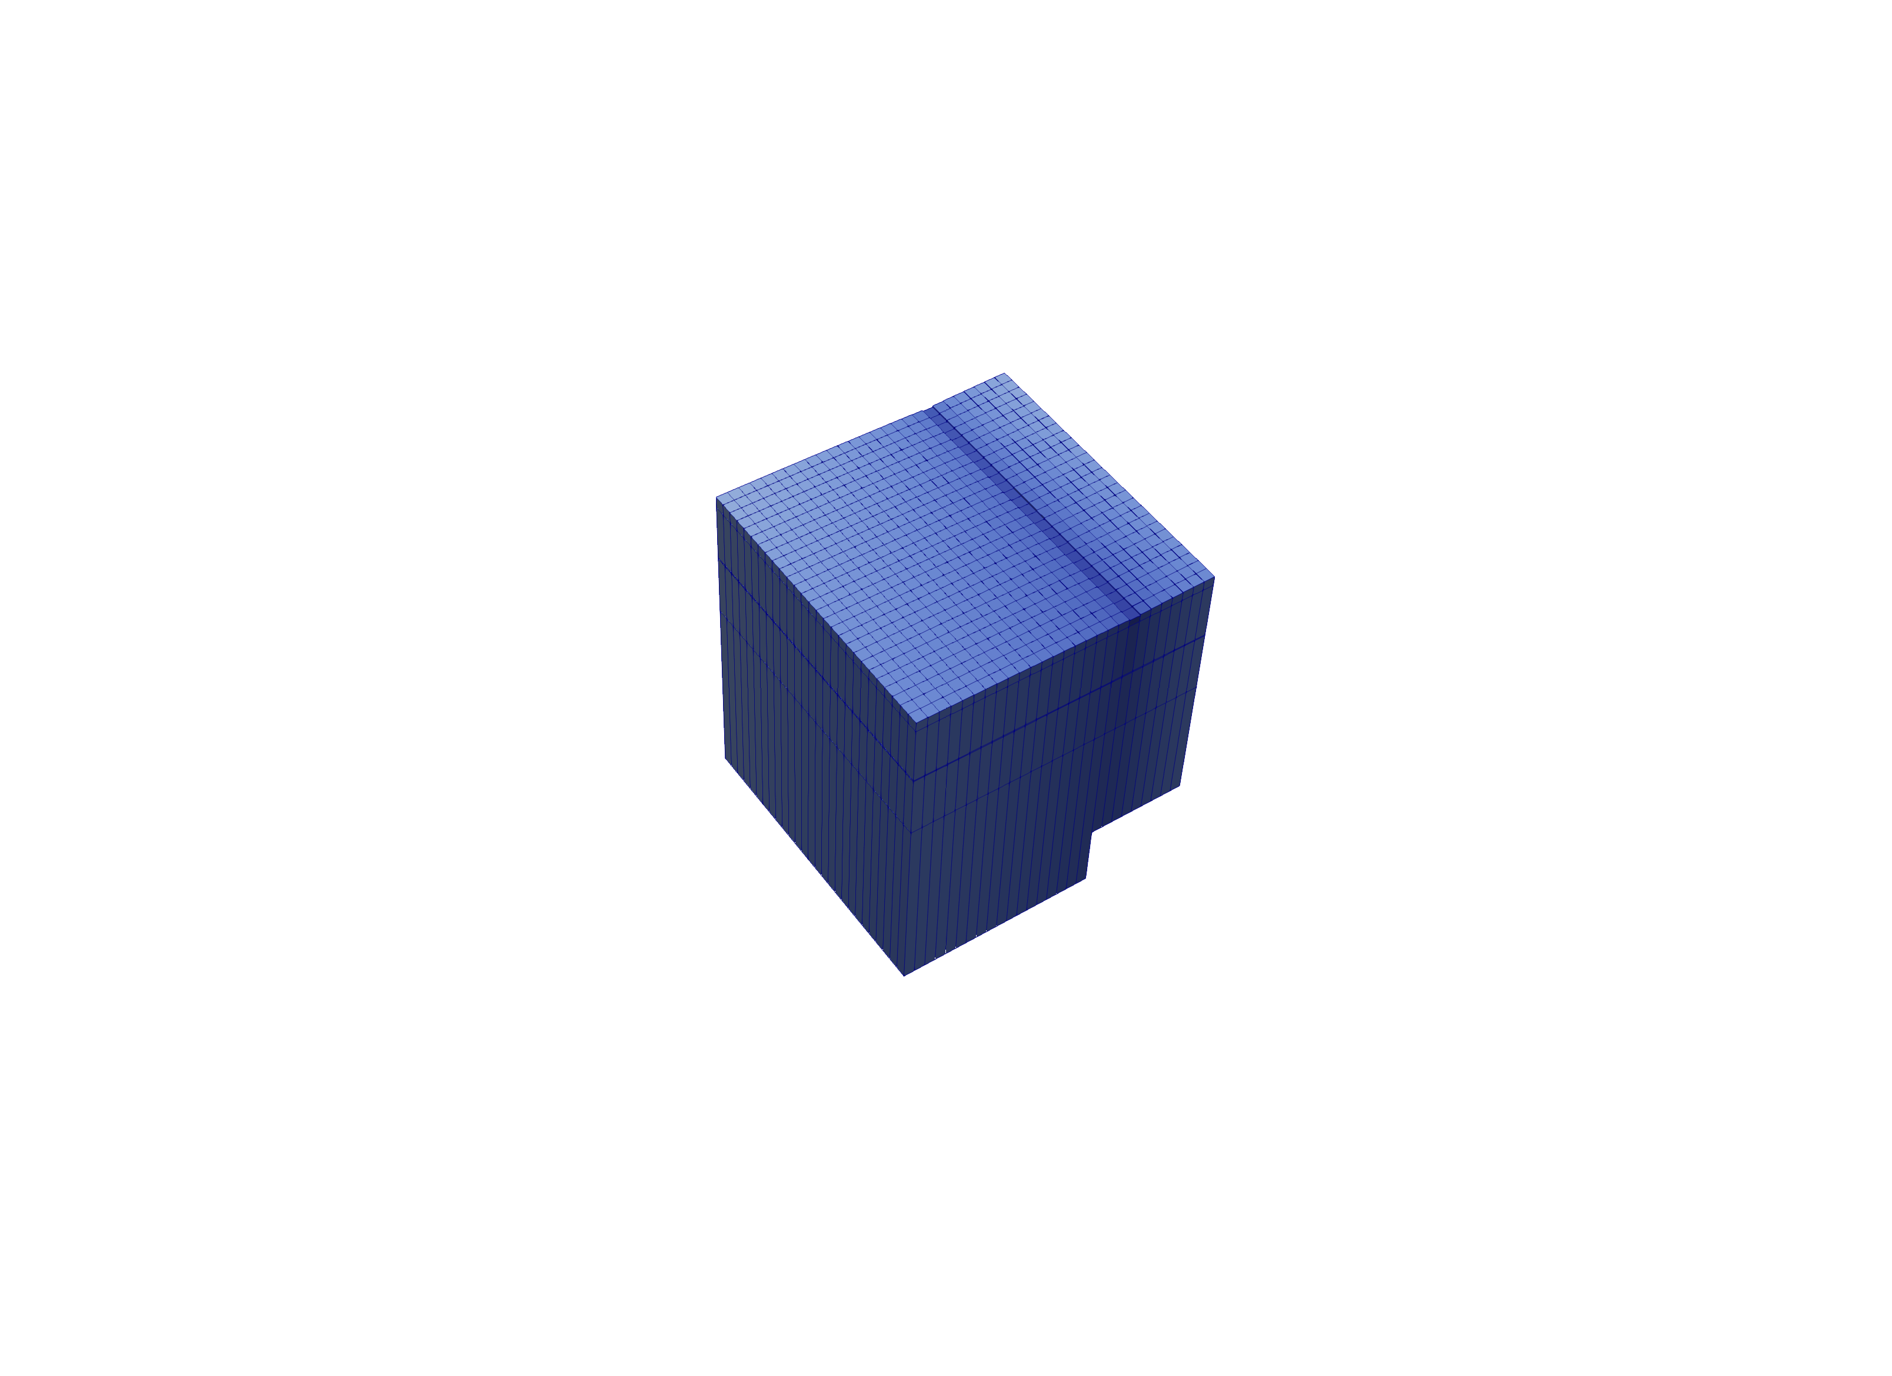
Multi-Model Coupling
Any number of models can be included in a simulation
Models coupled at matrix level
Flexibility supports coupling of parent, child, grandchild models, stacked models or adjacent models
Notes:
Another piece of the MF framework. Any number of models can be included in a simulation. The unique thing here is that the models can be tightly coupled in the simulation, so even though you the user works with them individually, they are solved simultaneously with a mass-balanced solution. Can have a patch-work of models.

Slide 2
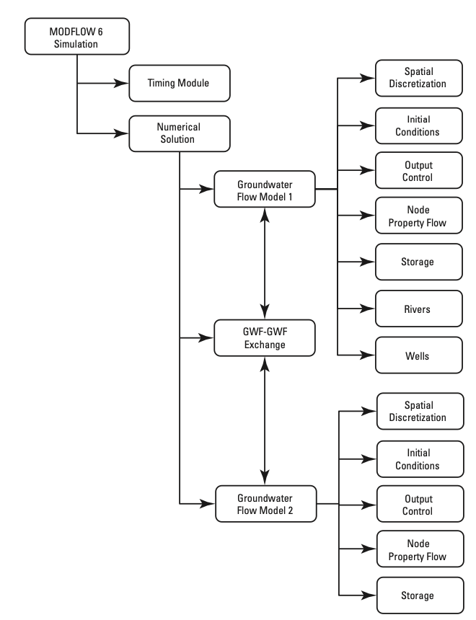
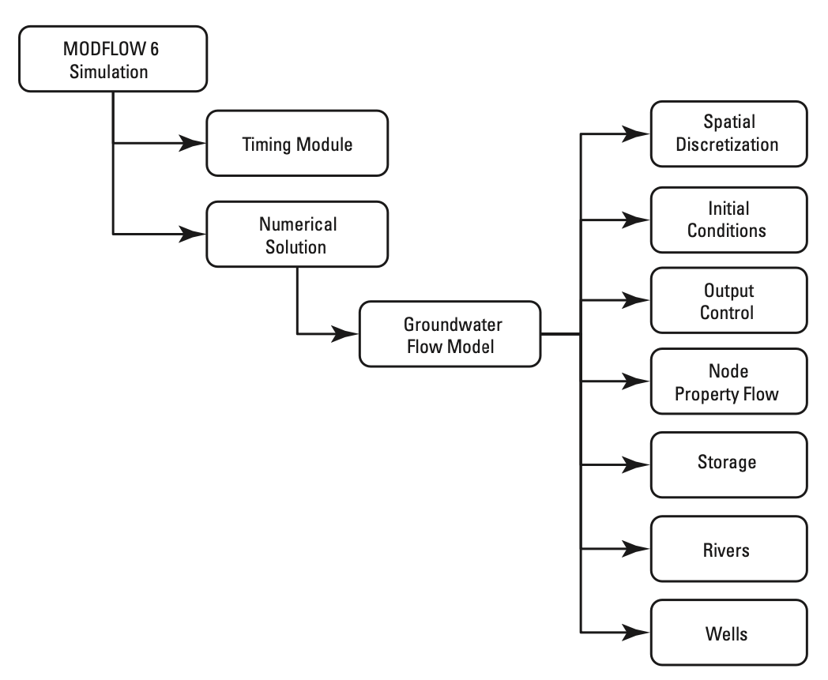
Simulation Types
Multiple Models
Single Model

Slide 3
LGR Simulation
Simulation
Temporal Discretization
PARENT
C1
C2
GC
Iterative Model Solution
Notes:
MODFLOW doesn’t care how many of the these models you have. Complete flexibility in how these models are wired-up, just need to establish the connections between them.

Slide 4
GWF Exchanges
Simulation
Temporal Discretization
PARENT
C1
C2
GC
Iterative Model Solution
PARENT-C1
PARENT-C2
C1-GC

Slide 5
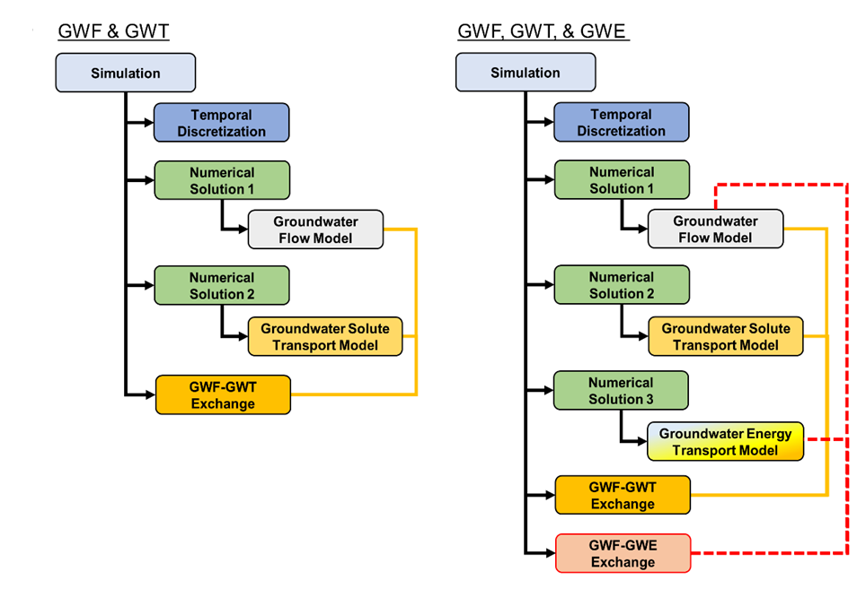
Models of a Different Type May Be Coupled
GWF-GWT
Pass fluxes in memory
Retrieve saved fluxes
GWF-GWE
Pass fluxes in memory
Retrieve saved fluxes
GWF-PRT
Pass fluxes in memory
Retrieve saved fluxes

Slide 6
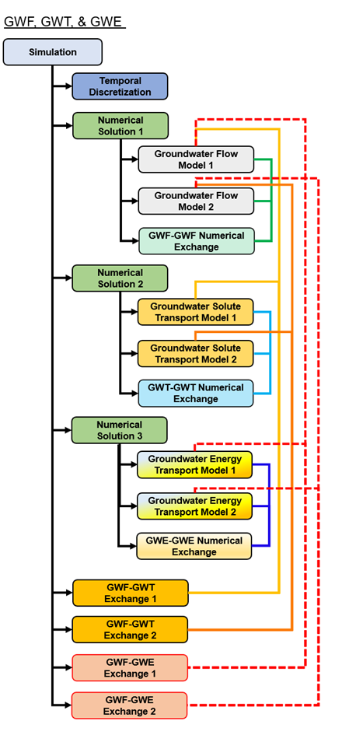
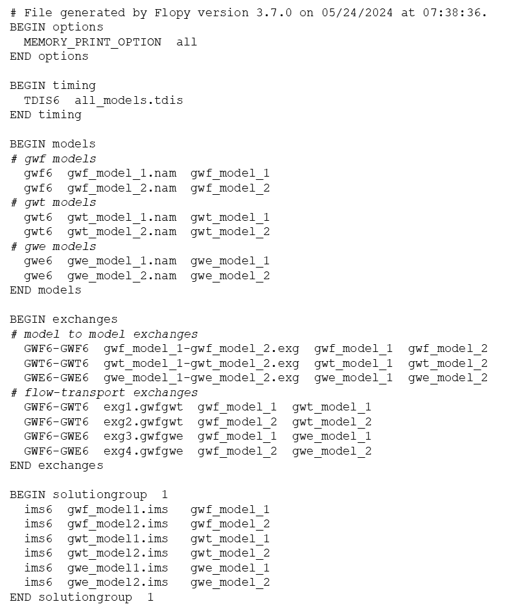

Models of the Same or Different Type May Be Coupled
GWF-GWF
GWF-GWT
GWF-GWE
GWF-PRT
GWT-GWT
GWE-GWE
PRT-PRT (coming in ’27)

