Slide 1

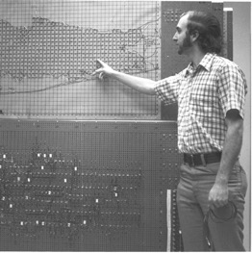
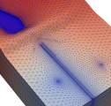
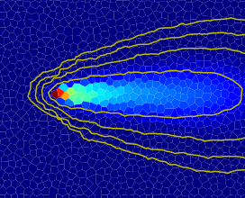



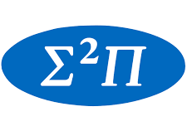




Parallel MODFLOW 6
By the MODFLOW Development Team
September 15-17, 2026

Slide 2
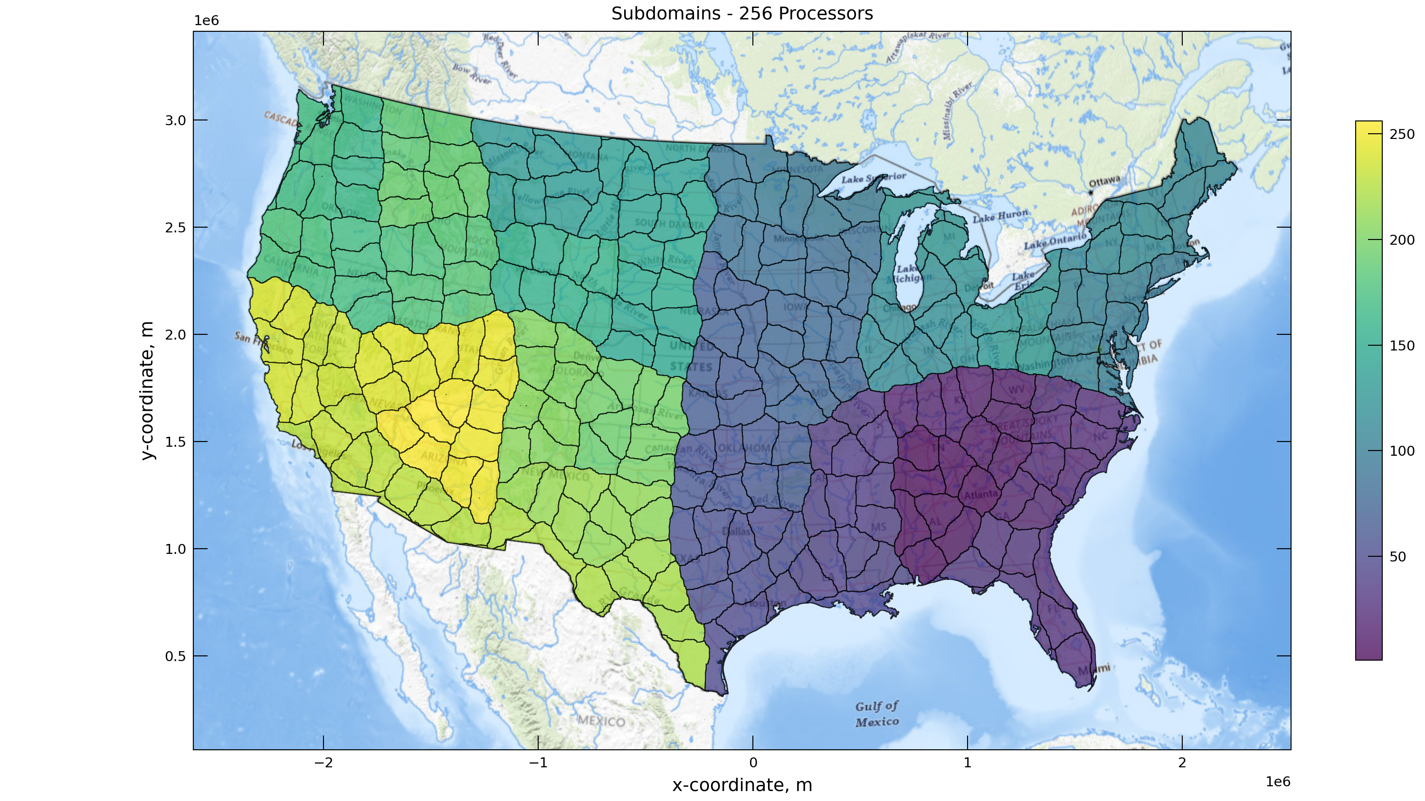
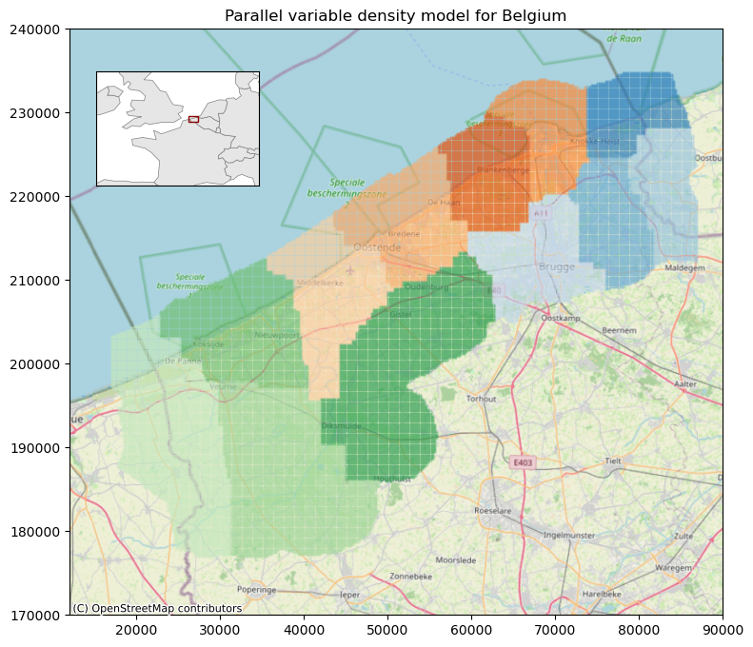
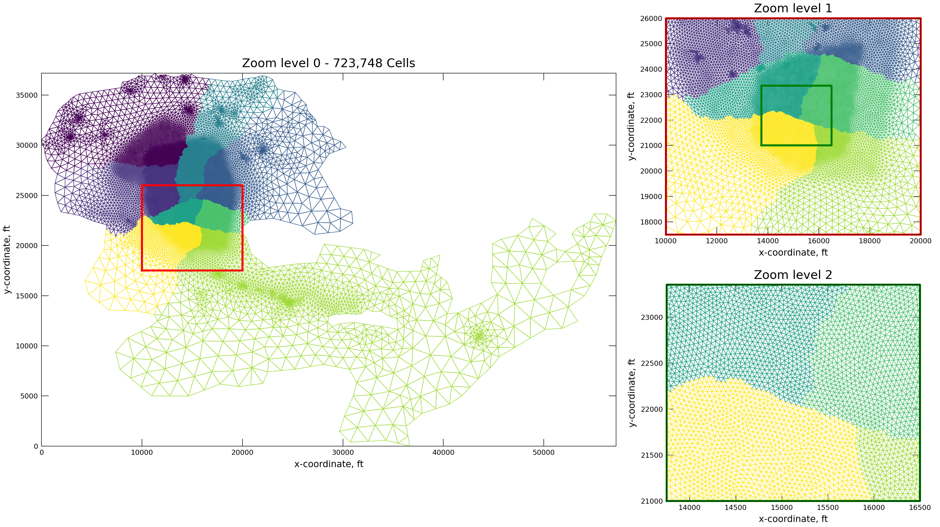
Motivation
CONUS runtimes:
1* core: > 250 hrs
250 cores: 1.7 hrs
Large national/continental scale models
High resolution, regional models
Variable Density flow
Variable Density model for the Belgian coast, Delsman et al., Deltares 2025.
Model of a Regional Groundwater Basin in Southern California, Tetra Tech 2023

Slide 3
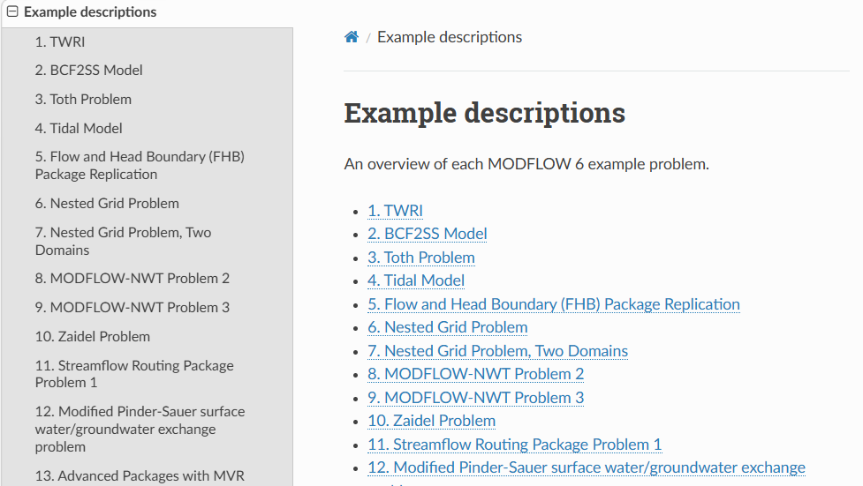
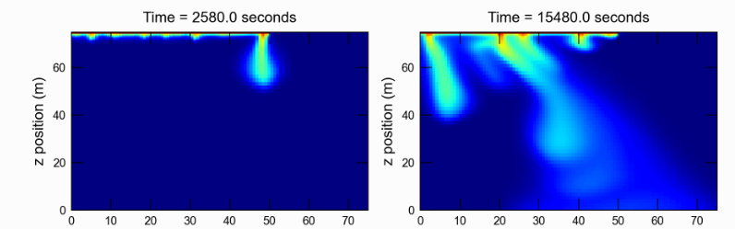
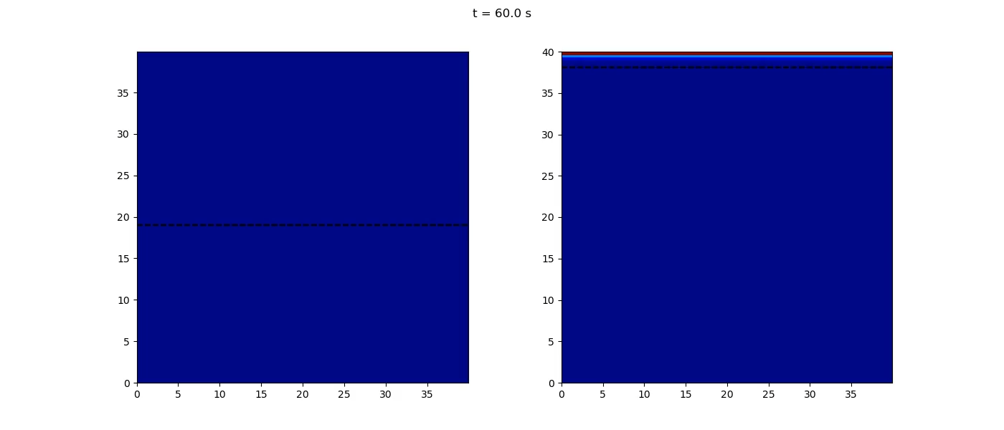
Motivation
https://modflow6-examples.readthedocs.io/en/master/examples.html
High accuracy studies, e.g., Salt Lake example:
Coupled variable density flow (Hele-Shaw)

Slide 4

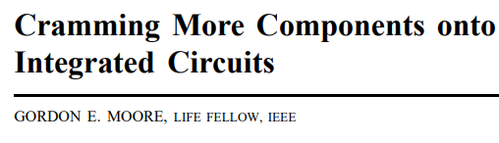
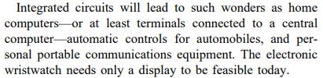
Moore’s Law
from Electronics, pp. 114–117, April 19, 1965
Gordon Moore (1929-2023)

Slide 5
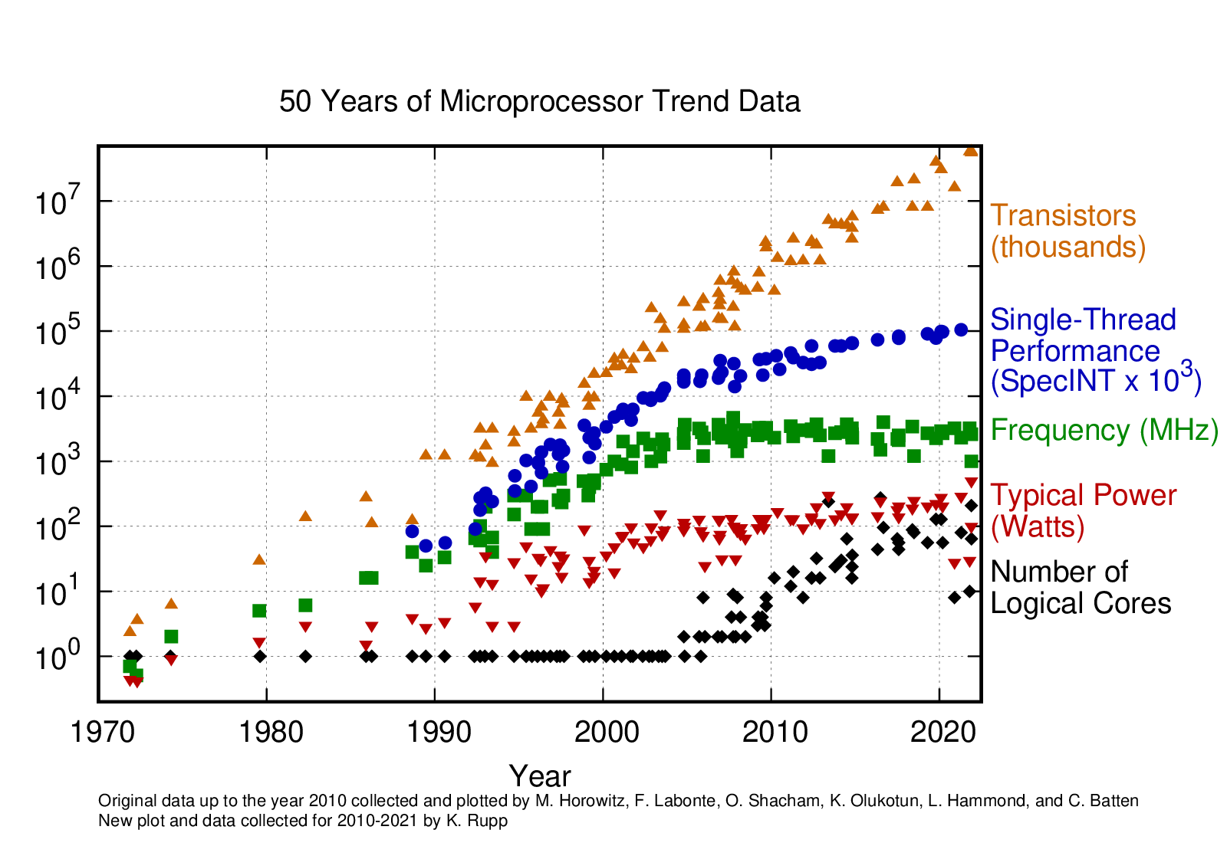
Moore’s Law: the end of it…
Processor frequency saturates, we need something else…
Notes:
Processor frequency saturates
Transistors go up, but because of cores: need parallel software to leverage that trend
(Why haven’t clock speeds increased, even though transistors have continued to shrink?
Dennard Scaling postulated that as transistors get smaller their power density stays constant, so that the power use stays in proportion with area. This allowed CPU manufacturers to raise clock frequencies from one generation to the next without significantly increasing overall circuit power consumption. But there was a limit to how long this would last. Smaller devices with thinner dielectrics and shorter channels are more prone to leakage.)

Slide 6
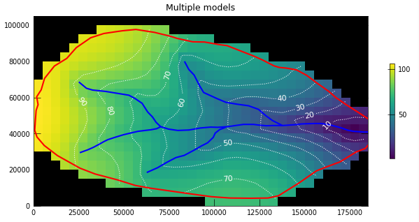

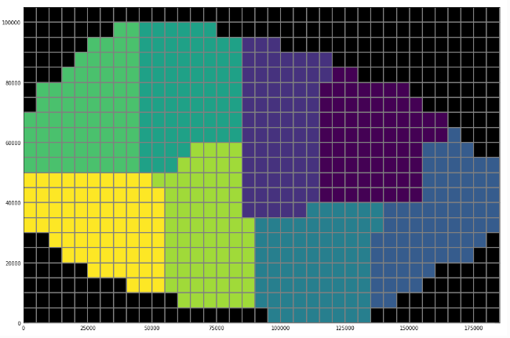
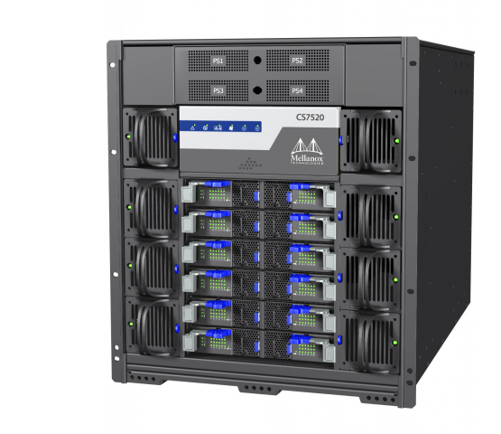
Strategy: Domain Decomposition
Instead of running a model on 1 processor core …
… distribute over many cores
Exchange of data at the domain interface
Efficiency affected by
Amount of communication between domains
Load imbalance: solution of multiple domains proceeds in lock step…
Advantage: within each individual domain MODFLOW runs as usual: minimally invasive!

Slide 7
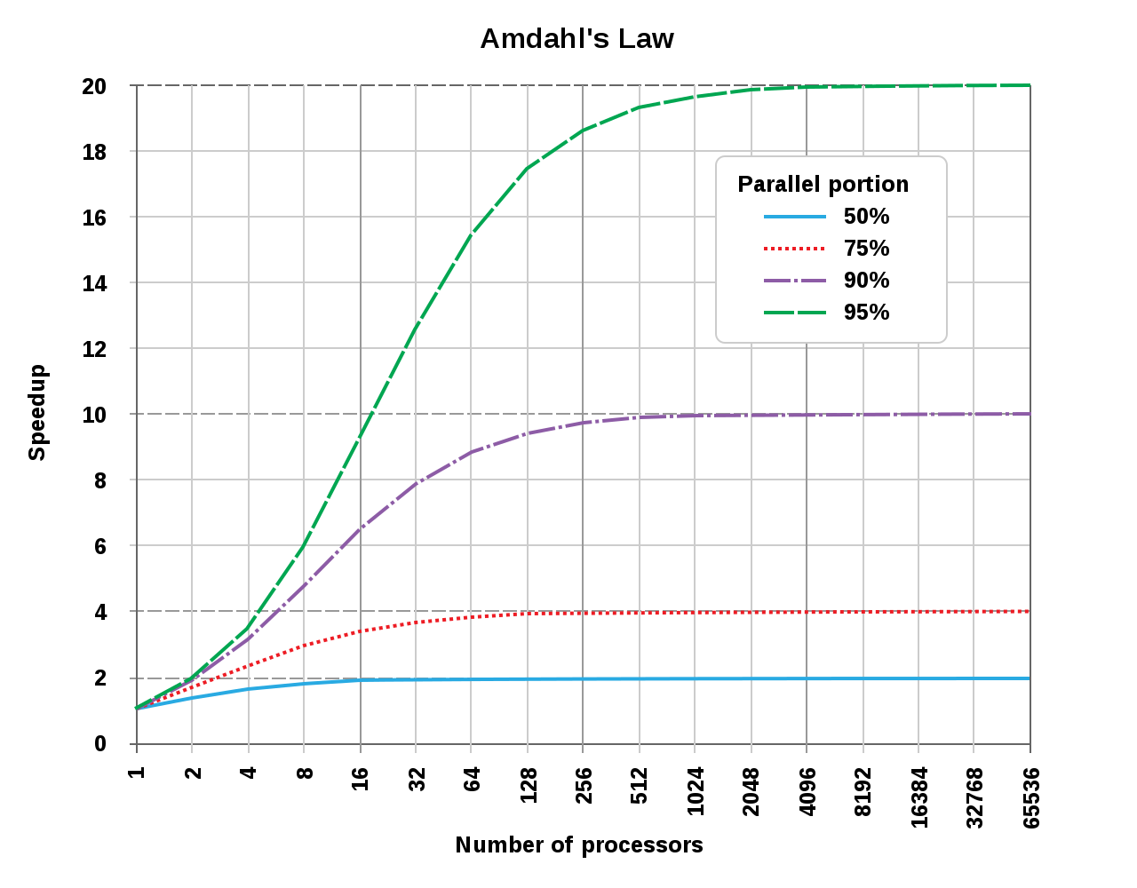
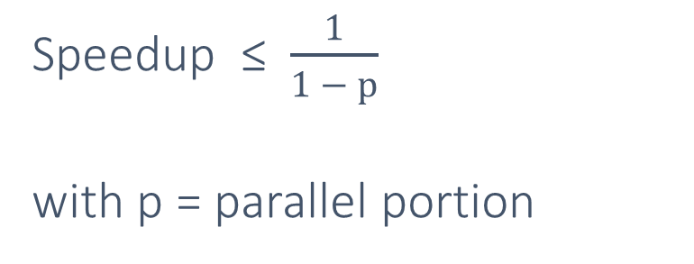
Limit on Speedup
Further division of the work (i.e. smaller domains, increase in processor cores) increases communication overhead
Put differently: how large can you make your model?!
Amdahl’s law:
Speedup ≤ $\frac{1}{1 − p}$
with p = parallel portion
Notes:
How much faster can you get?

Slide 8
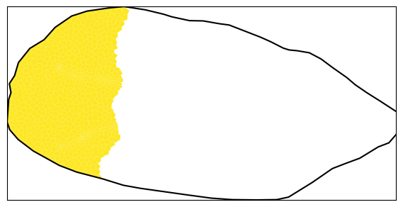
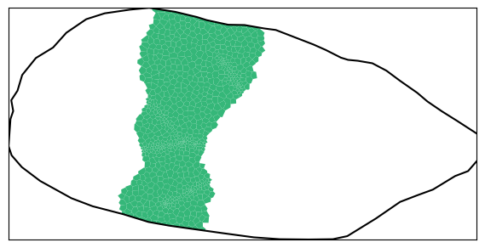
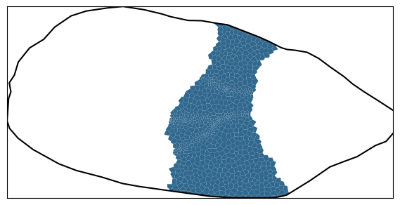
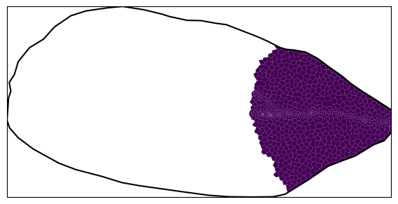
Parallel Solution
1
2
Example: solve the groundwater flow equation (Ax = b) over 4 domains
Dependent variable x (head) and right-hand side b are distributed
Each process now manages a contiguous set of rows of the system matrix
Parallel iterative solver:
choose A = M – N and rewrite Ax = b as
M_{ij}x_{j} = N_{ij}x_{j} + b_{j}
or as an iterative scheme, with k labeling iterations:
M_{ij}x_{j}^{k+1} = N_{ij}x_{j}^{k} + b_{j}
Note that we can freely choose M, so let’s take M_{ij} = 0 for all i ≠ j (this is called Block-Jacobi preconditioning) such that
x_{i}^{k+1} = M_{ii}⁻¹ (N_{ij}x_{j}^{k} + b_{i})
RHS now no longer depends on x_{j}^{k+1}: parallel!
3
4
A₁₁
x₁
b₁
A₂₂
x₂
b₂
=
A₃₃
x₃
b₃
A₄₄
x₄
b₄
Notes:
Solve the decomposed domain by:
A = M – N means in this case we apply the diagonal to M and N is the cross terms in the matrix (aka. Regular splitting or Block-Jacobi method).

Slide 9
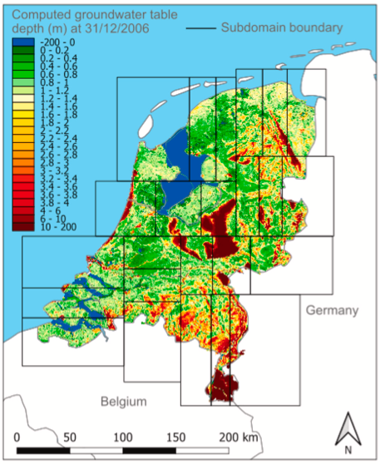
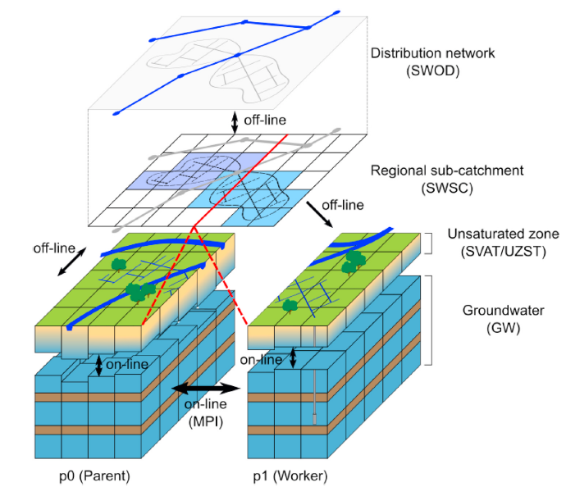
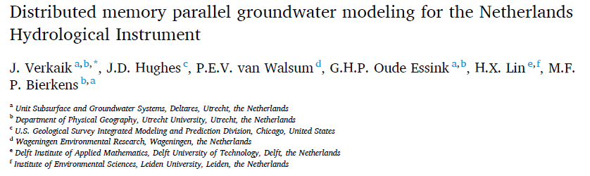
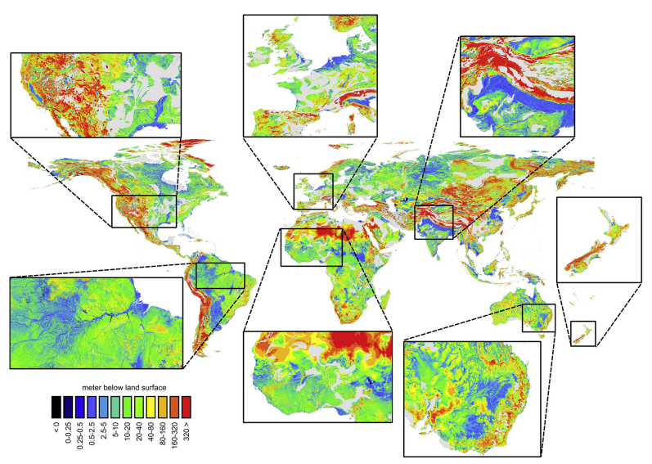
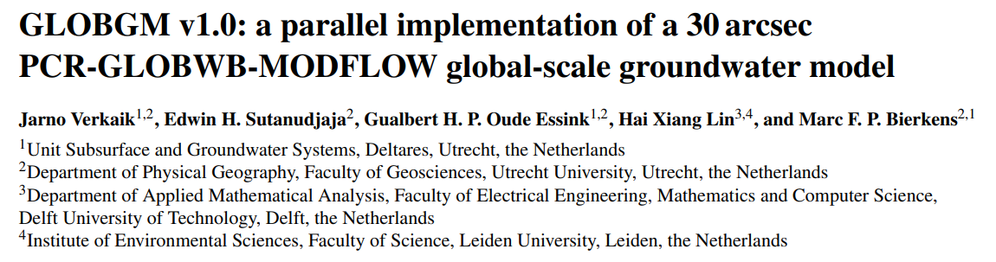
Earlier Work
Good results for national-scale model
Global groundwater with MODFLOW 6 prototype
More work needed: a framework solution
Current and future model types
Feature complete: XT3D, BUY, TVD, MVR, …
Possible to add or modify hydrologic concepts without expert knowledge on parallelization
MODFLOW remains available in its core set of functionality
FloPy support for pre- and post-processing
Notes:
USGS - Deltares working together on parallelization since 2017 (and first discussion in 2010 even)
Earlier work shows promising performance improvements for real, integrated (5 different codes) national-scale simulation (2021)
Global groundwater simulation with a MODFLOW 6 prototype (2024)
Still it has taken some time to have this available in the core version, because more work was needed
To come up with a framework solution, that
works for all model types
is feature complete
supports a separation of concerns such that the parallel details in the code are isolated from the hydrologic concepts
Has MODFLOW distributable in its core set of functionality
FloPy support

Slide 10
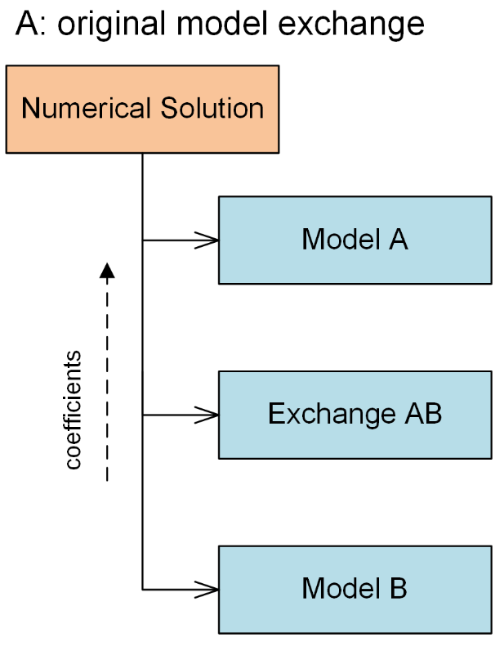
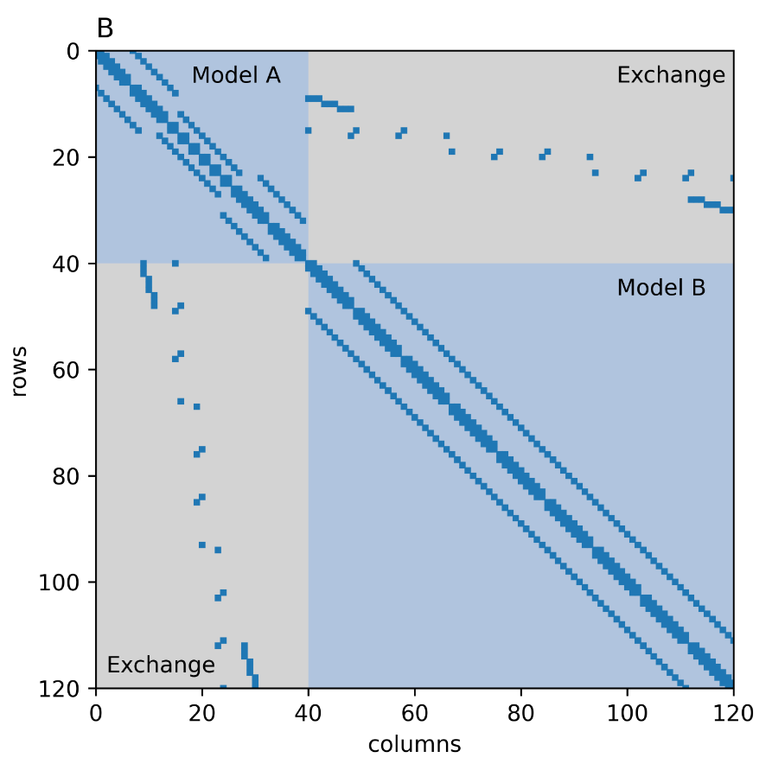
Framework Solution
MODFLOW 6 has conceptualized a hydrologic process model into a “Numerical Model”
Multiple models can be connected with Exchanges to be solved in a single Numerical Solution
When models are distributed over processors, “Virtual Models” are used to access remote data
The IMS solver is silently replaced internally with a PETSc solver
Notes:
MODFLOW was designed for domain decomposition
Tight coupling at the matrix level through used defined exchanges with connection data
Three building blocks to the method, all of them require no extra work or input from the modeler
Let’s have a look at those…

Slide 11
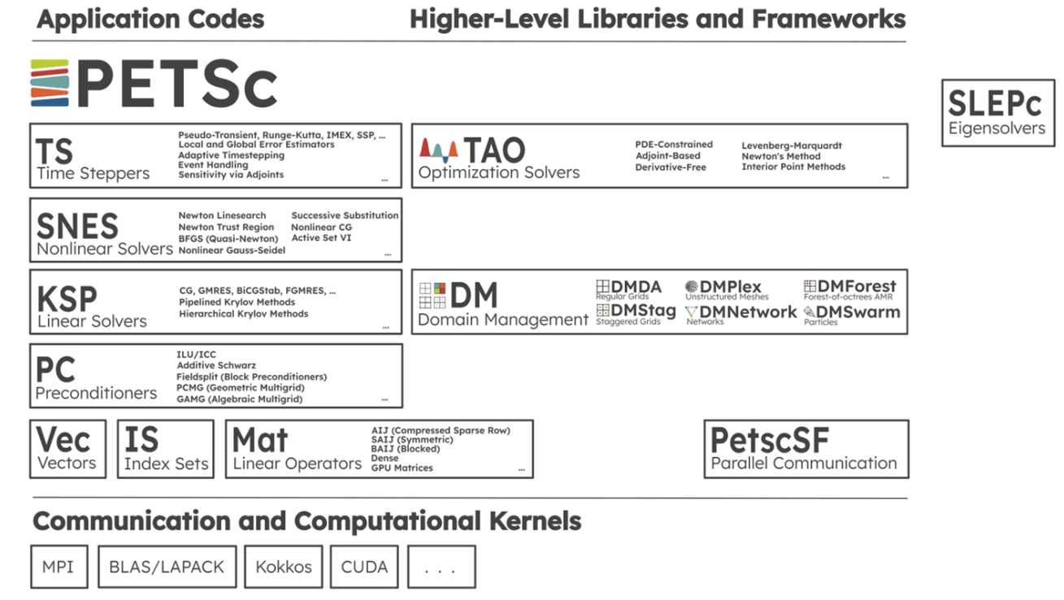
Parallel Solver: PETSc
The Portable, Extensible Toolkit for Scientific Computation
Suite of data structures and routines developed and maintained by ANL
Scalable (parallel) solution of scientific applications modeled by partial differential equations
Robust, Efficient, Portable
Fortran bindings
And: PETSc solver configured from IMS settings, including MILU(T)
The good news: you don’t need to know any of this to run Parallel MODFLOW!

Slide 12

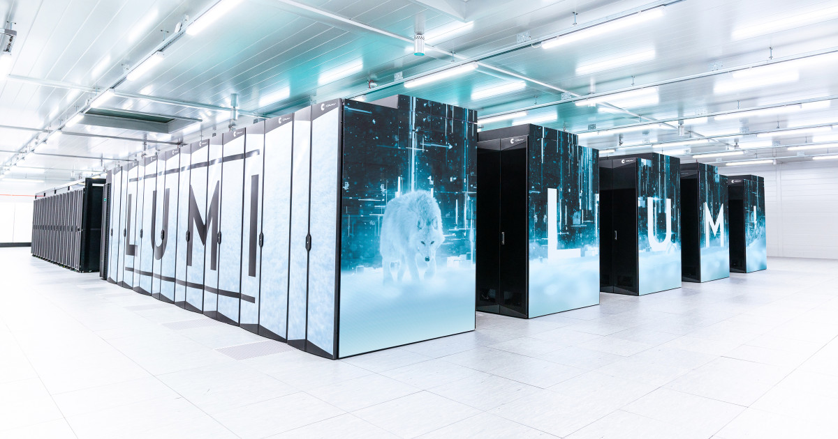
How to get Extended MODFLOW
On your laptop
Windows
get the zip file from the release (or nightly build)
Linux/MacOS
Easy: use the pixi environment for this class, and modify
Advanced: Install PETSc, netcdf, MPI, ... yourself and use the meson build system for the extended build
On your supercomputer
Ideally use the system MPI libraries for optimal performance
Easy: Load the MODFLOW 6 module if available
Easy: follow the approach on the left with the pixi environment (suboptimal)
Advanced: use the system libs and build extended MODFLOW using meson
Advanced: add MODFLOW 6 extended to the system’s software catalog (module, easybuild, …)
Notes:
MODFLOW parallel is not standalone, third party libraries are needed. Mostly MPI and PETSc.

Slide 13
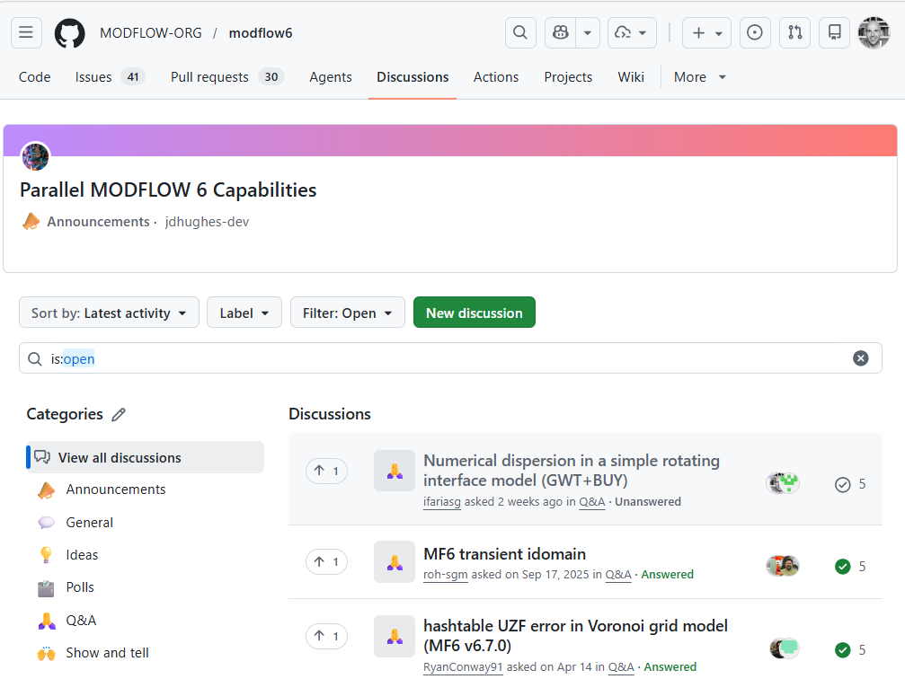
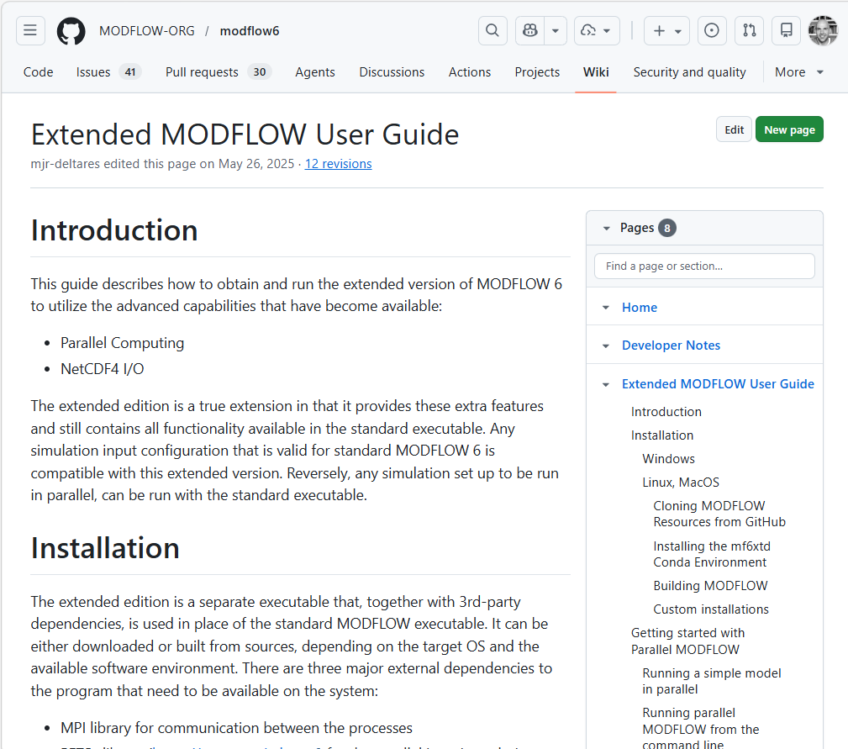
How to get Extended MODFLOW (support)
Discussion Board
Extended MODFLOW User Guide
https://github.com/MODFLOW-ORG/modflow6/discussions
https://github.com/MODFLOW-ORG/modflow6/wiki/Extended-MODFLOW-User-Guide
Notes:
MODFLOW parallel is not standalone, third party libraries are needed. Mostly MPI and PETSc.

Slide 14
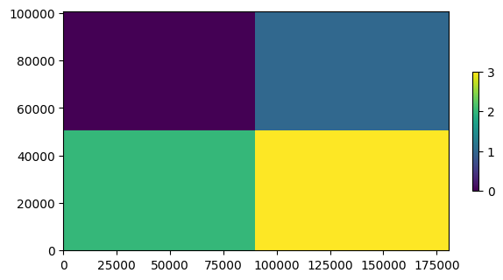
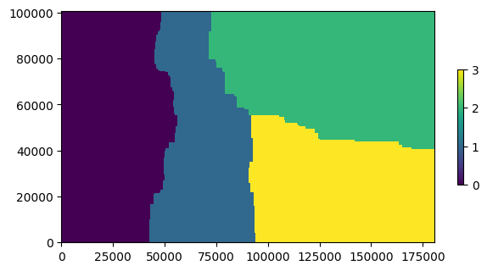
FloPy Model Splitter
Rectangular split:
FloPy contains a tool for partitioning a MODFLOW 6 model:
flopy/mf6/utils/model_splitter.py
Configure with the simulation object:
mfsplit = Mf6Splitter(base_sim)
Methods to generate a split_array by
division in rectangular blocks
optimized splitting with Metis
Split the model:
new_sim = mfsplit.split_model(split_array)
… and we will use this in today’s exercise
Metis split:

Slide 15
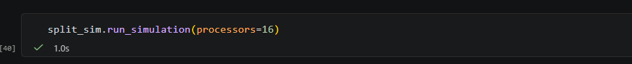

Running Extended MODFLOW: FloPy
To run extended MODFLOW from FloPy on multiple cores:
Alternatively, to run from the CLI:
Notes:
MODFLOW parallel is not standalone, third party libraries are needed. Mostly MPI and PETSc.

Slide 16
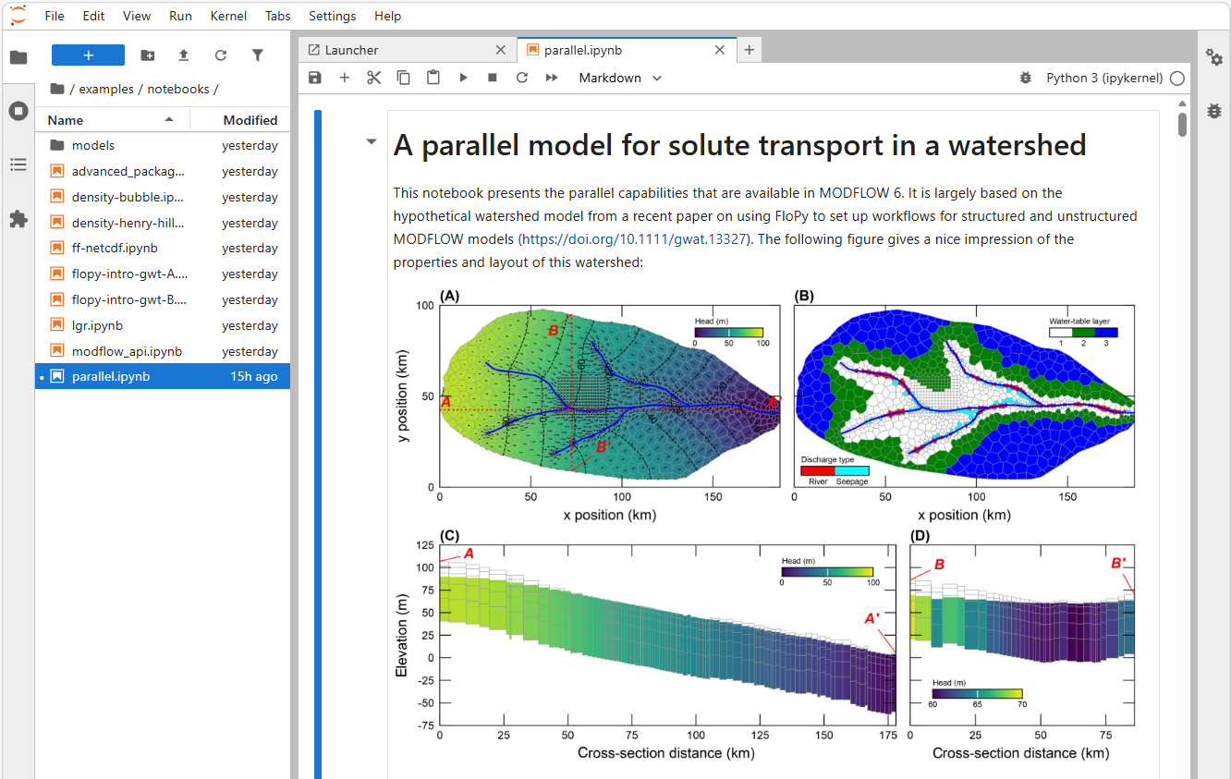
Today’s example:

