Slide 1
The Atmospheric Boundary Condition (ABC) Utility: A Process-Based Approach for Stream Temperature Modeling in MODFLOW 6
Katie Fogg, Montana State University, Bozeman, MT USA
Eric D. Morway, U.S. Geological Survey, Carson City, NV USA
Alden M. Provost, U.S. Geological Survey, Reston, VA USA
Christian D. Langevin, S.S. Papadopulos & Associates, USA
Joseph D. Hughes, INTERA, USA
Martijn J. Russcher, Deltares, Hydrology Software Group, Delft, Netherlands

Slide 2

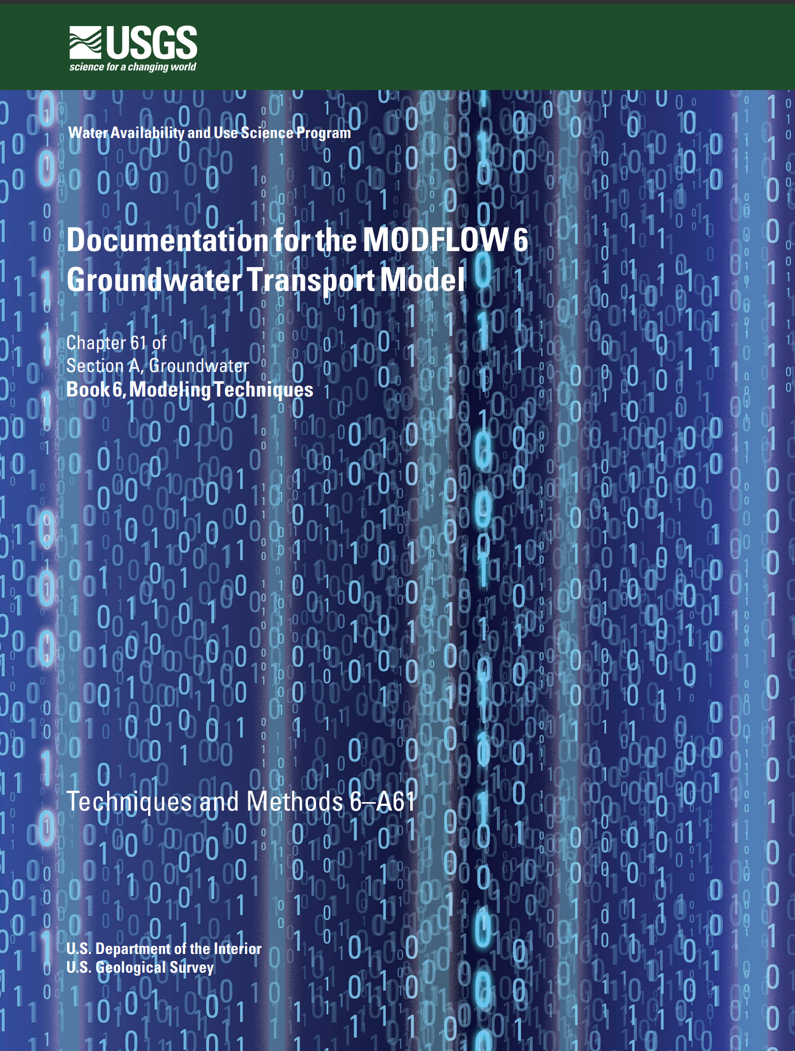
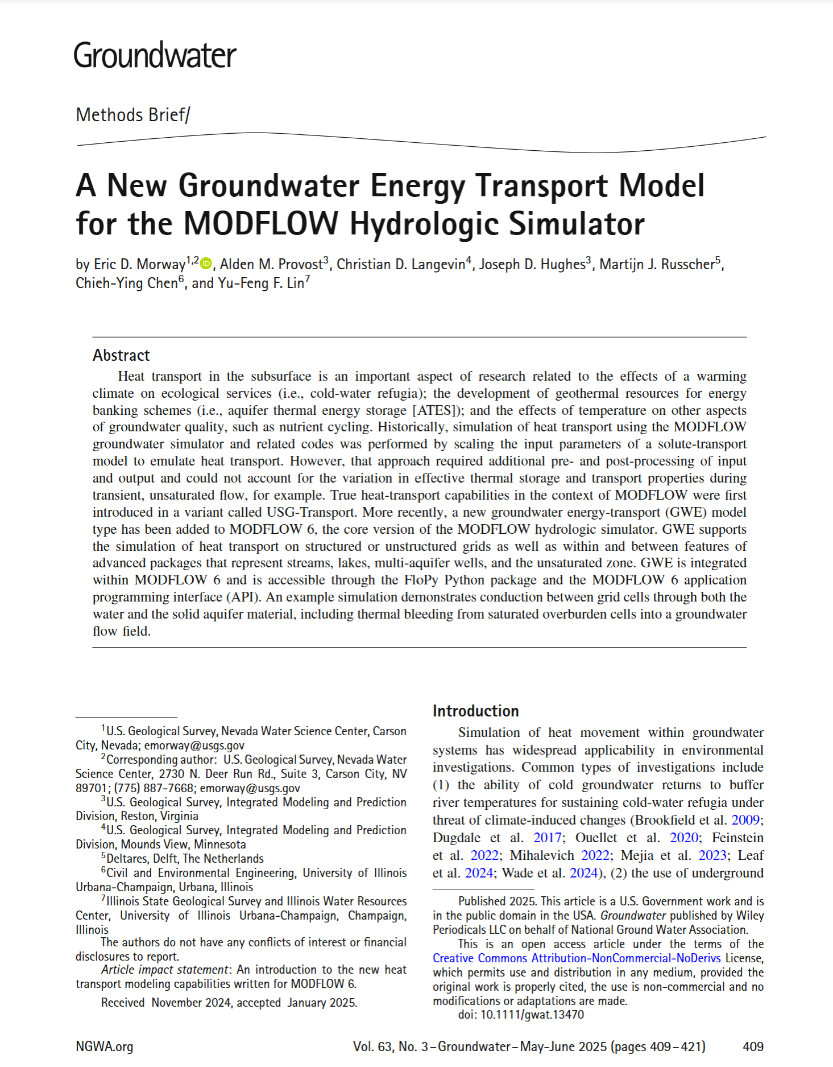
Mass and Heat Transport in MODFLOW 6
MODFLOW 6 Groundwater Flow Model
MODFLOW 6 Groundwater Transport Model
MODFLOW 6 Groundwater Energy Transport Model
2017
2022
2024/2025

Slide 3

Groundwater Energy (GWE) Transport Model
Starts with a groundwater-centric view of heat transport
Requires cell-by-cell flows be calculated by a groundwater flow (GWF) model
Supports thermal energy exchange with various boundary conditions, including streams
GWE currently lacks support for process-based stream temperature modeling

Slide 4

Process-Based Stream Temperature (PBST) Simulation
Initially being implemented as an Atmospheric Boundary Condition (ABC) “utility” for the Streamflow Energy (SFE) Transport Package
Plan to extend the utility to other packages, e.g., lakes (LAK)

Slide 5
Atmospheric Boundary Condition (ABC) Utility
The SFE Package can optionally invoke the ABC Utility
my_model.sfe
BEGIN OPTIONS
FLOW_PACKAGE_NAME sfr-1
SAVE_FLOWS
PRINT_FLOWS
ABC6 FILEIN my_model.sfe.abc
END OPTIONS
BEGIN PACKAGEDATA
…
END PACKAGEDATA

Slide 6
Energy-transport processes included in ABC
The ABC utility supports four heat fluxes:
  Shortwave Radiation
  Longwave Radiation
  Sensible Heat Flux
  Latent Heat Flux

Slide 7




Energy Sources and Sinks with SFE only
①: Evaporative cooling associated with a specified evaporation rate
②: Precip at a specified temperature
③: Inflow from upstream
④: Overland runoff
⑤: Groundwater discharge
⑥: Outflow to downstream
①
②
③
④
⑥
⑤

Slide 8
Conductive Heat Exchange (SFE only)
⑦: Conductive heat exchange with host
cell
①
②
③
Impermeable walls
Stream width
④
Stream surface
Streambed material
Streambed Thickness
⑦
⑥
Cell node
⑤

Slide 9


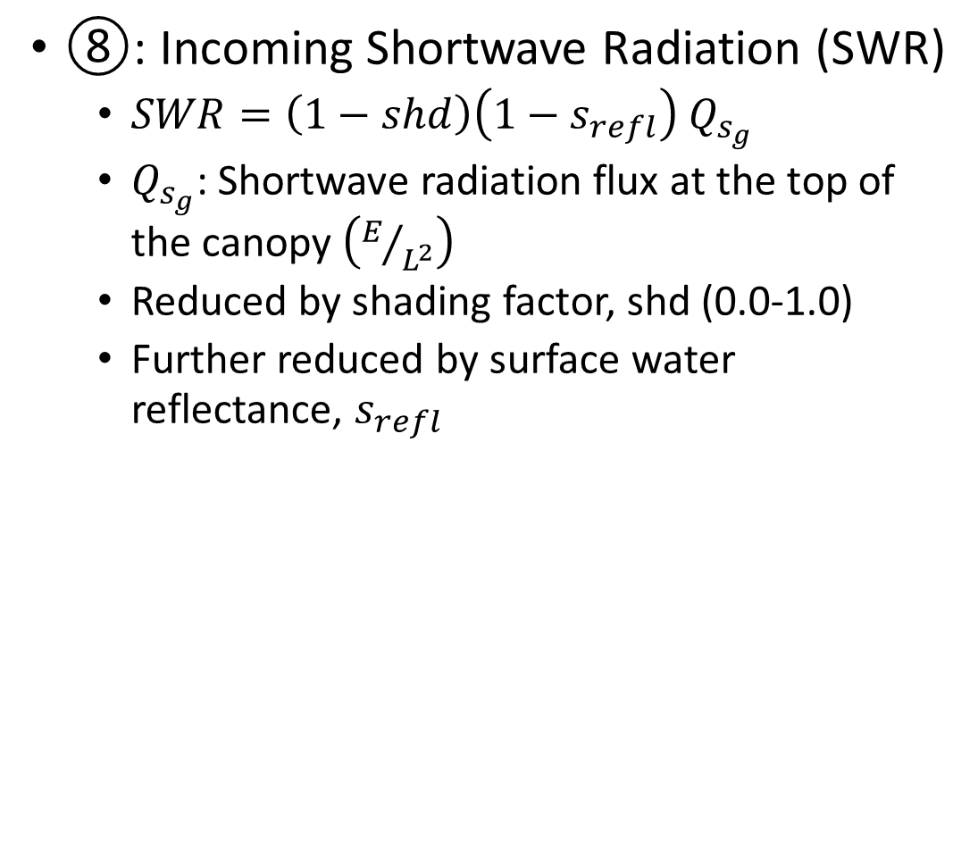


Atmospheric Boundary Condition (ABC) Utility
$$Q_{s_{g}}$$
$$\left(1−shd\right)$$
⑧: Incoming Shortwave Radiation (SWR)
  $SWR=\left(1−shd\right)\left(1−s_{refl}\right) Q_{s_{g}}$
  $Q_{s_{g}}$: Shortwave radiation flux at the top of the canopy $\left(E/{L^{2}}\right)$
  Reduced by shading factor, shd (0.0-1.0)
  Further reduced by surface water reflectance, $s_{refl}$
⑧
①
②
③
$$\left(1−s_{refl}\right)$$
④
⑦
⑥
⑤

Slide 10
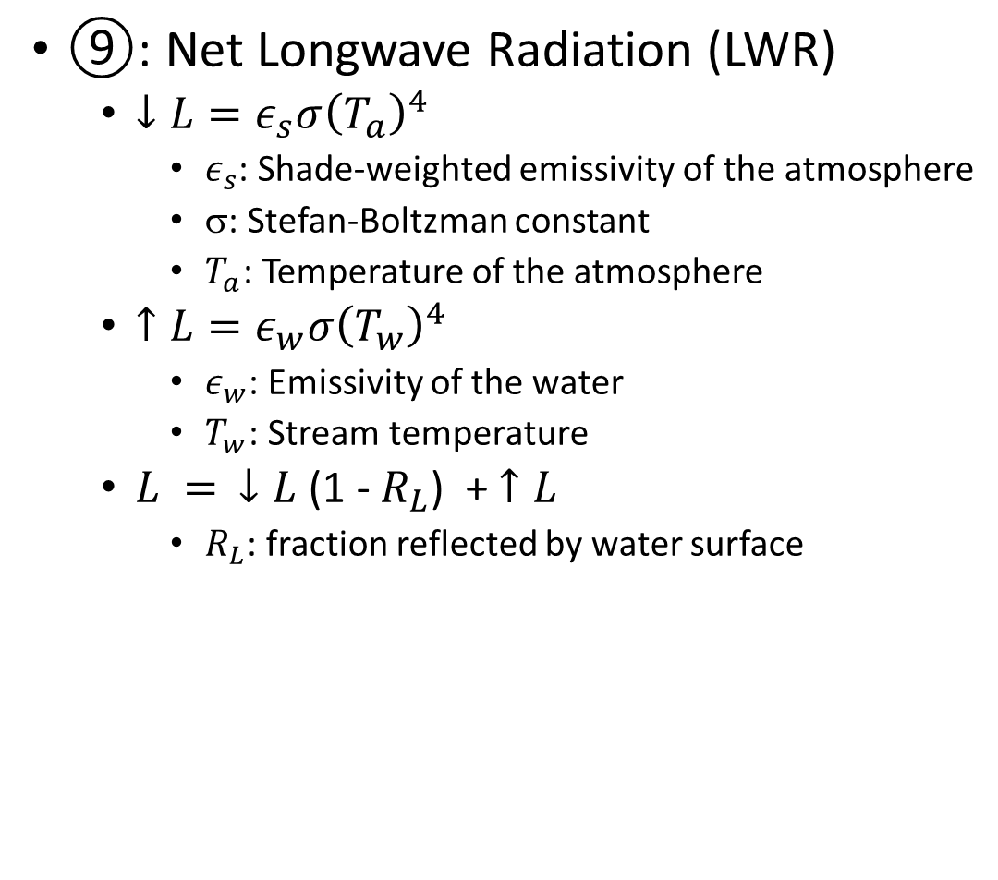
Atmospheric Boundary Condition (ABC) Utility
⑨: Net Longwave Radiation (LWR)
  $↓L=ε_{s}σ{\left(T_{a}\right)}^{4}$
    $ε_{s}$: Shade-weighted emissivity of the atmosphere
    σ: Stefan-Boltzman constant
    $T_{a}$: Temperature of the atmosphere
  $↑L=ε_{w}σ{\left(T_{w}\right)}^{4}$
    $ε_{w}$: Emissivity of the water
    $T_{w}$: Stream temperature
  $L = ↓L$ (1 - $R_{L}$) + $↑L$
    $R_{L}$: fraction reflected by water surface
⑧
①
②
③
④
⑨
(Evans, McGregor, and Petts 1998)
⑦
⑥
⑤

Slide 11
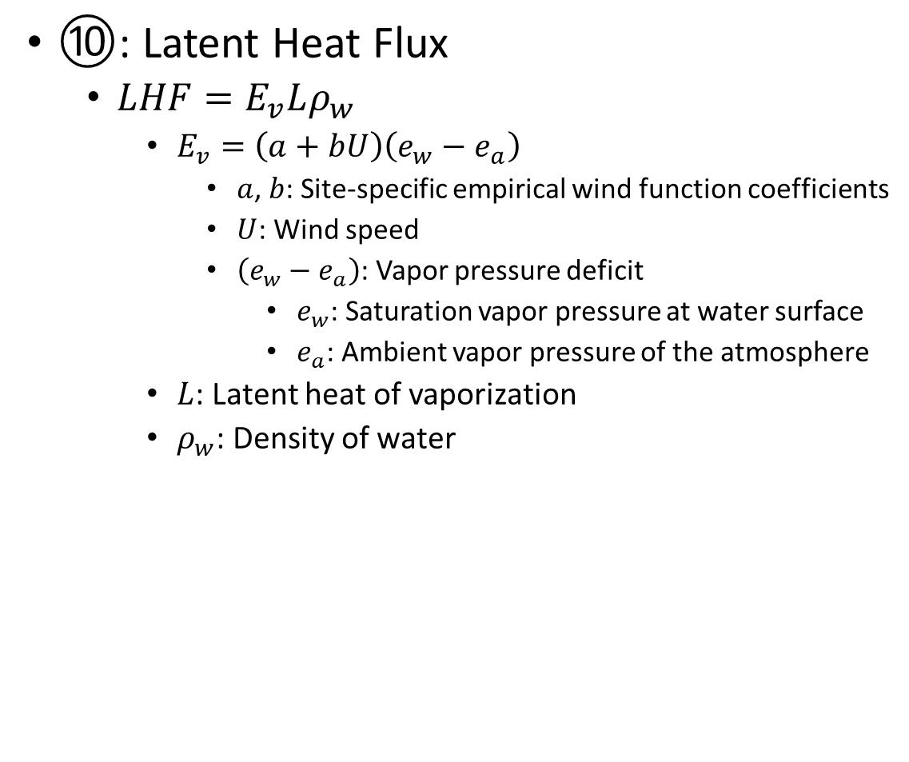
Atmospheric Boundary Condition (ABC) Utility
⑩: Latent Heat Flux
  $LHF=E_{v}Lρ_{w}$
    $E_{v}=\left(a+bU\right)\left(e_{w}−e_{a}\right)$
      $a$, $b$: Site-specific empirical wind function coefficients
      $U$: Wind speed
      $\left(e_{w}−e_{a}\right)$: Vapor pressure deficit
        $e_{w}$: Saturation vapor pressure at water surface
        $e_{a}$: Ambient vapor pressure of the atmosphere
    $L$: Latent heat of vaporization
    $ρ_{w}$: Density of water
⑧
①
②
(McCutcheon, 1989)
③
④
⑩
⑨
⑦
⑥
⑤

Slide 12
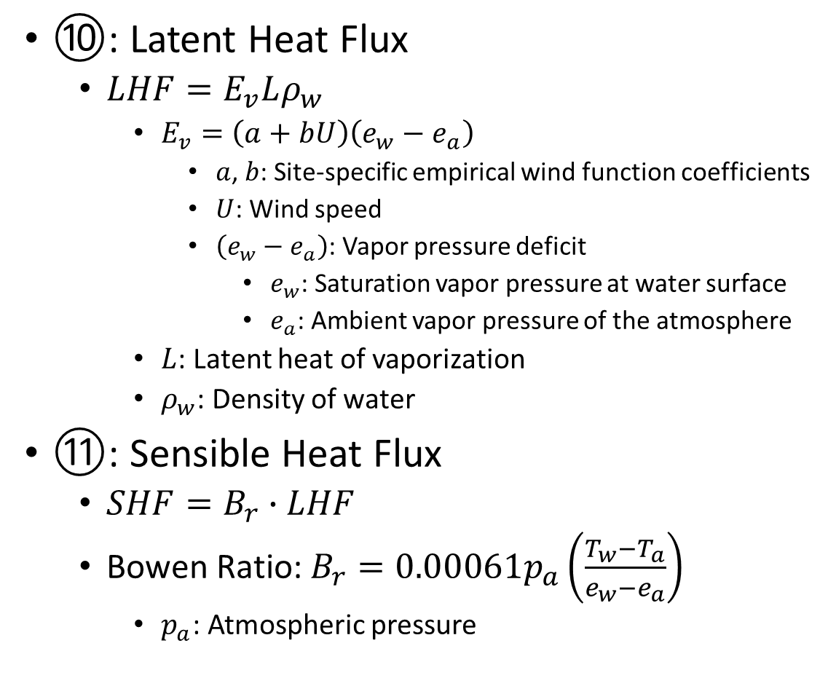
Atmospheric Boundary Condition (ABC) Utility
⑩: Latent Heat Flux
  $LHF=E_{v}Lρ_{w}$
    $E_{v}=\left(a+bU\right)\left(e_{w}−e_{a}\right)$
      $a$, $b$: Site-specific empirical wind function coefficients
      $U$: Wind speed
      $\left(e_{w}−e_{a}\right)$: Vapor pressure deficit
        $e_{w}$: Saturation vapor pressure at water surface
        $e_{a}$: Ambient vapor pressure of the atmosphere
    $L$: Latent heat of vaporization
    $ρ_{w}$: Density of water
⑪: Sensible Heat Flux
  $SHF=B_{r}∙LHF$
  Bowen Ratio: $B_{r}=0.00061p_{a}\left(\frac{T_{w}−T_{a}}{e_{w}−e_{a}}\right)$
    $p_{a}$: Atmospheric pressure
⑧
①
②
(McCutcheon, 1989)
③
⑪
④
⑩
⑨
⑦
⑥
⑤
(Bowen, 1926)

Slide 13

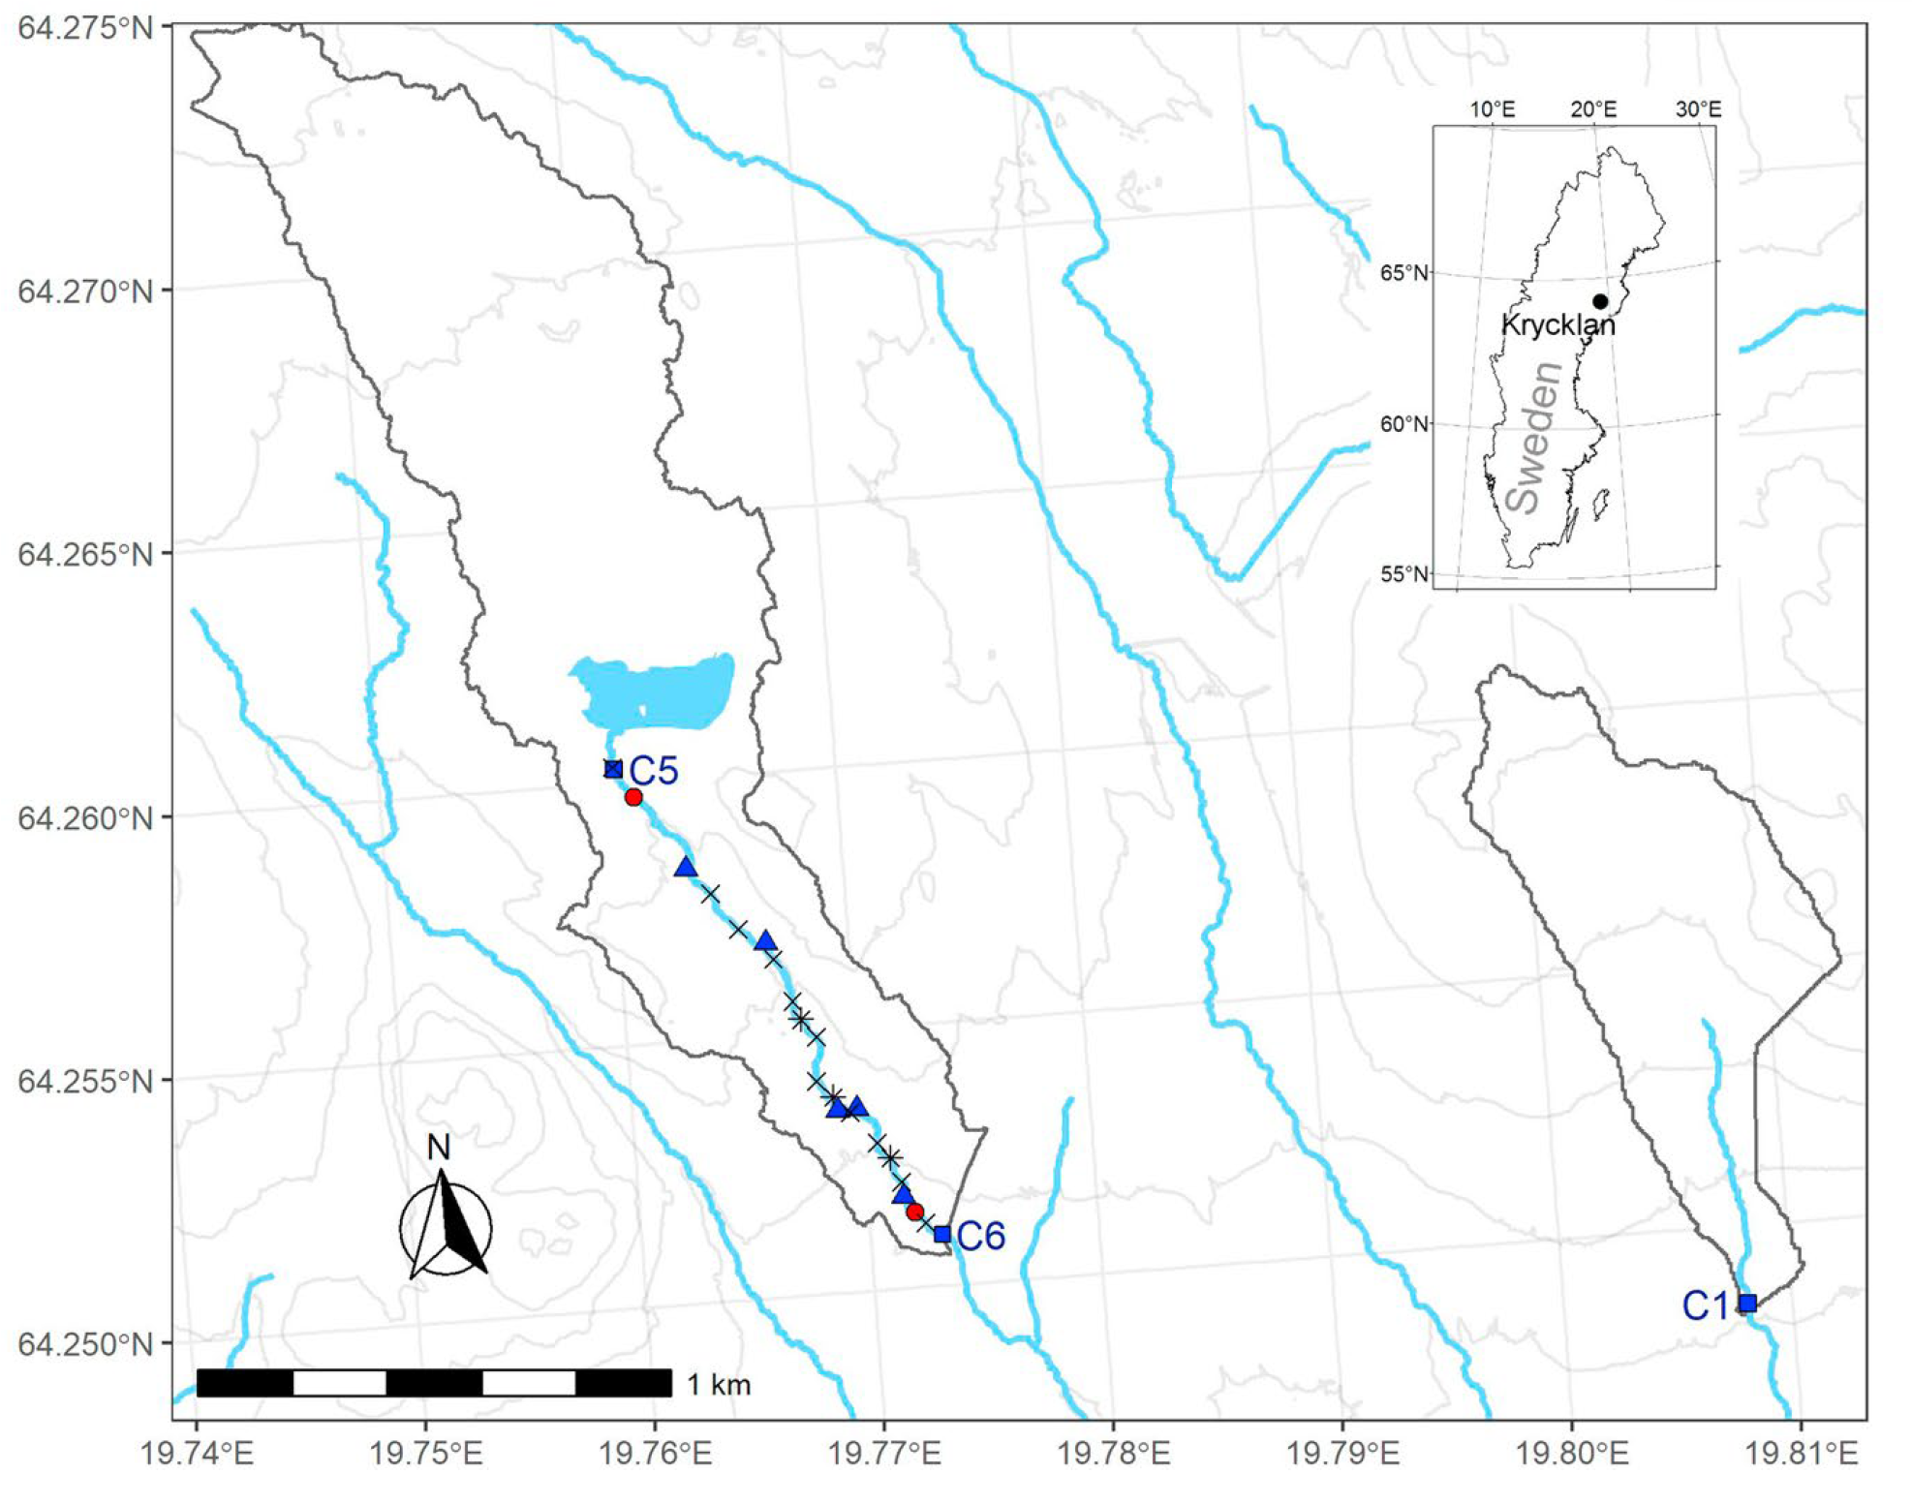
Tested against published results
Leach et al. (2021)
  27 ~50m stream reaches
  Detailed input includes:
    Channel properties: width, length
    Inlet and outlet stream temperature
    Incoming solar radiation
    Wind speed
    Relative humidity
    Atmospheric temperature
    Spatially varying estimates of “lateral” inflow
      Groundwater returns
      Overland flow
    Temperature of lateral inflow

Slide 14
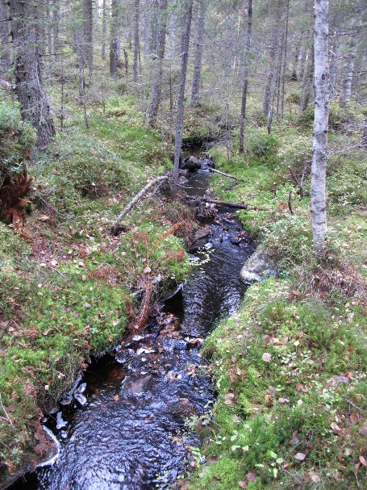
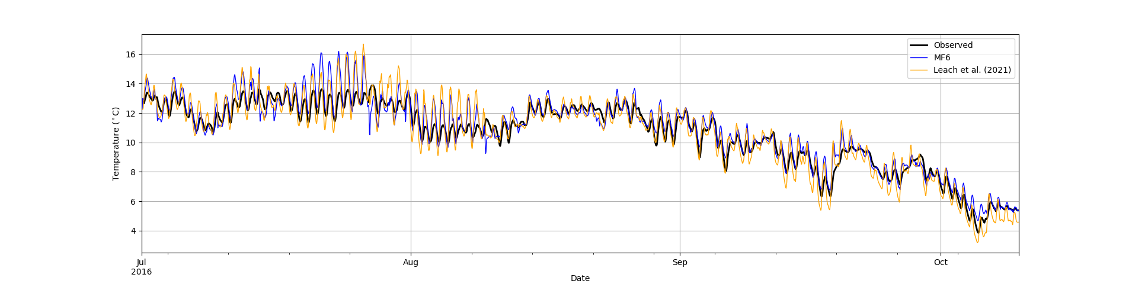
Comparison of output
Model setup uses FloPy
Extensive use of the Time Series utility
Initial results are encouraging:

Slide 15





Summary Statistics
$$NSE=1−\frac{\sum_{i=1}^{N}{{\left(S_{i}−O_{i}\right)}^{2}}}{\sum_{i=1}^{N}{{\left(O_{i}−\overline{O}\right)}^{2}}}$$
$$RMSE=\sqrt{\frac{1}{N}{\left(S_{i}−O_{i}\right)}^{2}}$$
$$VE=1−\frac{\sum_{i=1}^{N}{\left|S_{i}−O_{i}\right|}}{\sum_{i=1}^{N}{O_{i}}}$$
$$PBIAS=100∙\frac{\sum_{i=1}^{N}{S_{i}−O_{i}}}{\sum_{i=1}^{N}{O_{i}}}$$
RMSE: Root Mean Square Error; optimal value is 0.0
NSE: Nash-Sutcliffe Efficiency is a normalized statistic that determines the relative magnitude of the residual variance ("noise") compared to the measured data variance ("information"); varies between -$∞$ and 1; optimal value is 1.0
VE: Volumetric Efficiency was proposed in order to circumvent some problems associated with the Nash Sutcliffe efficiency. It ranges from 0 to 1; optimal value is 1.0
PBIAS: Percent bias; optimal value is 0.0

Slide 16
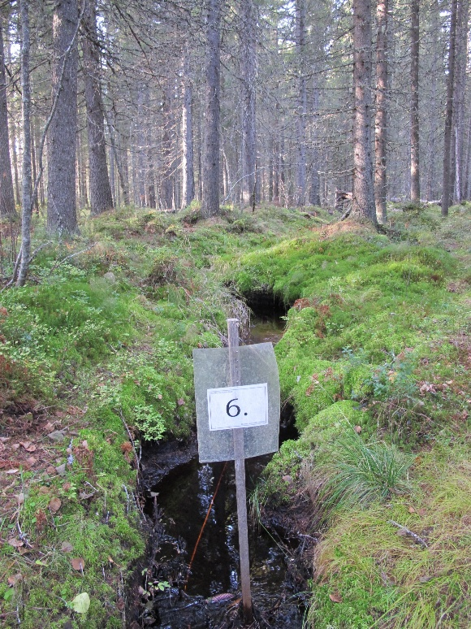
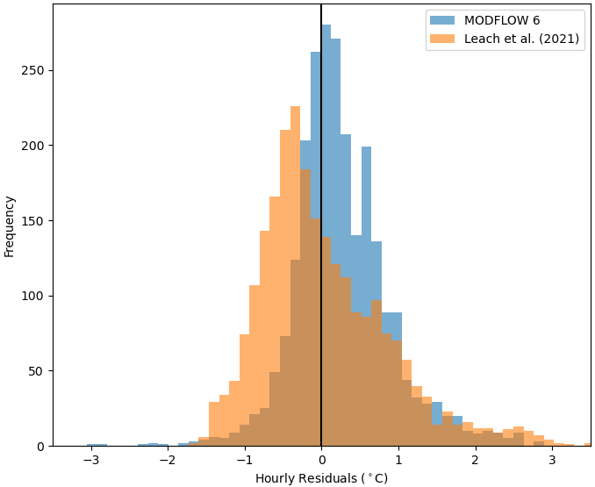
Comparison of output
Model setup uses FloPy
Extensive use of the Time Series utility
Initial results are encouraging:

Slide 17
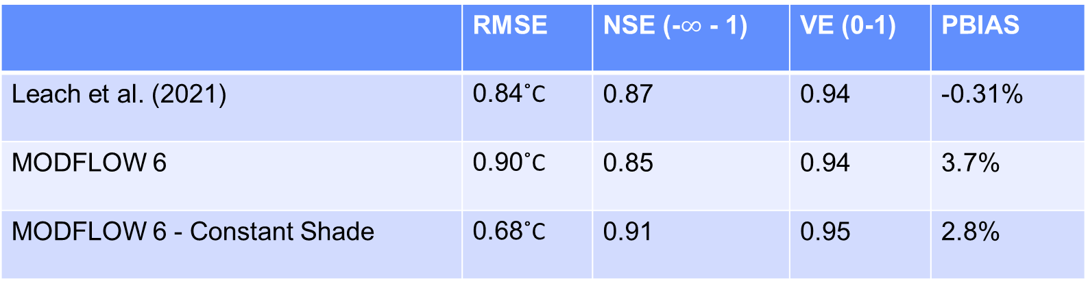
Comparison of output
 | RMSE | NSE (-$∞$ - 1) | VE (0-1) | PBIAS
Leach et al. (2021) | 0.84˚C | 0.87 | 0.94 | -0.31%
MODFLOW 6 | 0.90˚C | 0.85 | 0.94 | 3.7%
MODFLOW 6 - Constant Shade | 0.68˚C | 0.91 | 0.95 | 2.8%
(constant shade factor value was 0.98)
Notes:
Much of MODFLOW uses three letter acronyms to refer to different model types and also the packages within models

Slide 18
Summary
Process-based approach for improved stream temperature modeling readily fits within the object-oriented design of the MODFLOW 6 framework
The ABC Package maintains familiar look & feel of MODFLOW packages
Compatible with advanced MODFLOW 6 capabilities:
  Parallel-enabled
  Alternative input format: NetCDF
  Supported in the MODFLOW API
Supported in FloPy

Slide 19

Thank you

