Slide 1
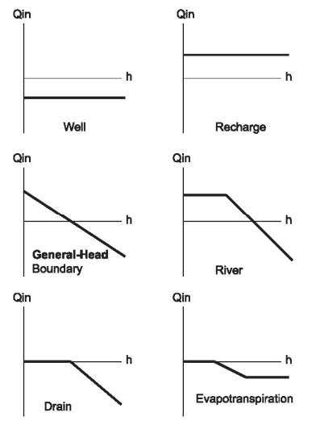
Basic Packages
Focus is on the following 4 packages:
  River (RIV) Package →
  Streamflow Routing (SFR) Package
  Recharge (RCH) Package →
  Unsaturated Zone Flow (UZF) Package
  Well (WEL) Package →
  Multi-Aquifer Well (MAW) Package
  High K Lake Cells →
  Lake (LAK) Package
“h”: head in the cell

Slide 2
Advanced Stress Packages
Include
  Lake (LAK)
  Streamflow Routing (SFR)
  Multi-Aquifer Well (MAW)
  Unsaturated Zone Flow (UZF)
  Mover (MVR)
Typically involve solving some form of a water budget equation
  As part of the formulation step (LAK, SFR, UZF, MVR)
  Added as rows in the system of equations solved (MAW)

Slide 3
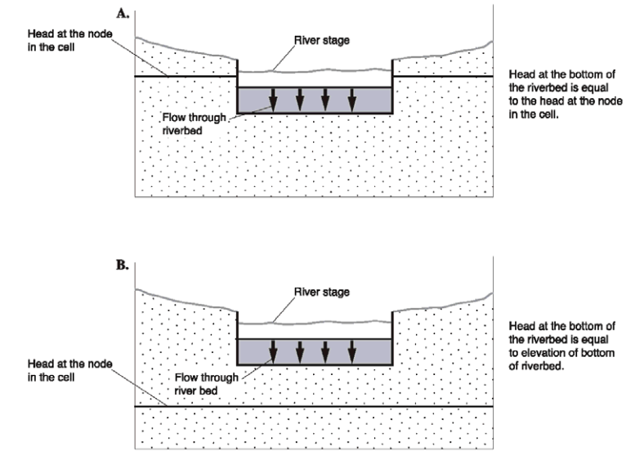
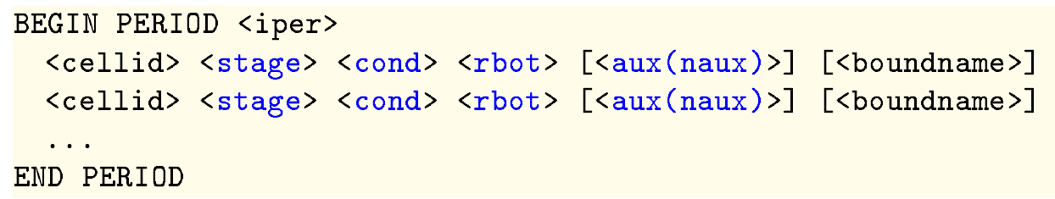
River (RIV) Package

Slide 4
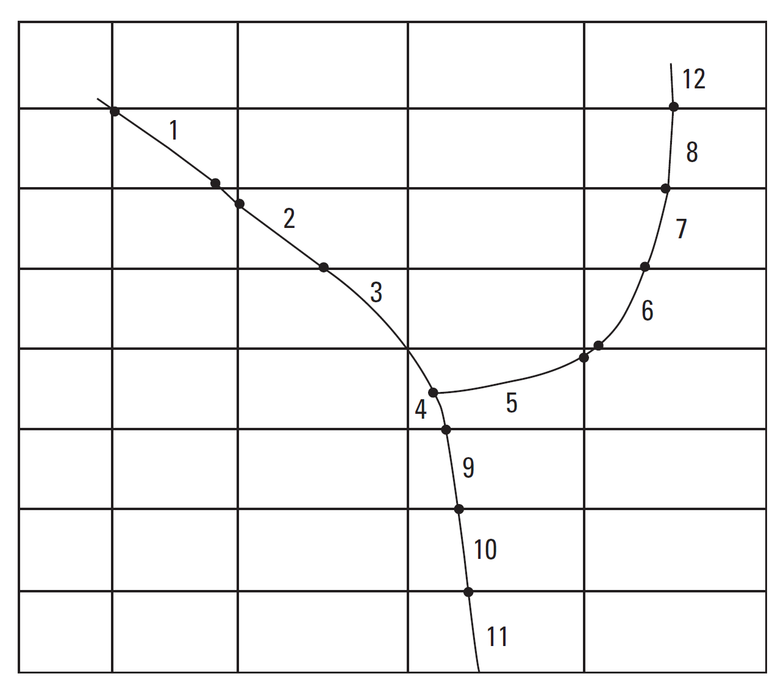
RIV Package Notes
Water is added to or removed from individual cells
There is no concept of routing and therefore no dynamic simulation of streamflow
May want to ignore short reaches
Can use the budget table to assess groundwater/surface-water exchanges

Slide 5
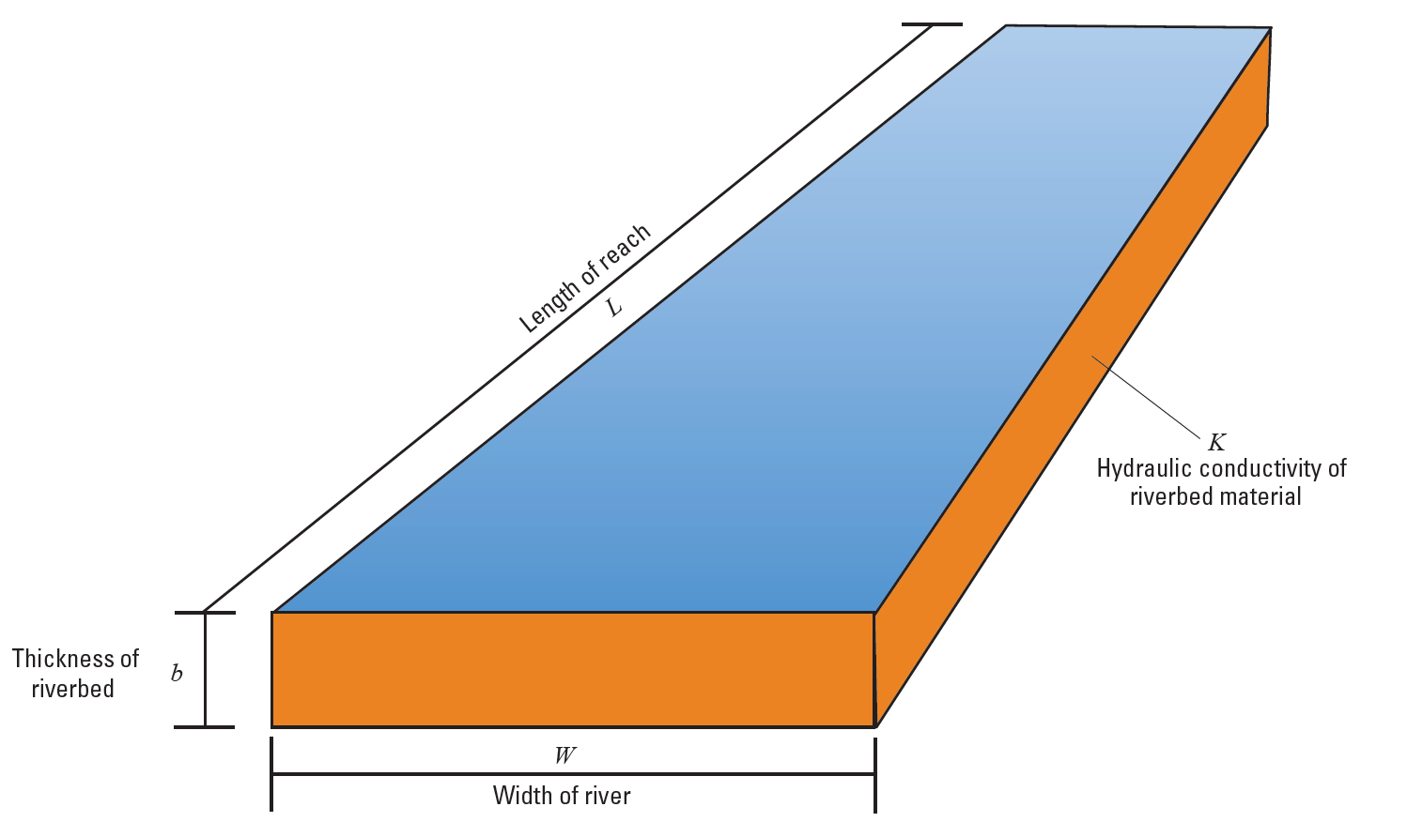
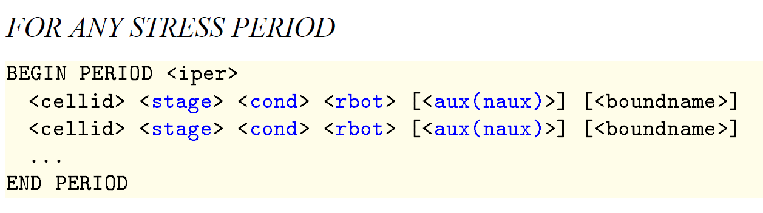

RIV Package Conductance:
$$C= \frac{K∙L∙W}{b}$$

Slide 6
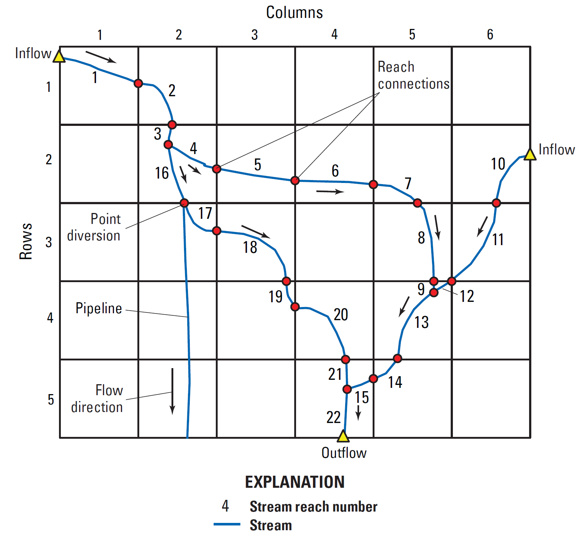
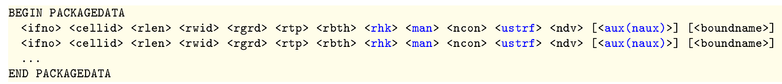
Streamflow Routing (SFR) Package
Streamflow is routed in one direction only
Groundwater/surface-water exchanges either add to or subtract from streamflow
Carries a much bigger parameterization requirement (see below)

Slide 7
Streamflow Routing (SFR) Package
BEGIN OPTIONS
END OPTIONS
BEGIN DIMENSIONS
END DIMENSIONS
BEGIN PACKAGEDATA
END PACKAGEDATA
BEGIN CROSSSECTIONS
END CROSSSECTIONS
BEGIN CONNECTIONDATA
END CONNECTIONDATA
BEGIN DIVERSIONS
END DIVERSIONS
BEGIN INITIALSTAGES
END INITIALSTAGES
BEGIN PERIOD <iper>
END PERIOD <iper>
SFR input blocks

Slide 8
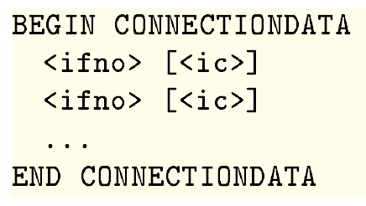
Streamflow Routing (SFR) Package
Streamflow is routed in one direction only
Groundwater/surface-water exchanges either add to or subtract from streamflow
A bigger parameterization requirement
Stream networks can be established through connections:
Reach: Connections:
-2
1 -3
2 -4 -16
3 2 -16 (alternative)
…
13 9 12 -14

Slide 9
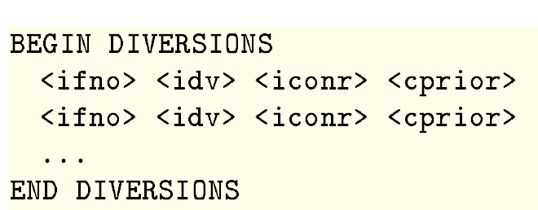
Streamflow Routing (SFR) Package
Streamflow is routed in one direction only
Groundwater/surface-water exchanges either add to or subtract from streamflow
A bigger parameterization requirement
Stream networks can be established through connections
“3 1 4 FRACTION”

Slide 10
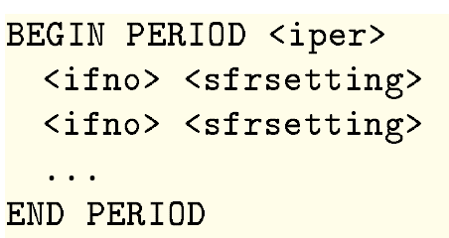
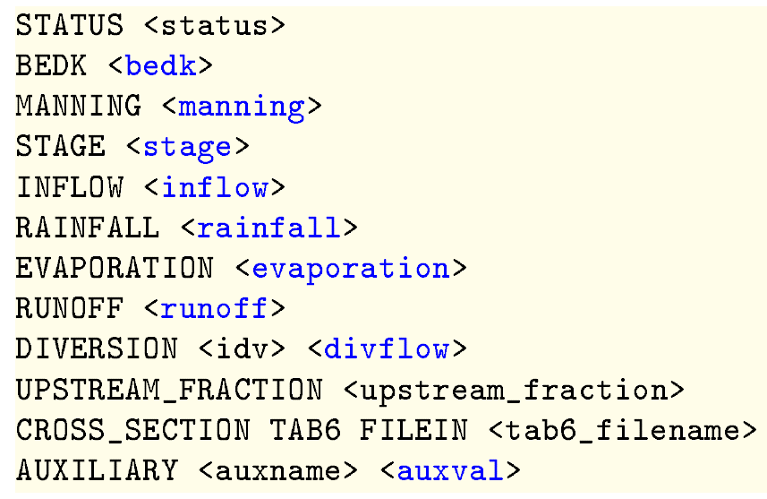
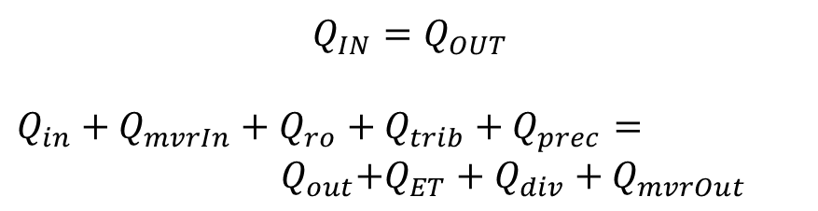



Streamflow Routing (SFR) Package
Stress Period Data:
$$Precip$$
$$Evaporation$$
$$L$$
$$w$$
$$Q_{IN}=Q_{OUT}$$
$Q_{in}+$ $Q_{mvrIn}+Q_{ro}+Q_{trib}+Q_{prec}= { Q}_{out}+Q_{ET}+Q_{div}+Q_{mvrOut}$

Slide 11
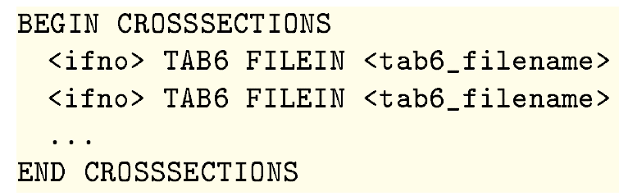
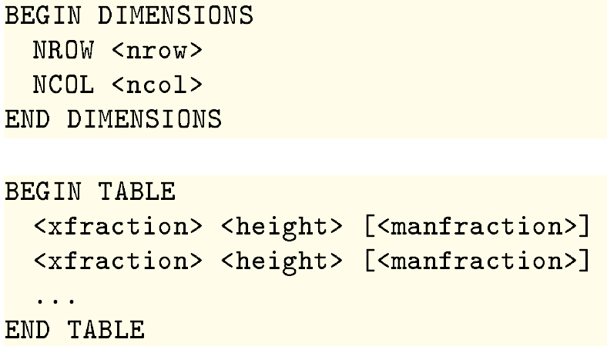
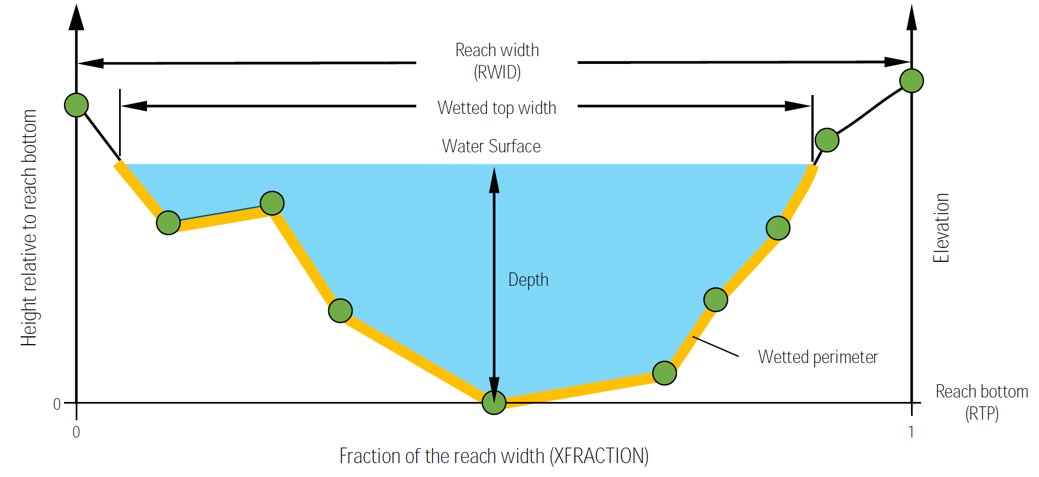
Streamflow Routing (SFR) Package

Slide 12
Unsaturated Zone Flow (UZF) Package
Intended for basin scale studies
Numerically stable
Simulates
Gravity flow in the unsaturated zone
Evapotranspiration (unsaturated and saturated)
Infiltration excess (rejected infiltration)
Saturation excess (groundwater discharge to land surface)

Slide 13
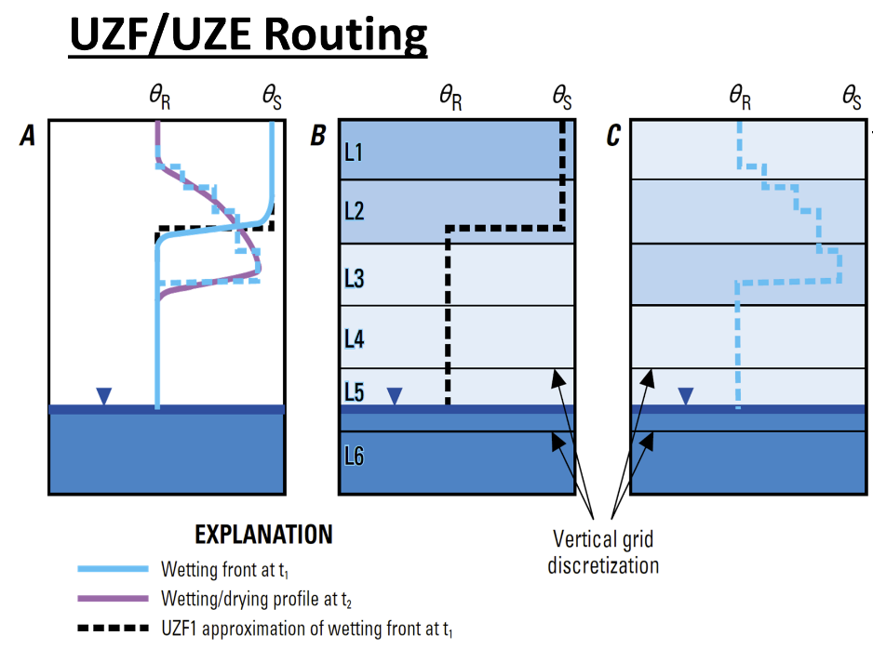
Unsaturated Zone Flow (UZF) Package
Unsaturated Zone Flow Package
Specified
ET
Recharge
Runoff
ΔS
Specified
Calculated

Slide 14
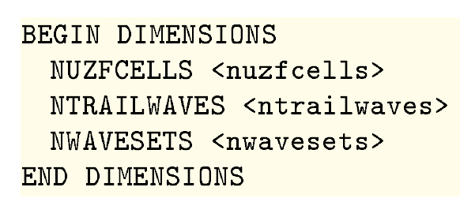
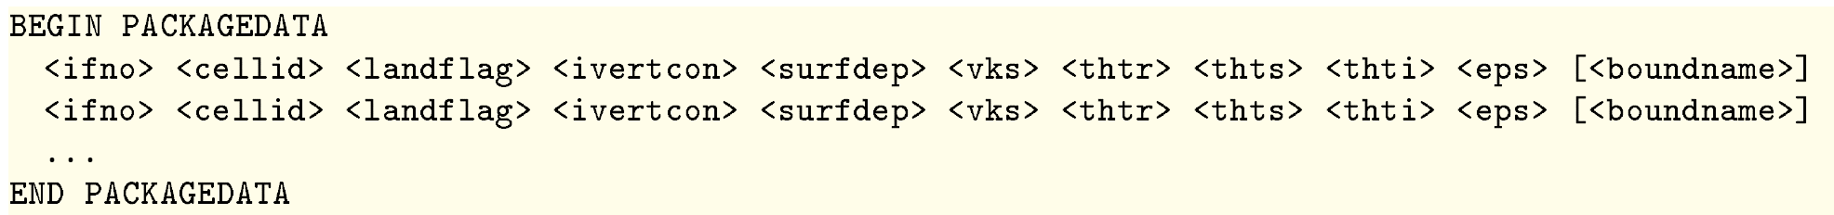
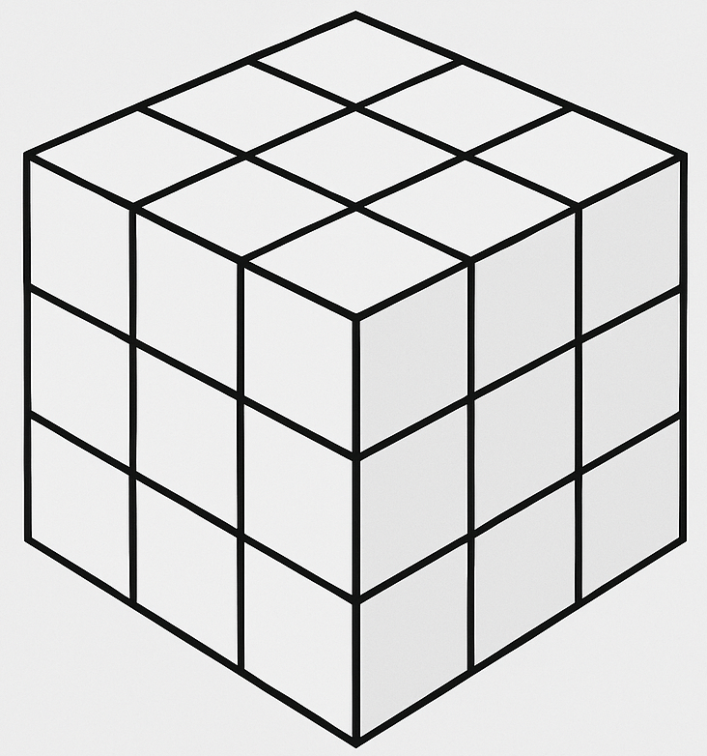
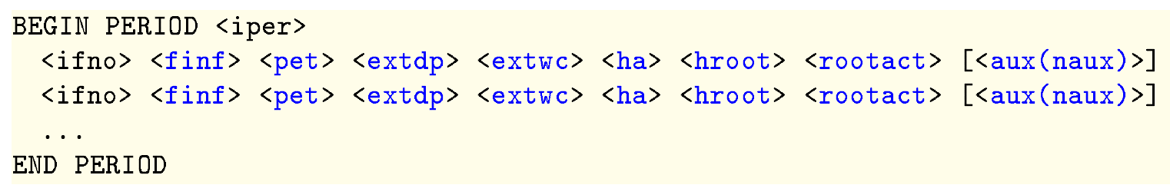
Unsaturated Zone Flow (UZF) Package
1
4
2
7
5
3
8
6
9
16
12
17
15
18
18

Slide 15
Multi-Aquifer Well (MAW) Package
Capabilities
Solved as part of the matrix solution
Simplified data input
Flexible connectivity
Several well conductance formulations
Constraints (flow reduction and well shutdown)
Flowing well option
Can account for interbore storage changes
Constant and inactive wells
Differences
No support for
  horizontal wells
  partial penetration
  non-linear head losses

Slide 16
Multi-Aquifer Well (MAW) Package
Capabilities
Solved as part of the matrix solution
Simplified data input (compared to MNW)
Flexible connectivity
Several well conductance formulations
Constraints (flow reduction and well shutdown)
Flowing well option
Can account for interbore storage changes
Constant and inactive wells
Differences
No support for

Slide 17
Multi-Aquifer Well (MAW) Package
BEGIN OPTIONS
END OPTIONS
BEGIN DIMENSIONS
END DIMENSIONS
BEGIN PACKAGEDATA
END PACKAGEDATA
BEGIN CONNECTIONDATA
END CONNECTIONDATA
BEGIN ANGLEDATA
END ANGLEDATA
BEGIN PERIOD <iper>
END PERIOD <iper>
MAW input blocks

Slide 18
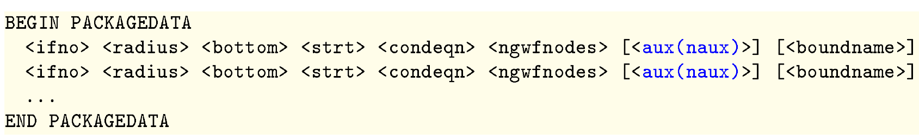
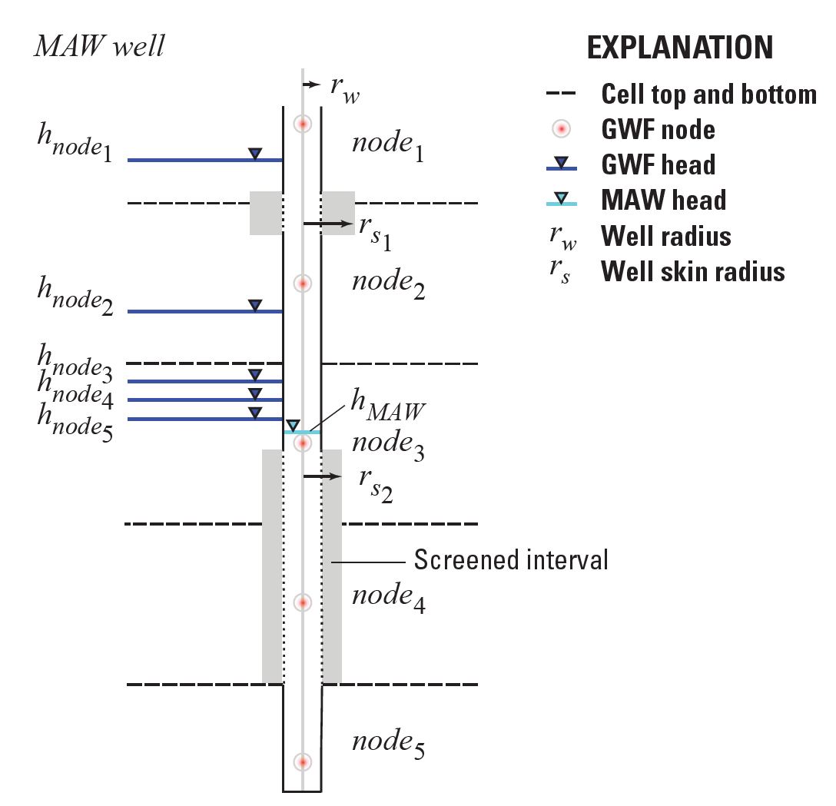
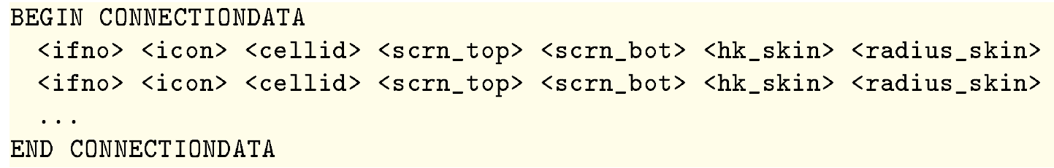
Multi-Aquifer Well (MAW) Package

Slide 19
Lake (LAK) Package
Multiple outlets per lake using 3 outlet equation options (specified, Manning, weir)
Lakes sit on top of model grid (overlying), incised lakes, embedded lakes (sub-grid scale lakes)
Constant stage and inactive lakes
Explicitly defined lake connectivity
Currently no UZF under lakes

Slide 20
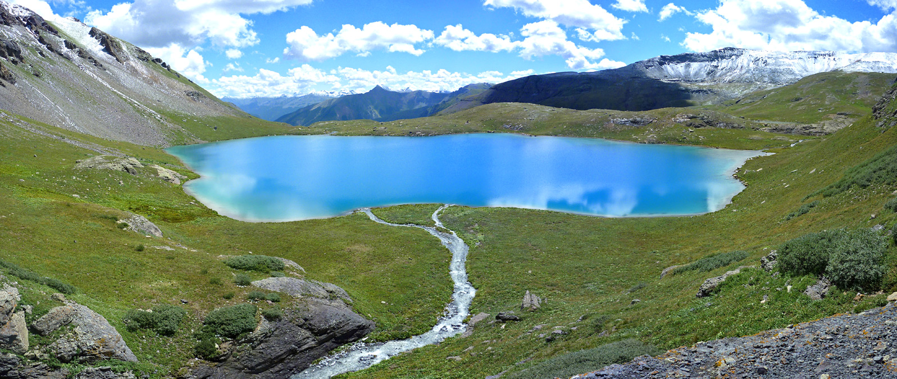
Lake (LAK) Package

Slide 21
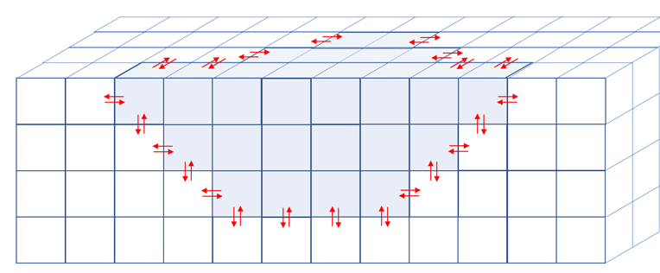
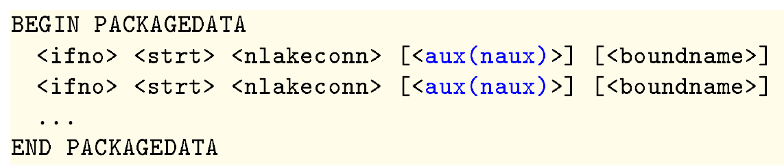
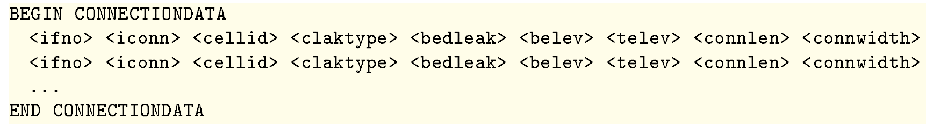
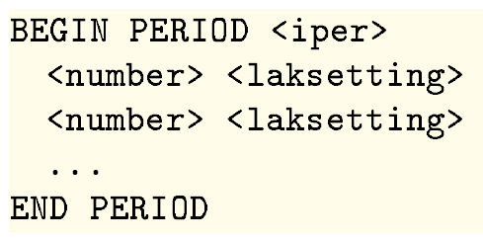
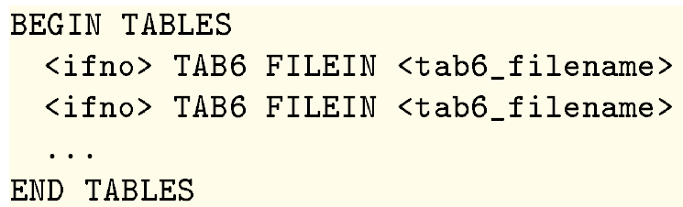
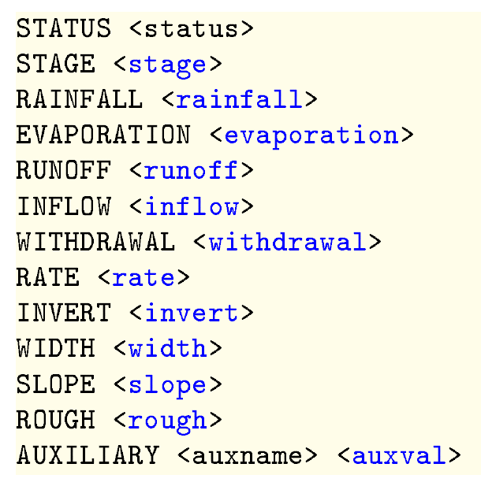
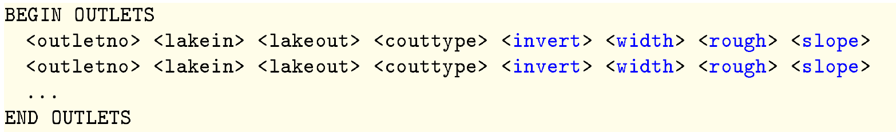
Lake (LAK) Package

Slide 22
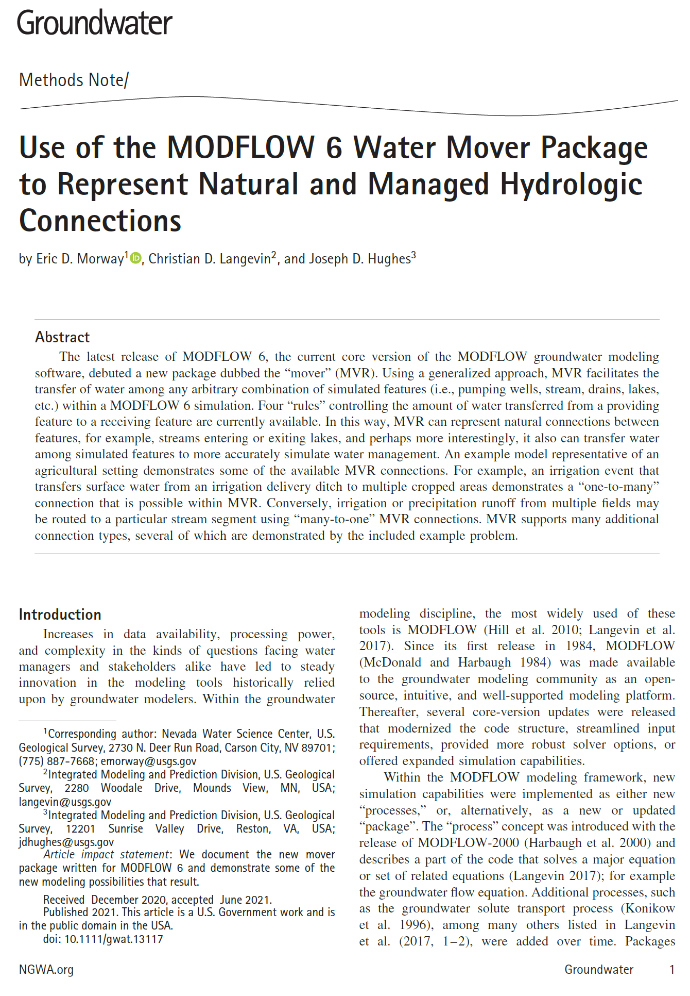
Mover (MVR) Package
https://doi.org/10.1111/gwat.13117

Slide 23
Mover (MVR) Package
CONSTRAINTS
PROVIDER
RECEIVER
Package
Discharge
One to One
Provider 1
Receiver 1
One to Many
Receiver 2
Provider 2
Receiver 3
Many to One
Provider 3
Receiver 4
Provider 4

Slide 24
MVR Package Providers and Receivers
Providers
  Drain package
  General-head boundary package
  River package
  Well package
Provider and Receiver
  Lake package
  Multi-aquifer well package
  Streamflow routing package
  Unsaturated zone package
    Water that is made available to the mover by a single provider and is subsequently allocated to multiple receivers is allocated in the order listed in Mover package

Slide 25
MVR Package Providers and Receivers
Similar to options available for CPRIOR in the SFR Package
1) Fraction
  Discharge x fraction is sent to the receiver
2) Excess
  Any water that exceeds the user-specified rate is provided to the receiver. No water is provided to the receiver if the available water is less than the user-specified value. (Flood control)

Slide 26
MVR Package Providers and Receivers
3) Threshold
  No flow is provided to the receiver until the available water exceeds the user-specified rate. Once the available water exceeds the user-specified rate, then the user-specified rate is provided to the receiver. (Priority)
4) Up To
  All of the available water will be taken from the provider up to the user-specified rate. Once user-specified rate is exceeded, the receiver will continue to get the user-specified rate.

Slide 27
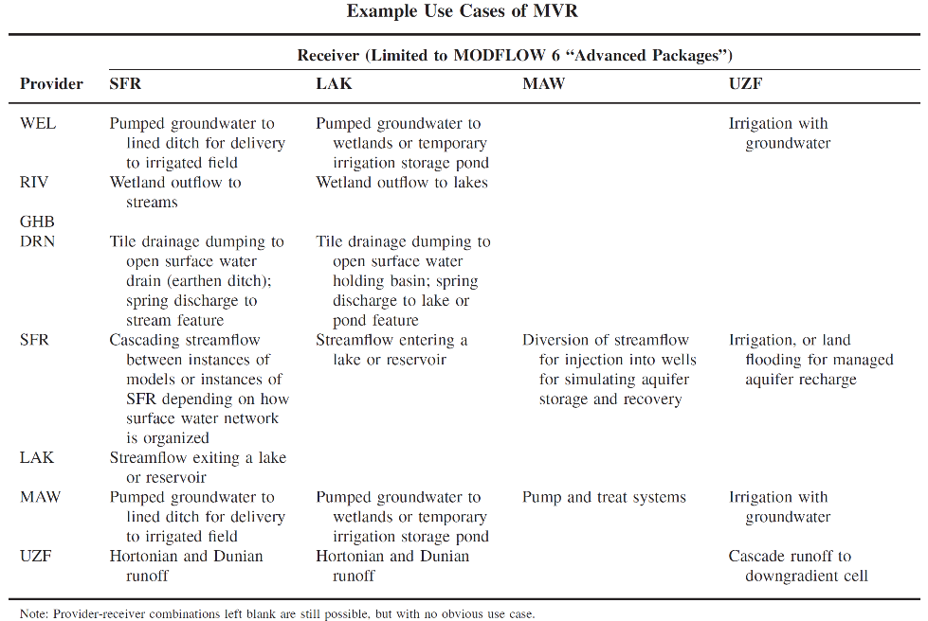
Example Use Cases of MVR

Slide 28
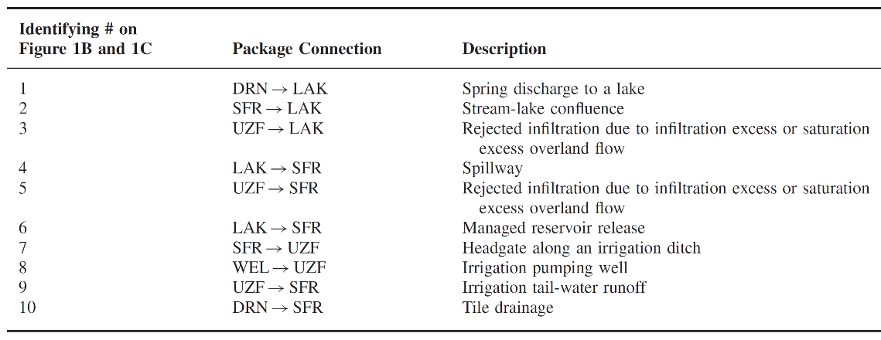
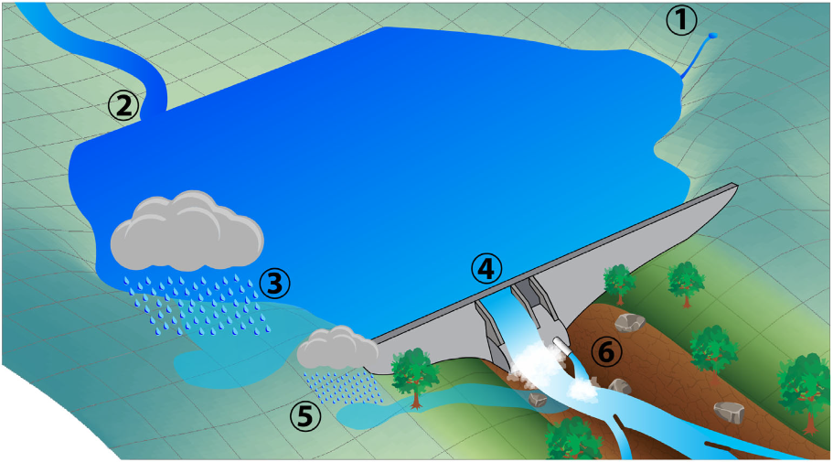
MVR examples
#

Slide 29
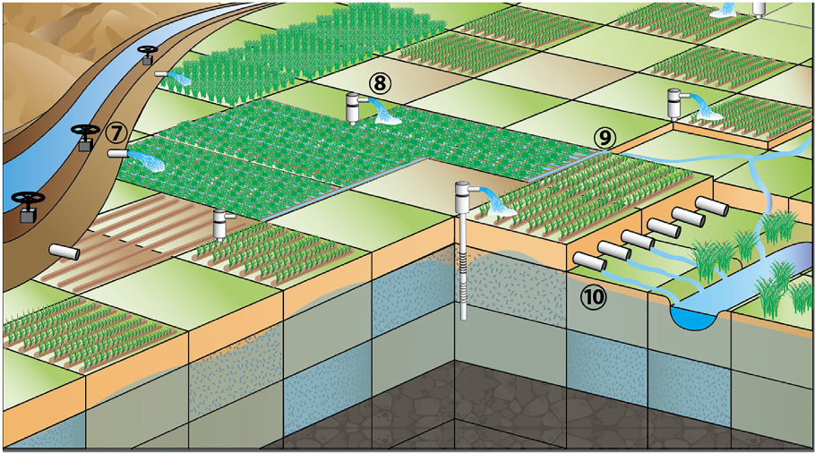
More MVR Examples
#

Slide 30
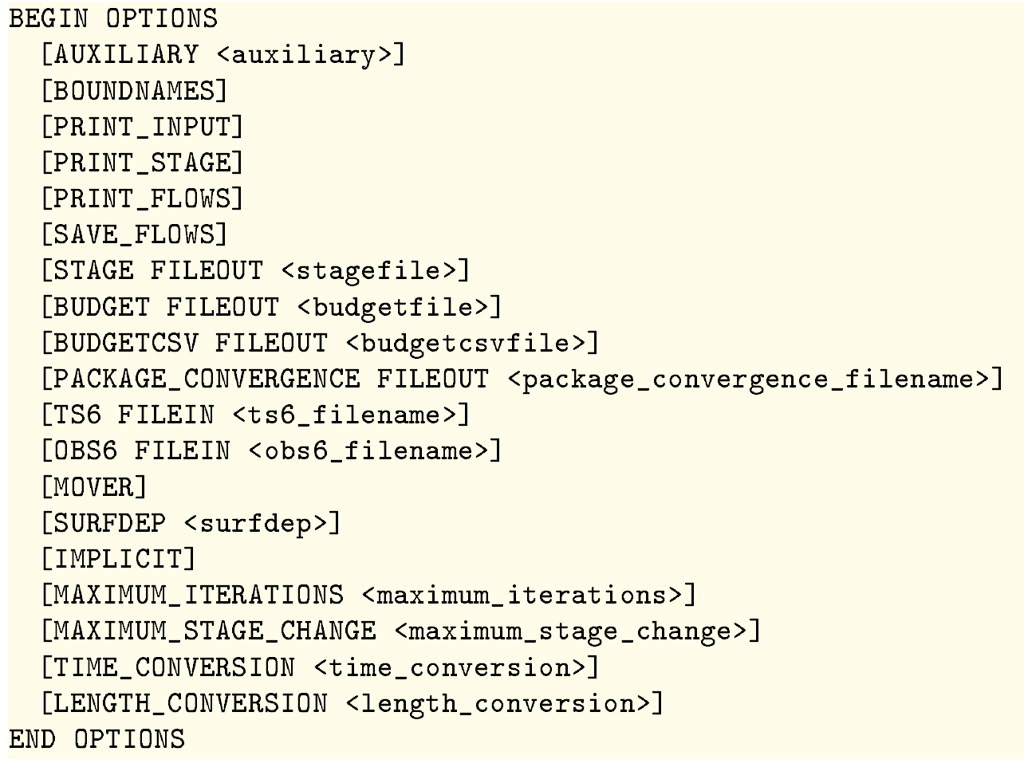
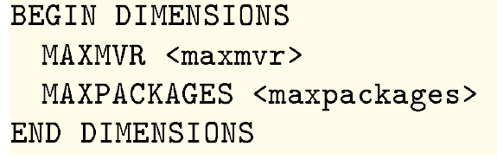
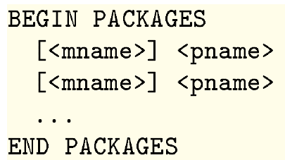
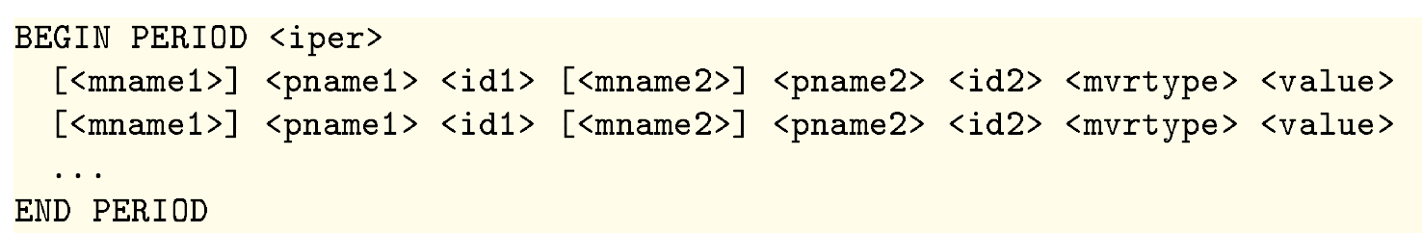
MVR Package Providers and Receivers
Lake Package Options Block

Slide 31
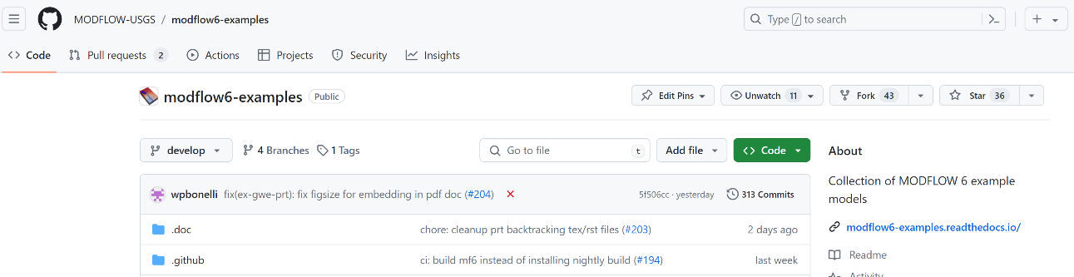
Worked Advanced Package Transport Examples

Slide 32
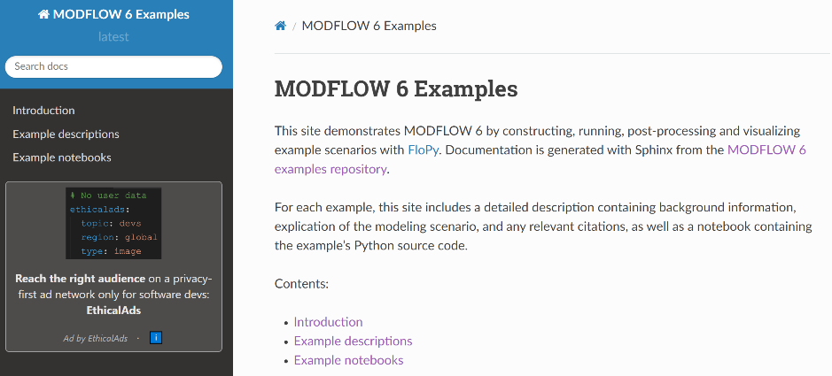
Worked Advanced Package Transport Examples
Search the examples by package type

Slide 33
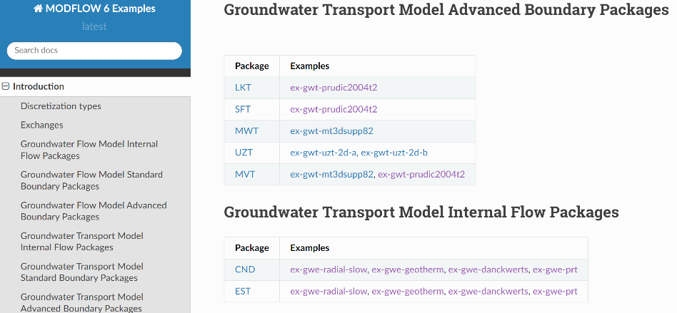
Worked Advanced Package Transport Examples
Search the examples by package type

Slide 34
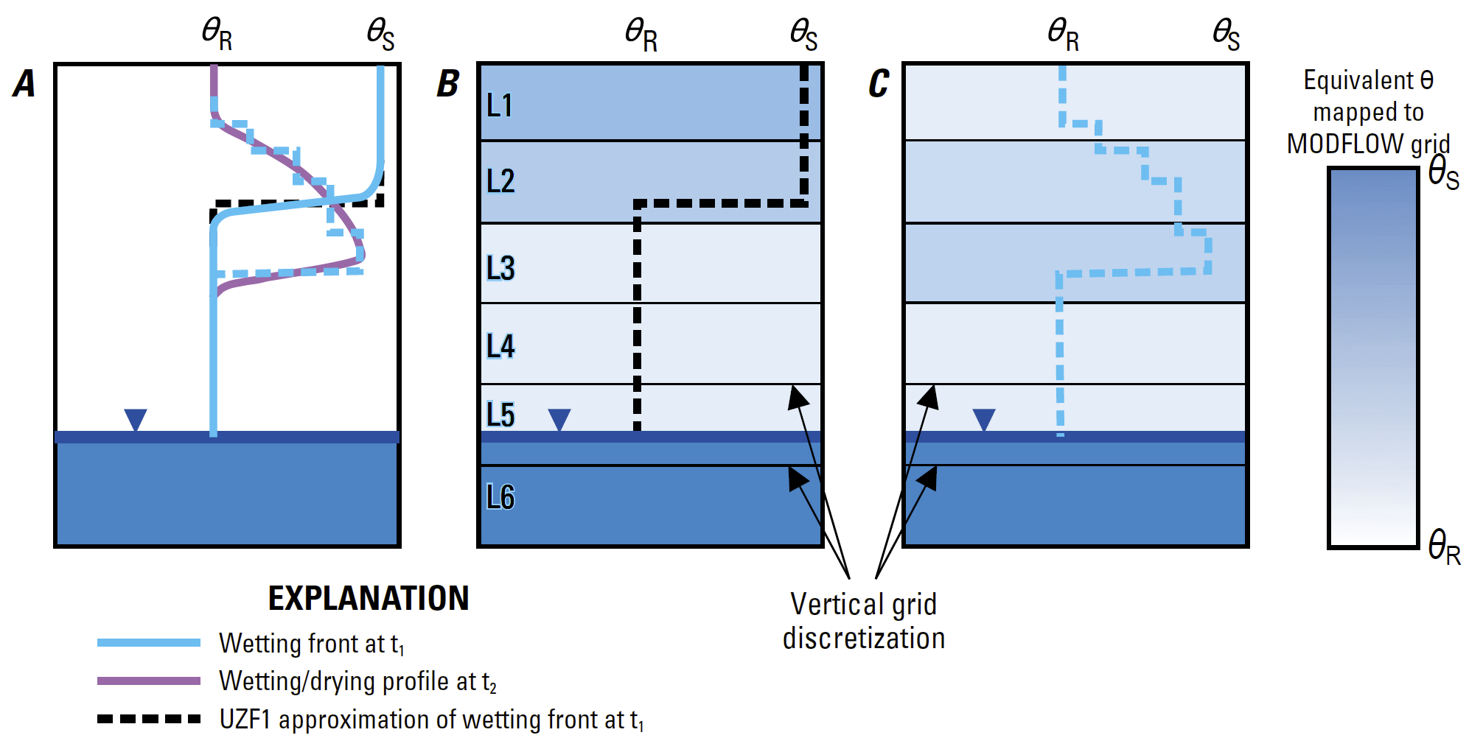

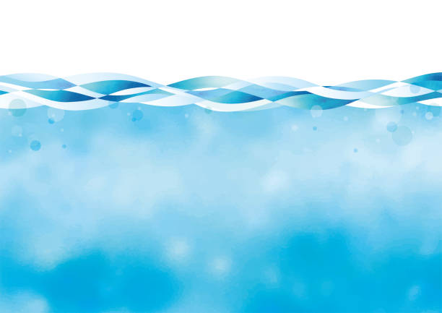

Advanced Package Transport
UZF/UZE Routing
Relative Cell
Temperature
Warm
Heat from precipitation
Runoff heat flow
Cool
Infiltrating heat flow
UZF/UZE
Infiltrating heat flow
Runoff heat flow
Recharging heat flow
Changes in UZ heat storage
Recharging heat flow
LAK/LKE
Groundwater/surface-water interaction, including
convective and conductive heat exchange
Takes into account temperature of precipitation
Evaporative Cooling
Runoff heat flow
Runoff heat flow
Evaporative cooling
Heat from precipitation
Runoff heat flow
Simulated lake temperature
Simulated
stream
temperature
Groundwater/surface-water conductive heat exchange
Deep groundwater heat flow to lakes
Q
Shallow groundwater heat flow to streams
Deep groundwater heat flow to streams
Shallow
groundwater heat flow to lakes
Groundwater/
surface-water conductive heat
exchange
SFR/SFE
Channel routing of heat flow
Evaporative cooling
Takes into account temperature of precipitation
Groundwater/surface-water interaction, including convective and conductive heat exchange

