Slide 1
Introduction: Stability, Stewardship, and the Future of MODFLOW 6

Slide 2
MODFLOW 6 Governance
Some hallmarks of MODFLOW have been
scientific rigor
steady support
transparency
teachability
flexibility

Slide 3
MODFLOW 6 Governance
Since its inception, MODFLOW has been a USGS-led project...
...but it has also been open-source.
With developers leaving USGS last year, there was disruption but also opportunity to codify the open-source goals and broaden the community
Enter the new MODFLOW Charter

Slide 4
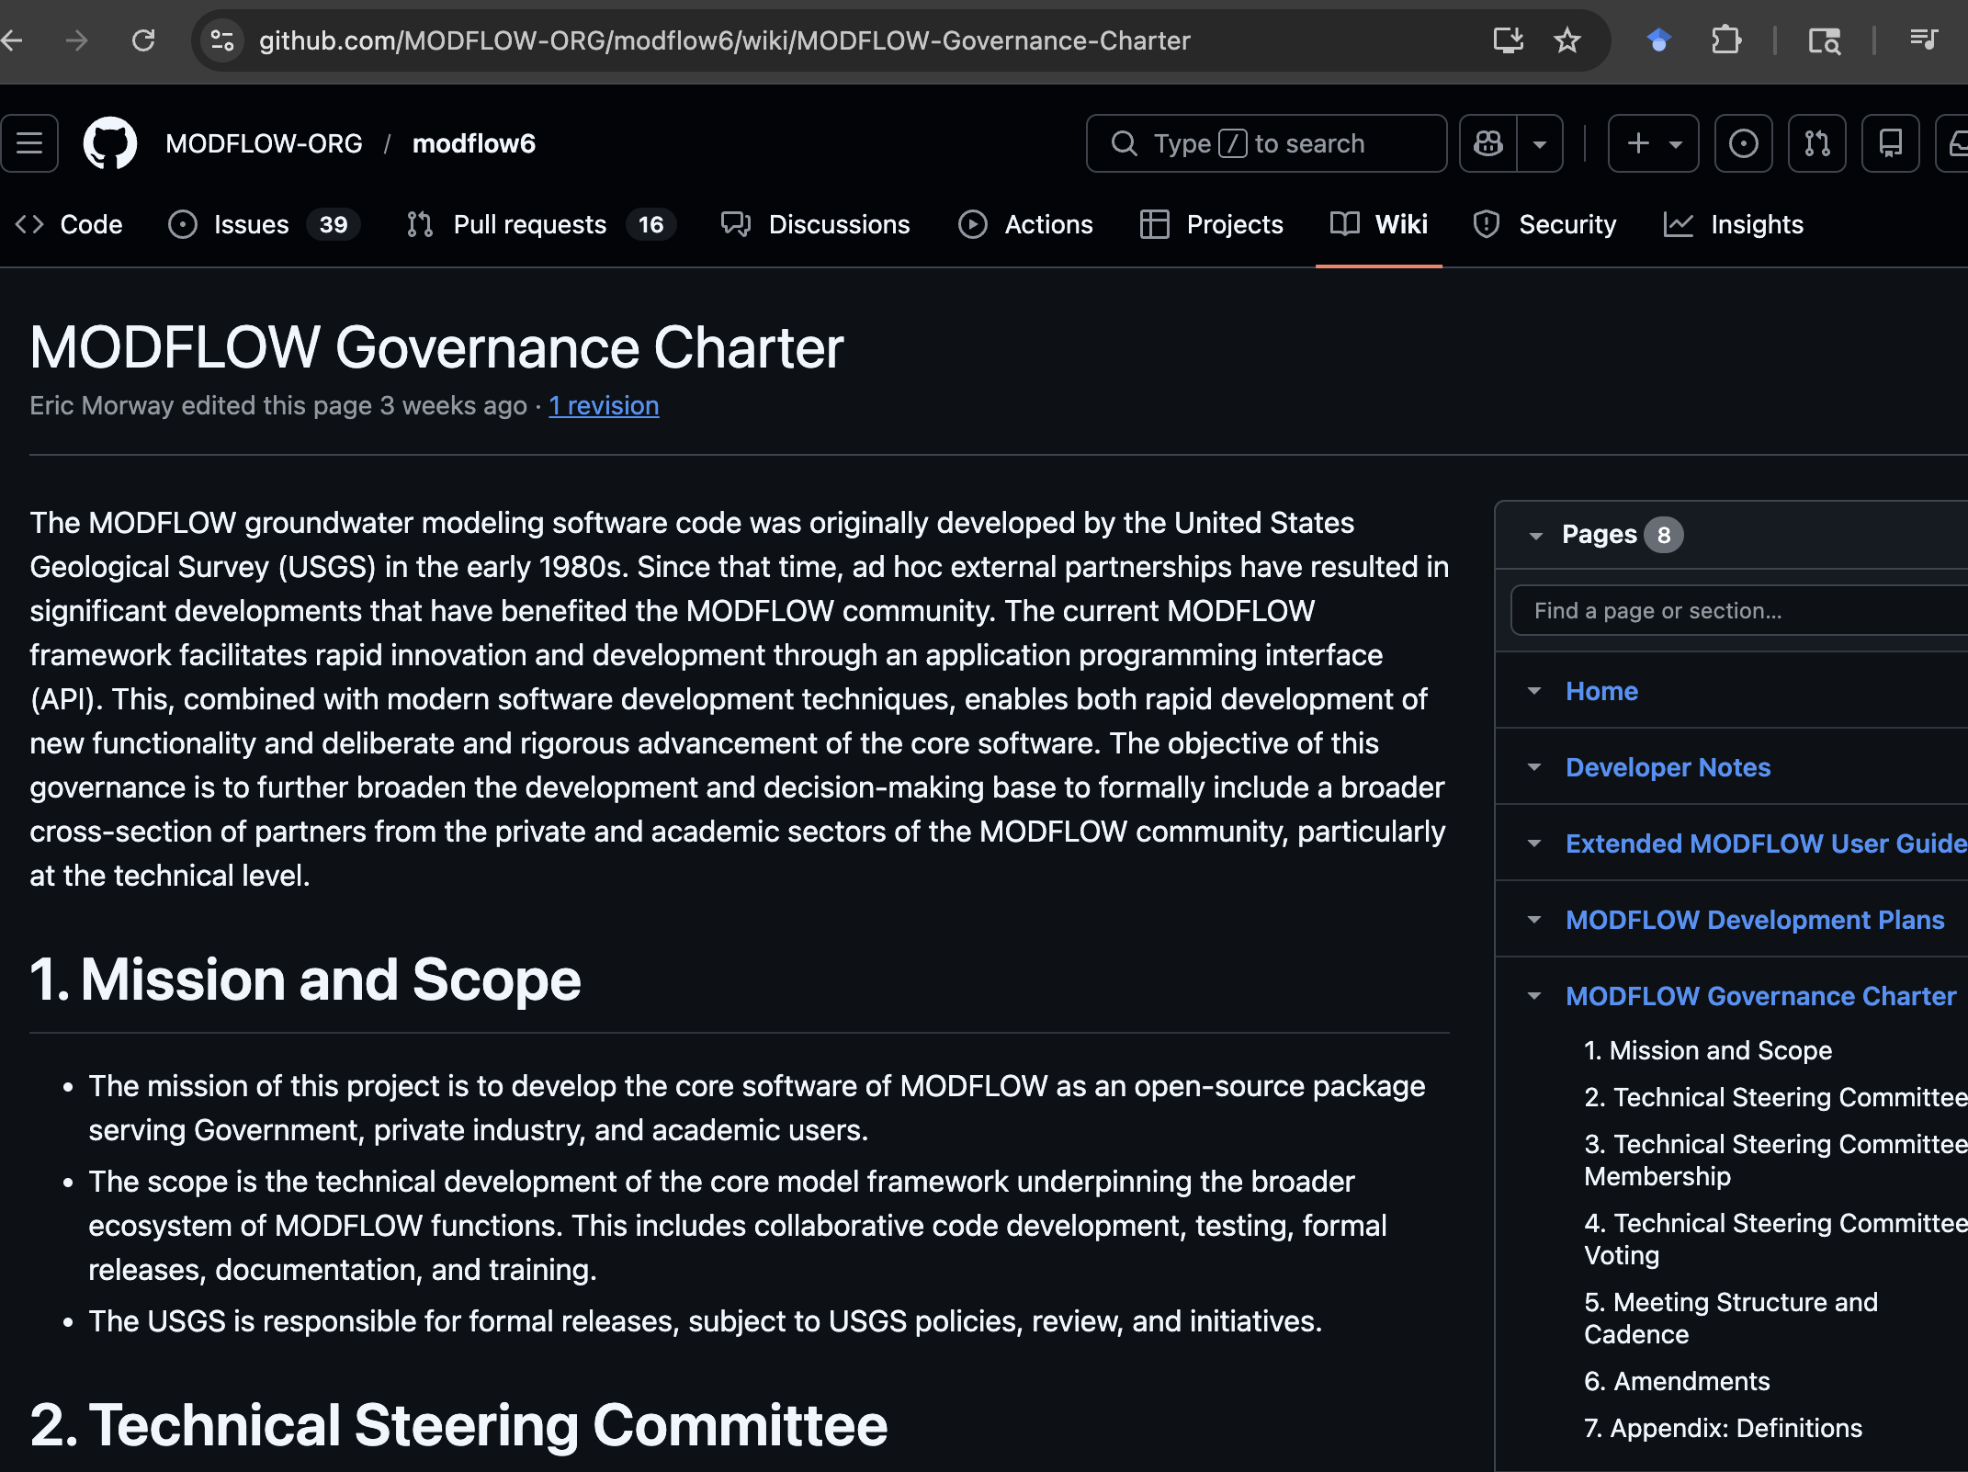
MODFLOW 6 Charter
https://github.com/MODFLOW-ORG/modflow6/wiki/MODFLOW-Governance-Charter

Slide 5
MODFLOW 6 Governance
Key attributes
Modeled on other open-source, multi-group projects (like Linux, Appvisor, etc.)
Establishes a Technical Steering Committee (why bother?)
Everyone can make their own special version of MODFLOW6 that inherits the base/core capabilities
TSC ensures that big, potentially breaking changes made by anyone are reconciled so that the base/core keeps working smoothly
Codifies external contributions to vision and implementation

Slide 6
MODFLOW 6 Governance
USGS Responsibility going forward
USGS will continue to make formal releases, subject to review processes and Fundamental Science Practices --- the USGS imprimatur is on the code
USGS or anyone else can develop offshoots for any specific project/program needs
Thanks to modern architecture and Git-based version control
Main development is collaborative with USGS playing an important role, but not directing all development
The State of MODFLOW is strong!

Slide 7
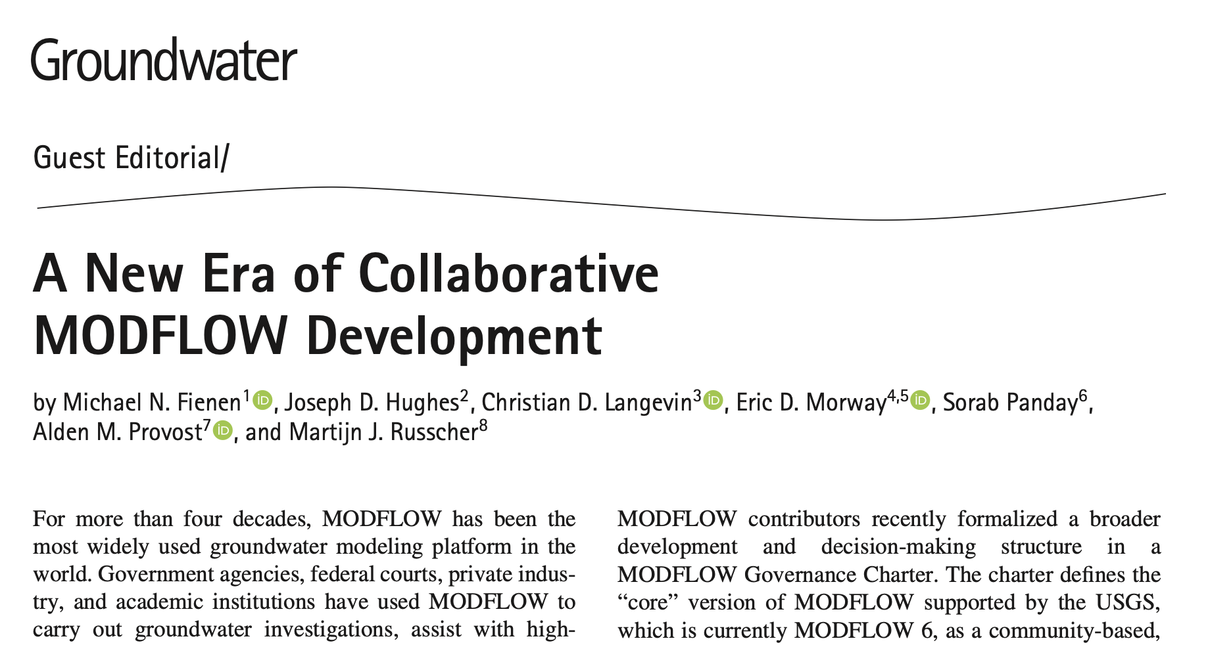
https://doi.org/10.1111/gwat.70073

