Slide 1
McDonald Valley Project

Slide 2
Exercise Description
McDonald Valley Exercise In this problem, we've designed a hypothetical field problem that parallels the model construction and calibration process much like a real field problem. This exercise is intended to give the student experience in building a flow model from GIS data sets and performing some hand calibration on that flow model. This problem will be approached in 3 - 4 stages depending on time: Stage 1: Review the included information and project objectives to design an effective approach to simulating the system. In this stage you may want to consider the pros and cons of various boundary conditions, discretization schemes, etc... Stage 2: Develop a model for the predevelopment condition based on the existing data that are provided to you Stage 3: Calibrate the model using "hand calibration" techniques. *Note* we will give you an example of how to update an existing boundary condition with FloPy Stage 4: Simulate the effects of the proposed stresses on the system using the calibrated model from stage 3.

Slide 3
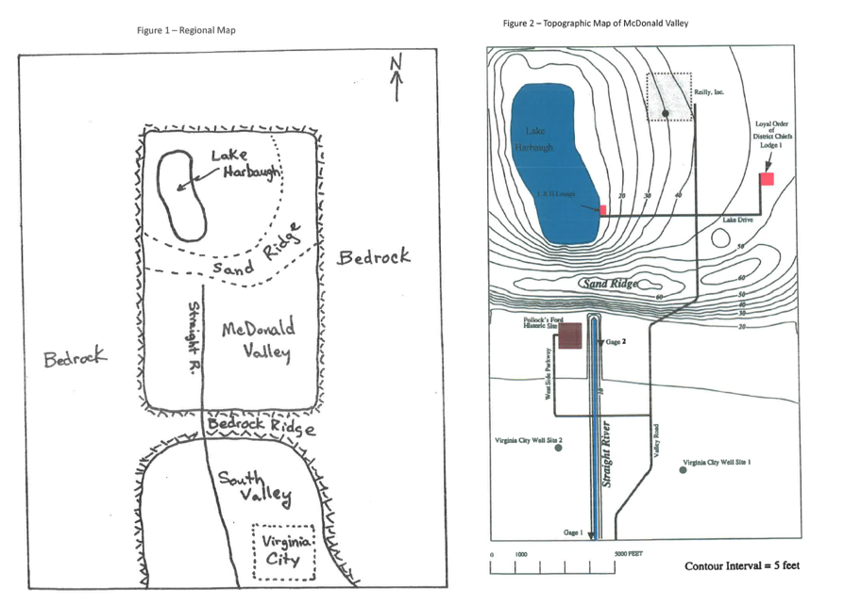
Study Area

Slide 4
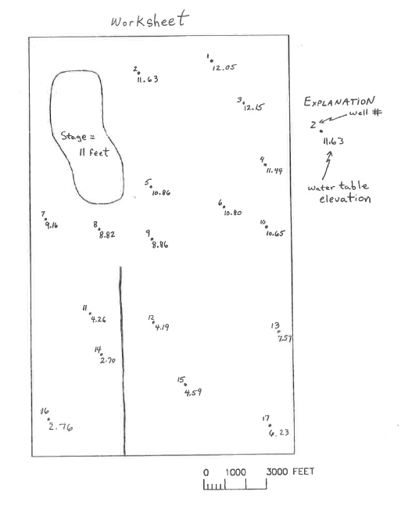
Water table elevations

Slide 5
Background and problem statement
Information stored in 04_class_project.ipynb

Slide 6
Problem formulation:
Take a few minutes to think through these questions and come up with a conceptual model of McDonald Valley.
Describe the elements of the hydrology of the system that you believe will be the most important in your analysis
Describe how you would treat the boundary conditions and stresses
Think about how you would incorporate the effects of the lake and river into this model? How will you simulate them and with which package(s)
Write a water budget for the lake given the information that you have. Is the lake a net source or sink of water for the groundwater system? Can you make a quantitative estimate of the net rate of groundwater recharge or discharge due to the lake.
What is the total amount of recharge to McDonald Valley and how is it distributed?

