Slide 1
Spartan Service
DeSmet Jesuit Coding Team
Ambassador: Ryan Sextro & Mentors: Kris Dalpiaz & Brian Ortbals
Justin Larson, Justin McNiel, Matthew Meyer, Karl Frank, Patrick Sanchez, Caleb Hackmann, Matthew Woodford, Joel Wisa, Jonathan Nelson

Slide 2
Problem
Finding service opportunities is currently inefficient and difficult
DeSmet students can’t always find a service site that is nearby and fits their schedule.
Extracurricular activities and driving distance often create scheduling issues
Some Service Sites may need assistance more than others
Some sites may fit student scheduling, but fail to garner student interest

Slide 3
Solution
We created a website that makes it easier for students to find community service providers, and for providers to find students
Providers can post events allowing students to signup for community service.

Slide 4
Long Term Goal
Make it easier for DeSmet students to find community service opportunites
Make it easier for service providers to find students when needed
Make Mr. Luecke’s (our Director of Student Services) job easier

Slide 5
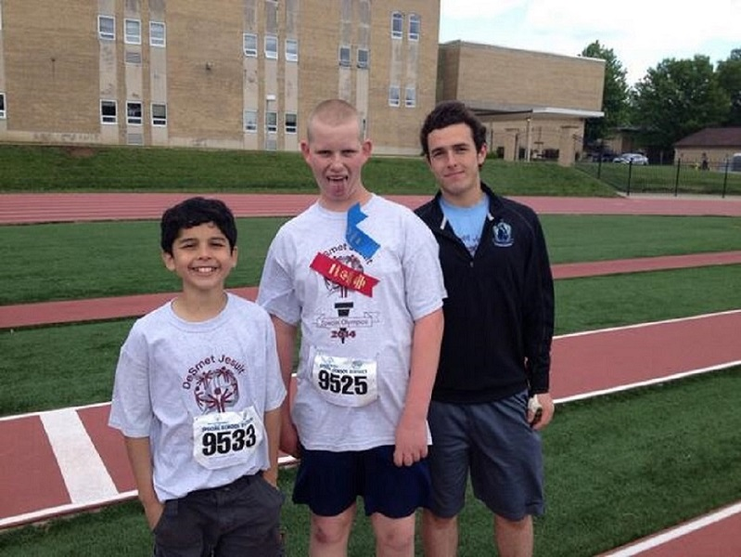
Impact
Students
Freshman, Sophomore, Junior, Senior Service
WWT Team
Learned to solve problem in community using STEM
Work together for common goal

Slide 6
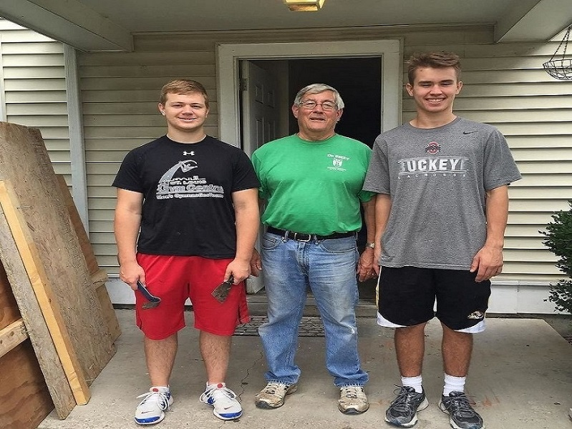
Impact
Faculty
Mr. Lueke (200+ hours)
Sophomore Theology teachers
Environment
paper waste
Community
Service all over Saint Louis Area
Easy for interface with De Smet Jesuit

Slide 7
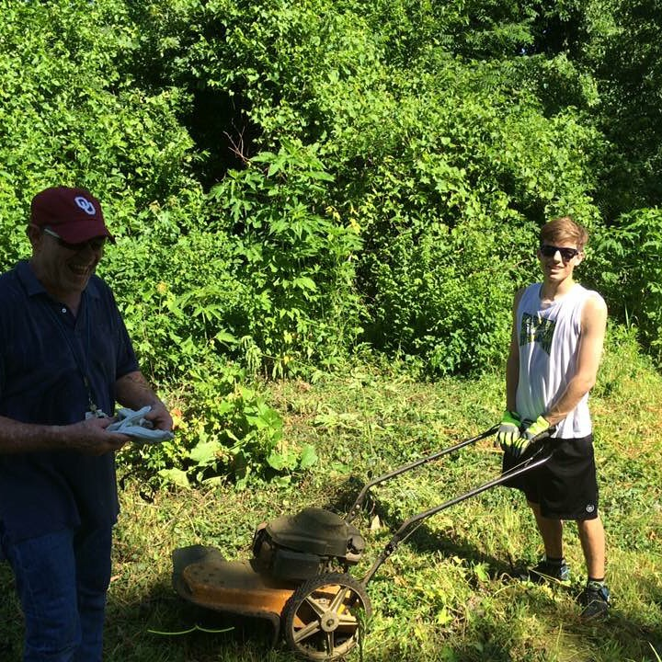
Technologies
Mysql
Php
HTML
Bootstrap
CSS
Javascript
GitHub
Slack
Notes:
These Forms of Code were new to the team. We all had to learn these together as a team. There wasn’t anyone who knew everything.
Communication: Slack, GitHub---Database: Mysql, php, Javascript, html, apache

Slide 8
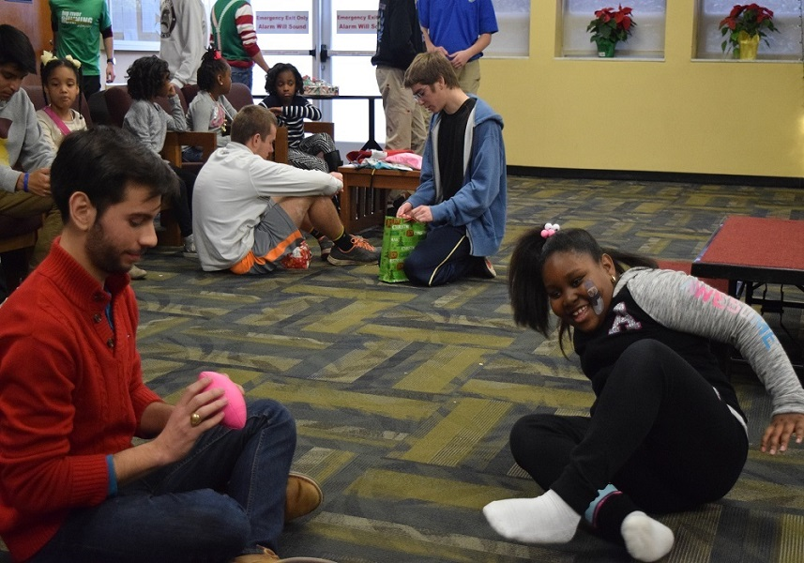
Integration (User Adoption)
Mandatory
Providers
Future:
IT
MySparta (Community Mobile App)
Notes:
Providers: Contact all service providers and have the mix into this system---Mandatory: This website will become mandatory in order to connect to service projects & fulfill service requirements (similar to Moodle)---MySparta: Possible integration into the app---IT: Future presentation to IT over the integration & security risks---

Slide 9
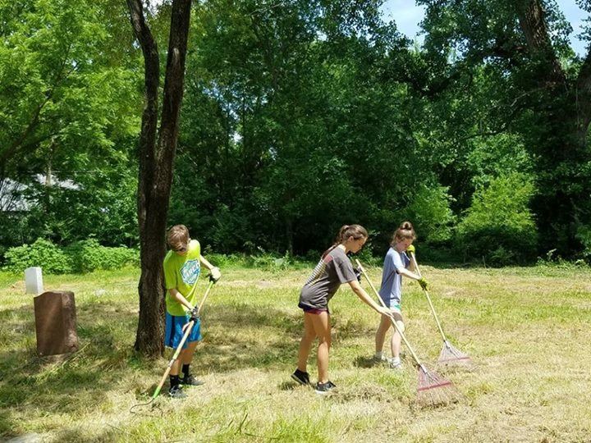
Production
DeSmet Server
Notes:
We will use the DeSmet server in order to reach the DeSmet community and the people we effect

