Slide 1
One definition.
One owner.
Every layer.
AN ASSET MANAGER · REFERENCE DATA MODEL
A reference taxonomy for asset management that becomes governed data products, a semantic model, and an AI assistant that answers the questions distribution actually asks.
Taxonomy
Data products
Semantic model
AI and analytics
1
Notes:
Open with the sentence on the slide, not with the deck. “Everything we are going to show you comes down to one rule: one definition, one owner, every layer. The taxonomy says what a thing means. The data products carry that meaning through without rewriting it. The semantic model publishes it once. And an AI assistant reads the same definition the dashboard does.” Then the hook: “I want to start with a question you ask every quarter and probably get five answers to.” Move to the next slide within thirty seconds. Do not explain the four chips yet; they are a map you will come back to.

Slide 2
“Net flows, last quarter.” One question, five answers.
THE PROBLEM DISTRIBUTION LIVES WITH
SALES
FINANCE
PRODUCT
PLATFORMS
EXECUTIVE PACK
$2.41bn
$1.86bn
$2.08bn
$2.67bn
$2.20bn
Counts exchanges in as gross and conversions as rep credit. Trade date.
Money market funds out. Settlement date. Reinvestments out.
Rolls fund net assets forward, so reinvested distributions count as sales.
Counts platform omnibus totals and the look-through sub-accounts under them.
Hand-adjusted from last quarter’s method, with two restatements.
Every difference is a definition question: what counts as a sale, which date, which account level, who owns the rule. None of them is a technology question.
2
Notes:
For the head of distribution: “You know this slide. The numbers are made up; the reasons are not. One team counts exchanges in as new money, one nets them. One counts reinvested distributions as sales, one treats them as market movement. One uses trade date, one settlement date. One counts the platform omnibus total and the sub-accounts under it.” Then the pivot: “The cost is not the arithmetic. It is the month-end hour arguing about which number is right, and not being able to tell a board, or a wholesaler whose payout depends on it, which definition a given report used.” Land the band: “Every one of those five differences is a definition question. Not one of them is a technology question. That is exactly what a taxonomy settles, and why a new BI tool or a new AI assistant on top of the old definitions gives you five answers faster.” For the head of data management, add one line: “And nobody downstream can fix this, because nobody downstream owns the definition.”

Slide 3
What most firms call a taxonomy is actually a glossary of measures.
It sits at the top. The value is in what sits underneath.
WHAT A TAXONOMY ACTUALLY IS
THE USUAL PICTURE
A REFERENCE DATA TAXONOMY
A glossary of measures
An inventory of the things measures are made of
Business definitions of the numbers a report aggregates for a use case: net flows, gross sales, a territory’s attainment. Written per team, per dashboard.
Share class, distributor firm, advisor, territory, transaction, position, omnibus account, agreement, campaign. Every concept the firm runs on, with one definition and one accountable owner, written once for the whole firm.
It tells you what a number means. It does not tell you what the number is made of, or who to call when it is wrong.
The glossary of measures is built on top of it, once, and published to every tool from the same place.
A measure is only as good as the concepts it is built from. If nobody owns what a sale is, or which omnibus account belongs to which firm, the definition is an opinion with arithmetic attached.
3
Notes:
This is the slide that moves their mental model, so take it slowly and do not be condescending about it. “When most people say taxonomy they mean the left-hand box: a glossary that defines the measures a report aggregates. That is a real and useful thing, and we have built it too. It is the top of the stack, not the bottom.” “What we mean by a reference data taxonomy is the right-hand box: the inventory of the things those measures are made of. Not net flows, but transaction, share class, distributor firm, advisor, territory, omnibus account. Each with one definition and one owner, written once for the firm.” Land the band: “A measure is only as good as the concepts under it. If nobody owns what a sale is, or when an exchange counts as a redemption, the definition of net flows is an opinion with arithmetic attached. That is why five teams get five numbers, even when they all have a glossary.” For the head of data management: “A glossary tool holds whatever you load into it. The taxonomy is what decides what gets loaded.”

Slide 4
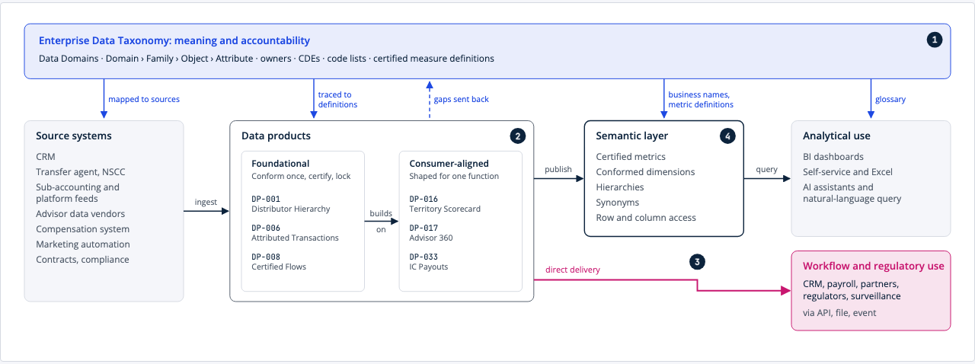
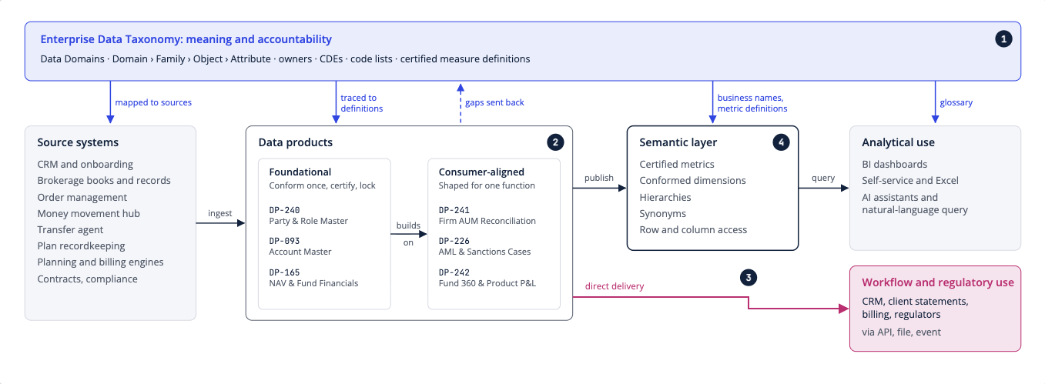
Four layers, and the taxonomy governs all of them.
WHAT WE BUILT
Taxonomy
What every concept means and who owns it.
Data products
Governed assets with an owner, a grain and quality rules, assembled from the taxonomy.
Semantic model
The measures, defined once, with the filters and access rules that make them safe to slice.
AI and analytics
Dashboards, Excel and an assistant reading the same named metric.
4
Notes:
The picture is the explorer’s own page, not a slide we drew; say so, because it is the first proof the model exists. “Read it left to right for data and top to bottom for meaning. Data starts in the systems you already have, the transfer agent, NSCC, the sub-accounting and platform feeds, the CRM, and moves through data products to the people and tools that use it. At every step the taxonomy says what the data means and who is accountable for it. It is not the first step in a pipeline; it governs every step.” Then the four lines on the right, one sentence each. “The taxonomy fixes meaning and ownership. Data products assemble those concepts for a purpose: a distributor hierarchy, certified flows and AUM, a territory scorecard. The semantic model is the layer you have been calling a taxonomy: the measures, defined once. And analytics and the assistant read that layer, not the tables.”

Slide 5
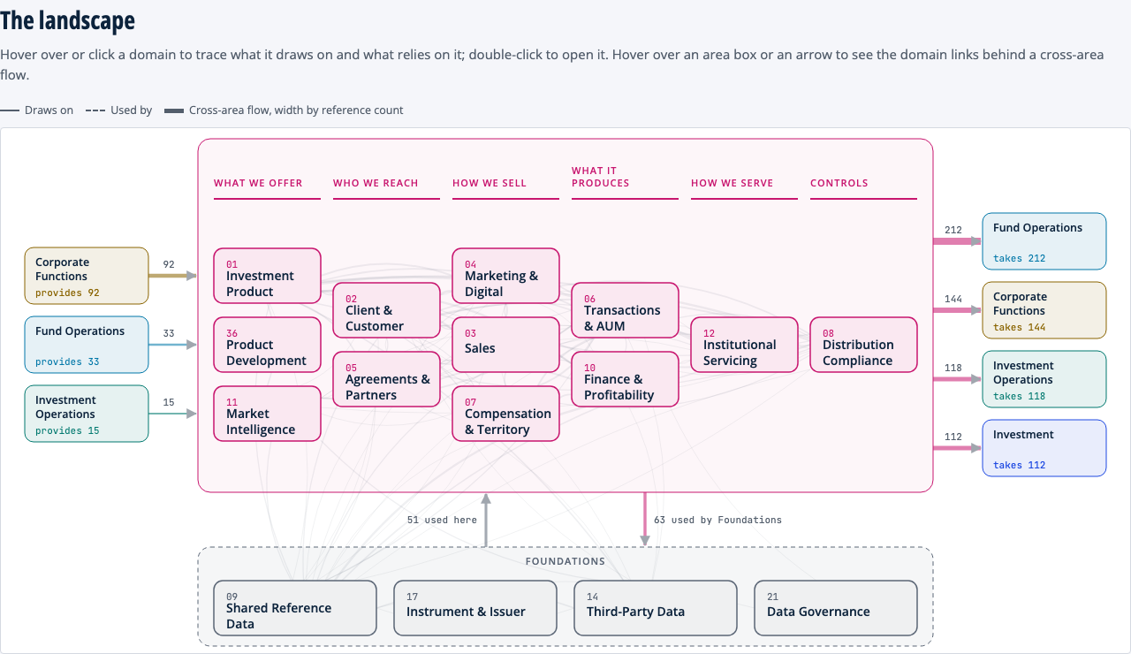
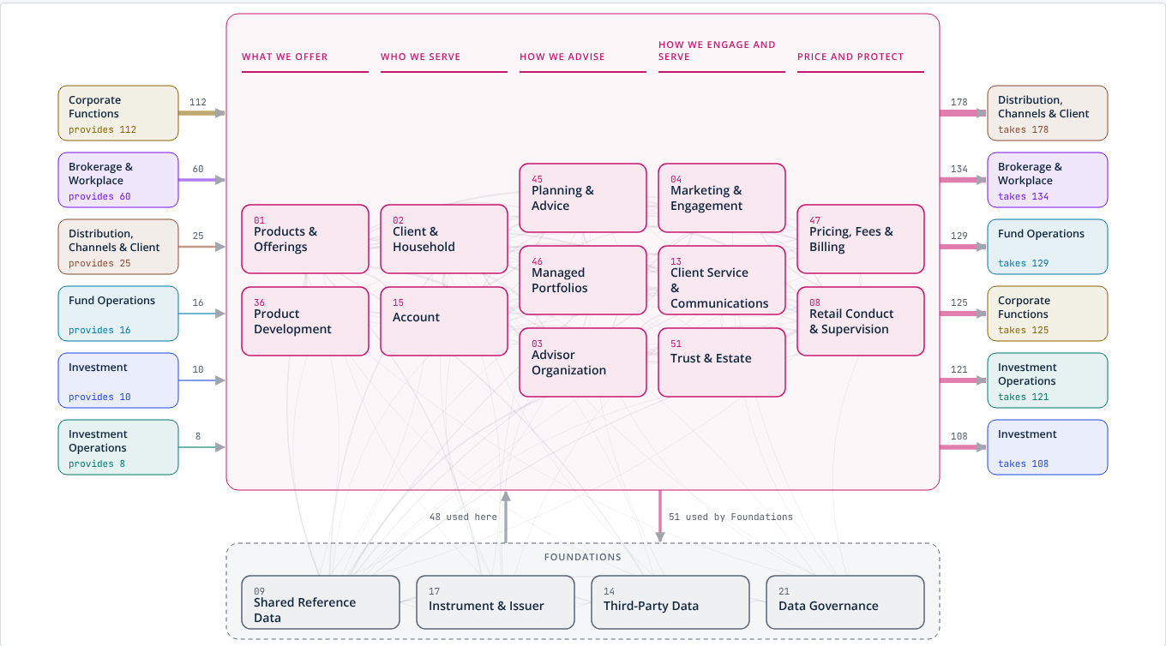
Laid out the way an asset manager runs, not the way its systems are built.
THE TAXONOMY
The distribution business on one page: what we offer, who we reach, how we sell, what it produces, how we serve, and the controls.
Arrows show which parts of the firm rely on this data and which parts it relies on. The foundations every area shares sit underneath.
Four more pages like this cover investment, investment operations, fund operations and the corporate functions, with the foundations every area shares underneath.
5
Notes:
Let them look for a few seconds before you speak; it is a map of their business. “This is the distribution and client part of the model. Every box is a Data Domain with an accountable owner. Read the headings: what we offer, who we reach, how we sell, what it produces, how we serve, controls. That is how an asset manager thinks about its distribution business, and it is deliberately not a list of systems.” “The arrows matter. Corporate functions, fund operations and investment operations provide data into this area; fund operations, investment and the corporate functions take data out of it. Hover on any box in the live model and it shows exactly what it draws on and who relies on it. That is the first thing a head of data management wants to know and the last thing a glossary can tell them.” If asked about scale: forty-four Data Domains across five areas and the foundations, each with its own page like this one.

Slide 6
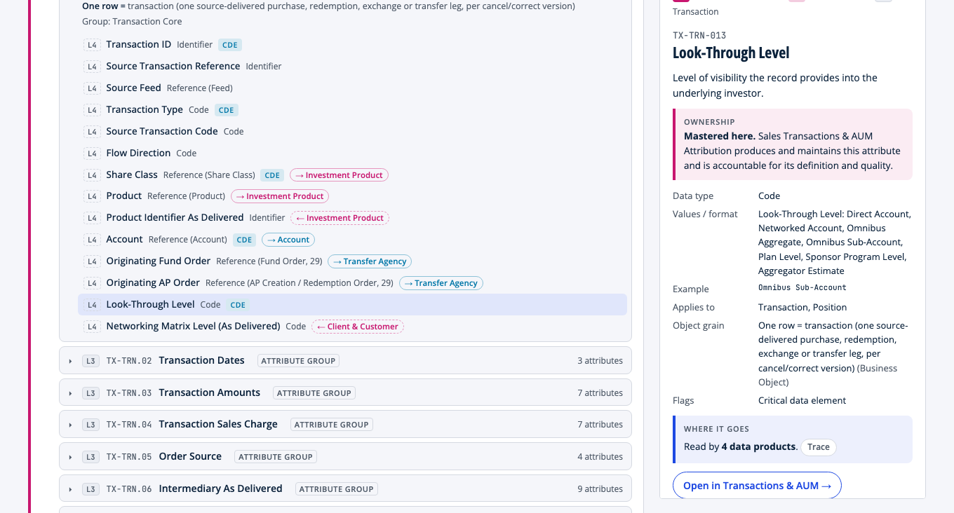
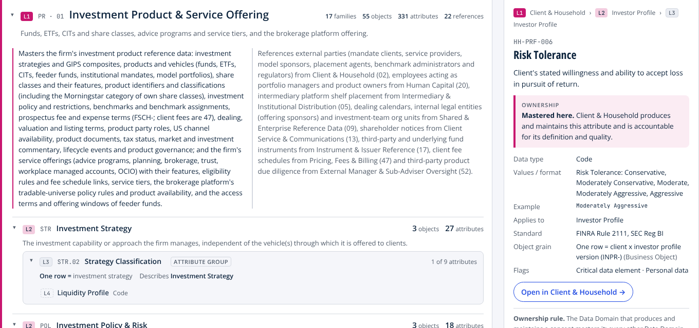
This is what one definition with one owner looks like. No formula in sight.
ONE DEFINITION, ONE OWNER
Look-Through Level. How far a record lets us see into the underlying investor.
Mastered by Transactions & AUM. That domain produces and maintains it and is accountable for its quality. Compensation references it; never copies it.
Cites the standard. DTCC Networking and Omni/SERV. Flagged as a critical data element.
Every attribute in the model carries this same record. That uniformity is what lets the layers above be checked by machine.
6
Notes:
This is the contrast with the glossary they have in mind. Say it plainly. “This is one attribute: look-through level. Notice what is on the page. A definition. Who masters it: sales transactions and AUM attribution produces and maintains it and is accountable. The values it can take. The industry standard it cites. That it is a critical data element. What one row of its object represents. And notice what is not on the page: a formula. This is a thing the business knows, not a measure.” “Every attribution record references the look-through level of the record it was built from. It never copies it. If it copied it, two versions could disagree, and that is exactly how an omnibus total and its sub-accounts both end up in the same number.” “Every one of the attributes in the model carries this same record. That uniformity is what lets us check the layers above by machine rather than by meeting.”

Slide 7
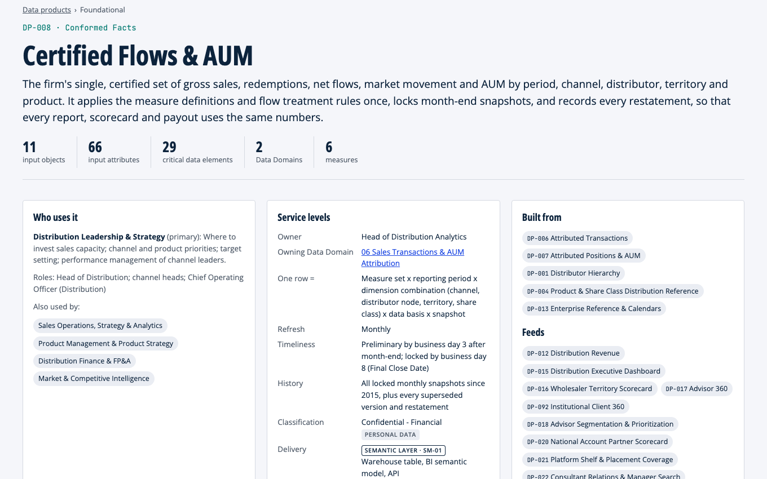
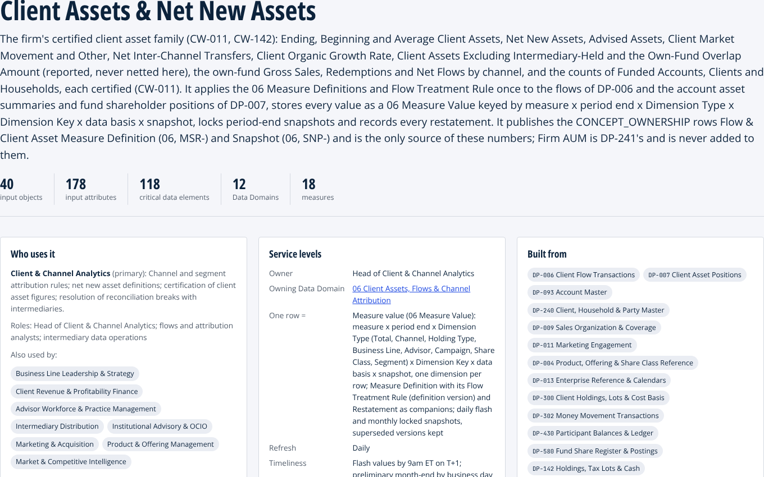
A data product is a governed asset, not a report. It has an owner, a grain and a bill of materials.
THE DATA PRODUCT
Certified Flows & AUM. The one place the firm’s headline flow and asset numbers are defined. Every other product reads them from here.
An accountable owner and the teams that use it. One row equals is stated, so nobody counts the same sale twice.
Built from other named products, never from raw tables. Further down the page: the exact attributes it reads and its quality rules.
7
Notes:
This is the layer the audience has never seen, so define it by what is on the page rather than by the term. “A data product is a governed, reusable asset. This one is certified flows and AUM: the one place the firm’s headline flow and asset numbers are defined. Read the page. Who uses it, with the primary team and the supporting ones. An accountable owner. What one row represents, which is the detail that stops the same sale being counted in two channels. When it refreshes and when it is locked. And what it is built from: other named products, never raw tables.” “Scroll down in the live model and you see the exact attributes it reads, each linked back to its definition and owner in the taxonomy, and the quality rules it is held to. That is the bill of materials.” If asked how many: two hundred and thirty-eight products in the catalog, foundational ones that conform a record or a number once and consumer-aligned ones shaped for a function.

Slide 8
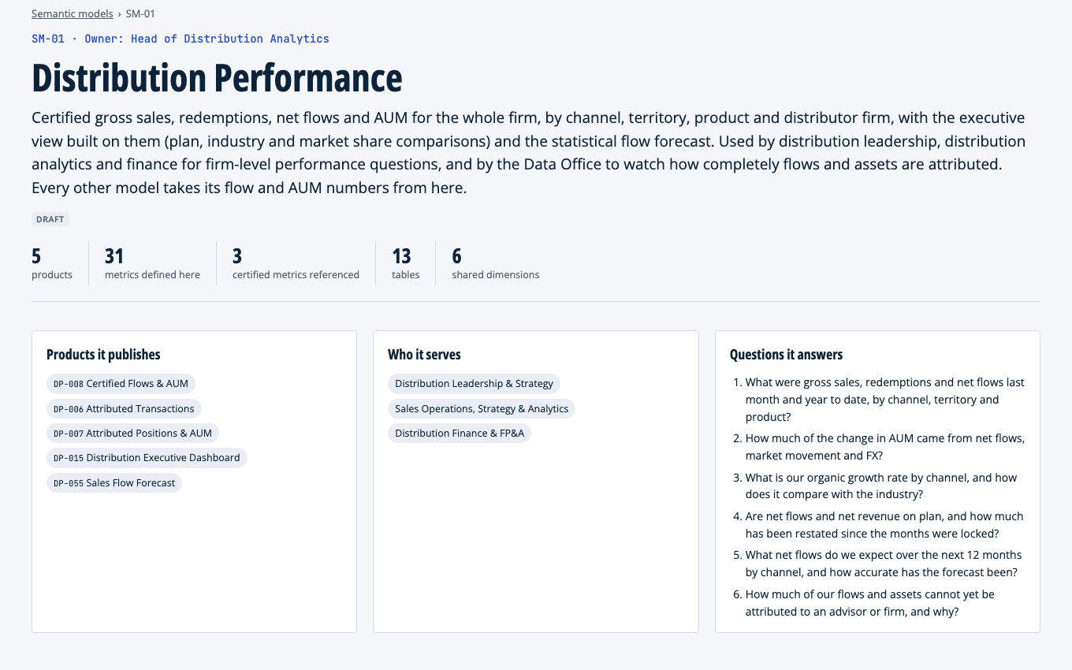
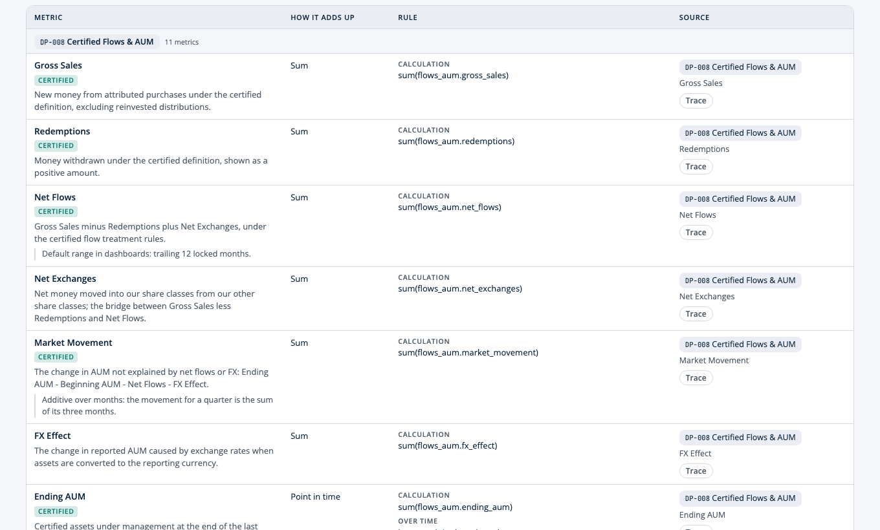
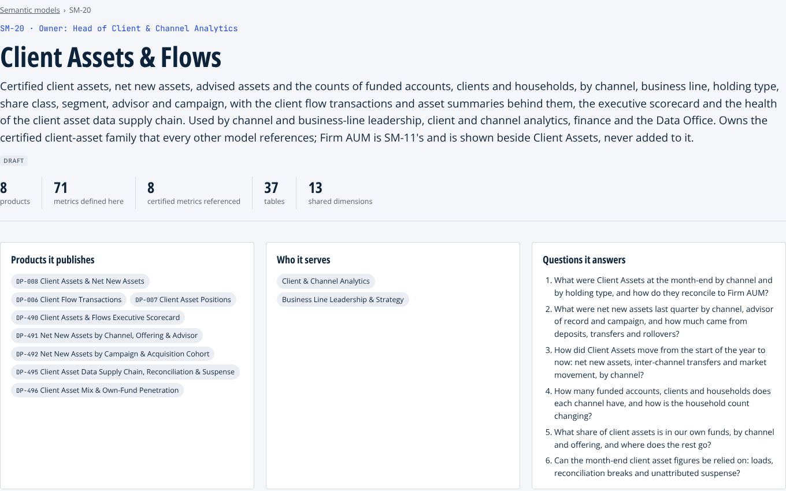
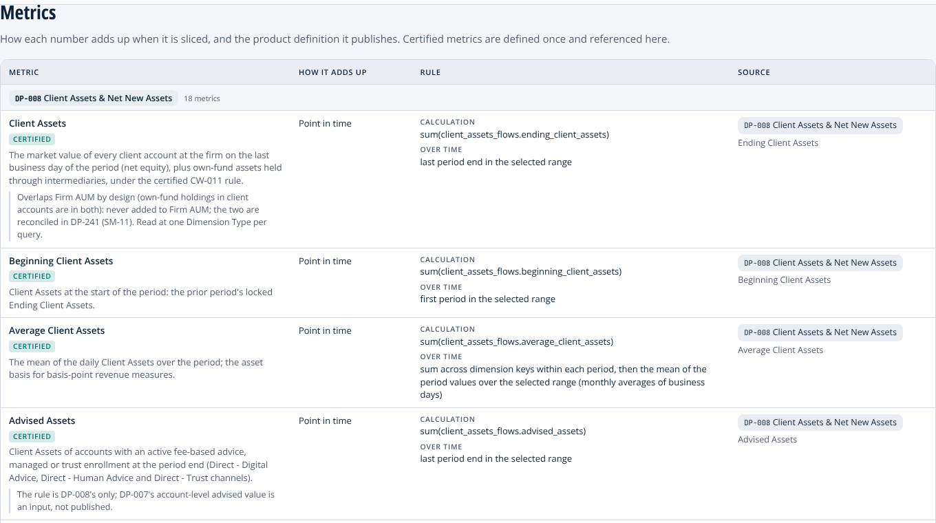
The semantic model defines what a number means – driven by a taxonomy telling you what the number is made of, who owns each part, and therefore who to call when it is wrong
THE SEMANTIC MODEL
Each measure, certified once: what it means, how it adds up, and the product it comes from.
The questions it answers, in the business’s words, with an accountable owner.
8
Notes:
This is the slide where their mental model and ours meet. Name it. “Here is the thing you have been calling a taxonomy: the measures. Gross sales, redemptions, net flows, AUM, defined in business words, with the questions they answer and an owner. We call it the semantic model, and it is the top of the stack.” Point at the right-hand screen. “Look at net flows. It is marked certified. It has a definition a business reader understands, a rule for how it adds up when you slice it by channel or by month, and the data product it comes from. Click the product and you get to the attributes; click an attribute and you get to who owns it. Every measure points down.” “Certified means defined in exactly one place. Every other model, dashboard or assistant references that definition. Nobody downstream owns the number, so nobody downstream can change it.” If asked whether this works in their BI tool: the models are defined as tables, joins, metrics and access rules, tool-neutral, and export as YAML a semantic layer tool can import. Mapping to a specific platform is part of the next engagement.

Slide 9
One certified number. A named reason for every difference.
THE FIVE ANSWERS, RESOLVED
SALES
$2.41bn
Counted exchanges in as gross and credited conversions to the rep.
Net, not gross. Exchanges net within the family and a conversion is the same money in a new class. Both still show, as their own lines.
CERTIFIED NET FLOWS
$2.02bn
FINANCE
$1.86bn
Settlement date, money market funds out, reinvestments out.
Same rule, different date. Reinvestments are already out. Everyone uses trade date; money market flows are a separate published line.
Gross sales less redemptions, plus net exchanges, on trade date.
Reinvested distributions and same-owner transfers excluded.
Conversions and money market funds reported separately.
PRODUCT
$2.08bn
Rolled fund net assets forward, so reinvested distributions counted as sales.
One reinvestment rule. Reinvested distributions are market movement, not sales. The roll-forward still ties: flows plus market movement equals the change in AUM.
PLATFORMS
$2.67bn
Counted platform omnibus totals and the sub-accounts under them.
Counted once, not twice. The omnibus is the control total; the look-through rows are the attribution. One look-through level per record, never both.
Defined once, in the Certified Flows & AUM data product. Owner: Head of Distribution Analytics. Every scorecard, payout and the assistant read it from there.
EXECUTIVE PACK
$2.20bn
Adjusted by hand from last quarter’s method, twice restated.
A dated snapshot. The pack reads the locked figure, dated on every page. Each adjustment is a restatement row with a reason.
Five numbers become one certified figure, and every difference becomes a line on the page instead of an argument in the room.
2
Notes:
Bring the five answers back. “Same question as slide two. Here is what happens to each of the five once the definition is owned.” Point at the dark card first: one certified figure, one rule in three lines, one owner. Then walk the rows, one sentence each: “Sales was counting exchanges in as new money and conversions as sales; both are still visible, as net exchanges and as a conversion line that nets to zero. Finance was on settlement date; the rule picks trade date for everyone, so the gap is timing, not substance, and money market funds are their own line. Product was rolling fund net assets forward, so reinvested distributions looked like sales; the reinvestment rule puts them in market movement, once. Platforms was counting the omnibus total and the sub-accounts under it; one look-through level per record means the money is counted once. The executive pack was hand-adjusted; now it reads the dated snapshot, and every adjustment is a restatement row with a reason.” Land the band: “Nobody lost their number. Each one became a line on the page instead of an argument in the room.” The $2.02bn is illustrative, like the five figures on slide two. If asked why it sits between Finance and Product: Finance was closest to the rule already; the difference is the date basis and the money market line.

Slide 10
Written once, in the taxonomy. Every layer above reads it.
WHERE THE RULE LIVES
TAXONOMY
Writes the rule, once, with an owner.
Net Flows: a business definition with one accountable owner, the Head of Distribution Analytics.
Flow Treatment Rule: every choice is a named attribute with a default. Reinvestment, exchange, transfer, conversion, money market, time basis.
Each choice is a lever the business pulls once, not five times.
DATA PRODUCTS
Apply the rule at the row. Keep the record.
Attributed transactions: every trade is classified and attributed as it lands. Purchase, redemption, exchange, conversion, transfer; omnibus or look-through.
Certified Flows & AUM: the figure by period, channel and territory, with the definition version, the dated snapshot and any restatement behind it.
SEMANTIC MODEL
Publishes the number. Never redefines it.
Net Flows is the product’s column, summed, with its description and source attached.
The differences sit beside it as named measures: net exchanges, market movement, reinvested distributions, restatement impact.
AI AND ANALYTICS
Reads the same number.
Dashboards, scorecards, payouts and the assistant return the same figure, and can say which definition version it used.
Nothing to reconcile, because nothing was redefined on the way up.
classified under it
summed, not redefined
read, not rebuilt
EACH OF THE FIVE DIFFERENCES IS NOW ONE TAXONOMY ATTRIBUTE, OWNED ONCE
SALES
Exchange Treatment
FINANCE
Time Basis
PRODUCT
Reinvestment Treatment
PLATFORMS
Look-Through Level
EXECUTIVE PACK
Snapshot and Restatement
Pull a lever once, in the taxonomy. The products reclassify, the model re-sums, the pack restates. Nobody downstream edits anything.
2
Notes:
This answers the question the last slide raises: where does the certified rule actually live? Walk left to right. “The taxonomy writes it. Net flows has one definition and one owner. Every choice that made the five numbers differ, how to treat a reinvestment, an exchange, a same-owner transfer, a share-class conversion, money market funds, which date, is a named attribute with a default. The business decides each one once.” “The data products apply it. Every trade is classified and attributed as it lands, so an exchange is net at the row, not in somebody’s report logic, and an omnibus record carries one look-through level. The certified flows product keeps the figure with the definition version, the dated snapshot and the restatements behind it.” “The semantic model publishes it. It sums the product’s column; it never writes its own version. The differences are published beside the number as their own measures.” “And the scorecards, the payouts and the assistant read that one number.” Then the chip row: “Every one of the five differences from the problem slide is now a single attribute, in the taxonomy, with an owner.” Land the band. If the head of distribution asks what happens when they disagree with a default: “You pull the lever, once. The products reclassify, the model re-sums without an edit, and prior periods get a restatement row with the reason. That is the difference between a lever and a workaround.”

Slide 11
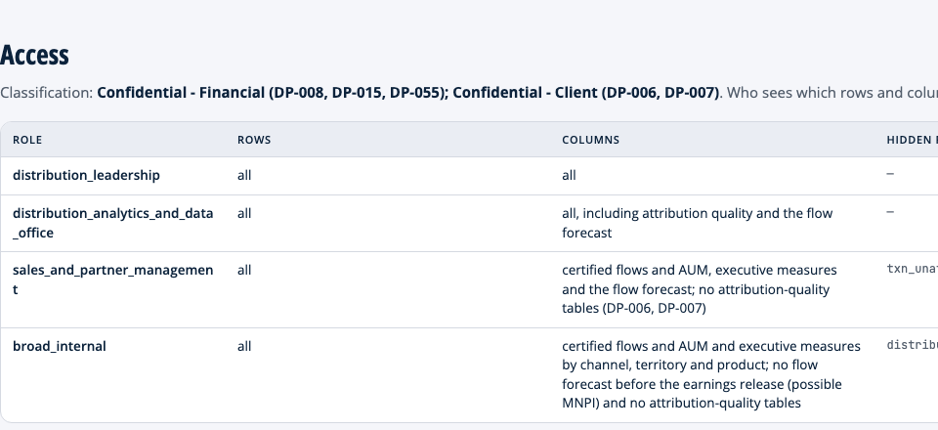
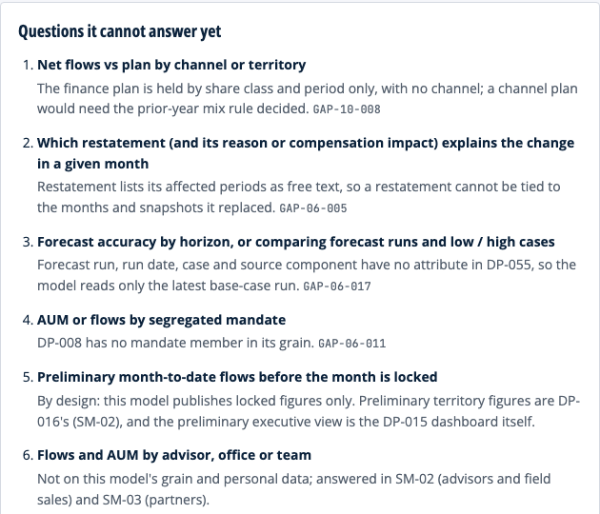
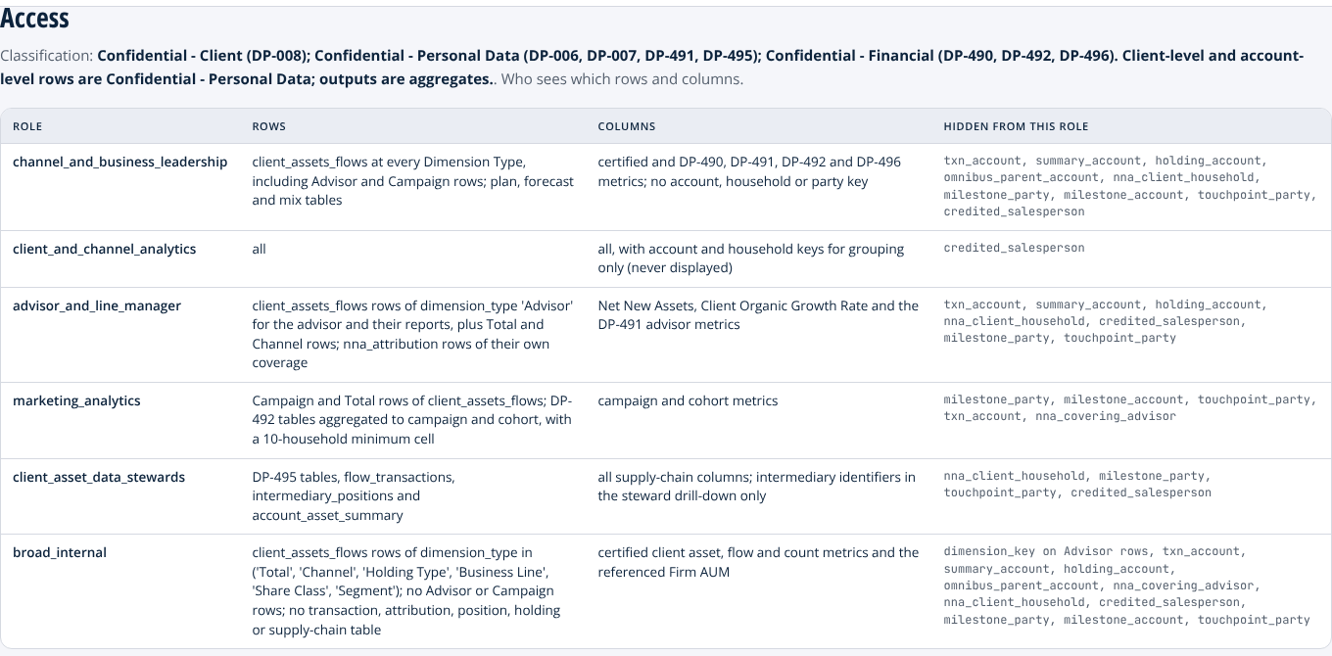
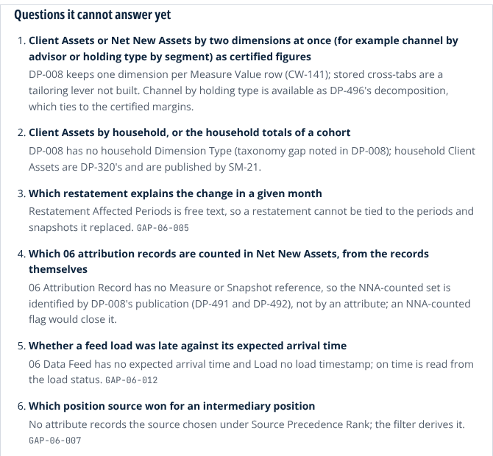
The assistant does not have to be taught the business. The model has already written it down.
WHY THIS ACCELERATES AI
Answers with the certified number. With the product and the owner behind it.
Inherits the asker’s scope. A wholesaler never sees a territory they do not cover.
Says what it cannot answer yet. With the reason and the gap that fixes it.
Net flows, last quarter, by channel
Net Flows · certified · Q3 2026 · 6 channels
Wirehouse
Independent broker-dealer
RIA and platforms
DCIO and recordkeepers
$0.74bn
$0.52bn
$0.41bn
$0.28bn
Rule gross sales less redemptions plus net exchanges; reinvested distributions, same-owner transfers and conversions excluded.
Lineage SM-01 Distribution Performance → DP-008 → TX-MEA-034 Net Flows (Net Sales) · owner Head of Distribution Analytics
Nothing has to be taught twice. The definitions, the access rules and the gaps the dashboard runs on are the ones the assistant runs on. Point it at today’s glossary instead and it gives you the five answers faster.
9
Notes:
This is the slide the head of distribution came for. Keep it concrete. “Everyone is putting an assistant on top of their data. The ones that work are pointed at a semantic layer, not at raw tables, and the time goes into teaching the assistant the business: what net flows means, who may see what, what it must refuse. Here that is already written down, so there is nothing to teach twice.” Left card: “A question in plain words. Back comes the certified metric, the period, the figures by channel, and under them the model, the product and the taxonomy attribute the figure was read from, with the owner’s name. The flow treatment rule from the five-answers slide is in the answer itself.” Middle: “Access by role, from the model’s own page. Distribution leadership sees every row. Sales and partner management see certified flows but not the attribution-quality tables. The broad internal role never sees the forecast before the earnings release. The assistant inherits exactly the scope of the person asking.” Right: “And the model says what it cannot answer yet, with the reason and the registered gap that would fix it: net flows against plan by channel, because the finance plan has no channel. An assistant that says ‘not yet, and here is why’ is the one people keep using.” Land the band. “The order matters. You cannot build this layer without governed products, and you cannot build governed products without one definition and one owner per concept. Skip the bottom and the assistant inherits the glossary you have today, and gives you the five answers faster.”

Slide 12



A data product assembles what the Data Domains master. It never remasters them.
THE ONE RULE UNDER ALL FOUR LAYERS
A certified number is defined in one product only. Every other product, dashboard and assistant reads it from there.
A missing concept is a taxonomy gap for the owning domain to fix, never a field invented in a report.
Consumption never changes ownership. A scorecard that reads the distributor hierarchy does not become its owner.
10
Notes:
This is the slide to slow down on. “If you remember one sentence from today, make it this one. Every layer we build applies it.” Explain the three cards in order. “Gross sales, redemptions, net flows, AUM, organic growth, fee revenue: each is defined in exactly one product under one owner. Finance does not get a vote each month; neither does the sales desk. They read the number.” “When a product needs something the taxonomy does not have, that is written down as a gap against the owning domain, with a priority and an owner. Hundreds of those are registered today, each with a name on it. That is the opposite of a side table in one team’s report.” “And reading a number never makes you its owner. The territory scorecard reads the distributor hierarchy and the certified flows; it owns neither. That is what keeps the payout and the board pack on the same figure.”

Slide 13
A reference model for an asset manager. Applying it is tailoring, not rebuilding.
MAKING IT YOURS
Your business lines
Your operating model
Your definitions
Your systems
A line you do not run, such as DCIO, private markets or an institutional channel, is switched off with the data that serves only it.
What you outsource, such as transfer agency or fund accounting, stays in the model as oversight data from the provider rather than your own record.
Define gross sales, net flows or AUM your way, once, in the place that owns it. Every consumer inherits the change.
Mapping your systems decides which inputs exist. Anything the mapping cannot supply becomes a written gap, never a silent assumption.
Every tailoring change is a named edit that traces to a decision. The reference assumes a US manufacturer selling through intermediaries, institutions and plans; a global or multi-boutique firm starts from the same model with more switched on.
11
Notes:
Pre-empt the objection before it is asked: “This is a reference model for a hypothetical firm. It is not your catalog. The point is that applying it is tailoring, and the levers are deliberate.” Walk the four cards briskly. “Switch off a business line you do not run. Mark a function as outsourced and its data becomes oversight data from the provider. Define a certified number your way, in the one place that owns it. Map your systems, and anything the mapping cannot supply becomes a written gap rather than a silent assumption.” The band is the honest line. If they are not a US intermediary-sold manufacturer, say so here: “The reference is built for a US firm selling through intermediaries, institutions and plans. A global or multi-boutique firm starts from the same model with more depth switched on, not from a different model.”

Slide 14
One definition.
One owner.
Every layer.
IN ONE SENTENCE
The taxonomy says what things mean. The products carry it through. The number on the dashboard, in the wholesaler’s scorecard, in the examiner’s file and in the assistant’s answer is the same number, because nobody downstream owns it.
Asset Manager Reference Model | Pitch, October 2026 | Every firm name and dollar figure is illustrative
12
Notes:
Close on the sentence and stop talking. “One definition, one owner, every layer. Thank you.” Then ask for the forty-five minutes.

