Slide 1
One definition.
One owner.
Every layer.
A DIRECT WEALTH MANAGER · REFERENCE DATA MODEL
A reference taxonomy for wealth management that becomes governed data products, a semantic model, and an AI assistant that answers the questions distribution actually asks.
Taxonomy
Data products
Semantic model
AI and analytics
1
Notes:
Open with the sentence on the slide, not with the deck. “Everything we are going to show you comes down to one rule: one definition, one owner, every layer. The taxonomy says what a thing means. The data products carry that meaning through without rewriting it. The semantic model publishes it once. And an AI assistant reads the same definition the dashboard does.” Then the hook: “I want to start with a question you ask every quarter and probably get five answers to.” Move to the next slide within thirty seconds. Do not explain the four chips yet; they are a map you will come back to.

Slide 2
“Net new assets, last quarter.” One question, five answers.
THE PROBLEM DISTRIBUTION LIVES WITH
ADVICE
FINANCE
WORKPLACE
MARKETING
EXECUTIVE PACK
$1.42bn
$1.18bn
$0.96bn
$1.61bn
$1.30bn
Counts rollovers from the firm’s own plans as new money. Trade date.
Excludes reinvested income. Settlement date. Net of fees.
Counts a separated participant’s balance only when the IRA funds.
Includes intermediary-held own-fund flows attributed to campaigns.
Hand-adjusted from last quarter’s method, with two restatements.
Every difference is a definition question: what counts as a flow, which date, which channel, who owns the rule. None of them is a technology question.
2
Notes:
For the head of distribution: “You know this slide. The numbers are made up; the reasons are not. One team counts reinvested income, one does not. One treats a rollover from your own plan as new money, one treats it as a transfer between channels. One uses trade date, one settlement date.” Then the pivot: “The cost is not the arithmetic. It is the month-end hour arguing about which number is right, and not being able to tell a regulator, or a board, which definition a given report used.” Land the band: “Every one of those five differences is a definition question. Not one of them is a technology question. That is exactly what a taxonomy settles, and why a new BI tool or a new AI assistant on top of the old definitions gives you five answers faster.” For the head of data management, add one line: “And nobody downstream can fix this, because nobody downstream owns the definition.”

Slide 3
What most firms call a taxonomy is actually a glossary of measures.
It sits at the top. The value is in what sits underneath.
WHAT A TAXONOMY ACTUALLY IS
THE USUAL PICTURE
A REFERENCE DATA TAXONOMY
A glossary of measures
An inventory of the things measures are made of
Business definitions of the numbers a report aggregates for a use case: net new assets, advised assets, a household’s return. Written per team, per dashboard.
Client, household, account, advisor, offering, order, flow, plan, recommendation. Every concept the firm runs on, with one definition and one accountable owner, written once for the whole firm.
It tells you what a number means. It does not tell you what the number is made of, or who to call when it is wrong.
The glossary of measures is built on top of it, once, and published to every tool from the same place.
A measure is only as good as the concepts it is built from. If nobody owns what a flow is, or which account belongs to which household, the definition is an opinion with arithmetic attached.
3
Notes:
This is the slide that moves their mental model, so take it slowly and do not be condescending about it. “When most people say taxonomy they mean the left-hand box: a glossary that defines the measures a report aggregates. That is a real and useful thing, and we have built it too. It is the top of the stack, not the bottom.” “What we mean by a reference data taxonomy is the right-hand box: the inventory of the things those measures are made of. Not net new assets, but flow, account, household, channel, advisor, plan, recommendation. Each with one definition and one owner, written once for the firm.” Land the band: “A measure is only as good as the concepts under it. If nobody owns what a flow is, or when a rollover counts as a transfer, the definition of net new assets is an opinion with arithmetic attached. That is why five teams get five numbers, even when they all have a glossary.” For the head of data management: “A glossary tool holds whatever you load into it. The taxonomy is what decides what gets loaded.”

Slide 4
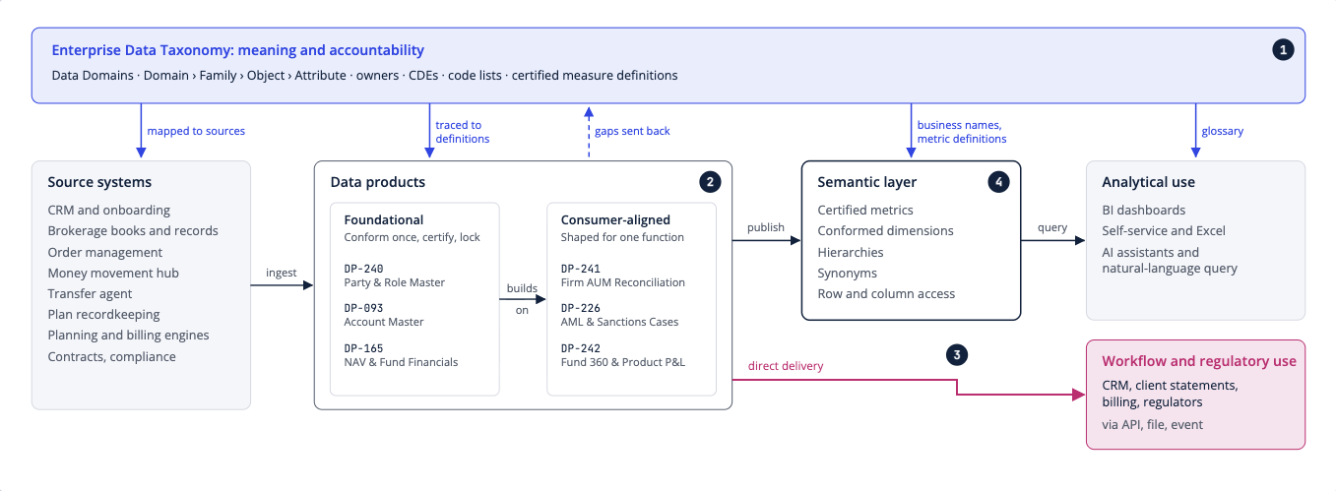
Four layers, and the taxonomy governs all of them.
WHAT WE BUILT
Taxonomy
What every concept means and who owns it.
Data products
Governed assets with an owner, a grain and quality rules, assembled from the taxonomy.
Semantic model
The measures, defined once, with the filters and access rules that make them safe to slice.
AI and analytics
Dashboards, Excel and an assistant reading the same named metric.
4
Notes:
The picture is the explorer’s own page, not a slide we drew; say so, because it is the first proof the model exists. “Read it left to right for data and top to bottom for meaning. Data starts in the systems you already have and moves through data products to the people and tools that use it. At every step the taxonomy says what the data means and who is accountable for it. It is not the first step in a pipeline; it governs every step.” Then the four lines on the right, one sentence each. “The taxonomy fixes meaning and ownership. Data products assemble those concepts for a purpose: a household 360, certified client assets, a Reg BI evidence file. The semantic model is the layer you have been calling a taxonomy: the measures, defined once, with the rules that make them safe to slice. And the fourth layer is yours: dashboards, Excel, an assistant, all reading the same thing.” Point at the pink box: “Not everything goes through the semantic layer. Some products go straight into a workflow or a regulatory filing. Both paths read the same certified products, so the examiner’s file and the dashboard cannot disagree.” If the head of data management asks how it is kept current: it is built as code. Every subject area is a module; the explorer, the workbooks and the catalog are generated from it, and a change in a definition or an owner traces to a numbered decision. Nothing is hand-edited.

Slide 5
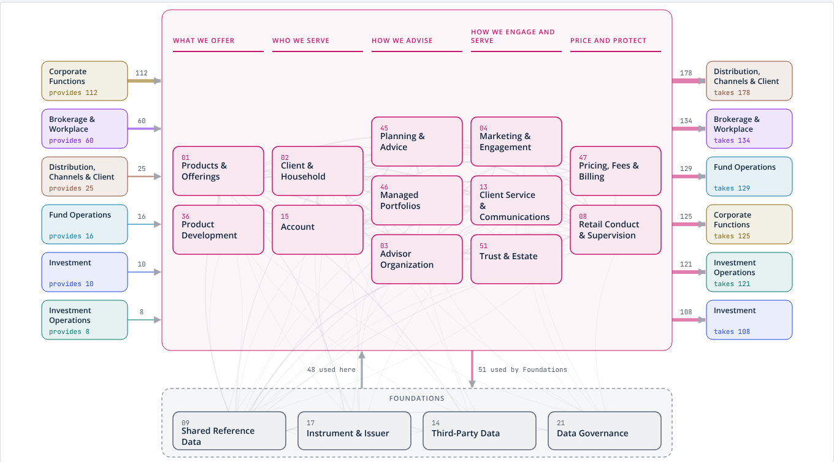
Laid out the way a wealth manager runs, not the way its systems are built.
THE TAXONOMY
The client and advice business on one page: what we offer, who we serve, how we advise, how we engage and serve, how we price and protect.
Arrows show which parts of the firm rely on this data and which parts it relies on. The foundations every area shares sit underneath.
Seven more pages like this cover investment, operations, the fund complex, brokerage and workplace, channels and economics, and the corporate functions.
5
Notes:
Let them look for a few seconds before you speak; it is a map of their business. “This is the client and advice part of the model. Every box is a subject area with an accountable owner. Read the headings: what we offer, who we serve, how we advise, how we engage and serve, how we price and protect. That is how a wealth manager thinks about itself, and it is deliberately not a list of systems.” “The arrows matter. Corporate functions provide data into this area; distribution, brokerage, fund operations take data out of it. Hover on any box in the live model and it shows exactly what it draws on and who relies on it. That is the first thing a head of data management wants to know and usually cannot answer.” If asked what else is in it: “Seven more landscapes like this one, covering the rest of the firm, with a shared foundations band underneath them all.”

Slide 6
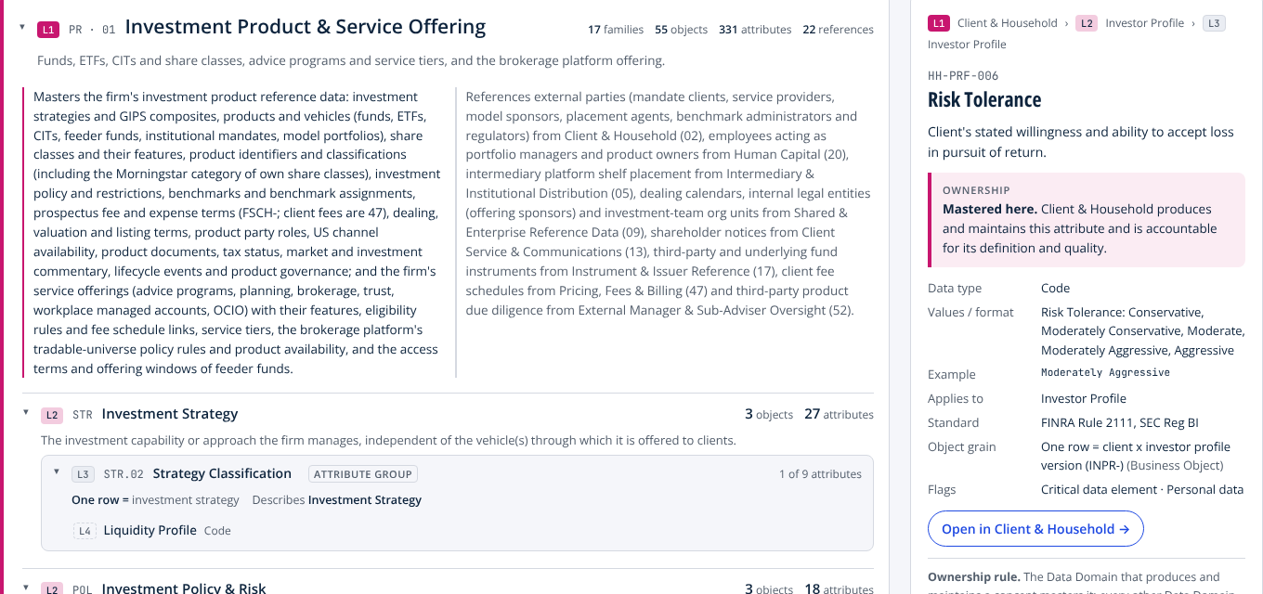
This is what one definition with one owner looks like. No formula in sight.
ONE DEFINITION, ONE OWNER
Risk Tolerance. A client’s stated willingness and ability to accept loss in pursuit of return.
Mastered by Client & Household. That domain produces it, maintains it and is accountable for its quality. Advice references it; advice never copies it.
Cites the rule. FINRA 2111 and Reg BI. Flagged as personal data and as a critical data element.
Every attribute in the model carries this same record. That uniformity is what lets the layers above be checked by machine.
6
Notes:
This is the contrast with the glossary they have in mind. Say it plainly. “This is one attribute: risk tolerance. Notice what is on the page. A definition. Who masters it: client and household produces and maintains it and is accountable. The values it can take. The regulation it cites. That it is personal data. What one row of its object represents. And notice what is not on the page: a formula. This is a thing the business knows, not a measure.” “The advice domain uses risk tolerance on every recommendation. It references the version of the profile it relied on; it never copies the value. If it copied it, two versions could disagree, and that is exactly how five numbers happen.” “Every one of the attributes in the model carries this same record. That uniformity is what lets us check the layers above by machine rather than by meeting.”

Slide 7
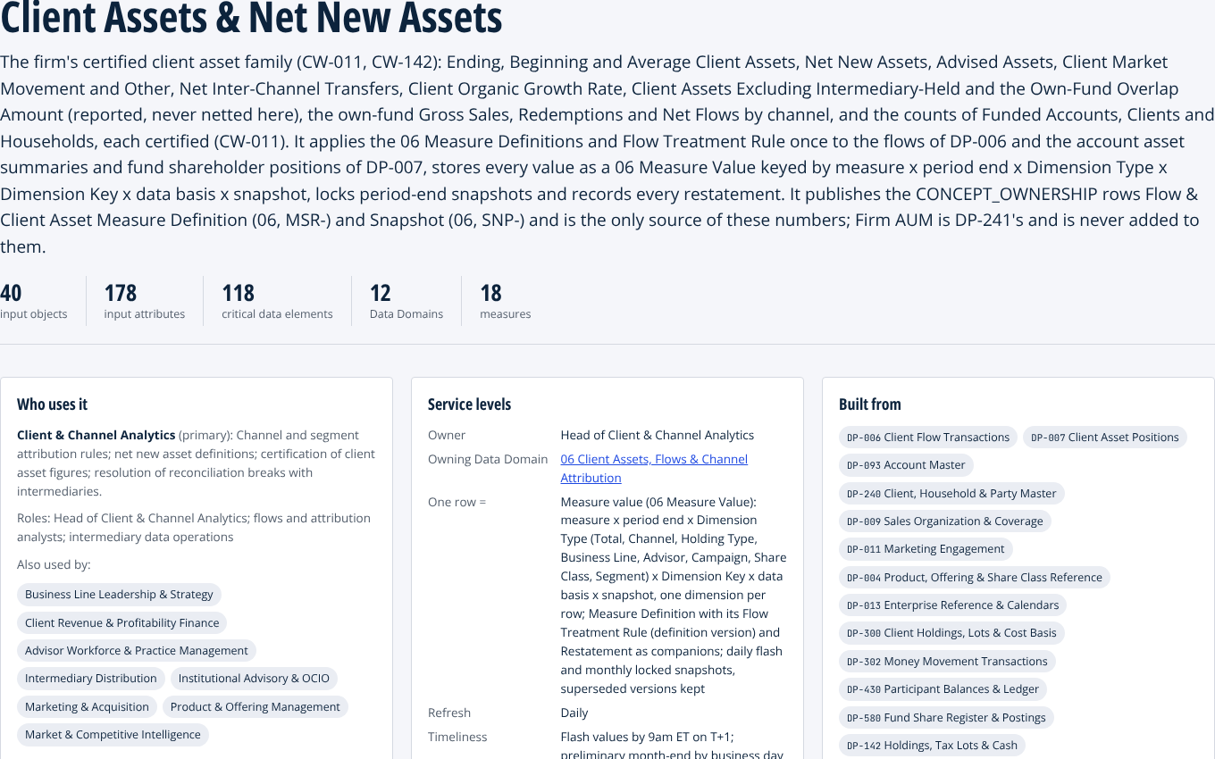
A data product is a governed asset, not a report. It has an owner, a grain and a bill of materials.
THE DATA PRODUCT
Client Assets & Net New Assets. The one place the firm’s headline client numbers are defined. Every other product reads them from here.
An accountable owner and the teams that use it. One row equals is stated, so nobody counts the same money twice.
Built from other named products, never from raw tables. Further down the page: the exact attributes it reads and its quality rules.
7
Notes:
This is the layer the audience has never seen, so define it by what is on the page rather than by the term. “A data product is a governed, reusable asset. This one is client assets and net new assets: the one place the firm’s headline client numbers are defined. Read the page. Who uses it, with the primary team and the supporting ones. An accountable owner. What one row represents, which is the detail that stops the same money being counted in two channels. When it refreshes and when it is final. And what it is built from: other named products, never raw tables.” “Scroll down in the live model and you see the exact attributes it reads, each linked back to its definition and owner in the taxonomy, and the quality rules it must pass before anyone calls it certified.” The sentence to land: “A product assembles what the taxonomy defines. It never redefines it. That is what makes it safe for anything above it to trust.”

Slide 8
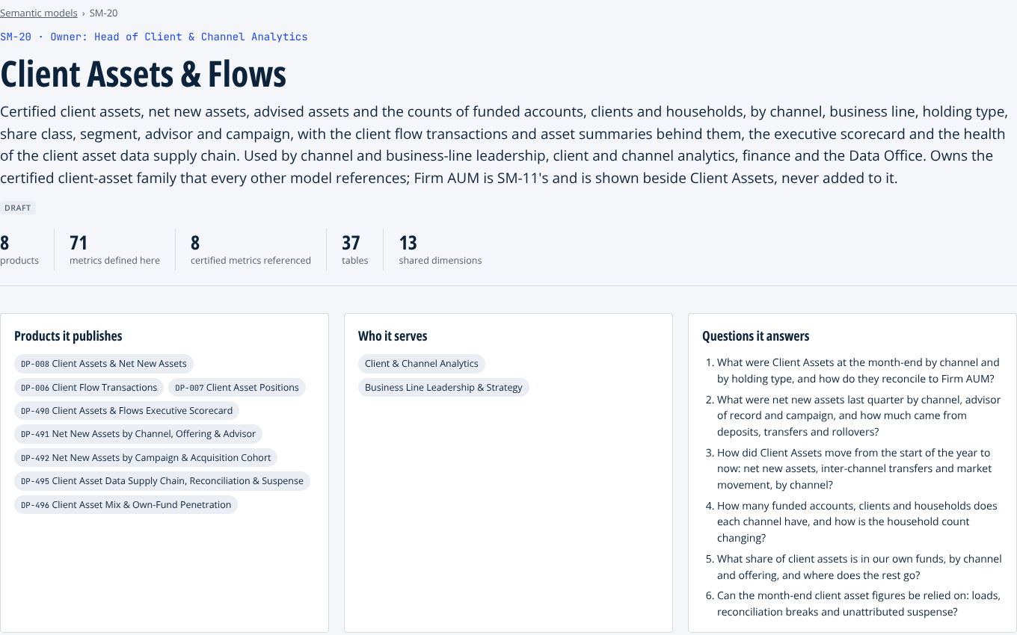
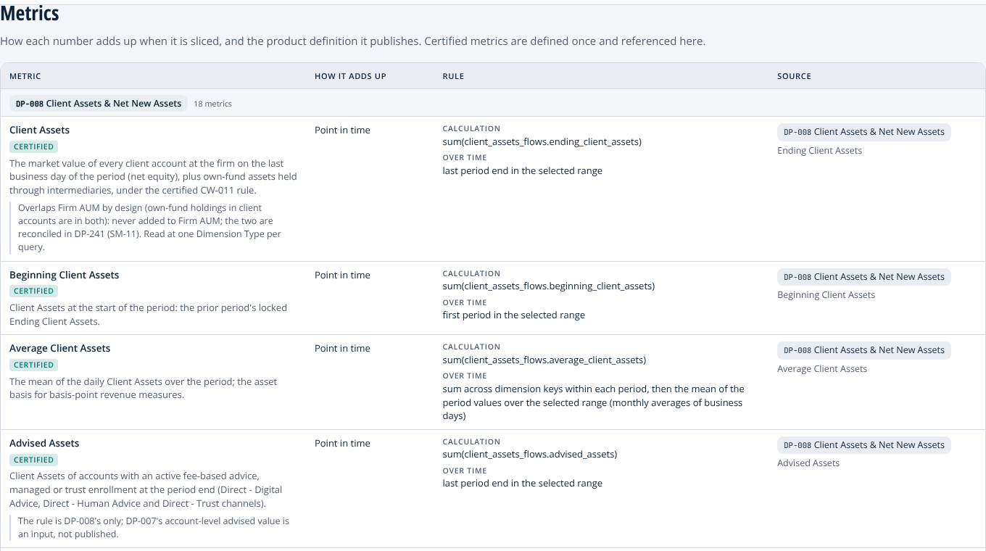
The semantic model defines what a number means – driven by a taxonomy telling you what the number is made of, who owns each part, and therefore who to call when it is wrong
THE SEMANTIC MODEL
Each measure, certified once: what it means, how it adds up, and the product it comes from.
The questions it answers, in the business’s words, with an accountable owner.
8
Notes:
This is the slide where their mental model and ours meet. Name it. “Here is the thing you have been calling a taxonomy: the measures. Client assets, net new assets, advised assets, defined in business words, with the questions they answer and an owner. We call it the semantic model, and it is the top of the stack.” Point at the right-hand screen. “Look at client assets. It is marked certified. It has a definition a business reader understands, a rule for how it adds up when you slice it by channel or by month, and the data product it comes from. Click the product and you get to the attributes; click an attribute and you get to who owns it. Every measure points down.” “Certified means defined in exactly one place. Every other model, dashboard or assistant references that definition. Nobody downstream owns the number, so nobody downstream can change it.” If asked whether this works in their BI tool: the models are defined as tables, joins, metrics and access rules, tool-neutral, and export as YAML a semantic layer tool can import. Mapping to a specific platform is part of the next engagement.

Slide 9
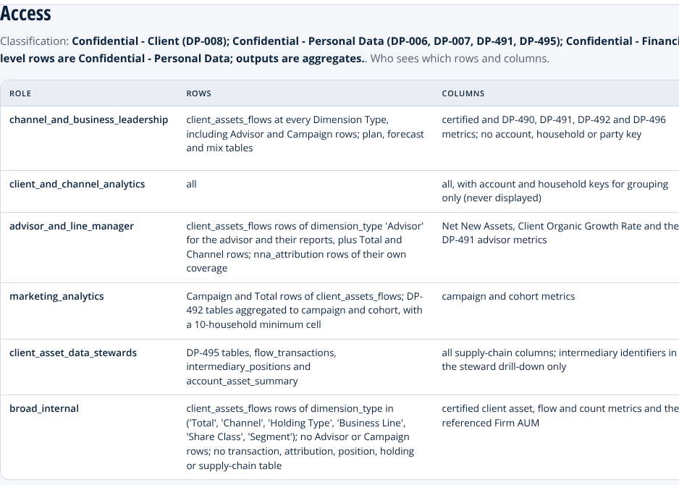
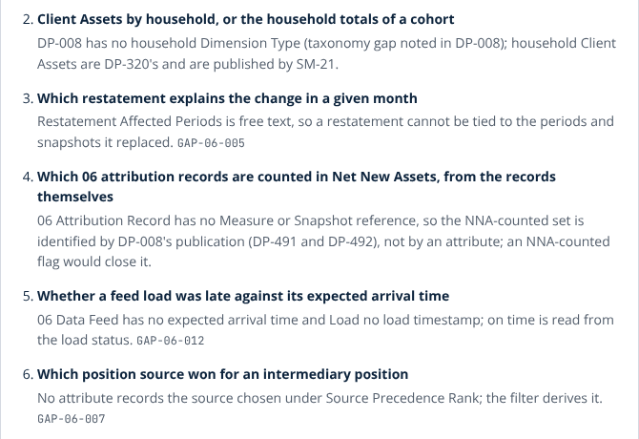
The assistant does not have to be taught the business. The model has already written it down.
WHY THIS ACCELERATES AI
Answers with the certified number. With the product and the owner behind it.
Inherits the asker’s scope. An advisor never sees a household they do not cover.
Says what it cannot answer yet. With the reason and the gap that fixes it.
Net new assets, last quarter, by channel
Net New Assets · certified · Q3 2026 · 8 channels
Direct self-directed
Intermediary
Direct digital advice
Direct human advice
$3.80m
$3.09m
$0.57m
$0.45m
Rule inflows less outflows; income, fees and same-owner transfers excluded; inter-channel transfers never counted.
Lineage SM-20 Client Assets & Flows → DP-008 → TX-MEA-048 Net New Assets · owner Head of Client & Channel Analytics
Nothing has to be taught twice. The definitions, the access rules and the gaps the dashboard runs on are the ones the assistant runs on. Point it at today’s glossary instead and it gives you the five answers faster.
9
Notes:
This is the slide the head of distribution came for. Keep it concrete. “Everyone is putting an assistant on top of their data. The ones that work are pointed at a semantic layer, not at raw tables, and the time goes into teaching the assistant the business: what net new assets means, who may see what, what it must refuse. Here that is already written down, so there is nothing to teach twice.” Left card: “This is a real answer from the assistant that runs on the model. A question in plain words. Back comes the certified metric, the period, the figures, and under them the model, the product and the taxonomy attribute the figure was read from, with the owner’s name. The flow treatment rule from the five-answers slide is in the answer itself.” Middle: “Access by role. Leadership sees every row. An advisor sees the households they cover. Marketing sees campaigns and cohorts with small cells suppressed. The assistant inherits exactly the scope of the person asking.” Right: “And the model says what it cannot answer yet, with the reason and the registered gap that would fix it. An assistant that says ‘not yet, and here is why’ is the one people keep using.” Land the band. “The order matters. You cannot build this layer without governed products, and you cannot build governed products without one definition and one owner per concept. Skip the bottom and the assistant inherits the glossary you have today, and gives you the five answers faster.” If asked whether an assistant is wired up today: yes, in the demonstration build. Eight source feeds, four semantic models and an assistant that answers over them or declines with the gap. The figures are synthetic; the definitions, the access rules and the lineage are the model’s. Connecting it to the firm’s own sources is the engagement.

Slide 10



A data product assembles what the Data Domains master. It never remasters them.
THE ONE RULE UNDER ALL FOUR LAYERS
A certified number is defined in one product only. Every other product, dashboard and assistant reads it from there.
A missing concept is a taxonomy gap for the owning domain to fix, never a field invented in a report.
Consumption never changes ownership. A report that reads the investor profile does not become its owner.
10
Notes:
This is the slide to slow down on. “If you remember one sentence from today, make it this one. Every layer we build applies it.” Explain the three cards in order. “Client assets, net new assets, advised assets, the household’s rate of return, fee revenue, firm AUM: each is defined in exactly one product under one owner. Finance does not get a vote each month; neither does marketing. They read the number.” “When a product needs something the taxonomy does not have, that is written down as a gap against the owning domain, with a priority and an owner. Hundreds of those are registered today, each with a name on it. That is the opposite of a side table in one team’s report.” “And reading a thing never makes you its owner. That single sentence removes most of the month-end argument.” For the head of data management: this rule is what the validators enforce. A consumer product that tries to recompute a certified number fails the build.

Slide 11
A reference model for a direct wealth manager. Applying it is tailoring, not rebuilding.
MAKING IT YOURS
Your business lines
Your operating model
Your definitions
Your systems
A line you do not run, such as trust, workplace plans or an intermediary channel, is switched off with the data that serves only it.
What you outsource, such as clearing or recordkeeping, stays in the model as oversight data from the provider rather than your own record.
Define client assets, net new assets or a household’s return your way, once, in the place that owns it. Every consumer inherits the change.
Mapping your systems decides which inputs exist. Anything the mapping cannot supply becomes a written gap, never a silent assumption.
Every tailoring change is a named edit that traces to a decision. The reference assumes a direct, advice-led, own-funds firm; a brokerage-and-bank or full-service firm starts from the same model with more depth switched on.
11
Notes:
Pre-empt the objection before it is asked: “This is a reference model for a hypothetical firm. It is not your catalog. The point is that applying it is tailoring, and the levers are deliberate.” Walk the four cards briskly. “Switch off a business line you do not run. Mark a function as outsourced and its data becomes oversight data from the provider. Define a certified number your way, in the one place that owns it. Map your systems, and anything the mapping cannot supply becomes a written gap rather than a silent assumption.” The band is the honest line. If they are not a direct, own-funds firm, say so here: “The reference is built for a direct manufacturer. A brokerage-and-bank or a full-service firm starts from the same model with more depth switched on, and the rules are identical.” For the head of data management: every lever is an edit to a register, and every edit traces to a numbered decision, so the model can be kept current without us.

Slide 12
One definition.
One owner.
Every layer.
IN ONE SENTENCE
The taxonomy says what things mean. The products carry it through. The number on the dashboard, in the advisor’s worklist, in the examiner’s file and in the assistant’s answer is the same number, because nobody downstream owns it.
Wealth Manager Reference Model | Pitch, October 2026 | Every client name and dollar figure is illustrative
12
Notes:
Close on the sentence and stop talking. “One definition, one owner, every layer. Thank you.” Then ask for the forty-five minutes.

