Slide 1

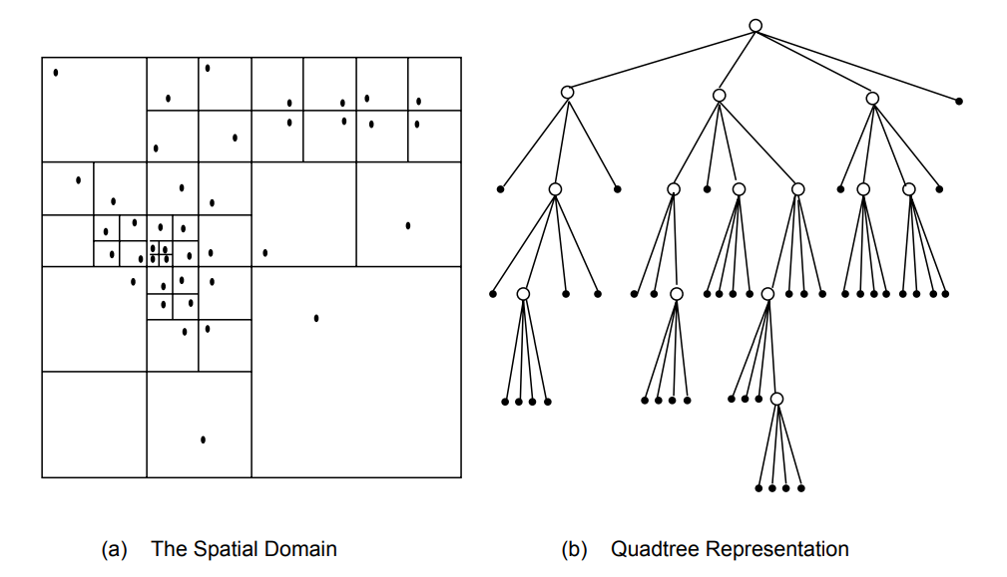
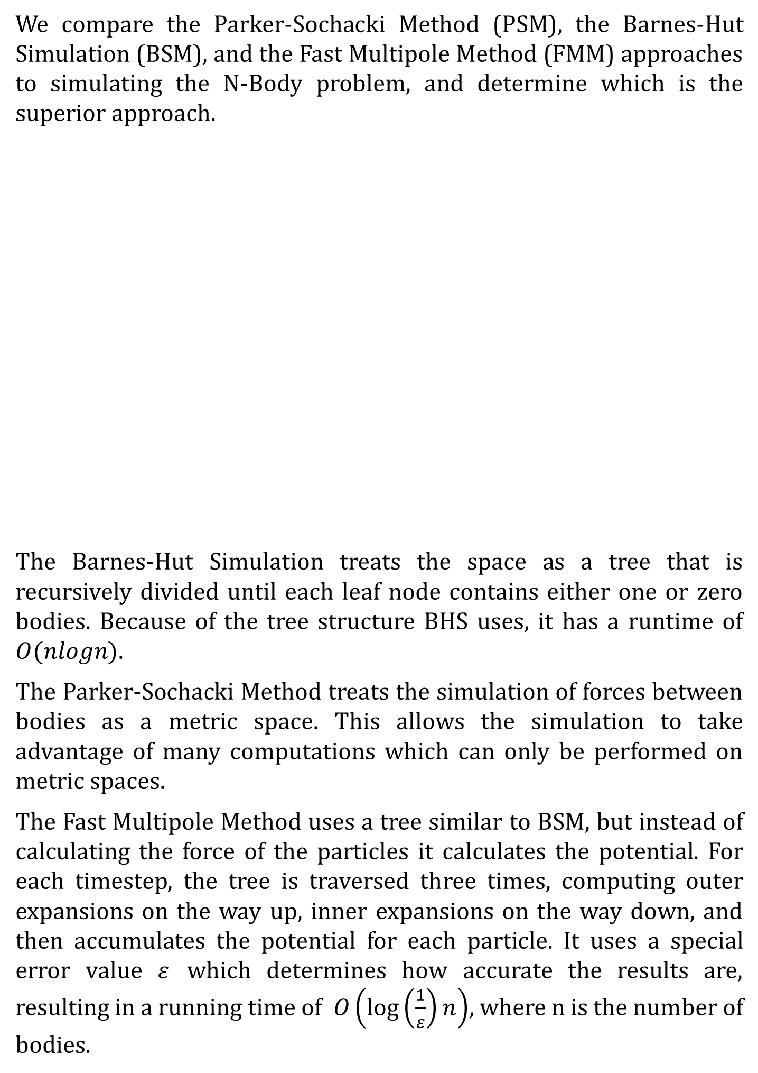
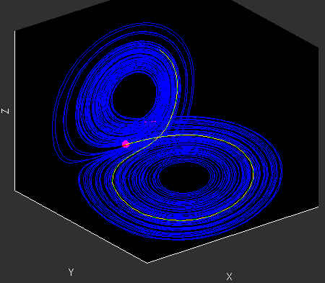
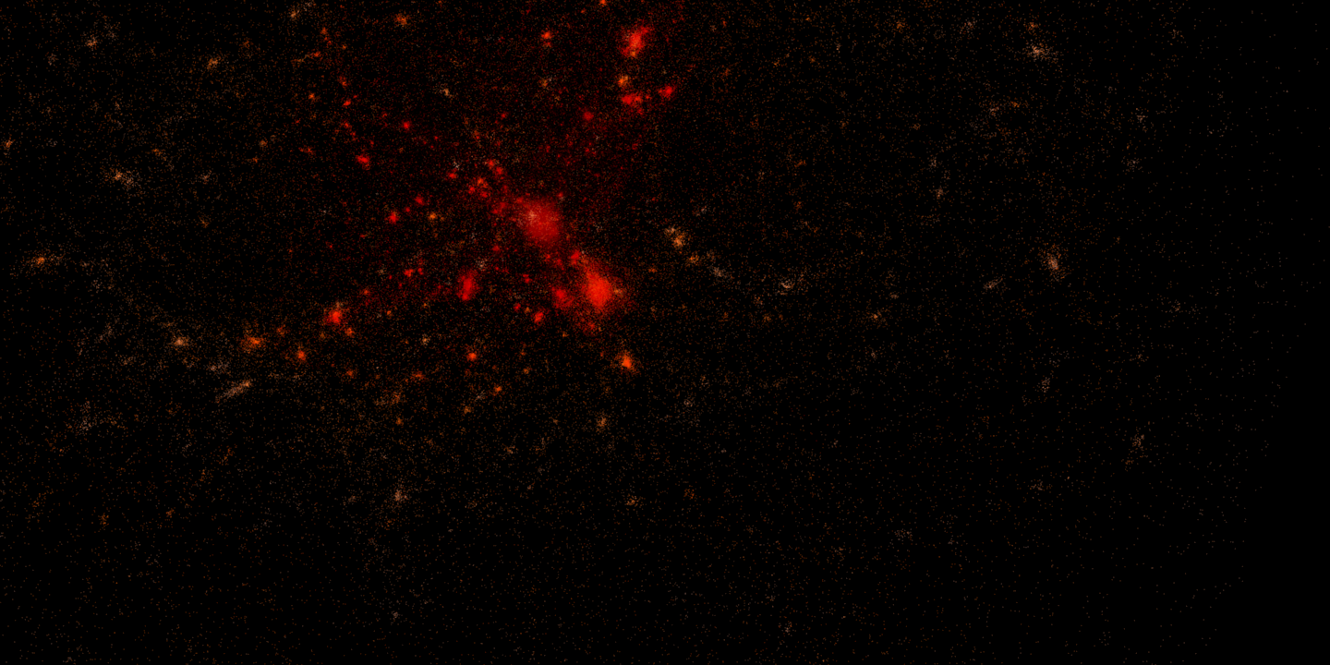
Parallel Approaches to N-Body
Ben Bole, John Latino, Kevin Kelly, Richard Bimmer
The N-Body Problem
Methods
The N-Body Problem seeks to simulate forces between bodies. The problem of simulation when the number of bodies is less than three is trivial, however, when the number of bodies is greater than three,, simulation becomes computationally intensive. The three approaches we examined to the N-Body problem attempt to speed up simulation by parallelizing the computation of forces.
We began our analysis by building off of three already existing code bases. In order to properly compare these three methods, we manipulated them so that they all had the same input and output format. We then created a script which randomly creates the mass, coordinates, and velocity vectors for each body.
We then began to perform analysis on the serial versions of these three approaches to the N-Bodies problem.
We are now currently analyzing the code for dependencies so that we can determine which regions of the code can be parallelized.
We will then test our programs with an accurate description of our solar system, to confirm that our code is correct.
We compare the Parker-Sochacki Method (PSM), the Barnes-Hut Simulation (BSM), and the Fast Multipole Method (FMM) approaches to simulating the N-Body problem, and determine which is the superior approach.
A representation of the Barnes Hut Simulation in two dimensions
Experiments
We will use the script we created to generate the same input parameters for each program, and compare each program’s running time and scaling behavior using 1, 2, 4, and 8 threads/processes.
We will start with 10,000 bodies and work up to 64,000 to determine weak scaling behavior, and will use a constant 100,000 bodies to determine strong scaling behavior.
For FMM, we will also experiment with different bin sizes and error values, in order to determine the optimal set up.
Simulation of a body’s trajectory using PSM
Future Work
Since most of the computation each approach is uses arrays/matrices, we could perform those operations on GPUs in order to speed up performance.
The BHS implementation uses MPI whereas FMM does not. It may be possible to parallelize FMM with MPI since they have similar tree structures. Our current FMM implementation only uses OpenMP.
Currently these implementations of the N-body problem only simulate gravitational potential. They could be modified to work with electrostatic forces in order to simulate protein and cell assemblies.
A visual representation of an N-Body Simulation
References
Jaswinder Pal Singh, Chris Holt, Takashi Totsuka, Anoop Gupta and John L. Hennessy. Load Balancing and Data Locality in Adaptive Hierarchical N-body Methods: Barnes-Hut, Fast Multipole, and Radiosity. Journal of Parallel and Distributed Computing Volume 27, Issue 2, June 1995.
C. David Pruett, Joseph W. Rudmin, Justin M. Lacy. An adaptive N-body algorithm of optimal order. Journal of Computational Physics, Volume 187, Issue 1, May 1 2003.
C. David Pruett, William H. Ingham, Ralph D. Herman. Parallel implementation of an adaptive and parameter-free N-body integrator. Computer Physics Communications, Volume 182, Issue 5, May 2011.
Atkinson P., McIntosh-Smith S. On the Performance of Parallel Tasking Runtimes for an Irregular Fast Multipole Method Application. Scaling OpenMP for Exascale Performance and Portability. Lecture Notes in Computer Science, vol 10468, 2017.

