Slide 1

Why You Really Need Azure Functions
WELCOME
Jason Lattimer
Development Manager, PowerObjects
Notes:
Have some code that's maybe not quite a full application that you need to deploy without worrying about the hassle of managing environments? Well look no further than Azure Functions! Yes, you're probably thinking there's already a dozen other ways to host an application that you already know about so why think about another? Azure Functions provide a uniquely flexible platform which allows developers to deploy code in multiple ways using multiple languages while being able to bind directly Azure or HTTP based triggers. If that doesn't sound appealing then at least you could tell everyone you're going serverless, which sounds cool, right? In this session we'll explore scenarios where using Azure Functions could be useful, pros and cons compared to other technologies, and plenty of examples to give you some ideas.

Slide 2

AGENDA
Serverless Computing
Azure Functions Overview
Using Visual Studio
Using Visual Studio Code / CLI
Other Features
Questions

Slide 3






About Me – Jason Lattimer
 | Development Manager - PowerObjects
 | Microsoft MVP – Business Solutions
 | @JLattimer
 | https://jlattimer.blogspot.com
 | https://github.com/jlattimer
Our POV

Slide 4
What is Serverless Computing?
Focus on code
No managing servers
Small unit = function
Stateless
BaaS (Backend as a Service
FaaS (Function as a Service)
Azure Functions, AWS Lambdas, Google Cloud Functions
Our POV

Slide 5
Pros and Cons
Pros
Cost – pay for execution time
Faster development
Multi-language
Auto-scaling by provider
Multiple triggers
Cons
Locked in the a specific vendor
No server access / optimizations
Execution duration
Performance (spin up time)
Debugging

Slide 6





A Few Uses
Centralize
APIs
Enhance
Logic Apps
Flow
PowerApps

Slide 7

Azure Functions
Create functions online or offline
Develop in multiple languages
NuGet & NPM package restore
Continuous integration
Available for Azure Consumption or App Service plans
CORS support
OpenAPI/Swagger definitions
Proxies
Our POV

Slide 8








Azure Functions – Supported Languages
Our POV

Slide 9



Azure Functions – Triggers & Bindings
Type | Service | Trigger | Input | Output
Manual | Azure Functions | X
Schedule | Azure Functions | X
HTTP (REST or Web Hook) | Azure Functions | X |  | X
Blob Storage | Azure Storage | X | X | X
Events | Azure Event Hubs | X |  | X
Queues | Azure Storage | X |  | X
Queues & Topics | Azure Service Bus | X |  | X
Tables | Azure Storage |  | X | X
Tables | Azure Mobile Apps |  | X | X
No-SQL DB | Azure Document DB |  | X | X
Push Notifications | Azure Notification Hub |  |  | X
SendGrid | SendGrid |  |  | X
Twilio SMS Text | Twilio |  |  | X
Bot (preview) | Azure Bot Service |  | X | X
External Files (preview) | Various | X* | X | X
Our POV

Slide 10
Azure Functions vs. Azure WebJobs
Functions | WebJobs
Scale automatically | Scaling done manually
Pay per use or App Service | App Service pricing
Tooling - preview | Tooling - established
Return response to HTTP caller | No response to HTTP caller
Consumption plan 5 min. timeout Basic+ plan w/ Always On – “unexpected timeouts” | Better handling of long running tasks
Consumption plan – cold start Basic+ plan w/ Always On – always running | Always running
More authentication options | Limited options
Our POV

Slide 11
Pricing
Meter | Price | Free Grant / Month
Execution Time* | $0.000016/GB-s | 400,000 GB-s
Total Executions* | $0.20 per million executions | 1 million executions
Our POV
*Free grants apply to paid, consumption subscriptions only.
Functions are billed based on observed resource consumption measured in Gigabyte Seconds (GB-s).
Observed resource consumption is calculated by multiplying average memory size in Gigabytes by the time in seconds it takes to execute the function

Slide 12

Visual Studio Tools for Azure Functions
Visual Studio 2015 (preview)
Project and Function templates
Local debugging (requires Azure Functions CLI tools)
Remote debugging
Easy package management with NuGet
Deploy directly to Function App
Publishes all Functions in Function App project
Poor intellisense support
Can’t add new files via “Add New Item”
Our POV
Download: https://aka.ms/azfunctiontools

Slide 13
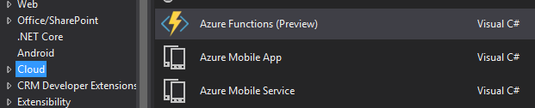
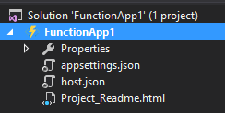
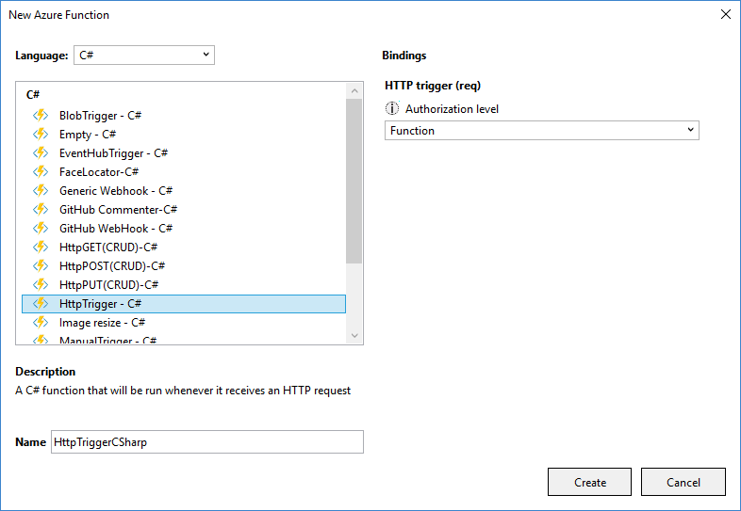
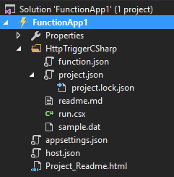
Visual Studio Tools for Azure Functions
Creating a new function
Our POV

Slide 14
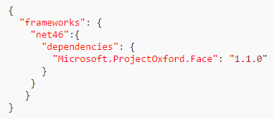
Visual Studio Tools for Azure Functions
Code in .csx files – use other .csx files using #load “path/filename”
Namespaces & external libraries
Some included by default (System, System.Net.Http, Microsoft.Azure.WebJobs, etc.)
Others included using #r “AssemblyName” (Newtonsoft.Json, Microsoft.WindowsAzure.Storage, Microsoft.ServiceBus, etc.)
NuGet hosted libraries can be added in project.json file (note only Major.Minor.Revision versioning)
Anything else can be added to Function App bin folder
Our POV

Slide 15

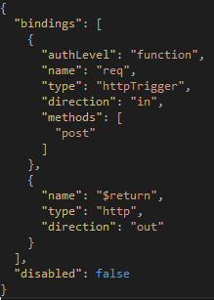
function.json
Defines triggers & input / output bindings
Trigger – type & config
Input – passed to function along with context
Output – use named output or return value
Binding info can be accessed in code
Not published with rest of function
Shouldn’t contain secrets
Our POV

Slide 16
Demo
Geocode
Give Away Bot
https://giveawayentry.azurewebsites.net
Our POV

Slide 17
Azure Functions CLI
Command line and / or Visual Studio Code
Creates local function host for debugging
Can scaffold projects with Yeoman & Azure Functions Generator
Debug JavaScript functions
More complicated package management using NPM
Our POV
Download: https://npmjs.com/package/azure-functions-cli

Slide 18
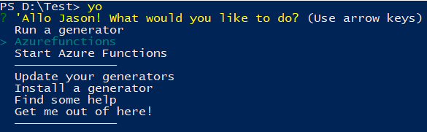

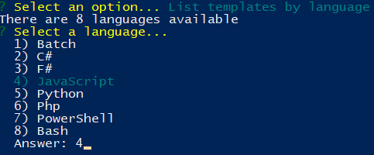
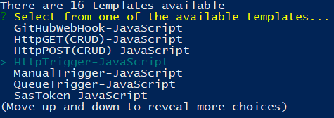
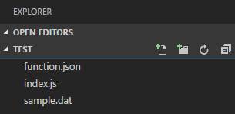
Azure Functions CLI
Creating a new function
Our POV

Slide 19
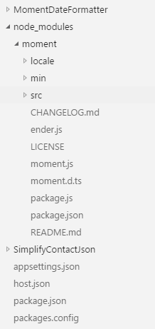
Azure Functions CLI
Code in index.js
Package management
Create package.json file
Upload to Function App root
Execute npm install under Function App -> Platform features -> Console
Our POV

Slide 20
Demo
Date Formatter
Our POV

Slide 21
Deploy As Class Library
Will be the future for .NET based functions
No cold start – code already compiled
Uses Visual Studio 2015/2017 Web Application project
Debug using Azure Functions CLI tools (modify project Start Action)
Use NuGet packages directly
Publish to Function App
Update function.json (scriptFile & entryPoint)
Our POV
Notes:
https://blogs.msdn.microsoft.com/webdev/2017/04/14/azure-functions-tools-roadmap/
https://blogs.msdn.microsoft.com/appserviceteam/2017/03/16/publishing-a-net-class-library-as-a-function-app/

Slide 22
Demo
Simplify JSON
Our POV

Slide 23
Debugging
Visual Studio
Local – manually trigger via Postman or other means
F5 debug – Function App as startup project
Remote – manually trigger or use portal test functionality
Cloud Explorer – attach debugger at Function App level
Visual Studio Code
func run FunctionName -c "{\"name\": \“data\"}" –debug
Start debugger
Secrets / environment variables – use appsettings.json
Our POV
Both require Azure Functions CLI tools

Slide 24
Function Authentication
Function
Key provided at function level – passed via query string or header
Only trigger enabled functions
Admin
Key provided at Function App level – passed via query string or header
Can trigger enabled and disabled functions
Anonymous
As you’d expect, open to everyone
App Service
Azure AD, Facebook, Google, Twitter & Microsoft

Slide 25
Application Settings (Secrets)
Configure under Function App -> Platform features -> Application Settings
Certain things expect pre-configured names – “AzureWebJobsBotFrameworkDirectLineEndpoint”
Could potentially be an issue when dealing with multiple functions in a Function App
Can update via REST, PowerShell, or manually
Use local appsettings.json to simulate locally (include “IsEncrypted": false)
Our POV

Slide 26
Azure Functions Proxies
New - still preview
Enable in portal under Function App -> Settings
Simplify existing function url
Redirect to different Function App / App Service or API all together
Present more unified API naming
Change underlying backend url more easily
Our POV

Slide 27
API/Swagger Definitions
New - still preview
Configure under Function App -> API Definition
Generated for entire Function App
OpenAPI / Swagger 2.0 standard
Can update manually
Public API definition URL (simplify with Proxy)
Download definition for PowerApps / Flow custom API
Important to define allowed HTTP methods at function level
Our POV

Slide 28
Questions?
https://github.com/jlattimer/WhyYouReallyNeedAzureFunctions
Our POV

