Slide 1

Predicting where to open a restaurant in Lisbon

Slide 2
Business Problem & Interested Stakeholders
Where to open a restaurant in Lisbon?
This is the question that we will help to answer, understanding the actual configuration and possibilities using available data.
Lisbon is the capital city of Portugal and one of the most beautiful and charismatic cities of Europe.
It has a vibrant life with lots of people coming from suburbs to work and many tourists.
It is also well known by having a great climate and of course the great food.
Those who try to open a new restaurant face a great competition and challenge.
All the help they can have is for sure wellcome.
This kind of knowledge can have a lot of interested stakeholders:
Someone who wants to open a new restaurant and know the competition.
Local authorities who want to better develop their municipalities.
Real estate agents who want to get additional knowledge for their clients.
Other intereste stakeholdes like students, foodies or just curious people.

Slide 3
Data Source
Coordinates to search from using the Foursquare API
Using the wikipedia page in which we can get the borough's coordinates: https://pt.wikipedia.org/wiki/Lisboa
Boroughs shapes to match with the venues location
Define in which borough the venue belongs, this information does not come from Foursquare API
https://geodados-cml.hub.arcgis.com/datasets/freguesias-2012?geometry=-9.315%2C38.702%2C-8.988%2C38.749&page=2&selectedAttribute=Shape__Length
Aditional information by borough (population, population density, visiting population)
It will be helpful for the final anaysis, use also wikipedia page: https://pt.wikipedia.org/wiki/Lista_de_freguesias_de_Lisboa
Venues information
Use the Foursquare API to get explore the venues location and other relevant information

Slide 4
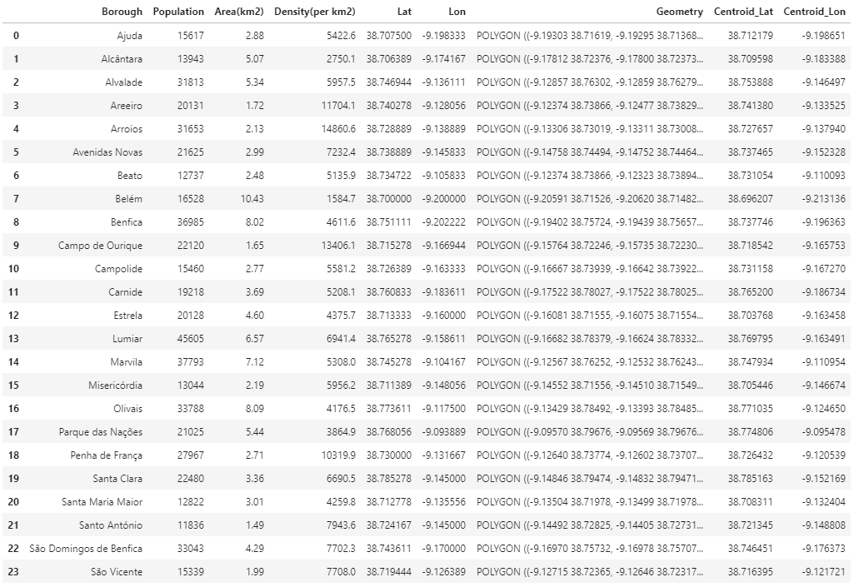
Data Acquisition and Cleaning
Borough Name
Population
Area
Population density
Shape of borough
Coordinates to search from using the Foursquare API
From Wikipedia page
Centroid of the shape file

Slide 5
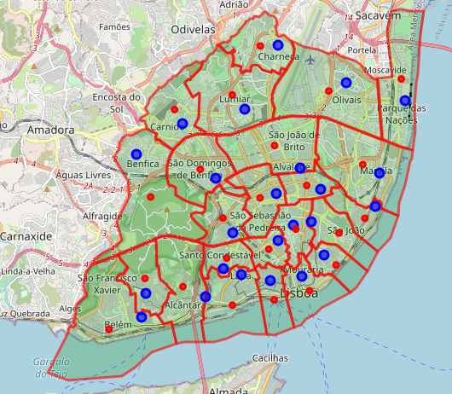
Borough Visualization
Centroids locations (red dots) are better option to request venues from Foursquare API.
Less probable to have duplicates
Less probable that a venue is not requested
Boroughs shape will be used to match venue with correspondent borough

Slide 6
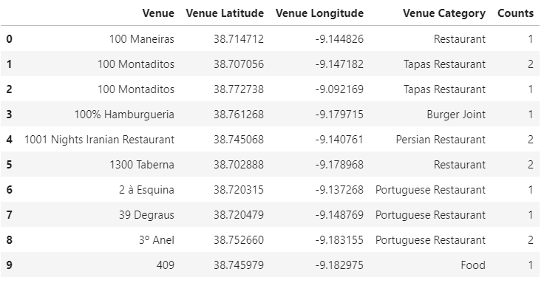
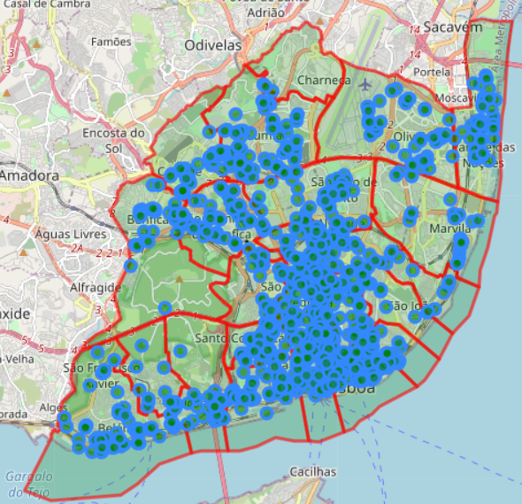
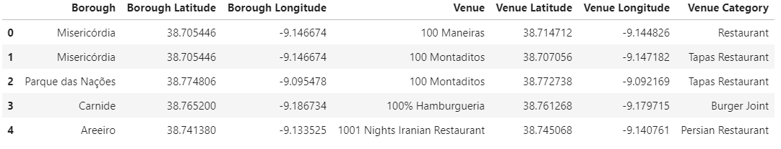
Venues from Foursquare
Some duplicates values are found meaning the venue was found from two different point of search
Removing the duplicates
Match the venue with the borough shape
Dataframe with venue location, category and correspondent borough

Slide 7
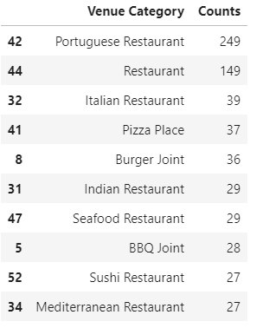
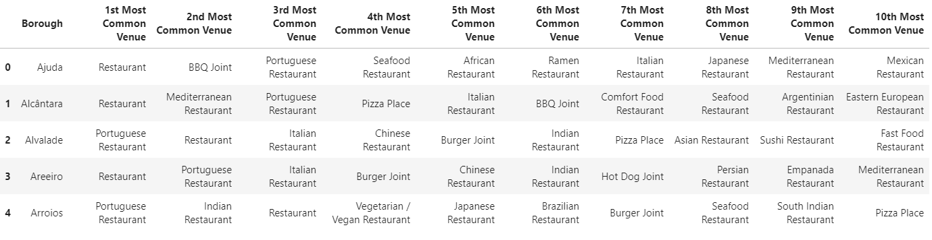
Common Restaurant Types per Borough
Most common restaurants are Portuguese & General Restaurants
Other types or ethnical restaurants are not so common in Lisbon
Applying one hot encoding , grouping by borough and calculating frequency occurrence to cluster boroughs
Organize by most common restaurant on each borough

Slide 8
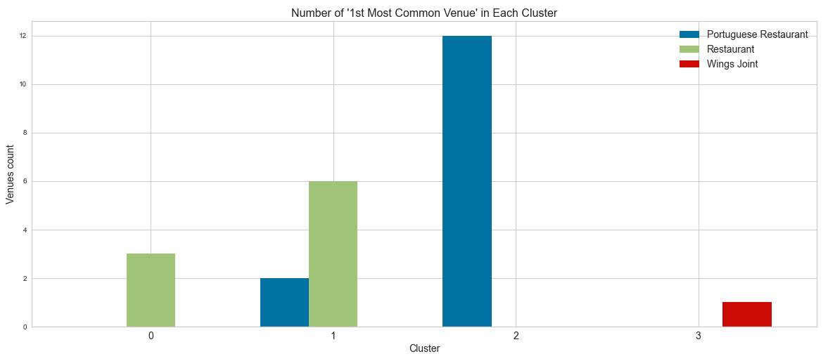
Clustering Boroughs
Clustering in 4 groups we can label the clusters:
0 – General Restaurant Cluster
1 – Mixed type Cluster
2 – Portuguese Restaurant Cluster
3- Wings Joint Cluster

Slide 9
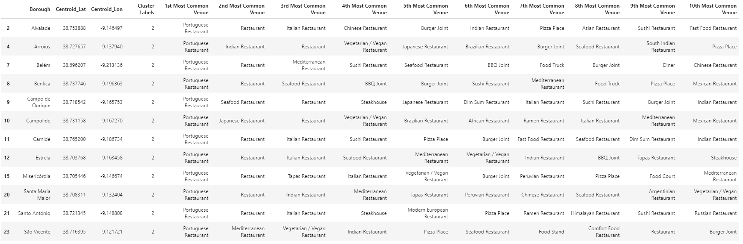
Exploring cluster – Portuguese Restaurant Cluster
On this cluster the boroughs have Portuguese Restaurant as most common type
Generic Restaurant are the second most common
Italian Restaurants are also popular in Lisbon as we have seen before
An Italian Restaurant on a borough were is not so common would be a good idea, less competition (ex: Arroios, Belém, Benfica, etc.)

Slide 10
Conclusion and next steps
A clustering algorithm was used to cluster the boroughs using the most common categories of restaurants.
Analyzing the clusters, insights can be derived to answer the question of where is the best location to open a new restaurant and which type.
Next steps to develop the study:
Upgrading the amount of information, for example:
Home sales/Rental prices
People movement around the city
Distance to market suppliers
Use a different Venue API with more data.
Try different machine learning algorithms.

