Slide 1
Graph Analysis: Link prediction and Node Classification in CORA citation network
Team 40:
Sai Laxman Jagarlamudi : sj1018
Vikram Sahai Saxena : vs799
Vishwas Gowdihalli Mahalingappa : vg421

Slide 2
Problem Statement
Aim: Build an efficient system for Link prediction and Node classification using CORA citation network dataset.
We wish to evaluate various models to understand which algorithms are best and appropriate to get the best results for our link prediction and node classification tasks.

Slide 3
Link Prediction and Node Classification
Link prediction is the problem of predicting the future connections among the graph entities
Node classification is the problem of classifying the entities into classes for better understanding.

Slide 4
DataSet
CORA citation network dataset
Scientific publications/nodes: 2708
Citations/Links/Edges : 5429
Classes: 7
Split the dataset into 80% training and 20% testing.

Slide 5
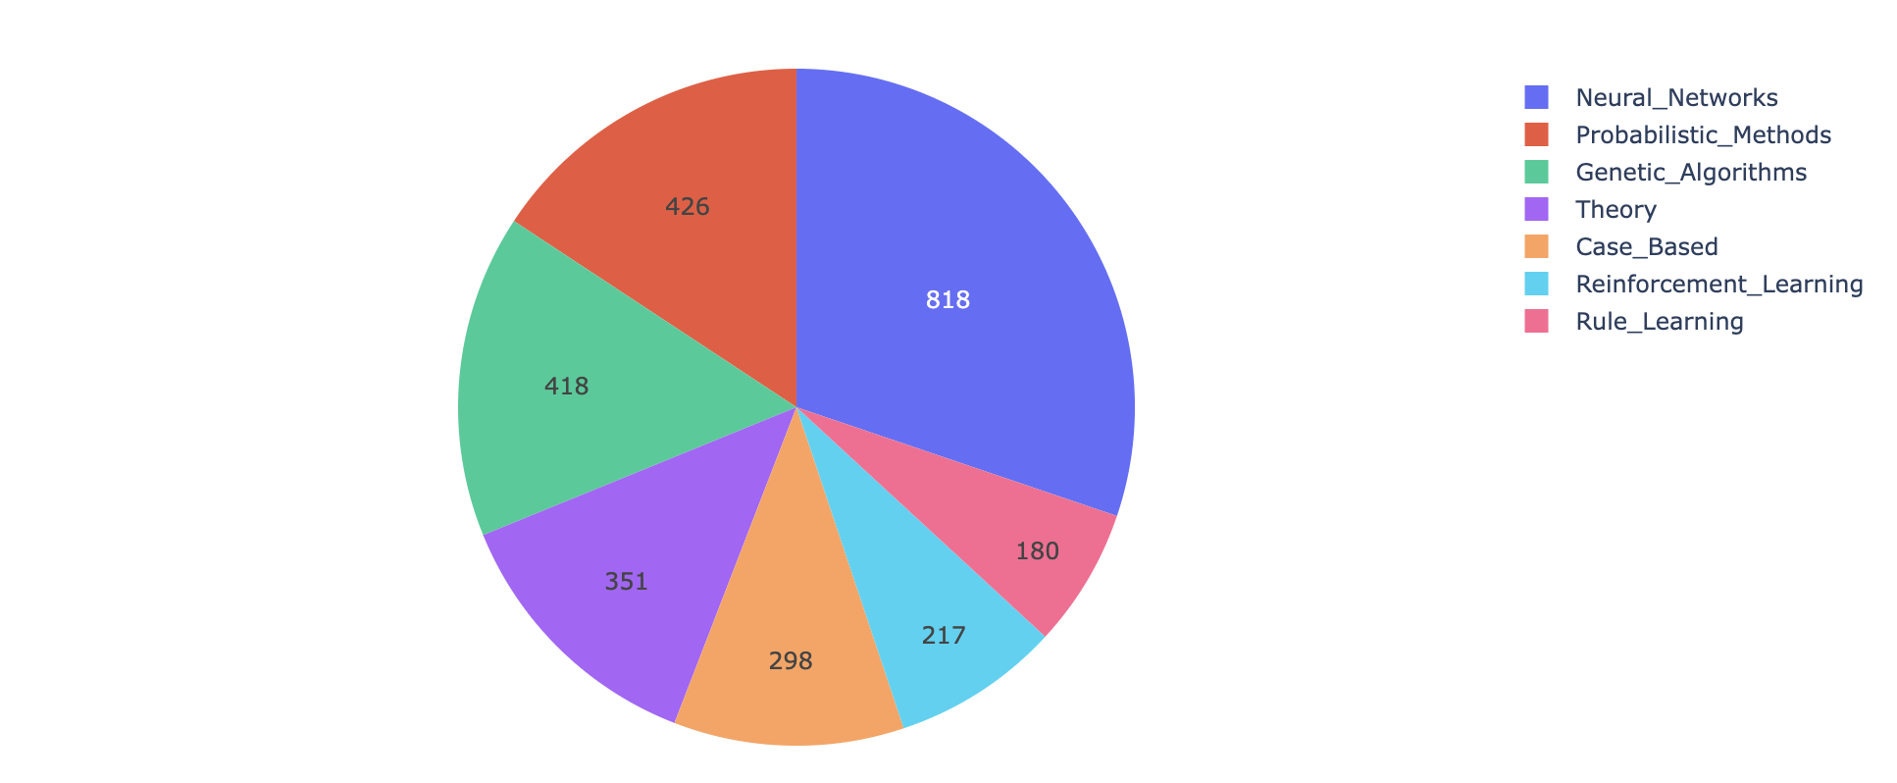
Data Analysis
The graph is not connected
3563 cliques are present in the dataset
Maximum clique size is 5
Notes:
The counts of paper in each class

Slide 6
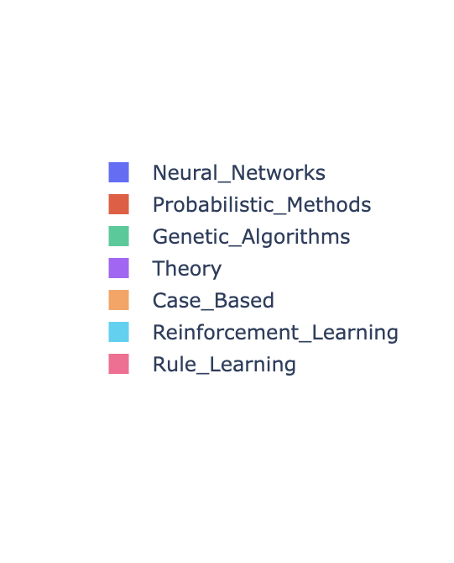
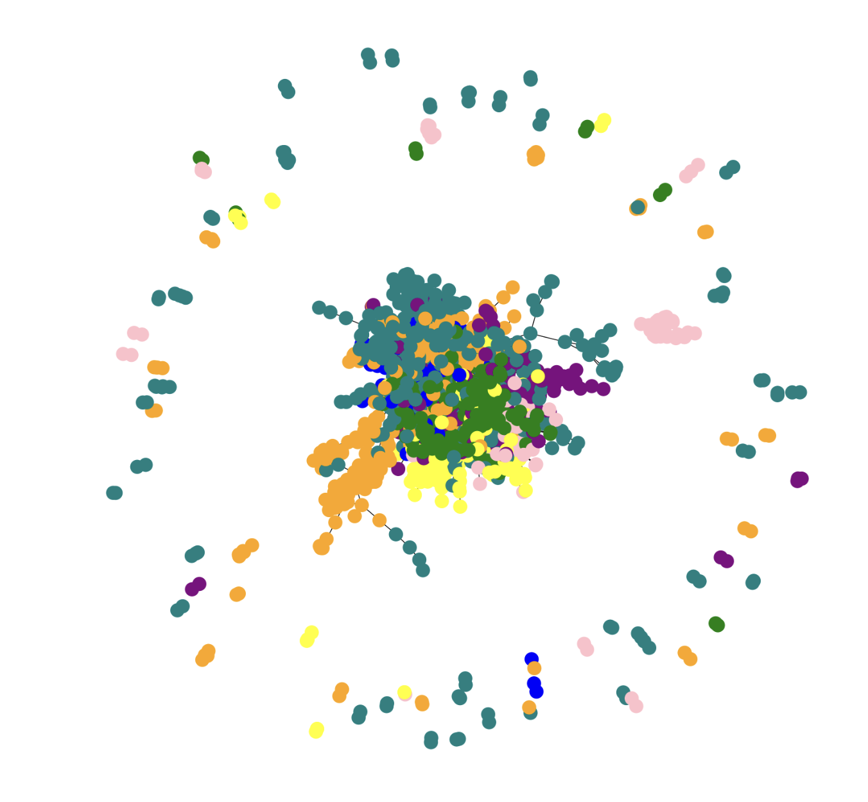
Visualisation of CORA

Slide 7
Models
Logistic Regression
Graph Convolutional Network (GCN)
GraphSAGE

Slide 8
Logistic Regression
Feed embeddings that are generated using the Node2Vec algorithm to a simple logistic regression model to predict links and classify nodes.
Nodes that are close together in the graph remain close together in the embedding space because of the way that embeddings are learned. To get our context pairs and use them for training the model, Node2Vec first performs random walks over the graph.
By using a binary operator on the embeddings of the source and target nodes of each sampled edge, we determine link/edge embeddings for the positive and negative edge samples.
We train the logistic regression classifier using the embeddings of the positive and negative samples to predict a binary value indicating whether or not an edge should exist between two nodes.
Notes:
We use Node2Vec algorithm to reduce dimensionality and obtain node embedding of the given graph entity

Slide 9
Evaluation Metrics (LR)
Link Prediction
The results obtained for this model:
Metric | Score
Accuracy | 0.594
F_Score | 0.688
Precision | 0.742
Recall | 0.642
Notes:
Baseline performance of LR

Slide 10
Evaluation Metrics (LR)
Node Classification
The results obtained for this model:
Metric | Score
Accuracy | 0.738
F_Score | 0.733
Precision | 0.739
Recall | 0.738

Slide 11
Graph Convolutional Network (GCN)
Efficient variant of convolutional neural networks that operates on graphs.
Obtains vector representations of each node by performing a simple forward propagation on inputs consisting of adjacency and feature matrices for each node.
These node embeddings are sent to a keras dense layer with softmax activation for node prediction to get the class prediction.
The node embeddings are concatenated for link prediction using a simple sum to create a link embedding, which is then sent to a dense layer to produce link predictions.
Notes:
Our 2 nde model is GCN

Slide 12
Evaluation Metrics (GCN)
Link Prediction
To obtain link embeddings, we produced vectors of length 16 for every node and concatenated them together. Then, these embeddings were input to a dense layer to make the link prediction.
The results obtained for this model:
Metric | Score
Accuracy | 0.7416
F_Score | 0.7148
Precision | 0.7977
Recall | 0.6476

Slide 13
Evaluation Metrics (GCN)
Node Classification
Vector representations of the graph were created via forward propagation.
Then, for multiclass classification, these representations were provided as input to a single hidden dense layer, followed by a softmax output layer.
The results obtained for this model:
Metric | Score
Accuracy | 0.7848
F_Score | 0.7852
Precision | 0.8091
Recall | 0.7626

Slide 14
GraphSAGE
Inductive semi-supervised learning framework.
By including node representation of not only a node's neighbors but also the neighbors of its neighbors, the framework improves over GCN.
To minimize the overhead, for a fixed number of iterations, it randomly samples a fixed number of neighbors and neighbors of neighbors at every iteration.
The model we created is made up of a single layer of a 32x32 GraphSageModel, whose inputs are the sampled inputs aggregated by the generator.
The model then generates the vectorized inputs and vectorized outputs that can be sent to a single dense layer of a neural network, whose outputs are then supplied to a softmax output layer to enable multi-class classification.
To determine the link score for link prediction, we use dot product between the source node vector and the destination node vector.
Notes:
Improvement over GCN! 2 4

Slide 15
Evaluation Metrics (GraphSAGE)
Link Prediction
Graph convolutional network with a single hidden layer and a 16 x 16 kernel is used.
Different kernel sizes and hop distances were tested. The metrics for the size 16 x 16 with hop distance two are shown in the local optimal test results that are shown below.
Metric | Score
Accuracy | 0.763
F_Score | 0.757
Precision | 0.777
Recall | 0.738

Slide 16
Evaluation Metrics (GraphSAGE)
Node Classification
A single hidden layer of Graph convolutional network was used with kernel size 32 x 32.
A softmax layer was used to classify the results.
Sample count of ten was set for the first hop and five for the second hop, respectively.
The results obtained for this model:
Metric | Score
Accuracy | 0.806
F_Score | 0.81
Precision | 0.824
Recall | 0.797

Slide 17
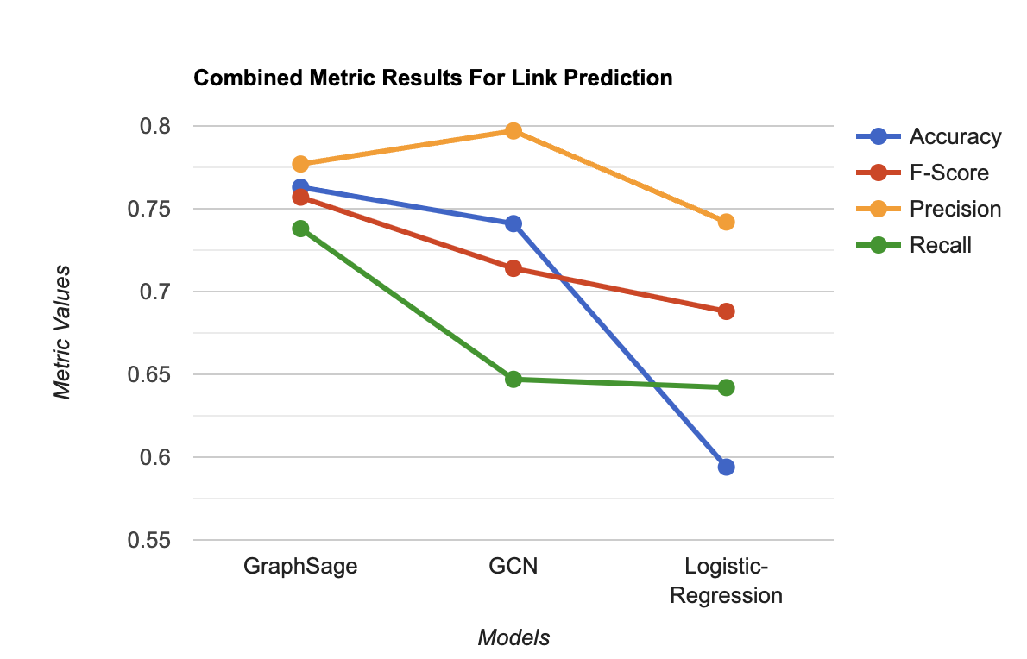
Link Prediction Evaluation of Different Models

Slide 18
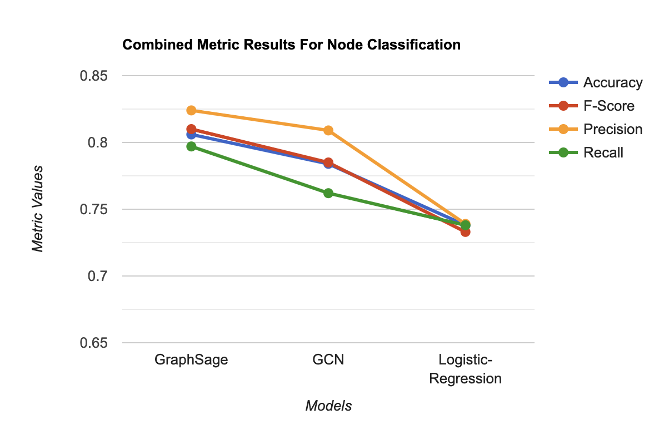
Node Classification Evaluation of Different Models

Slide 19
Transparency and Explainability of Graph-based Prediction (optional task)
GraphSAGE: The very fact that the inclusion of node’s neighbor’s neighbors(i.e nodes that are 2 edges away from the current node) in the node representation intuitively explains why graphSage performs better other algorithms described above.

Slide 20
Future Work
Conclusion
Compared and evaluated various models for link prediction and node classification tasks.
Clearly GraphSage outperforms GCN, Logistic regression based on popular metrics measured.
We propose to create a more advanced ensemble model of GraphSAGE, GCN and other effective models to improve the current results.
We plan to improve feature engineering by creating a robust feature transformation and selection methods to get better node or link embeddings.

Slide 21
References:
[1] Belkin et. al. 2006. Manifold Regularization: A Geometric Framework for Learning from Labeled and Unlabeled Examples. JMLR (2006). [2] Mikolov et. al. 2013. Distributed Representations of Words and Phrases and their Compositionality. arvix (2013). [3] Perozzi et al. 2014. DeepWalk: Online Learning of Social Representations. arxiv (2014). [4] Tang et al. 2015. LINE: Large-scale Information Network Embedding. arxiv (2015). [5] Thomas N. Kipf et al. 2017. Semi-supervised classification with graph neural networks. ICLR (2017).

Slide 22
Thank You!

