Slide 1
City of Montreal
Where Should I Eat?

Slide 2
the question of the day
“What are the most liked places around so I can eat at them too?”
In Montreal City, there are a number of places to grab a bite to eat, with a lot of variation over a large area.
Some people just want to grab and go and do not care about where they eat, but others want to look at their nearby options and compare,
From dessert, to coffee, to a meal, this rating system will help them in their determinations of where the best food place in their neighbourhood or borough would be.

Slide 3
what data are we using?
the Foursquare API will be used to pull data on food venues in Montreal.
the name of the establishment,
the Id for the API for the venue,
the coordinates of the venue,
the venue category
the number of likes that specific venue has.
Openstreetmap
used to create a list of coordinates for the Montreal neighbourhoods.
A dataset found from the City of Montreal website, "Quartiers de référence en habitation",
used to list the boroughs and neighbourhoods in Montreal.

Slide 4
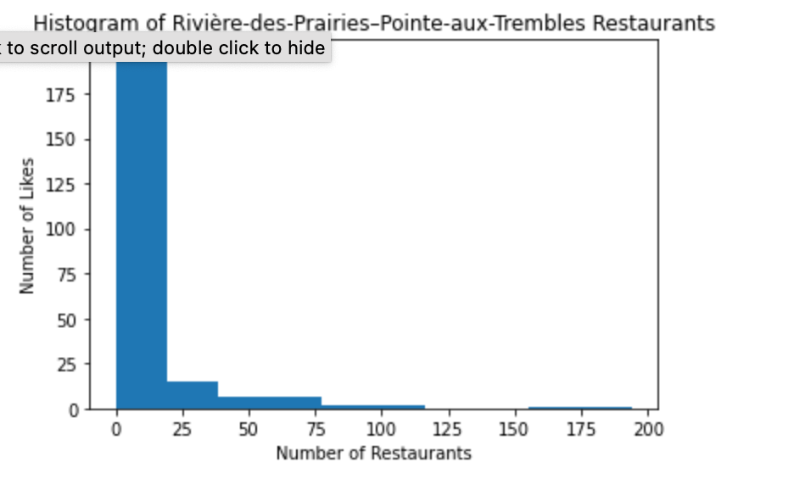
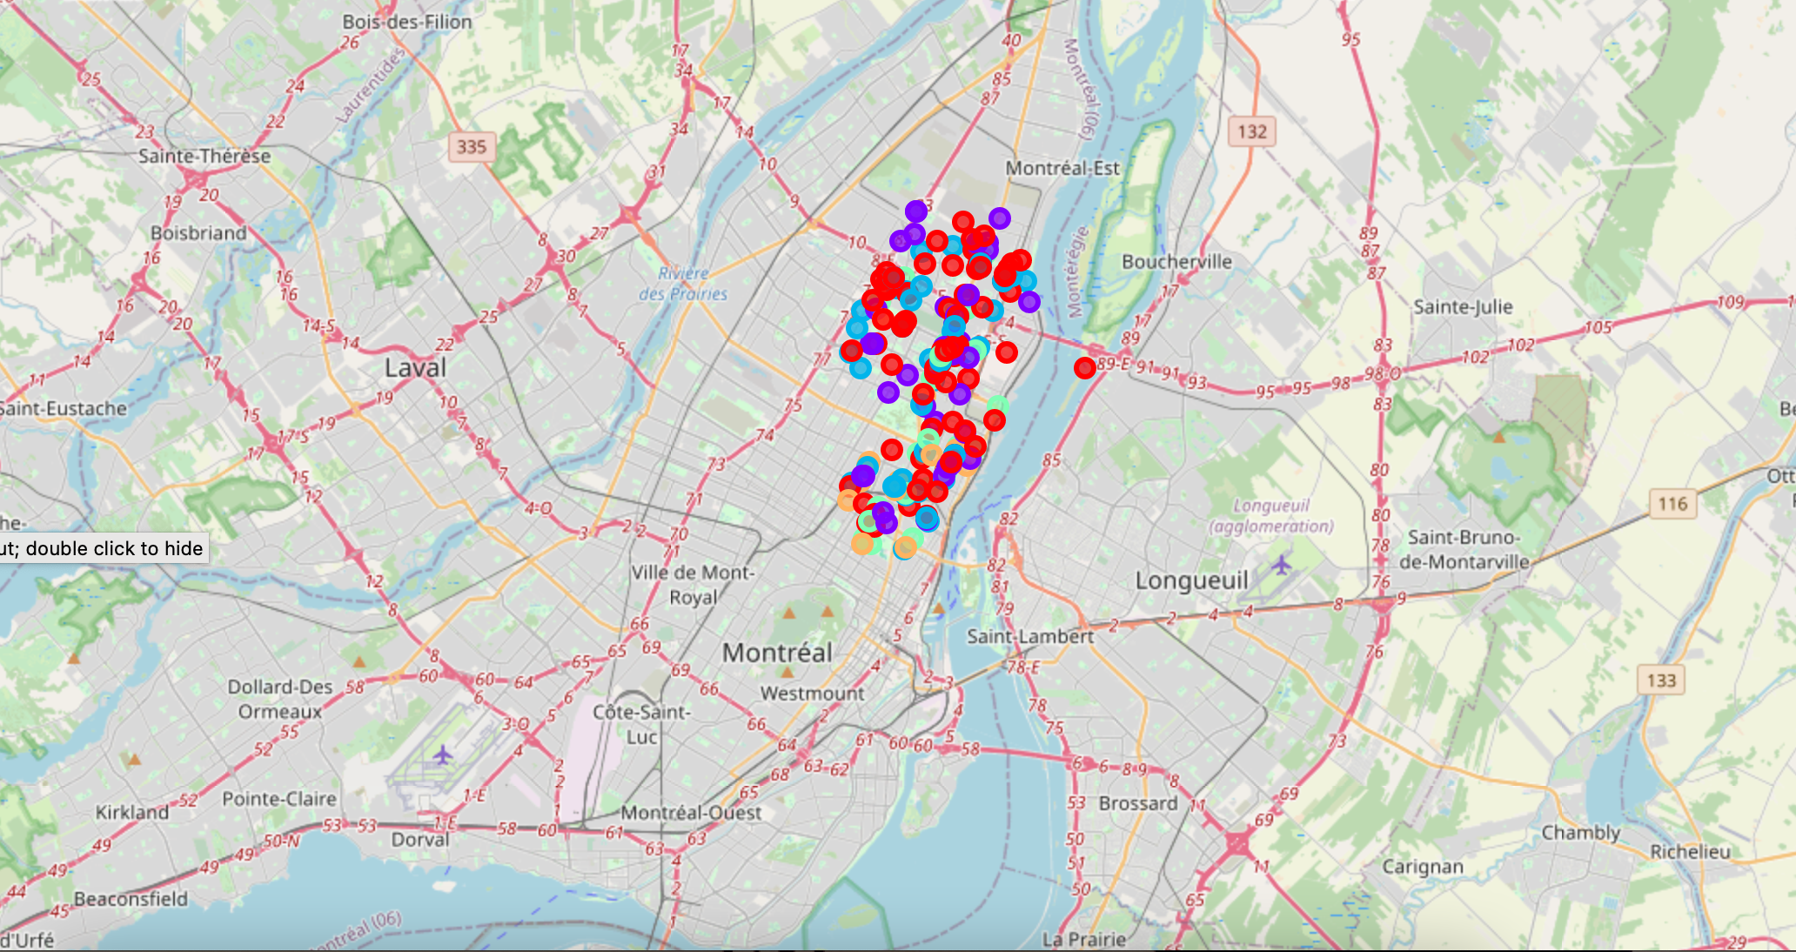
how do we get those liked venues
To find the food venues for those areas, that data was inputted into the FourSquare API
First the venues from specific coordinates were found, then their likes
A histogram was created to visualize the data frequencies,
To complete the visualization of the categories, the data was entered into a cluster map, grouped by the Venue Id. The clusters show the rating categories.

Slide 5
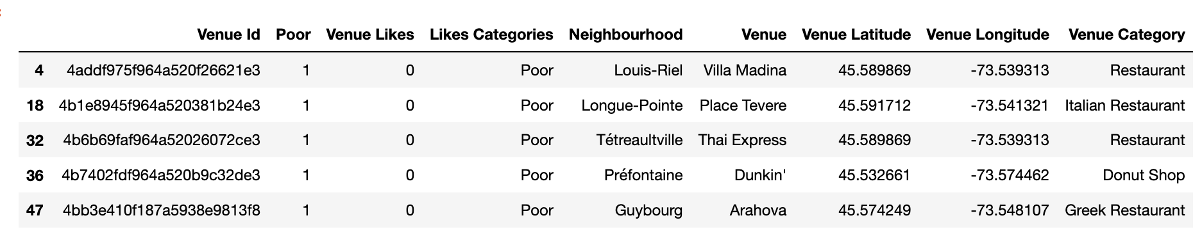
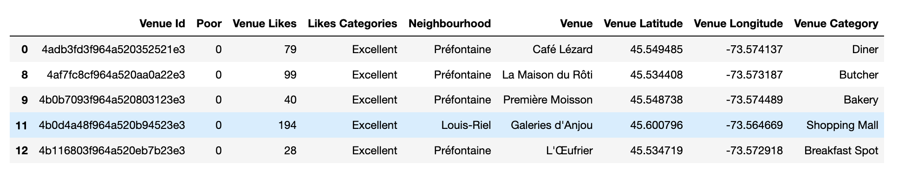
the rating clusters
The likes from the venues were separated by percentiles and clustered onto the map
These are five-row examples of the rating categories “poor” and “excellent”

Slide 6
limitations of this process
The data for all boroughs in Montreal was too large to run all at once with the API restrictions
used one borough and its neighbourhoods as a small sample for the entire city.
only provided what information was available on FourSquare
The results are percentile and venue based
the results would changed based on the locations inputted
a larger area would change the perception on a venue

Slide 7
What can we do with this information?
This project was created by using FourSqaure for its data gathering for food-associated venues.
More decisions can be made using the data gathered here.
It can be used as is, to contribute toward the public’s decision making while using an app.
it can be used as a part of another project as another source of information.

