Slide 1

The Prestige Trading Algorithm
Automating a simple, yet profitable, trading strategy
Dimitri Santos
José Gouveia
July 2021

Slide 2
Project Overview
1. Defining the strategy
2. Is it profitable?
Backtesting on a 20 year period, with over 5000 firms (>28 million observations)
3. Implementing the algorithm
Using IBM Watson Studio to run the code automatically in the cloud
Web scraping the data from the website
Sending which stocks to buy and sell via email

Slide 3
1. Defining The Strategy
The process:
Sample of all publicly traded US stocks with a market cap above $50 Million
Rank them according to two metrics: Earnings Yield and Return on Capital Invested
Compute the final ranking as the sum of the previous two
Keep track of the daily top 50 stocks
Any new stock appearing on the top 50, that hadn’t been there for at least one week, is set to buy
Keep these stocks for one week and then sell
*Inspired from the investment strategy in The Little Book That Still Beats the Market, by Joel Greenblatt

Slide 4

1. Defining The Strategy
The metrics:
$$Earnings Yield=\frac{EBIT}{Market Value+Preferred Stock+Net Debt}$$
$$Return on Capital= \frac{EBIT}{Working Capital+Net Fixed Assets}$$

Slide 5
2. Is It Profitable?
Backtesting Data:
Extracted from Refinitiv Datastream
5488* US stocks – all that were available in the Database for US, excluding financial fims and utilities
Daily returns on a 20 year period (Dec 2000 to May 2020)
Over 28 million rows of data
*Really important to include stocks that became obsolute to this day, so we won’t have a survival bias

Slide 6
2. Is It Profitable?
Backtesting Data:
Metrics extracted:
Daily Prices (on close, on open, low and high)
Market Capitalization
EBIT
Working Capital
Net Fixed Assets
Preferred Stock
Net Debt

Slide 7
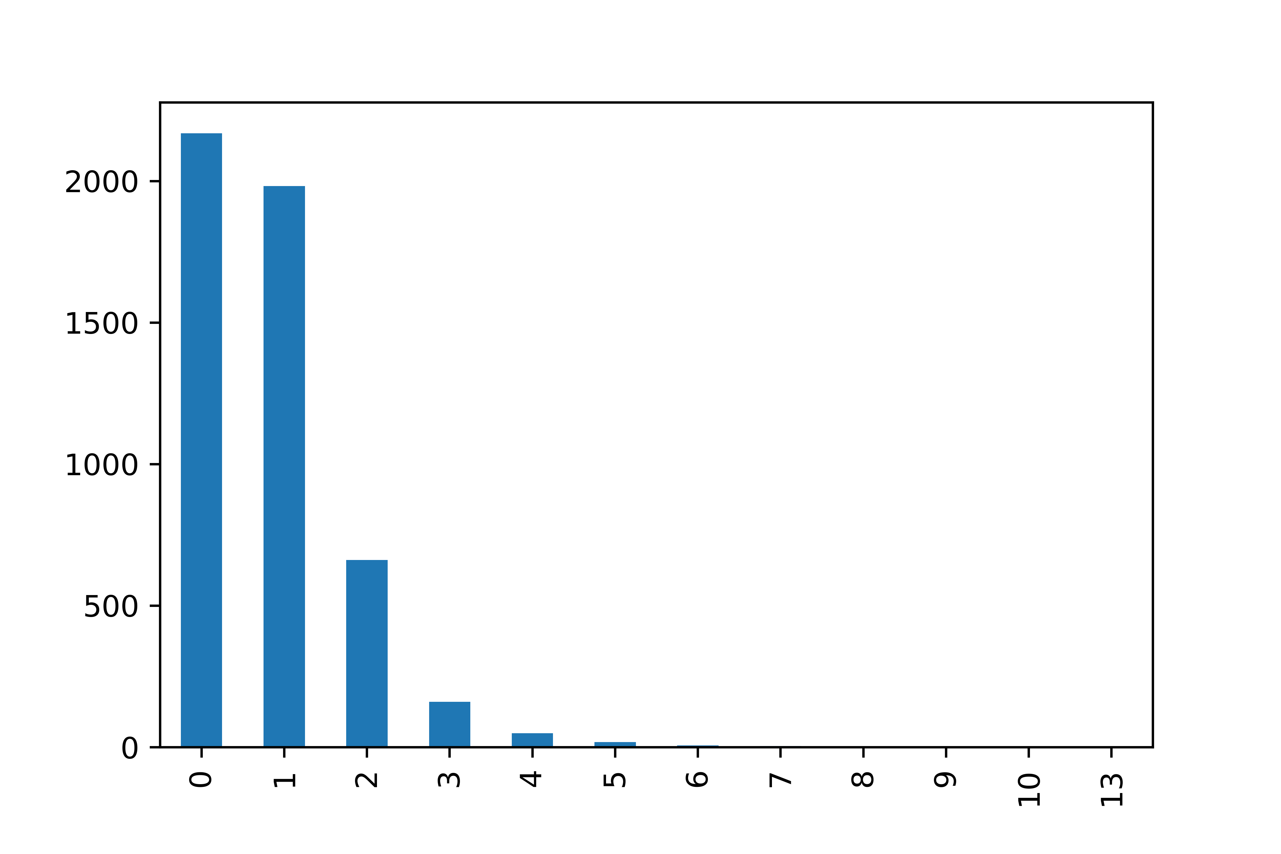

2. Is It Profitable?
Daily frequency of stocks o buy
Stocks to buy per week, on average
Number of stocks to buy, per day

Slide 8
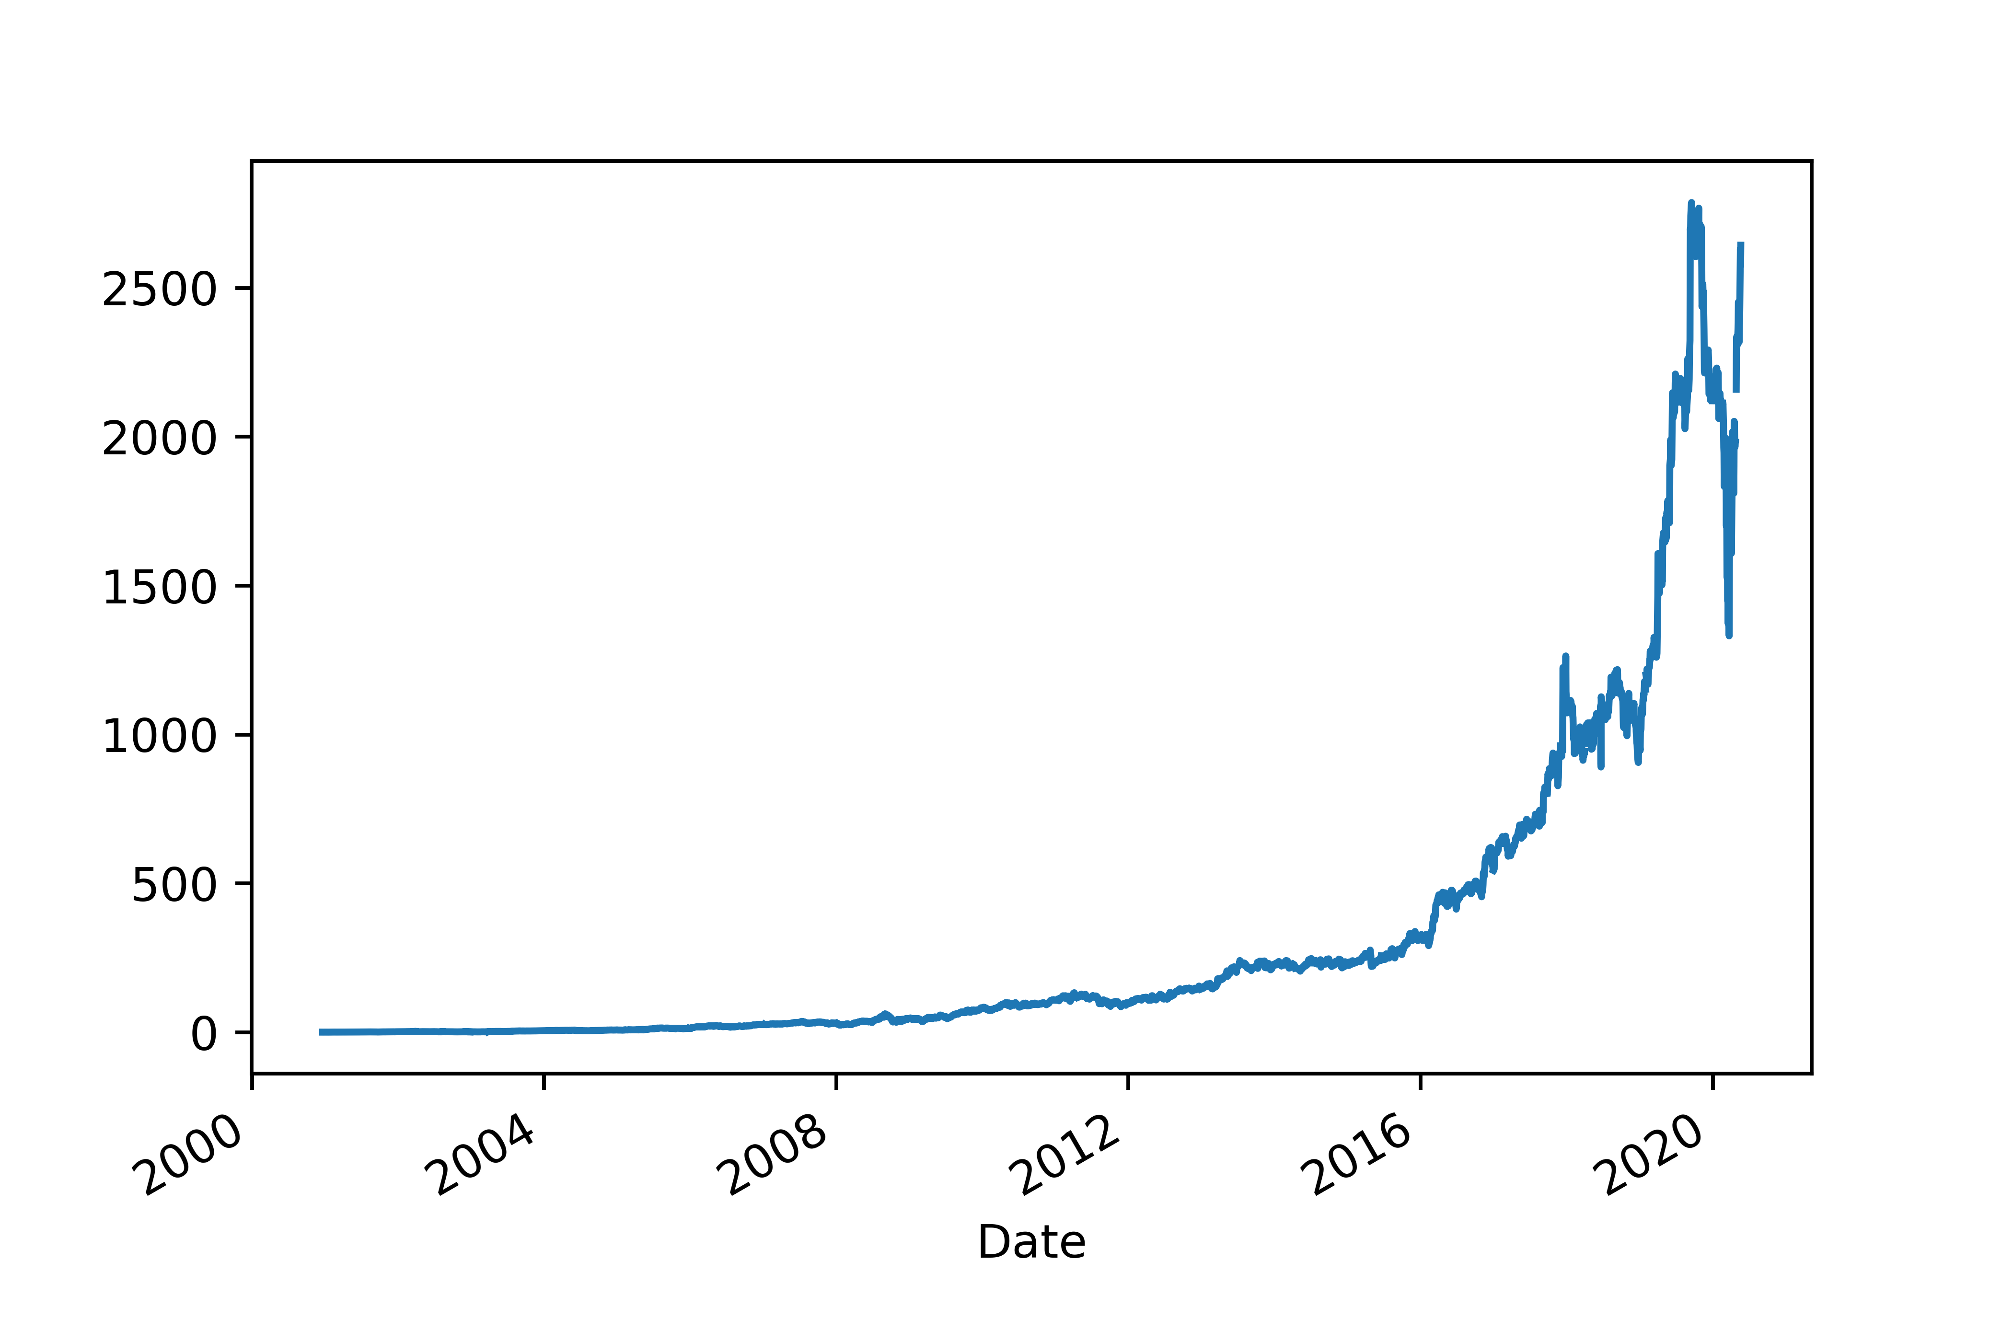
2. Is It Profitable?
Cumulative product of returns (original strategy)
Backtesting results:
Average yearly returns: 46.25%
Average yearly standard deviation: 44.97%
Sharpe Ratio: 1.02
Cumulative product of returns

Slide 9
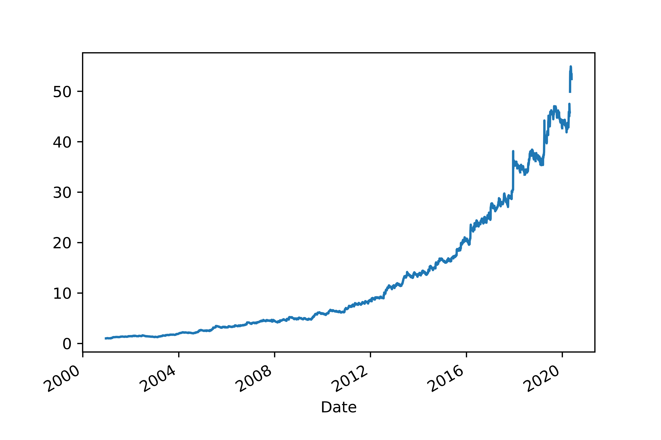
2. Is It Profitable?
Cumulative product of returns (with stop loss)
Including a -2% stoploss, on each stock
Backtesting results:
Average yearly returns: 20.89%
Average yearly standard deviation: 14.30%
Sharpe Ratio: 1.43
Cumulative product of returns

Slide 10
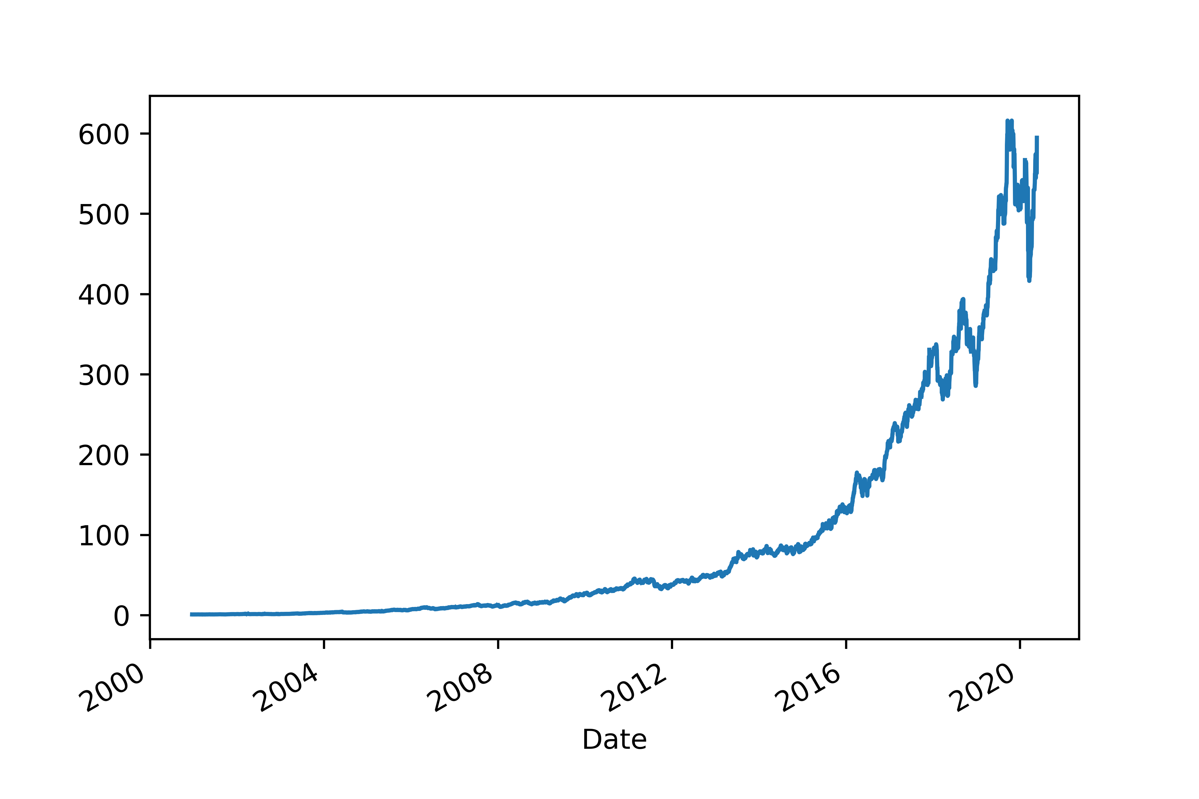
2. Is It Profitable?
Cumulative product of returns (with limit sell)
Including an 8% limit sell order
Backtesting results:
Average yearly returns: 35.35%
Average yearly standard deviation: 24.82%
Sharpe Ratio: 1.40
Cumulative product of returns

Slide 11

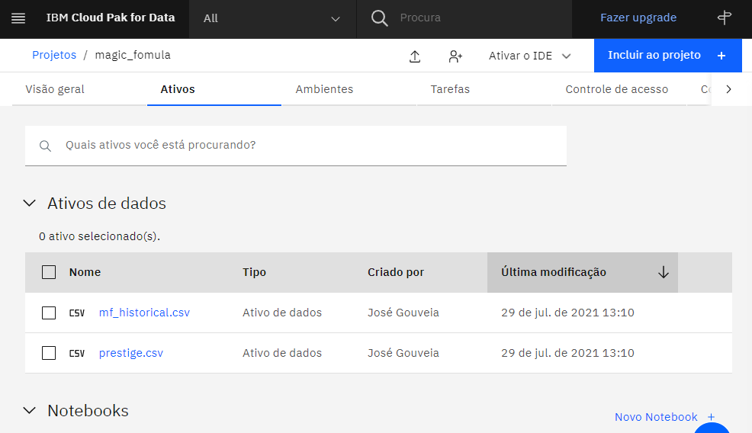
3. Implementing the Algorithm
Using the IBM Watson Studio to:
Run the code every day at 13h10 (GMT), automatically
Save the historical data

Slide 12
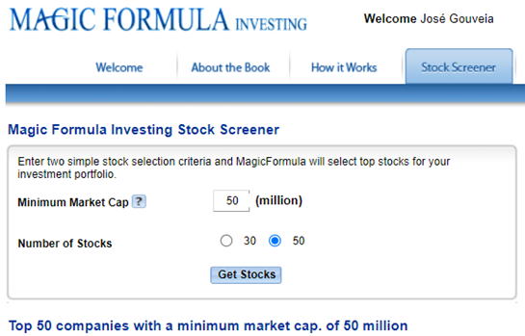
3. Implementing The Algorithm
The magic formula website already ranks the top 50 performing stocks on a daily basis
We webscrap that data and run the remaining steps in the code

Slide 13
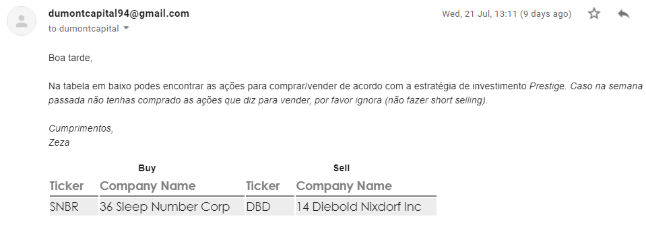
3. Implementing The Algorithm
Lastly, an automatic email is sent with the stocks to buy and sell each day
This approach was chosen so we can perform a final check of the firms before buying

