Slide 1
Sparse approximation
Compressed sensing; Greedy methods; Applications
Jean-Luc Bouchot, Ph.D.

Slide 2
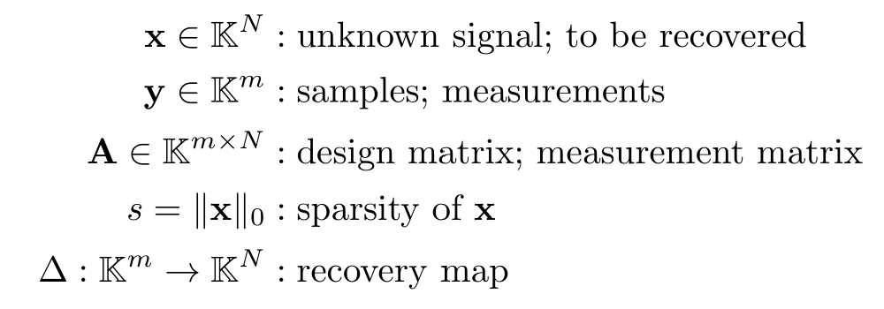


Some vocabulary and problem statement
Sparsity denotes the inherent complexity of a signal x.
The ambient dimension is large:
m << N
Compressed sensing problem:
How should the measurements and recovery be designed to ensure

Slide 3



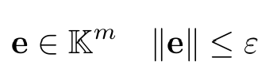

Stability and robustness
What if x is not actually sparse?
where
denotes the best s-term approximation
What if the measurements are noisy?
where the noise is such that
usually random; can be adversarial
The question becomes
Can we quantify the approximation results?

Slide 4
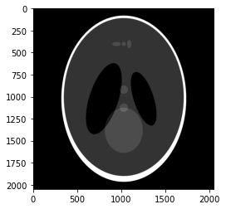

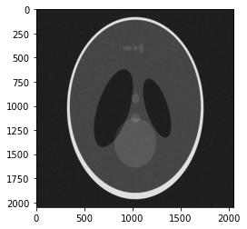
Applications: MRI Denoising
Recovery with TV minimization
Noisy
Original

Slide 5
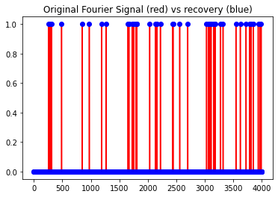
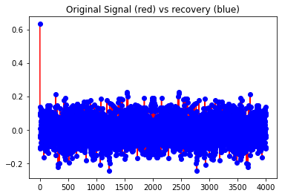
Applications: Fourier approximation

Slide 6
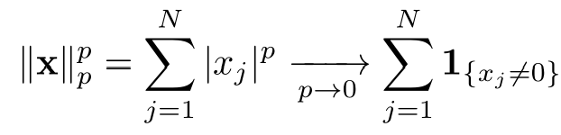


Naive approach
Cast the problem as an optimisation program
Note that
These two statements are equivalent
x is the unique s sparse solution of
x is the unique solution of
==> Combinatorial problem!

Slide 7
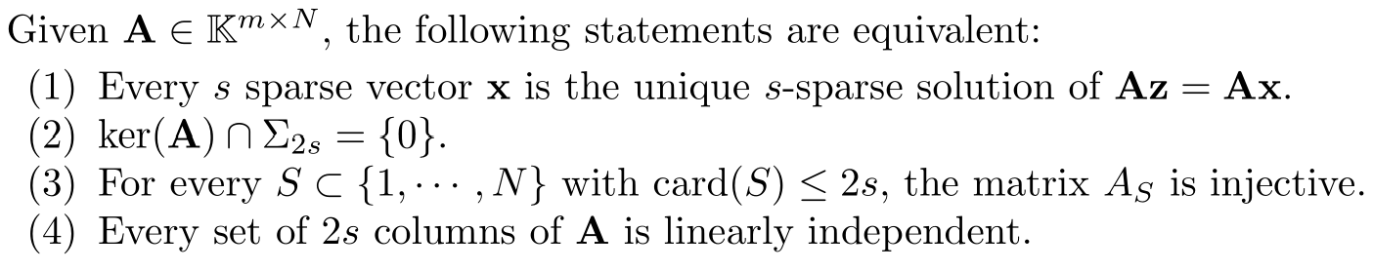
Minimum number of measurements
Assume Δ is an admissible recovery procedure, then m ≥ 2s.
This is a consequence of the following property.
N.B. Partial Vandermonde matrices allow such a recovery.

Slide 8
Example: Recovery from Fourier information
Fourier matrices extend the previous result. We have the following theorem:
For any N ≥ 2s, there exists a practical procedure to recover any 2s sparse vector from its first m = 2s Fourier measurements.
N.B. This is unstable numerically and lacks stability and robustness.

Slide 9
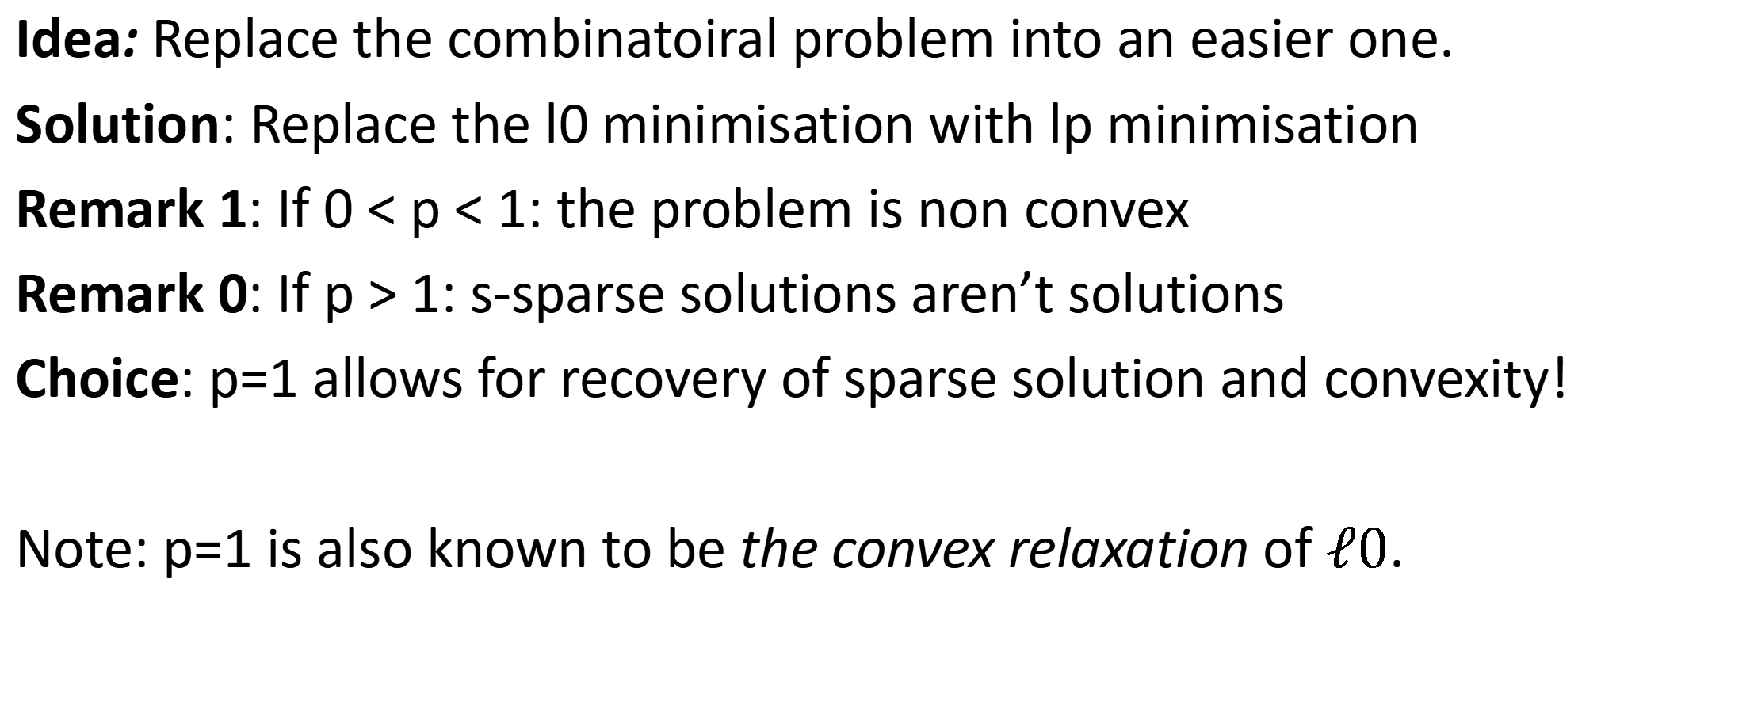
Basis pursuit
Idea: Replace the combinatoiral problem into an easier one.
Solution: Replace the l0 minimisation with lp minimisation
Remark 1: If 0 < p < 1: the problem is non convex
Remark 0: If p > 1: s-sparse solutions aren’t solutions
Choice: p=1 allows for recovery of sparse solution and convexity!
Note: p=1 is also known to be the convex relaxation of $ℓ0$.

Slide 10
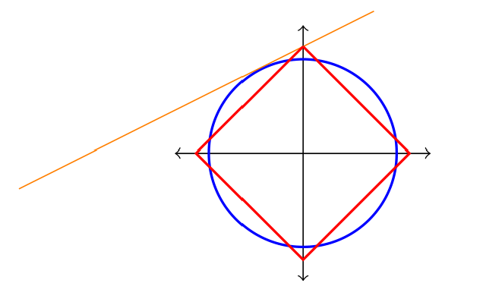

Basis Pursuit: Geometric intuition
The optimisation problem reads

Slide 11
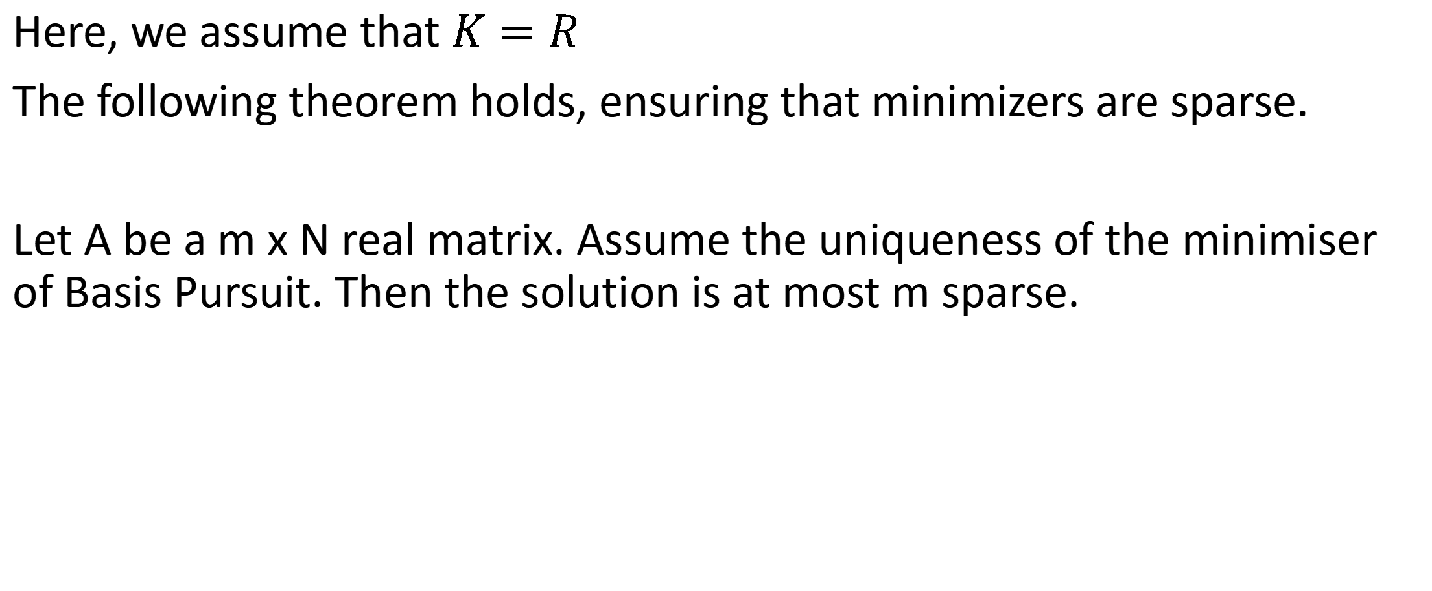
Basis Pursuit: the real setting
Here, we assume that $K=R$
The following theorem holds, ensuring that minimizers are sparse.
Let A be a m x N real matrix. Assume the uniqueness of the minimiser of Basis Pursuit. Then the solution is at most m sparse.

Slide 12
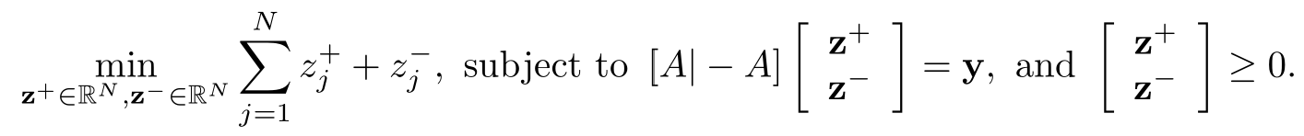
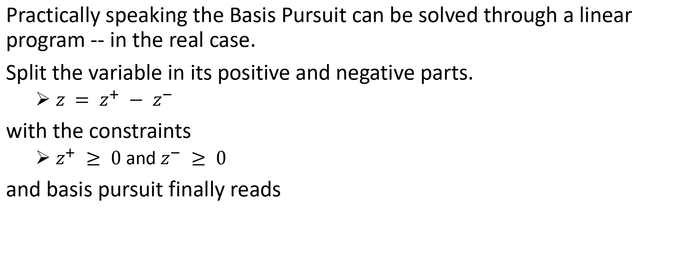
Basis Pursuit as a linear program
Practically speaking the Basis Pursuit can be solved through a linear program -- in the real case.
Split the variable in its positive and negative parts.
$z = z^{+} − z^{−}$
with the constraints
$z^{+} ≥ 0$ and $z^{−} ≥ 0$
and basis pursuit finally reads

Slide 13
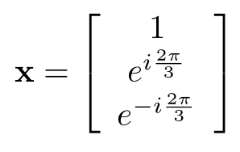
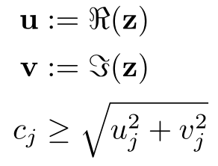
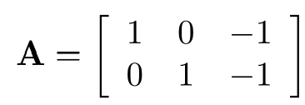
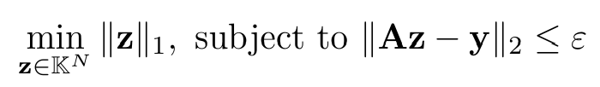
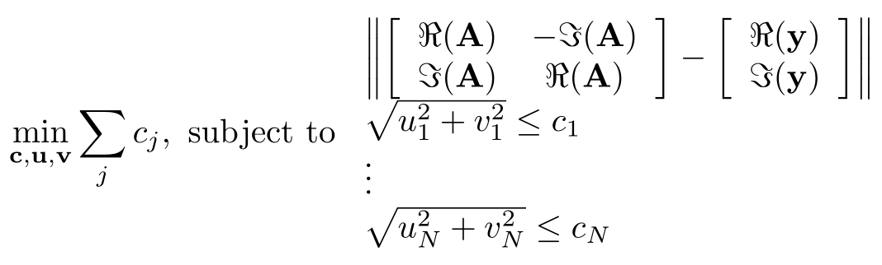
Basis Pursuit on Complex spaces
Counter example of sparsity of solution:
Current point of view does not allow robustness to noise!
Known as Basis Pursuit Denoising
Implementation through a second order cone program:
with
The problem reads

Slide 14
More optimisation problems
All the following optimisation problems are equivalent
Basis pursuit denoising
LASSO
Regularised

Slide 15

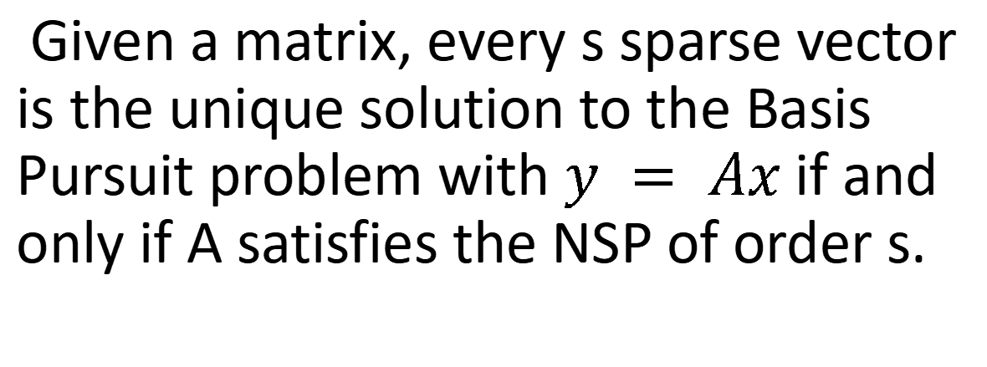
The Null Space Property
If
we say that the matrix A satisfies the null space property with respect to S .
If it holds for all set S of size s (or smaller), we say that A satisfies the NSP of order s.
Given a matrix, every s sparse vector is the unique solution to the Basis Pursuit problem with $y = Ax$ if and only if A satisfies the NSP of order s.

Slide 16
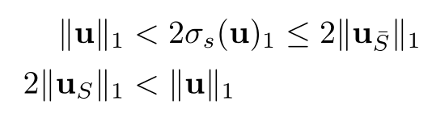
NSP equivalent formulation
Two formulations are of interest sometimes

Slide 17

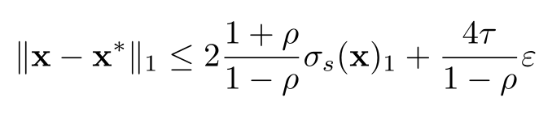
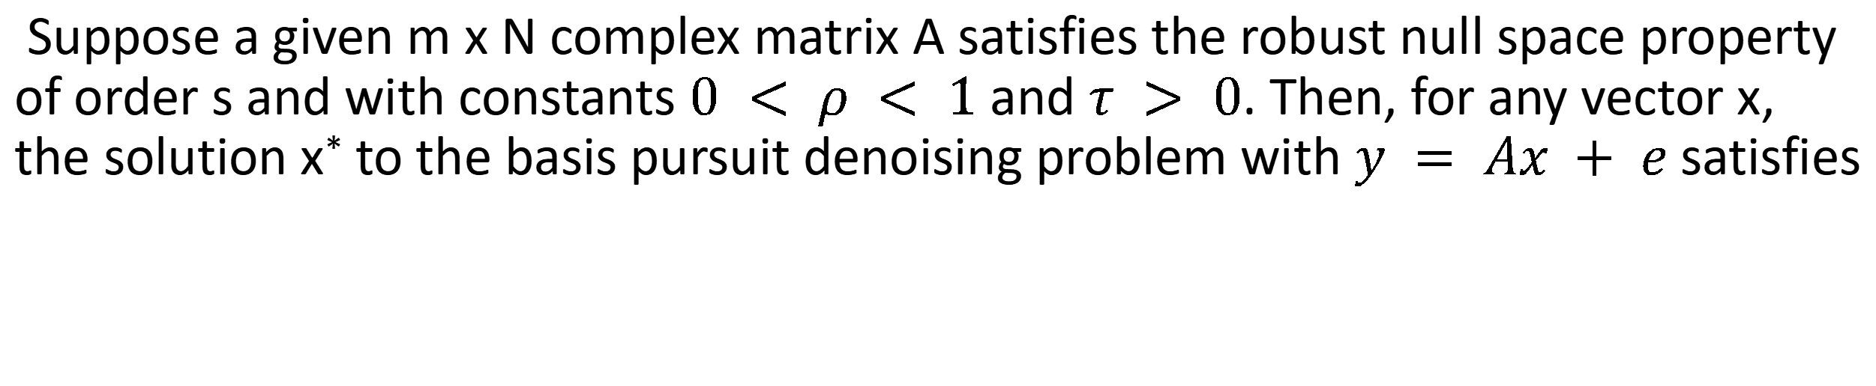
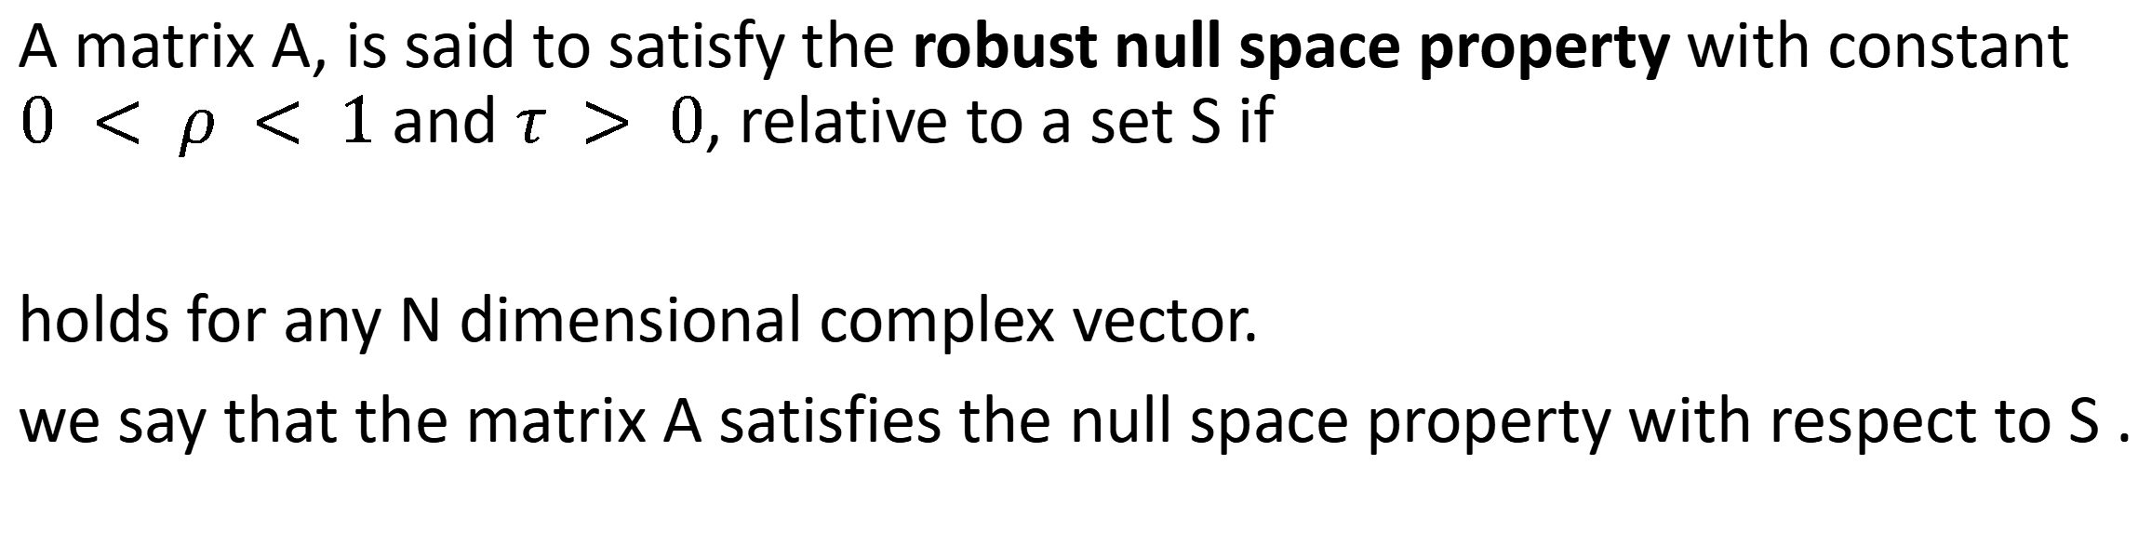
Robust and stable Null Space Property
A matrix A, is said to satisfy the robust null space property with constant $0 < ρ < 1$ and $τ > 0$, relative to a set S if
holds for any N dimensional complex vector.
we say that the matrix A satisfies the null space property with respect to S .
Suppose a given m x N complex matrix A satisfies the robust null space property of order s and with constants $0 < ρ < 1$ and $τ > 0$. Then, for any vector x, the solution x* to the basis pursuit denoising problem with $y = Ax + e$ satisfies

Slide 18

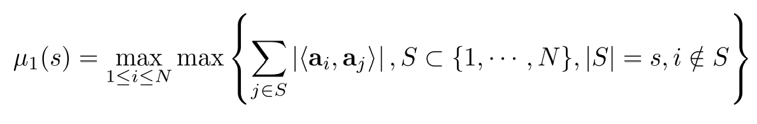
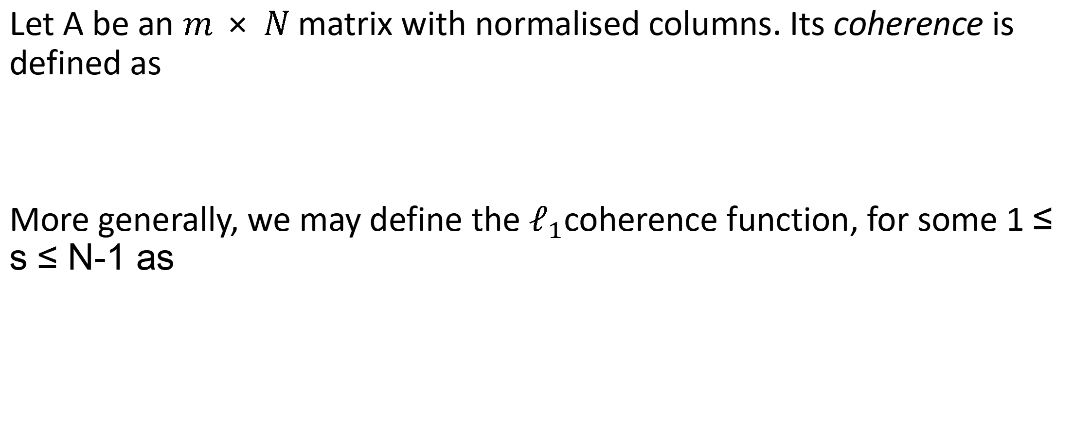
Coherence
Let A be an $m × N$ matrix with normalised columns. Its coherence is defined as
More generally, we may define the $ℓ_{1}$coherence function, for some 1 ≤ s ≤ N-1 as

Slide 19

Coherence and spectrum
Let A be an $$m × N$$ matrix with $ℓ_{2}$normalised columns and let $1 ≤ s ≤ N$. For all s-sparse vectors x
Equivalently for any set S with cardinality s the eigenvalues of the matrix $A_{S}^{∗}A_{S}$ lie in the interval $[1−μ_{1}(s−1), 1+μ_{1}(s−1)]$ . In particular, if $1−μ_{1}(s−1)< 1$ then $A_{S}^{∗}A_{S}$ is invertible.

Slide 20

Small coherence is good
Let A be an $m × N$ matrix with $ℓ_{2}$normalised columns and let $1 ≤ s$. If $μ_{1}(s) +μ_{1}(s−1) <1$,
then for set S such that $|S| ≤2s$ , the matrix $A_{S}^{∗}A_{S}$ is invertible and the matrix $A_{S}$ is injective. In particular, this is true if
$$μ < \frac{1}{2s−1}$$

Slide 21

Small coherence matrices do exist
Let A be an $$m × N$$ matrix with $$ℓ_{2}$$normalised columns. Its coherence satisfies Welch bound
$$μ ≥ \sqrt{\frac{N−m}{m(N−1)}}$$
Moreover, equality holds if and only if the columns of A form an equiangular tight frame.

Slide 22

Small coherence for basis pursuit
Let A be an $m × N$ matrix with $ℓ_{2}$ normalised columns. If
$$μ < \frac{1}{2s−1}$$
then every s-sparse vector is exactly recovered from the measurements $y = Ax$ via basis pursuit.

Slide 23


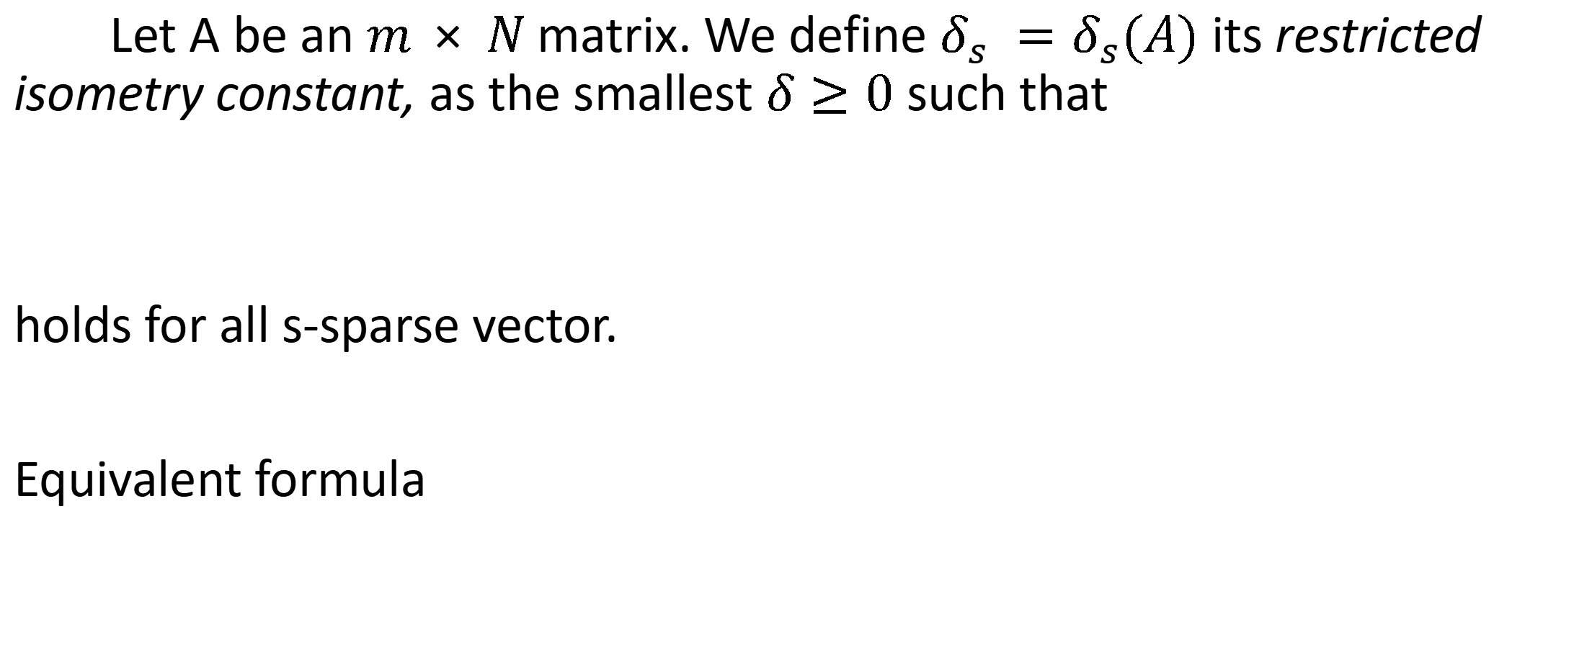
Restricted isometry property
Let A be an $$m × N$$ matrix. We define $δ_{s} =δ_{s}(A)$ its restricted isometry constant, as the smallest $δ≥0$ such that
holds for all s-sparse vector.
Equivalent formula

Slide 24


Sparse recovery under RIP
Let A be an $$m × N$$ matrix. Assume its 2s Restricted Isometry Constant $δ_{2s}$ satisfies
$$δ_{2s} <\frac{1}{3}$$
Then every s sparse vector x is the unique solution to the Basis Pursuit problem

Slide 25

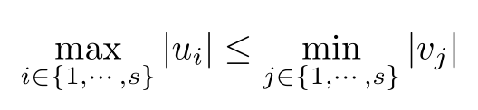
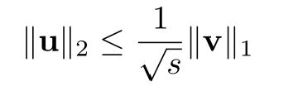

Some auxiliary results
Let u and v be two vectors such that $supp(u) ⋂ supp(v) = ∅$ and with $supp(u) = s$ and $supp(v) = t$. Then
If u and v are two s dimensional vectors, such that
then

Slide 26
Towards small RIP matrices
Estimating RICs is usually done using 3 ingredients
Concentration inequalities
Singular value estimation for a fixed S
Union bound and counting

Slide 27

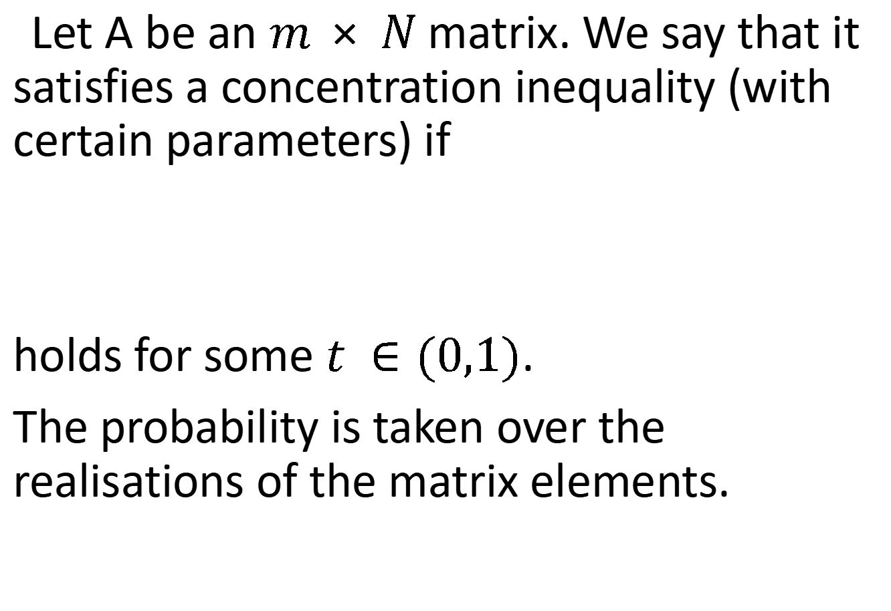
Concentration inequalities
Let A be an $$m × N$$ matrix. We say that it satisfies a concentration inequality (with certain parameters) if
holds for some $t ∈(0,1)$.
The probability is taken over the realisations of the matrix elements.
Examples:
Gaussian matrices
Bernoulli matrices
Subgaussian
...

Slide 28

Covering the space with balls
Suppose that an $m × N$ matrix A satisfies the concentration inequality. Then
provided
$$m ≥ \frac{c}{δ^{2}}s$$
The proof is based on a covering argument.

Slide 29


(random) Matrices with small RIC
Suppose that A is an $$m × N$$ matrix satisfying the concentration inequality.
provided
$$m ≥\frac{d}{δ^{2}}sln(eN/s)$$

Slide 30
More matrices with low RIC
Subsampled bounded orthonormal systems
t-designs (coming from physics)

Slide 31
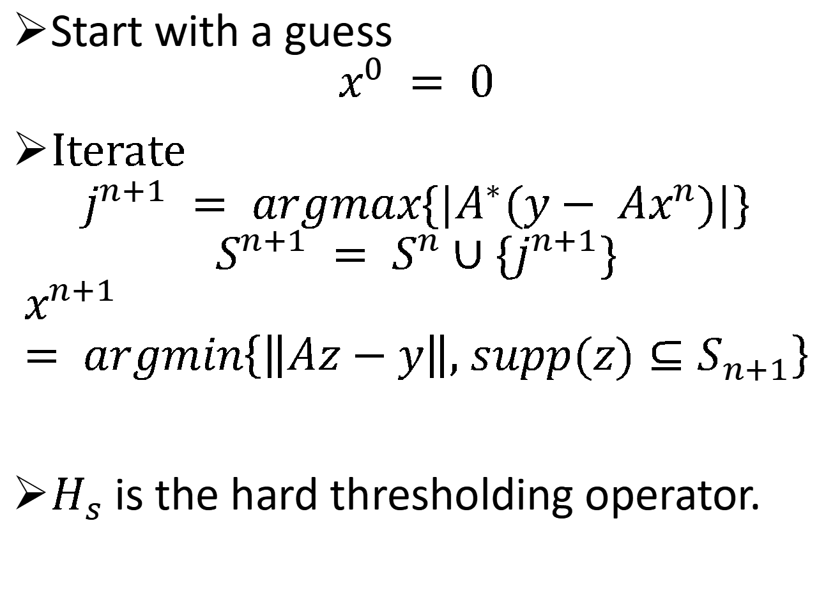
Orthogonal matching pursuit
Start with a guess
$$x^{0} = 0$$
Iterate
$$j^{n+1} = argmax\{|A^{∗}(y− Ax^{n})|\}$$
$$S^{n+1} = S^{n}∪\{j^{n+1}\}$$
$$x^{n+1} = argmin\left\{\left\|Az−y\right\|, supp(z)⊆S_{n+1}\right\}$$
$H_{s}$ is the hard thresholding operator.
Some characteristics
very fast and efficient
Use of rank 1 updates for faster computations
better not make a mistake

Slide 32
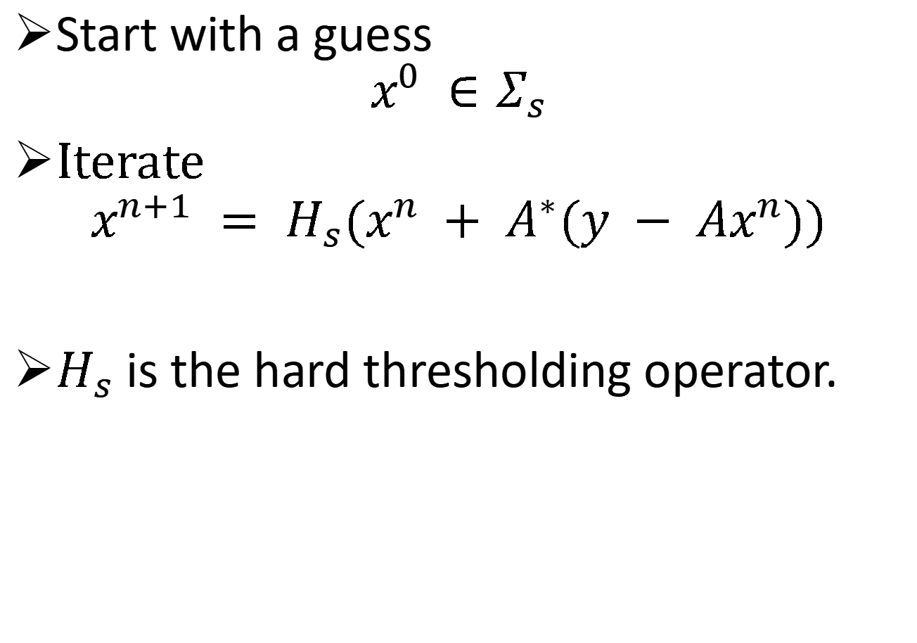
Iterative Hard Thresholding
Start with a guess
$$x^{0} ∈Σ_{s}$$
Iterate
$$x^{n+1} = H_{s}(x^{n} + A^{∗}(y − Ax^{n}))$$
$H_{s}$ is the hard thresholding operator.
Can be interpreted as
a fixed point problem
a gradient descent
a learning speed can be added

Slide 33
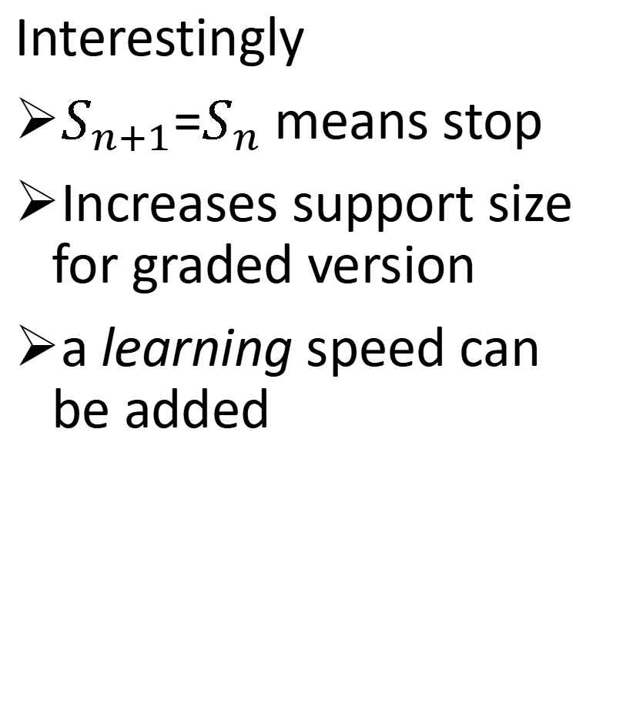
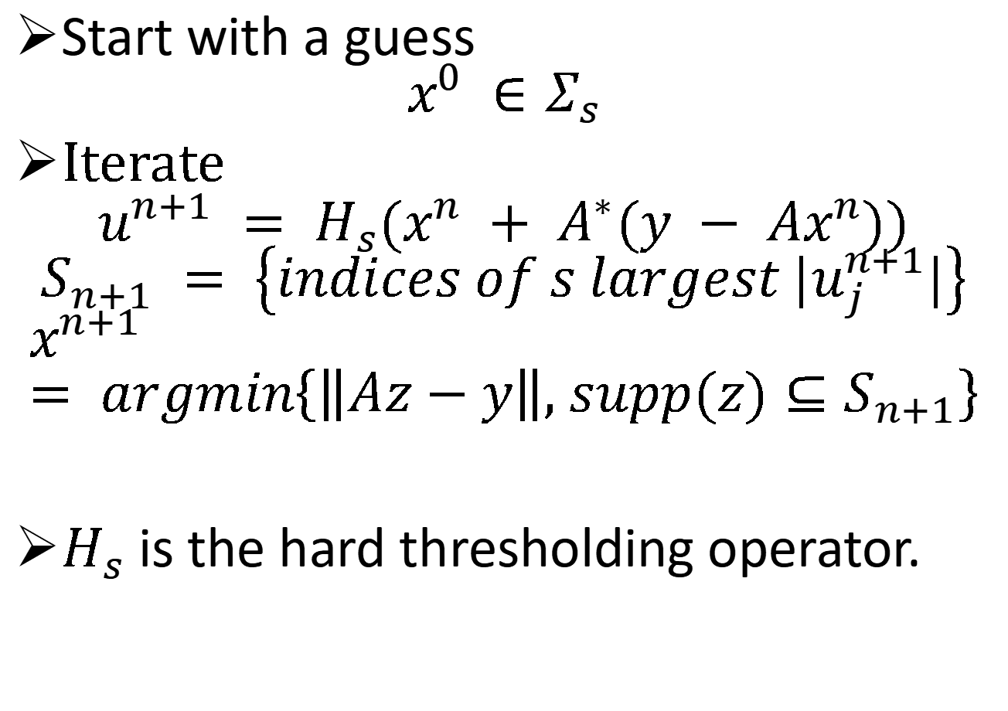
(graded) Hard Thresholding Pursuit
Start with a guess
$$x^{0} ∈Σ_{s}$$
Iterate
$$u^{n+1} = H_{s}(x^{n} + A^{∗}(y − Ax^{n}))$$
$$S_{n+1} = \left\{indices of s largest |u_{j}^{n+1}|\right\}$$
$$x^{n+1} = argmin\left\{\left\|Az−y\right\|, supp(z)⊆S_{n+1}\right\}$$
$H_{s}$ is the hard thresholding operator.
Interestingly
$S_{n+1}$=$S_{n}$ means stop
Increases support size for graded version
a learning speed can be added

