Slide 1


Slide 2
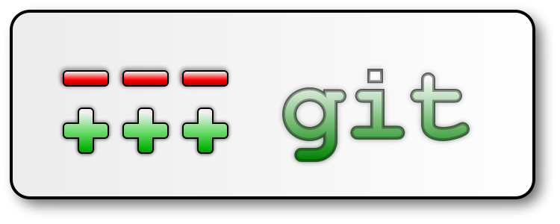

Slide 3
Who's speaking?
Jean-luc Chasseriau
  Software Engineer @ Crossing-Tech
  Scala Enthusiast
  Geek
Contact
jl@lo.cx - Twitter: @jeanluc_c - Github: jlc

Slide 4
Where are we going tonight?
1 → Introduction : what are we talking about?
2 → Theory : Git bases
3 → Git first actions!
4 → Humm... Theory!

Slide 5
Where are we going tonight?
1 → Introduction : what are we talking about?
2 → Theory : Git bases
3 → Git first actions!
4 → Humm... Theory!
5 → Practice for geeks

Slide 6
Git revolution?
Git miracle?
Why? Why everybody is talking about Git?
Really?

Slide 7

Git revolution?
Distributed
Branches

Slide 8
1 → Introduction : what are we talking about?

Slide 9
1 → Introduction
1.1 → About Version Control
& SCM (Source Code Management)
1.2 → Git history
1.3 → Git name
1.4 → Git anecdotes

Slide 10

1.1 → About Version Control
Local Version Control Systems

Slide 11

1.1 → About Version Control
Centralized Version Control Systems

Slide 12

1.1 → About Version Control
Distributed Version Control Systems

Slide 13
1.2 → Git history
“Linus is not a SCM person”
10 years of Linux development based on...
...tarballs and patches

Slide 14
1.2 → Git history
Linux kernel's sources were managed by BitKeeper
  Commercial product
  Even though it was the best tool to do the job
  2 restrictions:
    No reverse engineering
    Not trying to create a competing product

Slide 15
1.3 → Git name
Git : British English Slang for a
stupid or unpleasant person.
Linus is known for his strong opinion…
and therefore said:
"I'm an egotistical bastard,
and I name all my projects after my self.
First 'Linux', now 'git'.”

Slide 16
1.4 → Git anecdotes
  Git began on 3 April 2005
  Self-hosted as of 7 April [5 days later]
  (It tooks SVN 1 year to be self-hosted!)
  First entry of the Linux kernel: 17 of April 2005!
  (2.6.12-rc2)
  First merge of multiple branch on 18 of April

Slide 17
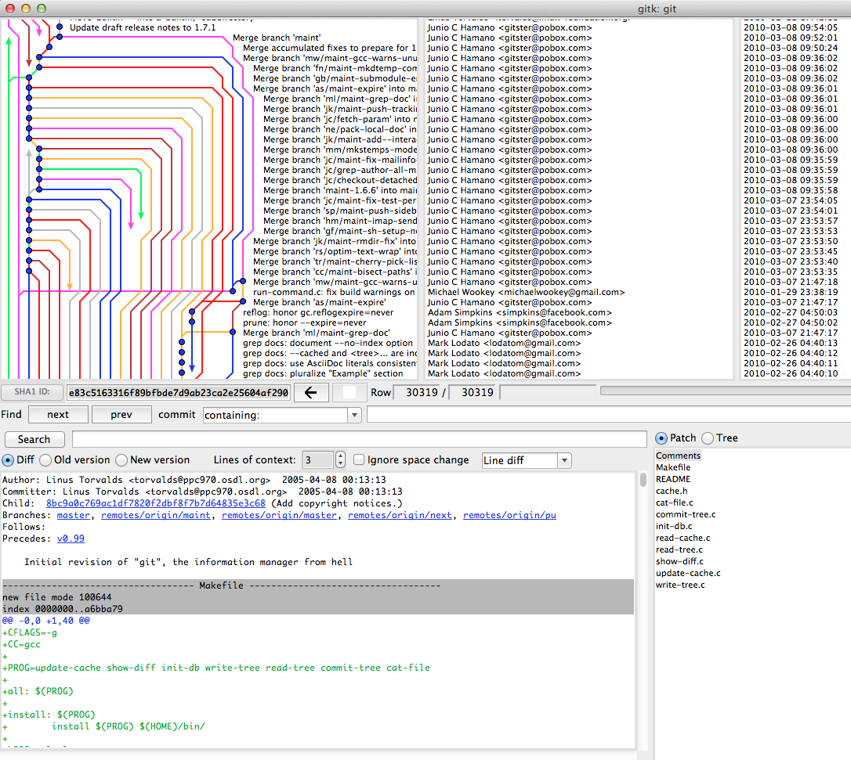
1.4 → Git anecdotes

Slide 18
2 → Theory : Git bases

Slide 19
2 → Theory: Git bases
2.1 → Clear your mind
2.2 → Snapshots, not differences
2.3 → Everything is local (almost)
2.4 → Integrity
2.5 → Adding data
2.6 → The three states of Git consciousness
2.7 → Dear branches
2.8 → Configuration
2.9 → Help!

Slide 20
2.1 → Clear your mind…
…from other VCSs! Specially Subversion and Perforce!
Git…
…stores and thinks about information much differently,
…even if it has a similar user interface!
a) Avoid subtle confusions
b) Think distributed!

Slide 21
2.2 → Snapshots, not differences
Unlike most others VCSs,
Git is based on snapshots.
Commits are not thought neither stored as patches,
but as snapshots of what the project looks like.

Slide 22

2.2 → Snapshots, not differences
As view by CVS, Subversion, Perforce, Bazaar,…etc.

Slide 23

2.2 → Snapshots, not differences
Git thinks as a set of snapshots of a mini-filesystem

Slide 24
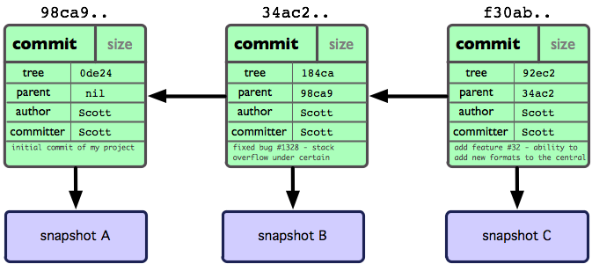
2.2 → Snapshots, not differences
Git reconsider almost every aspect of version control
“Soon” will come a quick overview of Git internals

Slide 25
2.3 → Everything is local (almost)
“Git will make you think that the gods of speed have
blessed Git with unworldly powers.”
[master]$ time git log > /dev/null
real 0m0.352s
user 0m0.300s
sys 0m0.034s
$ time svn log > /dev/null
real 0m3.709s
user 0m0.482s
sys 0m0.168s
time 'git add icons; git commit -m "added icons"'
real 0m0.273s
user 0m0.032s
sys 0m0.008s
time 'svn add icons; svn commit -m "added icons"'
real 0m45.276s
user 0m15.997s
sys 0m5.503s
time git push
real 0m6.219s
user 0m0.023s
sys 0m0.011s

Slide 26
2.3 → Everything is local (almost)
The entire repository is in local, work offline
  Browse history,
  Compare,
  Add, remove,
  Commits! By committing we create the history!

Slide 27
2.3 → Everything is local (almost)
Everything is here, but keep it small!
$ du -d 1 -h
44M ./django-git
53M ./django-svn

Slide 28
2.4 → Integrity
As defined by Linus Torvalds,
the fundamental requirements are:
  Distributed nature,
  Performance,
  Security and trust

Slide 29
2.4 → Integrity
  Built at Git lowest level,
everything is checksumed before storage
  SHA-1 hash: 40 hexadecimal characters string
  Key-value database addressed by SHA-1
  Impossible to:
    Change the content of files/directories,
    Lose information in transit,
    Corrupt

Slide 30
2.4 → Integrity
03f86a5adb930eac55dea1e903fb958c002d5bc4

Slide 31
2.5 → Adding data
Nearly all actions only add data to Git database
  Very difficult to lose any changes
(as soon as it is commited)
  Very hard to screw up the repository
  Develop without worries

Slide 32
2.6 → The three states of
Git consciousness
Files states:
  Modified : work in progress
  Staged : marked in their current version
To go into next commit – Also known as the Index
  Commited : commited in Git database

Slide 33

2.6 → The three states of
Git consciousness

Slide 34
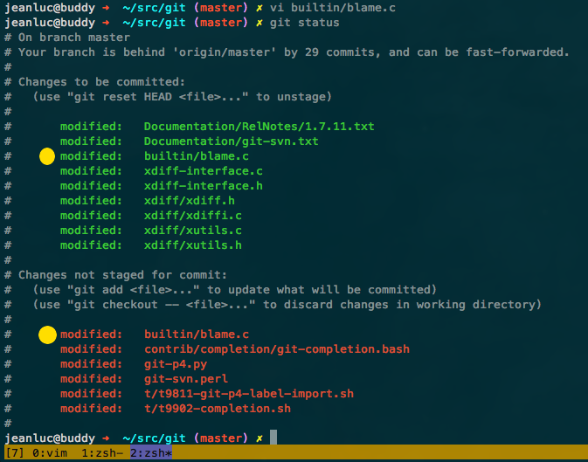
2.6 → The three states of
Git consciousness

Slide 35
2.7 → Dear branches
  Git branches model often fundamentally changes
  the way we work!
  Switch between branches within the same Directory...
  ...Nearly instantly!
  Local branches

Slide 36
2.7 → Dear branches
  Instead of few branches for major development lines
  Git developers routinely
    create, merge, and destroy
    multiple branches a week or even a day!
  Features and bugs have their own branches
    merged only when completed
  Enable and encourage a non-linear development cycle
  True power, true work, true history...
                ...comes with local commits

Slide 37
2.7 → Dear branches
By default,
in a distributed system,
you are already in a branch

Slide 38
2.8 → Configuration
$ git config
Configuration of Git parameters such as your
  Identity
Name, email address
  Editor
  (e.g. used to write commit messages)
  Diff tool
  (e.g. used to resolve conflicts)

Slide 39
2.8 → Configuration
Local to the repository project/.git/config
$ git config user.name "John Smith"
User wide $HOME/.gitconfig
$ git config --global user.name "John Smith"
System wide /etc/gitconfig
git config --system user.name "John Smith"

Slide 40
2.9 → Help!
Deeply explained
$ git help <command>
$ git <command> --help
Reminder
$ git <command> -h

Slide 41
3 → Git first actions!

Slide 42
3 → Git first actions!
Your mission : Hello World (again!)

Slide 43
3 → Git first actions!
Create a directory:
$ mkdir git-actions
Jump into it:
$ cd git-actions
Initialize it as a git repository:
$ git init
Check the status:
$ git status
Check branches
$ git branch

Slide 44
3 → Git first actions!
Tell Git who we are
$ git config user.name “Dr. Git”
$ git config user.email dr@git.com
What has changed?
$ cat .git/config
User wide?
$ git config –-global user.name “Dr. Git”
$ git config –-global user.email dr@git.com
What has changed?
$ cat $HOME/.gitconfig

Slide 45
3 → Git first actions!
Create pom.xml:
$ curl -O \
https://raw.github.com/jlc/segl-git-action/master/pom.xml
Status:
$ git status
Add:
$ git add pom.xml
Status:
$ git status
Commit:
$ git commit

Slide 46
3 → Git first actions!
Log ?
$ git log
Create source directories:
$ mkdir -p src/main/scala
Edit src/main/scala/HelloWorld.scala
$ vim src/main/scala/HelloWorld.scala
object HelloWorld {
def main(args: Array[String]) {
println("Hello World... again and again...")
}
}

Slide 47
3 → Git first actions!
Add sources:
$ git add src
How to commit?
$ git commit -h
Commit
$ git commit
Log?
$ git log
Branches?
$ git branch
Build and run:
$ mvn clean scala:compile scala:run \
-DmainClass=HelloWorld

Slide 48
3 → Git first actions!
Checkout a branch:
$ git checkout -b exercise_1
Branch? Which branches?
$ git branch
Branch name too long!
$ git branch -h
$ git branch -m ex1
Create src/main/scala/Easy.scala and add it
$ touch src/main/scala/Easy.scala
$ git add src/main/scala/Easy.scala
$ git commit -m “Begin of easiness”

Slide 49
3 → Git first actions!
S-99 to the rescue!
P01 (*) Find the last element of a list.
Example:
scala> last(List(1, 1, 2, 3, 5, 8))
res0: Int = 8
2 possible solutions:
  Builtins
  Recursive standard functional approach
(and call it from main())

Slide 50
3 → Git first actions!
Status ?
$ git status
We have: 2 “modified”, 0 or more “untracked”
Add interactively:
$ git add -i
Choose “u”, “enter”
Enter the number for Easy.scala + “enter”
“enter”, “q”
Status ?
$ git status
Commit:
$ git commit -m “Implement exercise 1”

Slide 51
3 → Git first actions!
Status ?
$ git status
We have: 1 “modified”, 0 or more “untracked”
Add interactively:
$ git add -i
Choose “u” + “enter”
Enter the number for HelloWorld.scala + “enter”
“enter”, “q”
Status ?
$ git status
Commit:
$ git commit -m “Call exercise from main”

Slide 52
3 → Git first actions!
Annoying “untracked” files?
.gitignore at the rescue!
Edit file .gitignore and add:
*.swp
Add and commit
$ git add .gitignore
$ git commit -m “Rise git awareness”
Check
$ git status

Slide 53
3 → Git first actions!
Branch ?
$ git branch
Exercie 2 on its way!
$ git checkout -b ex2 master
Branch ?
$ git branch
Status ?
$ git status
(Annoying files may be back...)
By the way, we forgot to add “target” in .gitignore:
Edit .gitignore, add “*.swp \n target”
$ git add .gitignore
$ git commit -m “Rise git awareness again”

Slide 54
3 → Git first actions!
S-99! Help!
Edit src/main/scala/Easy.scala (which does not exist)
P03 (*) Find the Kth element of a list.
By convention, the first element in the list is element 0.
Example:
scala> nth(2, List(1, 1, 2, 3, 5, 8))
res0: Int = 2
2 possible solutions:
  Builtins
  Recursive standard functional approach
(...call it from main())

Slide 55
3 → Git first actions!
Add the files and commit:
$ git add -i
“u”, “1”, “enter”
“a”, “1”, “enter”
“q”
Status?
$ git status
Commit
$ git commit -m “Exercise 2 done”
Log?
$ git log
$ git log --all

Slide 56
3 → Git first actions!
What about the Directed Acyclic Graph???
$ tig --all
Or
$ gitk –-all
Or
SourceTree
Or
...etc.!

Slide 57
3 → Git first actions!
We saw it coming...
$ git checkout master
$ git merge -h
$ git merge ex1
$ gitk –-all &
Humm... Fast-forward may be annoying...
$ git reset –-hard 70a16 (Hello world is back again)
$ git merge –-no-ff ex1

Slide 58
3 → Git first actions!
Reset, reset what?
$ git reset 2d71 (Call exercise from main)
$ git reset 893d (Begin of easiness)
$ git status
It's like the changes have been freshly edited!
$ git reset –-hard 893d (Begin of easiness)
$ git reset ex2
$ git reset –-hard 1ec6 (previous master)

Slide 59
3 → Git first actions!
Go back to branch 'ex2'
$ git checkout ex2
Say goodbye: edit ./bye.scala
object GoodBye {
def sayIt { println("Bye!") }
}
Add and commit it
$ git add bye.scala
$ git commit -m “Implement extremely hard feature: bye!”

Slide 60
3 → Git first actions!
Oups! Need to rename and move in the source directory...
No worries, you are with Git!
$ git mv bye.scala src/main/scala/GoodBye.scala
$ git commit –-amend
$ git status

Slide 61
3 → Git first actions!
THE ULTIMATE GIT FEATURE: REBASE !
$ git checkout ex2
$ git tag exercise_number_2
Rebase current branch (ex2) on top of master
$ git rebase -i master
-i : interactive, power + knowledge!
…conflicts? Good!

Slide 62
3 → Git first actions!
2 solutions:
By hand:
$ git status
Edit .gitignore
$ git add .gitignore
Or:
$ git mergetool
Finally:
$ git rebase --continue

Slide 63
3 → Git first actions!
Another conflict... Good!
Which conflict?
$ git diff
Resolve and continue rebase
$ git mergetool
$ git rebase –continue
Another conflict...
$ git mergetool
$ git rebase –continue
Done.
$ git rebase --continue

Slide 64
3 → Git first actions!
Move HEAD of master branch
$ git checkout master
$ git reset –-hard ex2

Slide 65
3 → Git first actions!
Push!
Create a local remote
$ cd ../
$ git init –-bare git-actions.git
Curious?
$ ls git-actions.git
Go back to our project
$ cd git-actions
List current remotes
$ git remote -v

Slide 66
3 → Git first actions!
Push!
$ git remote add faraway ../git-action.git
$ git remote -v
$ git push faraway master
$ cd ../git-action.git
$ gitk –-all &

Slide 67
3 → Git first actions!
Clone!
$ cd ..
$ git clone https://github.com/jlc/segl-git-action.git
Well, better to add it to our project
$ cd git-action
$ git remote add jlc https://github.com/jlc/segl-git-action.git
$ git fetch –-all
$ gitk –-all &

Slide 68
Git revolution ?

Slide 69
Git revolution?
Distributed
  New revolution!
With mercurial, only viable open source distributed SCM.
  Speed! No network access!
Full diff almost instantaneously, create and
switches between branches, log, everything!
  Commit access to everyone!
Pulled or not onto the main repository...
  Every repository may be the “main” one, the community decide
  Merges are done by the developers, not others!

Slide 70
Git revolution?
Distributed
  Rework commits
  well developed, tested, documented, valided
  The story matters more than the history

Slide 71
Git revolution?
Branches
  Branches are developers best friends!
  Fit developers' reality! Ideas pop up and need receptacles!
  Not only technical, it fit naturally the way we are wired!
  Local branches, only for you, or maybe few others,
  before the “Initial Public Offering”!

Slide 72
4 → Humm... Theory!

Slide 73
4 → Hums... Theory!
4.1 → “Just” a DAG
4.2 → Git internals
4.2 → Workflows

Slide 74
4.1 → “Just” a DAG

Slide 75
4.1 → “Just” a DAG
A Directed Acyclic Graph (DAG),
Is a directed graph with no directed cycles.
  A collection of vertices and directed edges
  Each edge connecting one vertex to another
  Such that there is no way...
...that eventually loops back.

Slide 76
4.2 → Git internals
Git object storage is "just" a DAG of objects,
with a handful of different types of objects.
compressed and identified by an SHA-1 hash

Slide 77
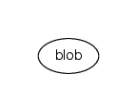
4.2 → Git internals
Just a bunch of bytes.

Slide 78
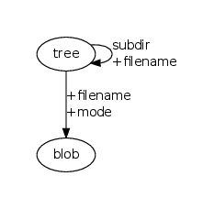
4.2 → Git internals
Tree
  Store filename,
  access mode...etc.
  Refer to blobs (content)
  Refer to other trees
  (subdirectories)

Slide 79
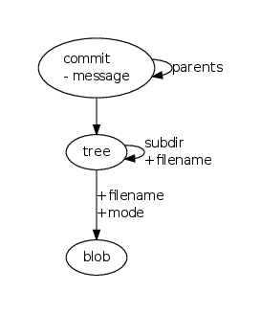
4.2 → Git internals
Commit
  Refers to trees
  (state of files)
  Refers to 0..n parent commits
  Body is the message

Slide 80
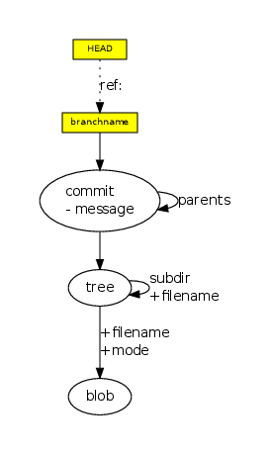
4.2 → Git internals
Refs, heads, branches
  Post-it or bookmarks
  Not stored in the history
  HEAD is special:
it points to another ref,
current active branch

Slide 81
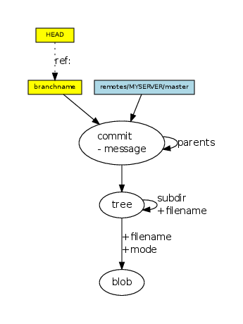
4.2 → Git internals
Remote refs
  Controlled by remote server
  Updated by git fetch

Slide 82
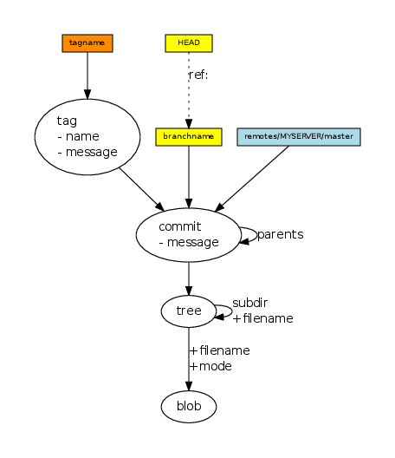
4.2 → Git internals
Tag
  node in the DAG
And
  post-it

Slide 83
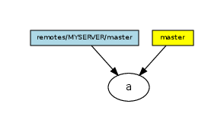
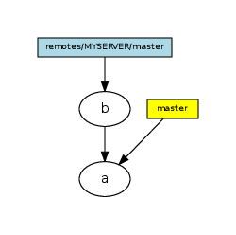
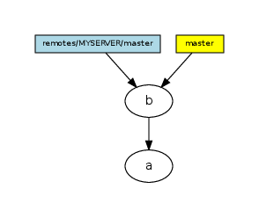
4.2 → Git internals

Slide 84
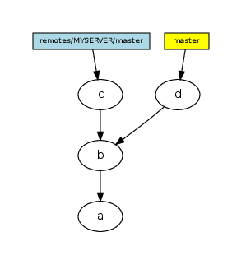
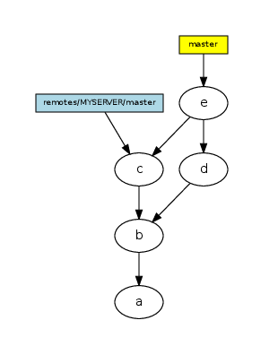
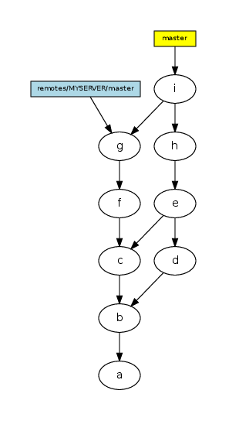
4.2 → Git internals

Slide 85
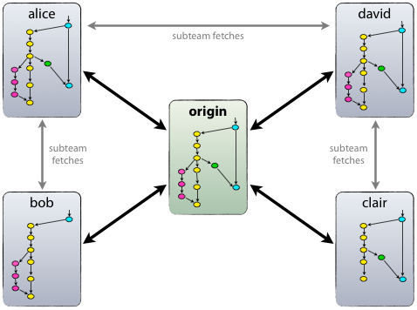
4.3 → Workflows
  Personal → as a developer
  Inter-personal → as a team of developers

Slide 86

4.3 → Workflows
Organizational
/
Company

Slide 87
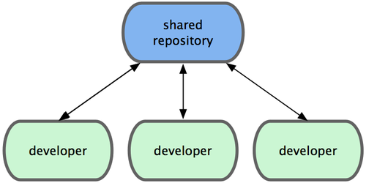
4.3 → Workflows
Centralized workflow

Slide 88
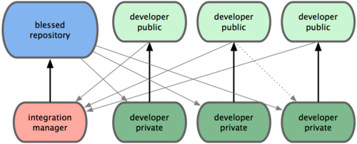
4.3 → Workflows
Integration-Manager Workflow

Slide 89
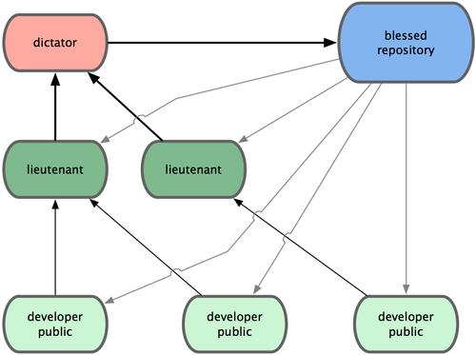
4.3 → Workflows
Dictator and Lieutenants Workflow

Slide 90
5 → Practice for geeks!

Slide 91


Credits
  Pro Git
http://git-scm.com/book
  Learn.github
http://learn.github.com/p/intro.html
  Git Home
http://git-scm.com/
  Git for Computer Scientists:
http://eagain.net/articles/git-for-computer-scientists/
                Linus Torvalds

Slide 92
Thanks.

