Slide 1
F
Markets
Portfolio
Screen
Compare
Optimize
Backtest
Workflows

Slide 2
F
Markets
Portfolio
Screen
Compare
Optimize
Backtest
Workflows
Ticker | Position | EUR
Plot 1
Plot 2
Plot 3

Slide 3
F
Markets
Portfolio
Screen
Compare
Optimize
Backtest
Workflows

Slide 4
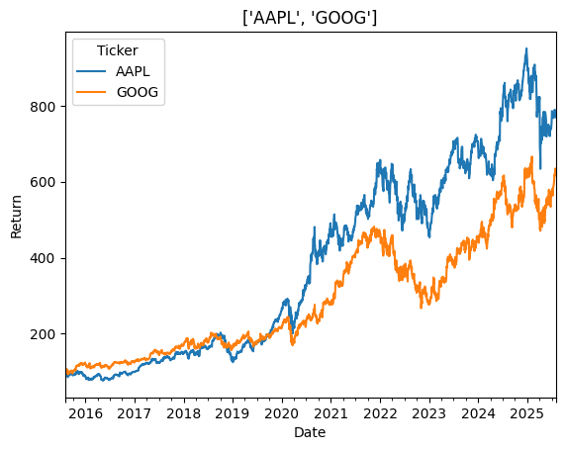
F
Screen
Compare
Portfolio
Optimize
Backtest
Workflows
Ticker:
MSFT
V
+
Metrics
Plot
AAPL
$212.54
Base:
01/07/2015
V
Apple, Inc
♥︎
-
GOOG
$175.82
Google, Inc
♥︎
-

Slide 5
F
Markets
Portfolio
Screen
Compare
Optimize
Backtest
Workflows

Slide 6
F
Markets
Portfolio
Screen
Compare
Optimize
Backtest
Workflows

Slide 7
F
Markets
Portfolio
Screen
Compare
Optimize
Backtest
Workflows

