Slide 1

NAML Project: Lasso and Sparse compressed sensing
Jiali Claudio Huang
May 26, 2026

Slide 2
Introduction
This project presents multiple acceleration algorithm of Lasso Regression including ISTA,FISTA,CD,ADMM and their applications.

Slide 3

Project Background
Main task: Reconstruct a high-dimensional sparse signal x from noisy, under-sampled measurements y where M≪N.
Objective Function (Lasso Formulation):
Constitutive Components:
Data Fitting Term: The Least-squares cost ensuring physical alignment with measurements.
L1​ Regularization: It is a sparse-inducing prior that drives non-essential coefficients to absolute zero.

Slide 4
Sensing Matrix A — Algorithmic Encoders
Definition:
A sensing matrix is a data sampling rule that projects information from a high-dimensional space (N) into a low-dimensional space (M).
Common Types :
Gaussian Random Matrices: Exhibits directional uniformity (isotropy) and can capture features from all dimensions.
Fourier Under-sampling Matrices: Imposes continuous k-space trajectories via custom frequency masks due to physical constraints in MRI scanning.

Slide 5
Core Operator: Soft-Thresholding
Formula: Sκ(v) = sign(v) max(|v|−κ,0)
Eliminate small signals and “pull” larger signals slightly closer to zero.
Smooth Continuity: Ensures the proximal mapping function is continuous at the boundaries (v=±κ), preventing algorithmic volatility.
Compensation for costs: Surviving coefficients must pay a constant "friction price" (κ) for the global sparse structure, providing the distinct ability of L1​ to output absolute zeros.

Slide 6
Parameter Tuning Strategies
Noise σ: The environmental disturbance level in physical signal acquisition channels.
Penalty Coefficient λ:
When λ = 0:The penalty term is completely eliminated. Lasso regression degenerates into ordinary least squares (OLS) linear regression.
As λ approaches infinity: The penalty becomes infinitely large. To minimize the total loss function, all feature coefficients β must be forced to 0.

Slide 7
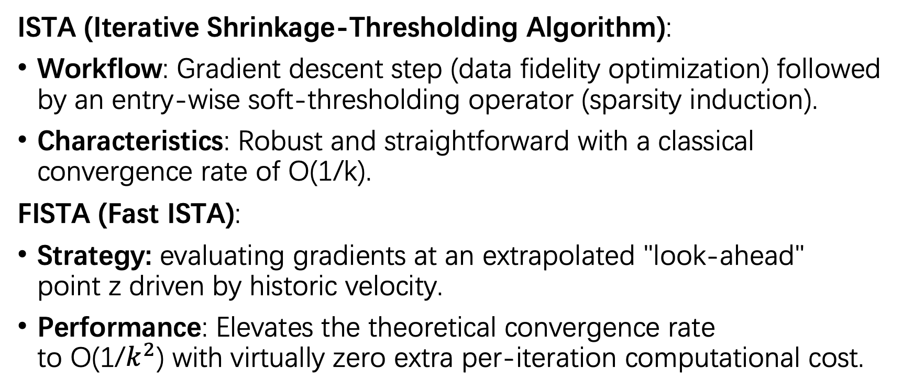
Algorithm (Part I): ISTA & FISTA
ISTA (Iterative Shrinkage-Thresholding Algorithm):
Workflow: Gradient descent step (data fidelity optimization) followed by an entry-wise soft-thresholding operator (sparsity induction).
Characteristics: Robust and straightforward with a classical convergence rate of O(1/k).
FISTA (Fast ISTA):
Strategy: evaluating gradients at an extrapolated "look-ahead" point z driven by historic velocity.
Performance: Elevates the theoretical convergence rate to O(1/$k^{2}$) with virtually zero extra per-iteration computational cost.

Slide 8
Algorithm (Part II): CD & ADMM
Coordinate Descent (CD):
Strategy: Optimizes one scalar coordinate at a time while treating the other N−1 entries as immutable constants.
Advantage: Utilizes a dynamic "Residual Updates" mechanism, reducing per-step complexity to a minimal O(M).
ADMM (Alternating Direction Method of Multipliers):
Strategy: Splitting variables (x, z) to decouple data fidelity from non-smooth sparsity, using u to enforce consensus.
Advantage: Highly parallelizable. Employs a pre-cached out-of-loop matrix inversion to compute stable, closed-form updates inside the iterations.

Slide 9
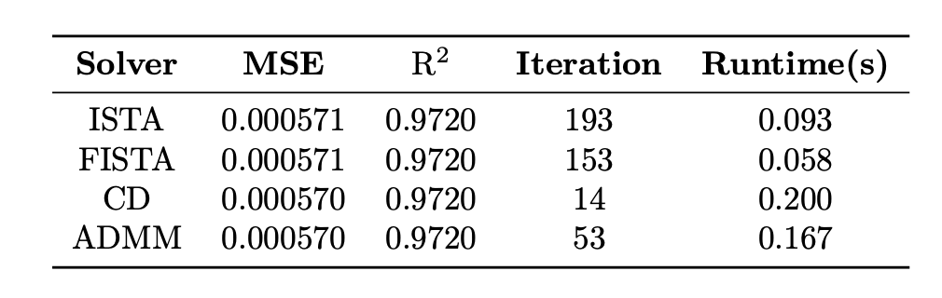
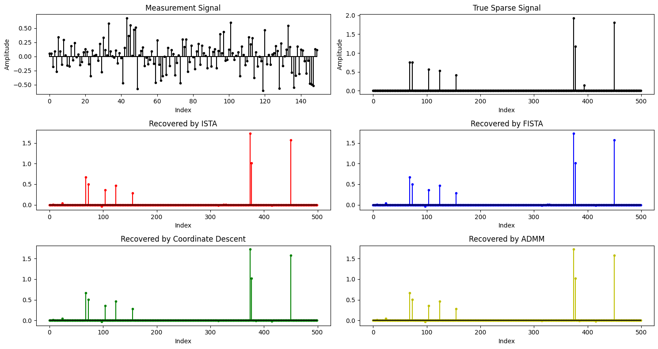
Experiment I: 1D Sparse Signal Recovery
Data: 1x500 sparse signal(10 nonzero elements).

Slide 10
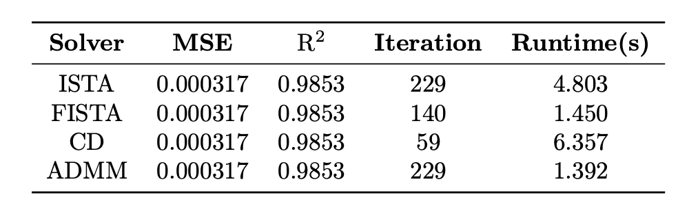
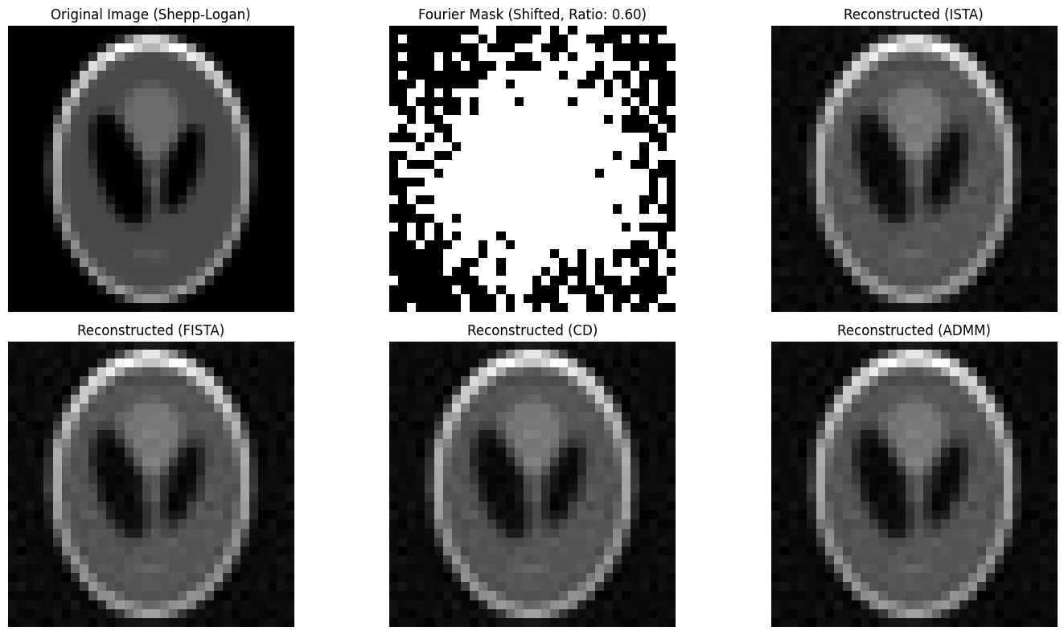
Experiment II: 2D MRI Image Reconstruction
Data: 32x32 image (MRI/CT).
Compressed sensing allows us to
collect 60% less data during the
acquisition phase while still perfectly
reconstructing lossless images using
backend algorithms, thereby significantly
reducing scanning time.

Slide 11
Conclusion
Convergence consistency:
All four algorithms ultimately converge to the same global optimal value of the objective function.
Performance:
Speed: FISTA and ADMM perform best.
Sparsity sensitivity: The coordinate descent method demonstrates excellent sparsity-preserving capabilities.

Slide 12
Thanks!

