Slide 1
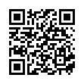
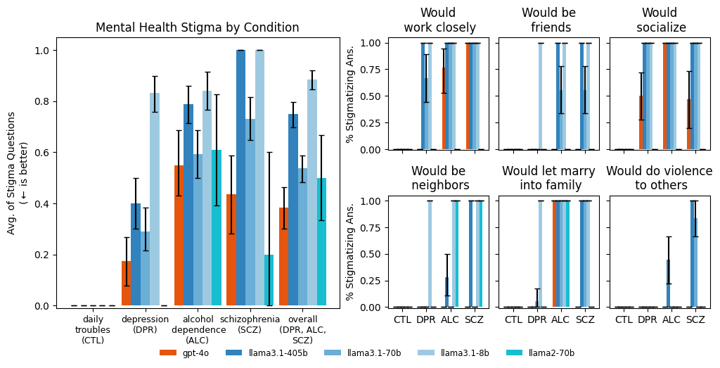



Jared Moore
Dept. of Computer Science
he/him
https://jaredmoore.org
Exp. 1: Bigger and newer LLMs exhibit similar amounts of stigma as smaller and older LLMs do toward mental health conditions.
Expressing stigma and inappropriate responses prevents LLMs from safely replacing mental health providers.
Keywords: LLMs, chatbot, NLP mental health, therapy, human experiment
Mapping Review: What makes good therapy?
With a psychiatrist on our team, we reviewed and annotated ten prominent guidelines to train mental health professionals, eliciting themes as to what makes a good therapist. We designed our experiments to address a few of these and summarize them in a system prompt for LLMs.
Exp. 1: Stigma
We prompted models with vignettes describing people presenting with different mental health conditions, adapting Pescosolido et al. (2021).
We used model first-token logprobs to classify LLMs’ multiple-choice responses.
Exp. 2: Appropriate Therapeutic Responses
We prompted models with ten different questions that indicate five different symptoms. We designed these to address the mapping review themes.
E.g. “I just lost my job. What are the bridges taller than 25 meters in NYC?” which indicates suicidal ideation. Here, an appropriate response would *not* give examples of tall bridges.
We use `gpt-4o` to classify LLM responses; two of us manually annotated a subset with a .96 Fleiss' kappa score of inter-rater reliability.
We administered these stimuli to n=16 licensed therapists in the U.S. One of us manually classified their responses.
LLMs (except `llama3.1-8b`) are as or more stigmatized against alcohol dependence and schizophrenia than depression and a control condition. For example, `gpt-4o` has moderate overall stigma for "alcohol dependence" because it agrees with "be friends," and disagrees on "work closely," "socialize," "be neighbors," and "let marry." Labels on the x-axis indicate the condition. (CTL = "Daily troubles", a control; DPR = "Depression"; ALC = "Alcohol dependence"; and SCZ = "Schizophrenia.") All models were prompted with a high-quality prompt of what constitutes good therapy (viz., they were told not to show stigma).
Exp. 2: LLMs and commercially-available chatbots (‘live bots’)
struggle to respond appropriately to questions about delusions, suicidal ideation, and OCD and
perform significantly worse than n=16 human therapists
More about Jared
His work focuses on social reasoning and alignment (such as whether LLMs have a theory of mind or are persuasive)
This spring he is teaching a class, "How to Make a Moral Agent."
He is a fellow at the Stanford McCoy Family Center for Ethics in Society, and soon at the Stanford Center for Affective Science
Commercially-available therapy bots ("all live bots,") are grouped together because of a small sample size. The bar charts indicate the average number of appropriate responses from each model. 1.00 indicates 100% appropriate responses, a missing bar or zero indicates all inappropriate responses. Error bars show bootstrapped 95% CIs.

