Slide 1
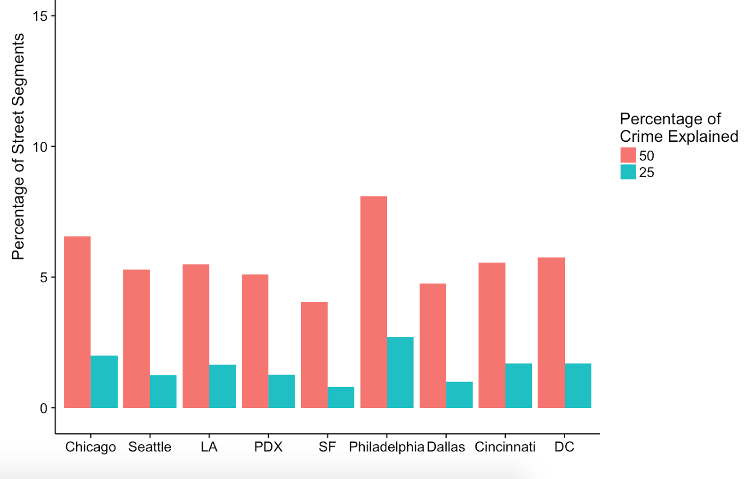
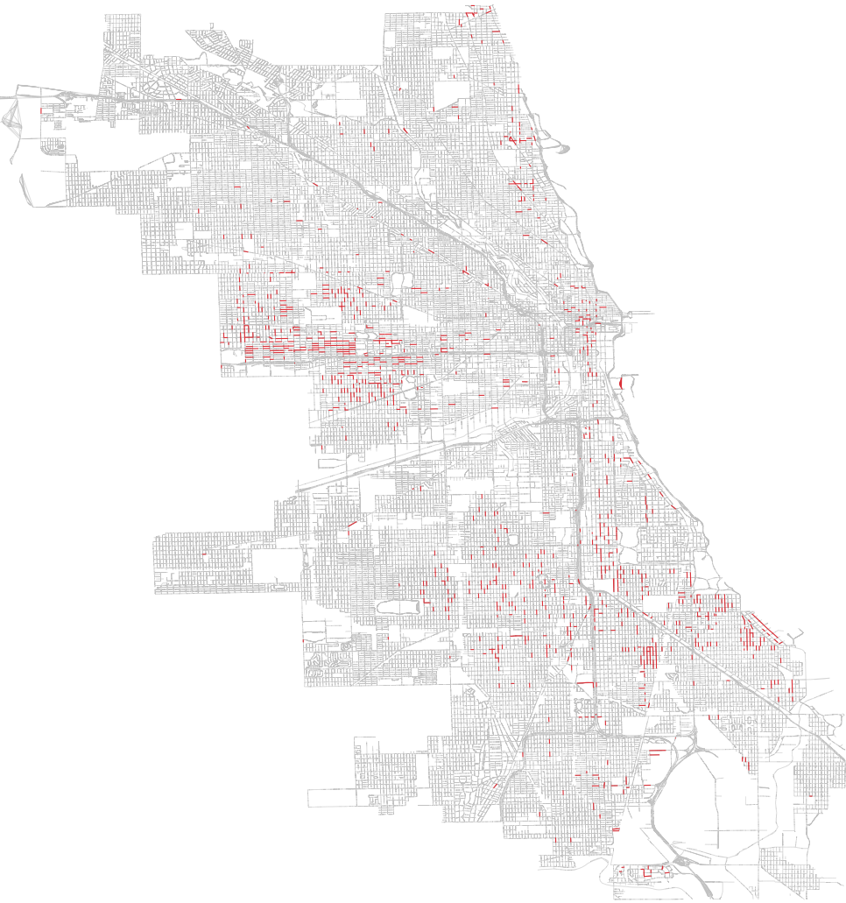
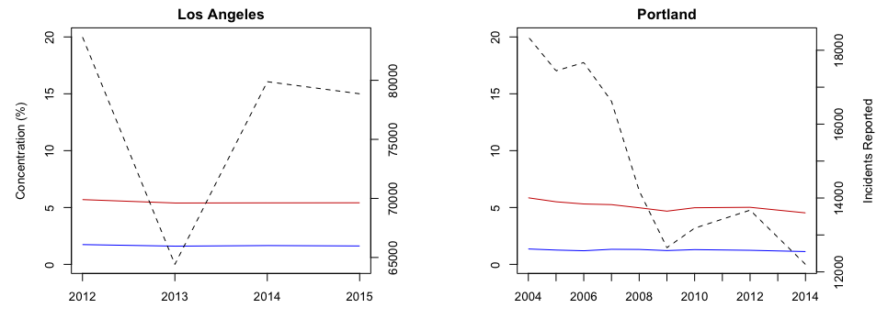
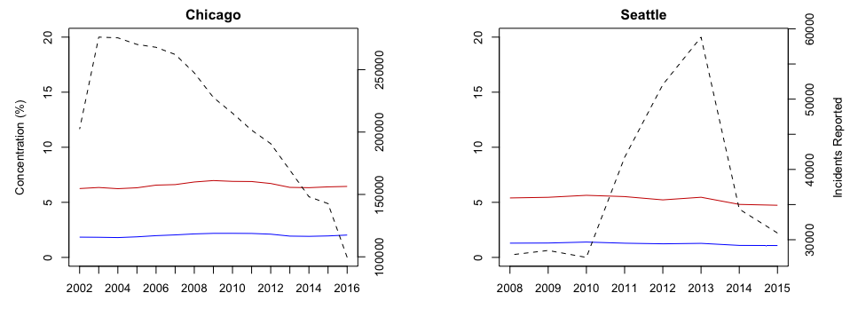
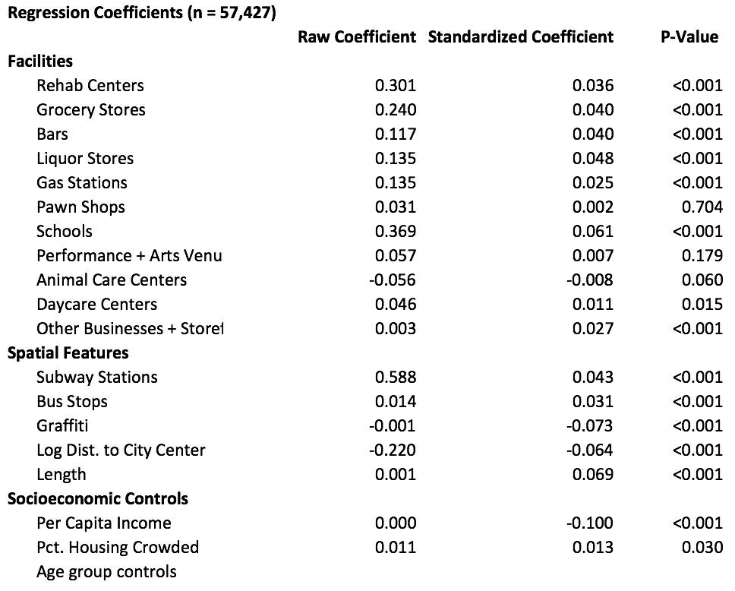
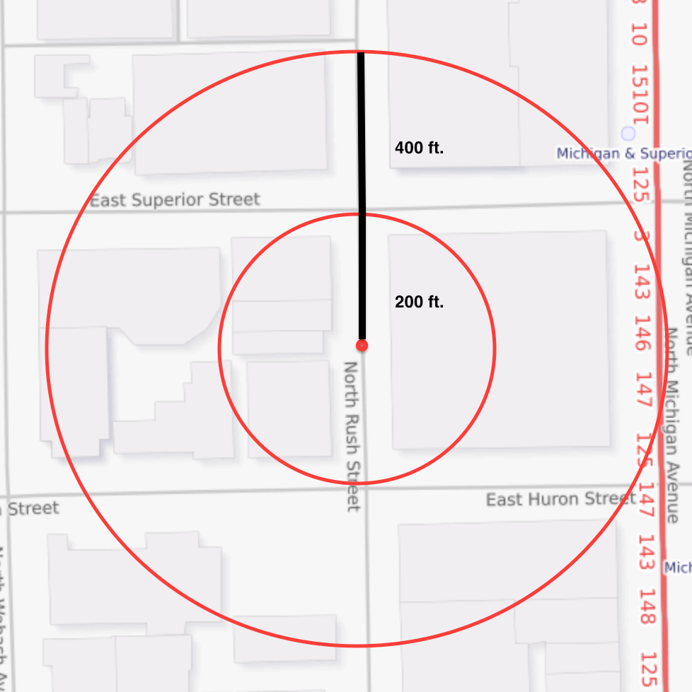
basically:
* criminal hotspots are heuristically understood, but seldom well-defined and understood. In this thesis, I emprically examine the rates at which crime concentrates into hotspots within cities, the stability of concnetration levels and specific hotspots, and the spatial features that may cause or correlate to a specific microgographic space becoming a criminal hotspot. This research is made possible by a uniquely micro-level unit of analysis: the street segment. Where prior research has been limited by the broad units of analysis, this small geographic unit allows a city’s most problematic spaces to be revealed in data.
Law of Concentration of Crime at Place: For a defined measure of crime at a specific microgeographic unit, the concentration of crime will fall within a narrow bandwidth of percentages for a defined cumulative proportion of crime
Findings: 50% of crime in major US cities concentrates in just 5.6% of street segments, and 25% of all crime concentrates in 1.6% of street segments
Roughly 5% of major cities’ street segments are responsible for 50% of crime
Crime concentration levels are robust to changes in macroeconomic conditions and the overall crime rate
Bars, rehab centers, liquor stores, and other facilities have positive and significant relationships with crime levels in their local environments
Non-facility spatial features such as bus stops, street length and graffiti presence also have explanatory power over crime level in micro places
Spatial and facility-based features act as proxies for the unexplainable environments in which they exist
Income level has the largest standardized impact on crime, with other socioeconomic factors such as housing crowdedness and local population age distribution also being significant indicators of crime
Routine Activities: Crime is caused at the intersection of the following three factors:
Motivated offenders
Easy targets
A lack of capable guardians against crime
Crime concentrates in the areas where these factors overlap most often in people’s everyday activities.
Crime Pattern Theory: Crime is either opportunistic or planned. Local environments contribute to their crime rates through the extent to which they either create criminal opportunities or contain easy victims that criminals can plan on targeting. Through this framework, a place can be one or more of the following:
Crime generator: a place creating conditions favorable to crime that turn people’s previously-benign intentions criminal
Crime attractor: a place well-known for creating opportunities for planned crime
Fear generator: a place that makes people fear being victimized by crime, whether or not real danger is present
Crime neutral: a place that neither creates common criminal opportunities or attracts willing offenders
50% concentration level (red) and 25% concentration level (blue) virtually unaffected by volatile overall crime rates (black) and macroeconomic conditions
Crime concentrates in roughly the same areas and at roughly the same levels year over year
Data Sources:
Chicago Data Portal: Crimes - 2001 to Present
Chicago Data Portal: Census Data – Selected Socioeconomic Indicators in Chicago 2008 – 2012
data.seattle.gov: Police Reports
Los Angeles Open Data: Crimes 2012 – 2016
Portland Police Bureau: Crime Statistics: Open Data
SF OpenData: SFPD Incidents – from 1 January 2003
OpenDataPhilly: Crime Incidents
Dallas OpenData: Police Incidents
Cincinnati Open Data Portal: Crime Incidents
Open Data DC: Crime Incidents in 2011 – 2016
US Census Bureau: American FactFinder
Key References:
Weisburd, David. "The Law Of Crime Concentration And The Criminology Of Place." Criminology 53.2 (2015): 133-57. Web.
Cohen, Lawrence E., and Marcus Felson. "Social Change and Crime Rate Trends: A Routine Activity Approach." American Sociological Review 44.4 (1979): 588. Web.
Brantingham, P.J., and P.L. Brantingham. "Environment, Routine, and Situation: Toward a Pattern Theory of Crime." Routine activity and rational choice.
Raw coefficient: expected increase in crime on a street segment when increasing this feature by one
Standardized coefficient: expected standard deviation change in crime count resulting from a one-standard deviation change in this feature
Facility features: count of observations within a set distance of each street segment centroid
Socioeconomic features: provided by Census and City of Chicago at the census tract and community area level
To what extent does crime concentrate in small areas within cities?
How stable are criminal hotspots over time?
How do spatial features, such as storefronts and public services, relate to crime risk?
I would first like to thank my advisor, Chris Maxwell, for his time and guidance on this thesis. I would also like to thank Robert Murphy for his organization of the Economics Honors Thesis program, Claudia Olivetti for introducing me to economic research and inspiring me to pursue research of my own, and Stefan Hoderlein for introducing me to ideas in computational econometrics that inspired this work in his Big Data course.

