Slide 1
Novo Vista
MadiDrop+

Slide 2
Relevant Articles and Links
https://news.virginia.edu/content/uva-engineers-quadruple-performance-their-water-purification-tablet
http://www.cavalierdaily.com/article/2018/06/uva-engineers-develop-water-purification-tablet
https://www.ultimatemission.net/projects/madidrop-water
https://www.youtube.com/watch?v=6cZMLGnDE2g&t=738s

Slide 3
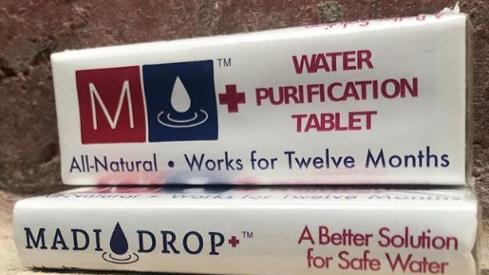

Slide 4
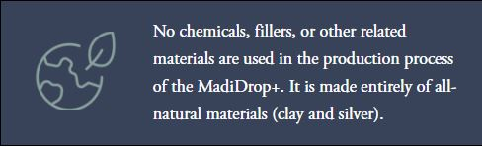

Slide 5
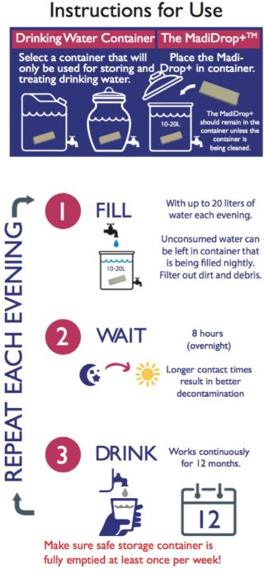

Slide 6
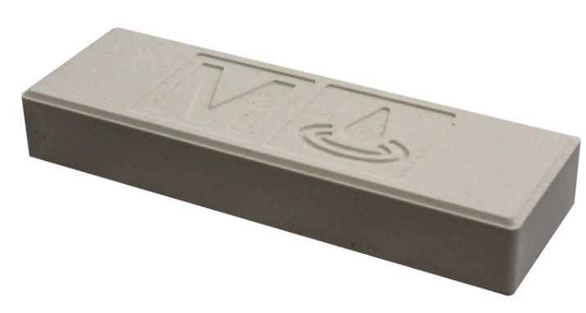

Slide 7


Slide 8
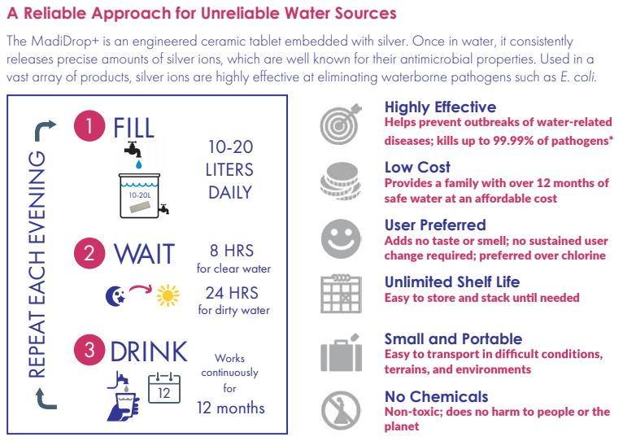

Slide 9
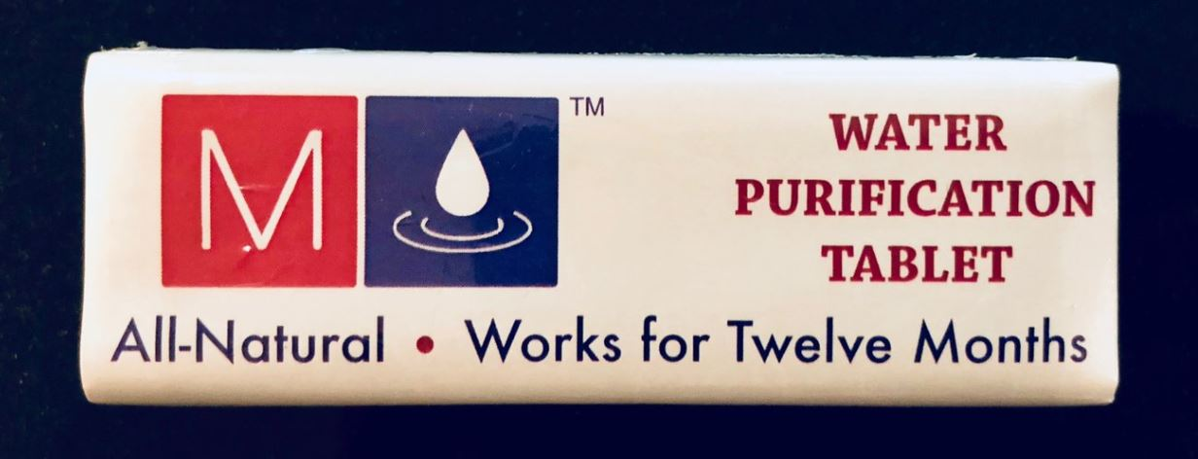

Slide 10
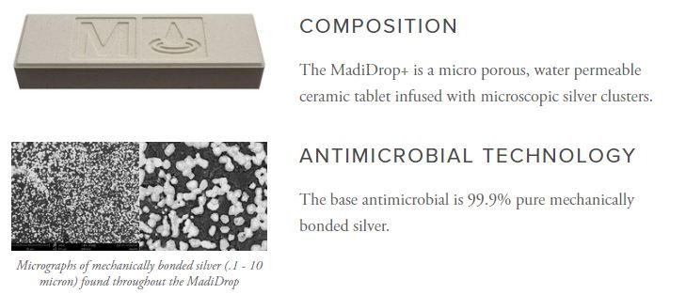

Slide 11
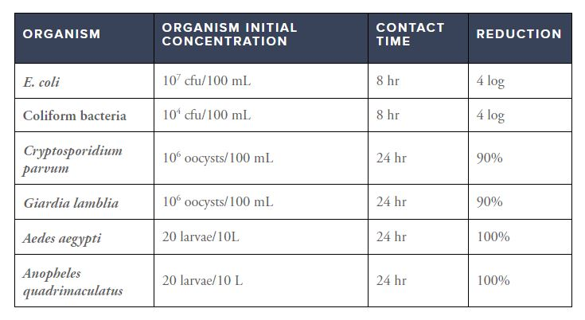

Slide 12
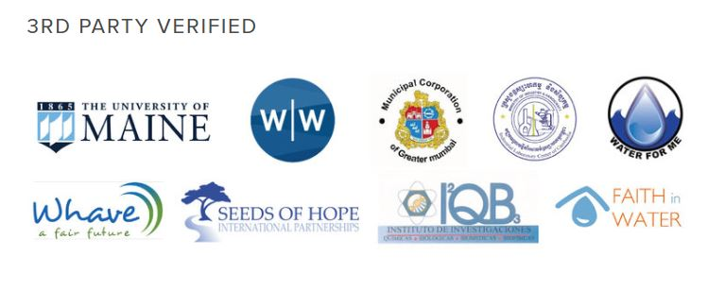

Slide 13
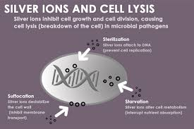

Slide 14
