Slide 1
Design patterns are SOLID
Jean-Luc Delarbre

Slide 2
Introduction
In previous lecture, we studied the SOLID principles
  Make software design understandable, flexible and maintainable
Our today topic: Design patterns
  Well designed solutions of recurring problems
  Objectives
    Not a long description of each one, but
    How patterns fulfill SOLID principles
    How patterns usage allows to be compliant with SOLID principles

Slide 3
Chronology of patterns and SOLID principles
Parnas: Information
hidding
OCP
Meyer: Object Oriented
Software Construction
Uncle Bob: Design Principles
and Design Patterns
Feathers: SOLID acronym
LSP
Keynote – Data
abstraction & hierarchy
LSP
Paper – Behavioral
Notion of subtyping
Dijkstra: Separation
of concerns
Uncle Bob articles:
SRP, ISP, DIP
Coupling and Cohesion
1970
1980
1990
2000
SOLID principles
THE BOOK:
Design Patterns: Elements of
Reusable Object-Oriented Software
Alexander: Pattern Language
Book - architecture
Beck, Cunningham: Using Pattern Languages
for Object-Oriented Programs (OOPSLA)
GOF creation (OOPSLA)
(...)
1970
1980
1990
2000
Design patterns

Slide 4
Creational Patterns
Abstract factory, builder, factory method, static factory… allow
  SRP
    Wire the application is a full fledged responsibility
      Avoid object to fetch other objects
      Avoid to unrelated things into object just to allow easy access on them
  OCP / DIP
    Since code shall be built upon abstractions, you need to link it with concrete things
    Lower coupling in the application

Slide 5
Roles of factories / builders
Build concrete instance
  Initialize data
  Inject collaborators (wires dependencies)
    Build or retrieve them
    Select concrete implementation
  Call constructor (factory privilege for object construction only)
    Constructor only set class fields
  Initialize object with init method (almost never)
Select (and hide) concrete class to build for client
  Return object of a given interface: select implementation
Select instance to return
  Create a new one or return an unique instance (immutable object)
Ease construction of complex objects (builder)
Return ready to use object or fail
  Check network connection established or file opening

Slide 6
Factory
Factory
<<call>>
Client
Product build(type)
<<use>>
Product
<<instantiate>>
ProductA_Impl
ProductB_Impl

Slide 7
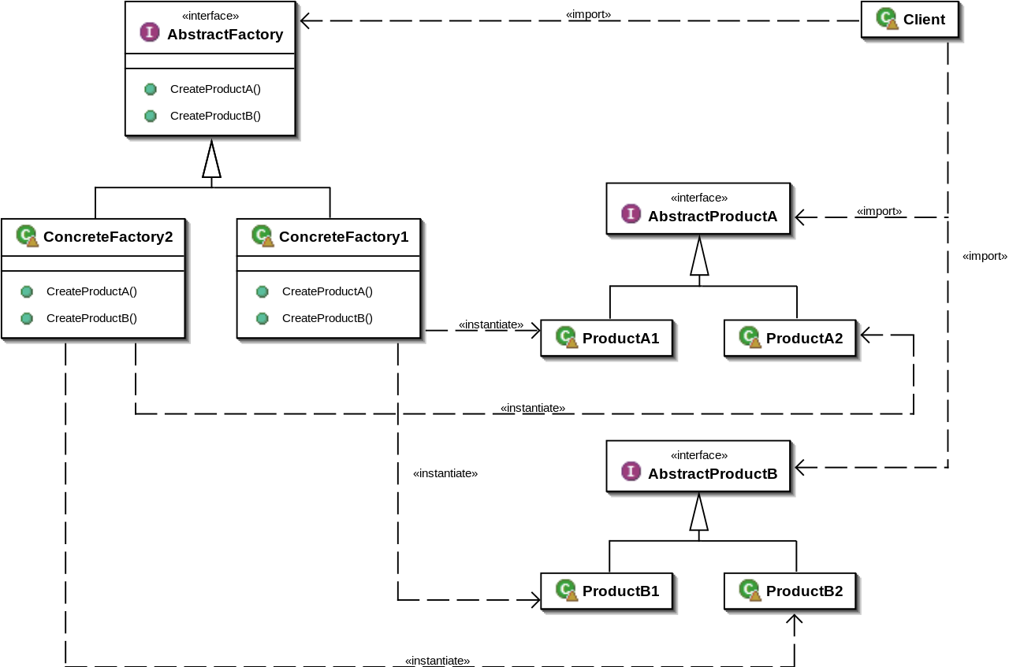
Abstract factory
Source: wikipédia

Slide 8
Command
Behavioral pattern
Simplest pattern ever
  Highly focused on 1 responsibility (SRP)
  Highly handy and reusable
    Components that use a “command” object fulfill OCP and DIP
Often work with factory

Slide 9
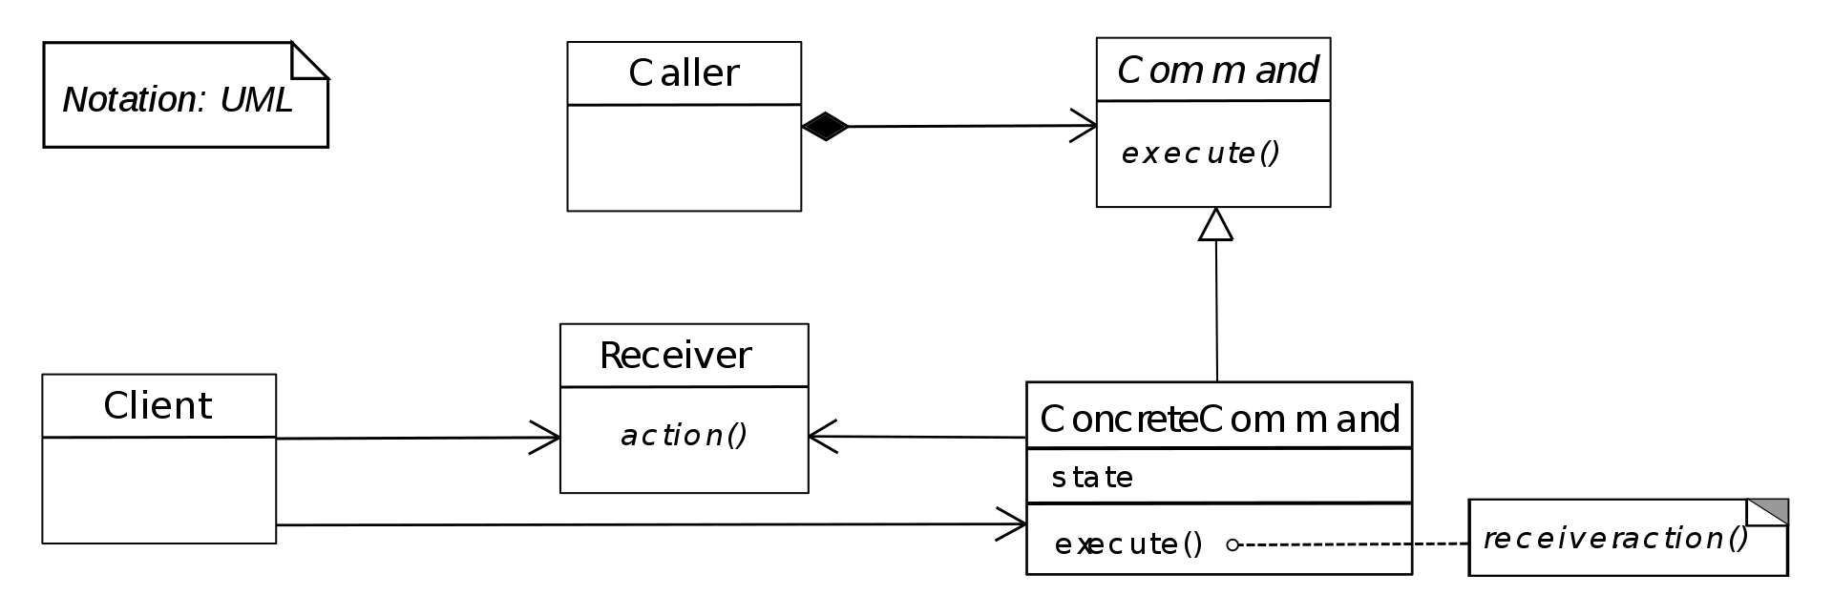
Command
Source: wikipédia

Slide 10
Strategy
Behavioral pattern
Delegate a part of behavior to dedicated object (SRP)
  Implemented by a family of algorithm
  Algos and clients in this pattern vary independently (OCP / DIP)
  Changeable at runtime
Like a command pattern with rich interface

Slide 11

Strategy
Source: wikipédia

Slide 12
Template method
Behavioral pattern
Equivalent to strategy but with inheritance
  Stronger coupling
  Strategy not updatable

Slide 13
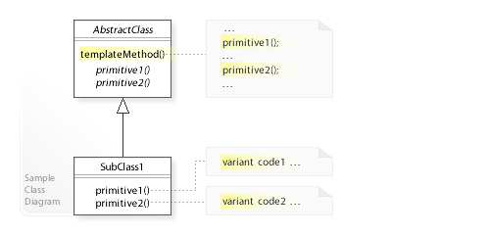
Template method
Source: wikipédia

Slide 14
Facade / Mediator
Impose a policy on a group of objects
  Ensure coherence or application policy is a full fledged responsibility (SRP)
Facade
  Structural pattern
  Hide complexity, give better readability and usability of complex components
  Impose policy (often with business value) through an API which impose a way to use it
Mediator
  Behavioral pattern
  Encapsulate interaction between objects
  Allow a given policy behind the scene

Slide 15
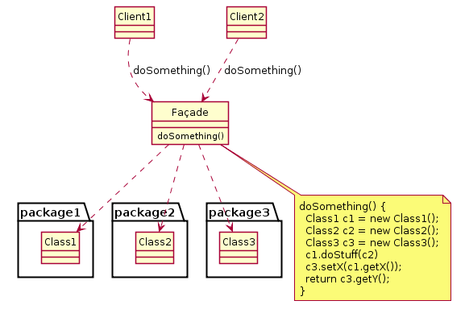
Facade
Source: wikipédia

Slide 16
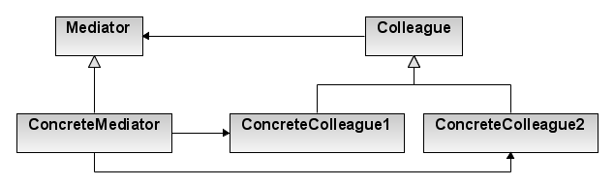
Mediator
Source: wikipédia
Colleague1
Colleague2
Mediator
Simpler diagram

Slide 17
Null Object / Optional
Avoid use of null pointer (or exception handling)
Null Object
  Not in GOF (Fowler)
  Allow to easily do nothing on special cases (SRP)
    Simplify code architecture (avoid if / else)
    Main algo does not have to bothered with special cases
    Ex: File processing in a directory tree, use null object with empty directory
  Special case of strategy or state pattern
  Degenerated case of mediator which deals with nothing

Slide 18
Null Object / Optional
Avoid use of null pointer (or exception handling)
Optional
  Explicitly manage special cases
    Kind of facade: impose policy of special case management
  Simplest monad (functional programming)

Slide 19
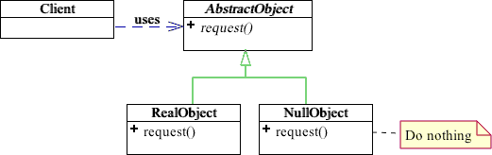
Null Object
Source: Google image / cs.oberlin.edu

Slide 20
Composite
Structural pattern
Manage in the same way individual or composite elements
  One to many
  Avoid client to manage cardinality (SRP, DIP)

Slide 21
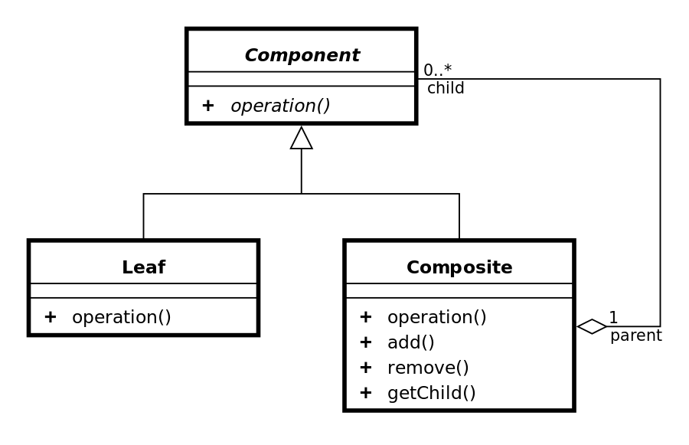
Composite
Source: wikipédia

Slide 22
Adapter
Structural pattern
Convert an interface of foreign element
  Let other client access through original original interface
  Allow us to be independent from external library
    Creation of our own interface to use external library (not used it directly)
    For already existing interface: adapter is needed

Slide 23
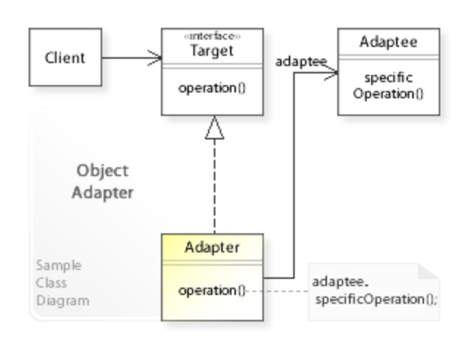
Adapter
Source: wikipédia

Slide 24
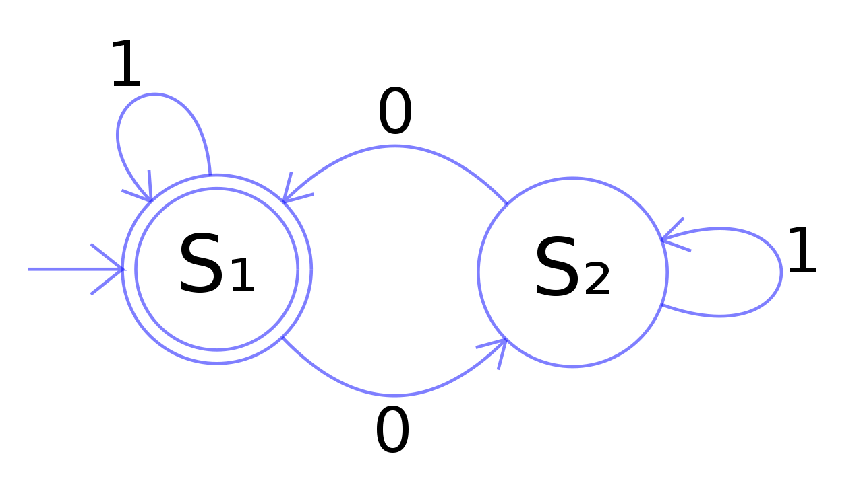
State
Behavioral pattern
Close to Finite State
Machine
State pattern
  State specific behaviors are delegated to dedicated state objects
    State objects can vary independently
    Implement a common interface
  Main (context) class
    Receive requests and transfer it to active state for execution
    Memorize active state

Slide 25
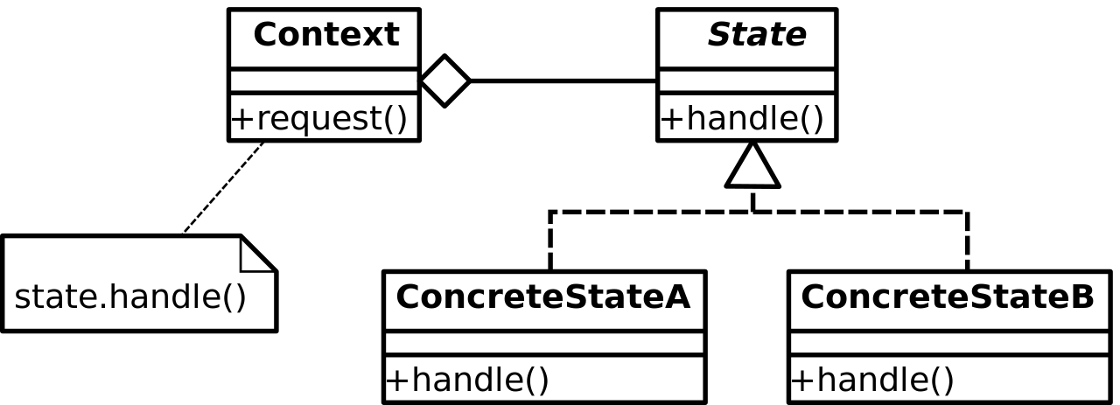
State
Source: wikipédia

Slide 26
State
Very helpful for GUI
Ease State/transition of FSM decoupling
State versus Strategy
  State is also a Strategy pattern (see UML diagram)
    Both strategy and state delegate behavior to derivative classes
  Strategy instances are not always state
    In state, derivative classes have the logic to change the state of the context class

Slide 27
Bridge
Structural pattern
Decouple interface from its implementation
  Let them vary independently
  Use both aggregation and inheritance
Simplified in other languages by traits or mixins (Scala)

Slide 28
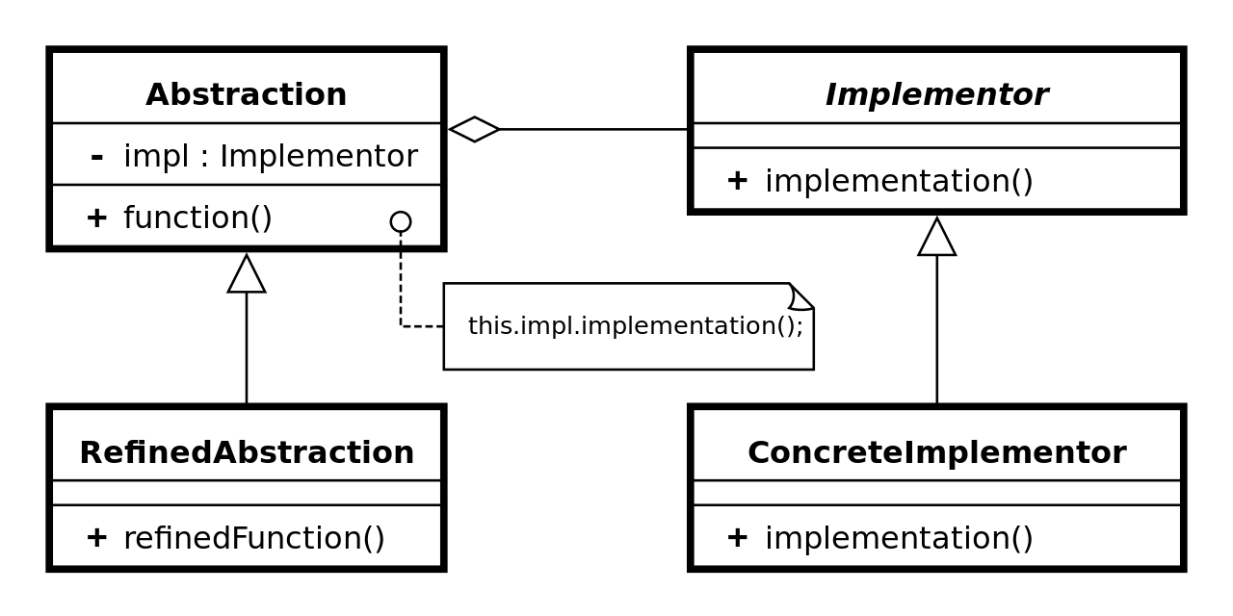
Bridge
Source: wikipédia

Slide 29
Bridge (frequent use case)
Abstraction
Implementation
bridge
Application interface
Application core
userAction1()
userAction2()
...
coreFeature1()
coreFeature2()
...
GUI
WEB
CLI
Windows core
Linux core
MacOS core

Slide 30
Next objective
Tools for today programmers
One more pattern

Slide 31
Reference
Design Patterns: Elements of Reusable Object-Oriented Software - GOF - Erich Gamma, Richard Helm, Ralph Johnson et John Vlissides
Agile Principles, Patterns, and Practices in C# - Martin C. Robert, Martin Micah
Clean Code, A Handbook of Agile Software Craftsmanship - Robert C. Martin
Refactoring: Improving the Design of Existing Code - Martin Fowler, Kent Beck (Contributor), John Brant (Contributor), William Opdyke, don Roberts

