Slide 1
Essence of Software and SOLID principles
Jean-Luc Delarbre

Slide 2
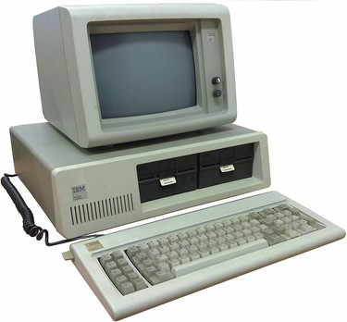
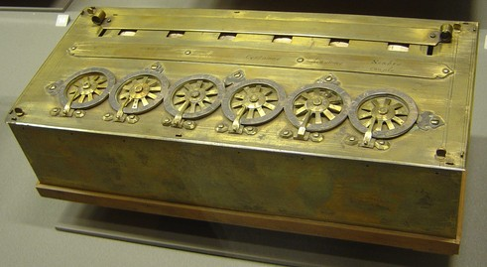
Some famous machines
La Pascaline (1652)
First IBM PC (1981)
What is the main difference between those two machines ?

Slide 3
Some famous machines
La Pascaline (1652)
First IBM PC (1981)
What is the main difference between those two machines ?
NOT THE HARDWARE

Slide 4
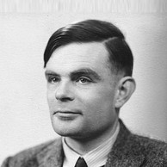
A little bit of computer science history
What makes a computer what it really is, is the work of:
Turing machine
Turing machine
Turing machine
Alan Turing

Slide 5
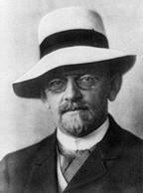
A little bit of computer science history
What makes a computer what it really is, is the work of:
Entscheidungsproblem (Decision problem): The Crisis in the Foundations of Mathematics (1928)
  Find a machine (algorithm) that answers “Yes” or “No” whether a statement is universally valid.
Computer (Universal Turing machine) is a side effect of the answer brought to those fundamental questions (1936)
  Behavior defined by a program
Turing machine
Turing machine
Turing machine
Entscheidungsproblem
Alan Turing
David Hilbert

Slide 6

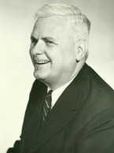
A little bit of computer science history
What makes a computer what it really is, is the work of:
Entscheidungsproblem (Decision problem): The Crisis in the Foundations of Mathematics (1928)
  Find a machine (algorithm) that answers “Yes” or “No” whether a statement is universally valid.
Computer (Universal Turing machine) is a side effect of the answer brought to those fundamental questions (1936)
  Behavior defined by a program
Turing machine
Lambda calculus
Church-Turing thesis
Turing machine
Turing machine
Entscheidungsproblem
Alan Turing
David Hilbert
Alonzo Church

Slide 7
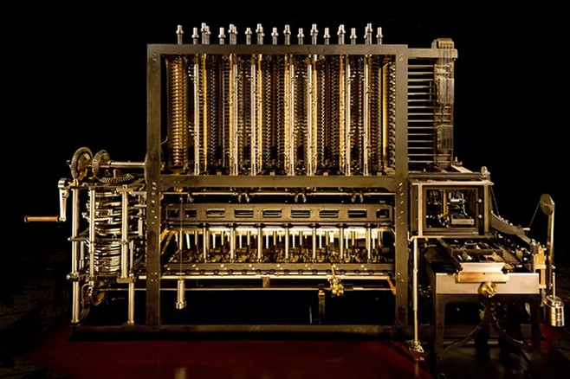
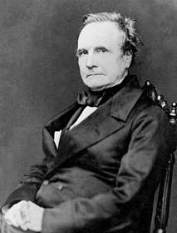
The other half of computer history:
The engineers work (1/2)
Computer design starts before computer science
Charles Babbage
Height:
~ 2,5 m
Difference engine 1822
Compute mathematical functions using polynomial interpolation

Slide 8
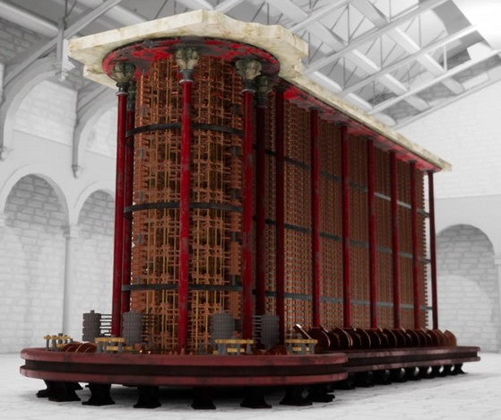
The other half of computer history:
The engineers work (1/2)
Computer design starts before computer science
Charles Babbage
Height:
~ 3,5 m
Analytical engine (Turing complete) 1837
Capable of any computation

Slide 9
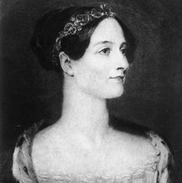
The other half of computer history:
The engineers work (2/2)
May be not the first programmer but she had glimpses of the future
More than writing a program for the analytical engine to compute Bernoulli numbers, she was the first to recognize that the machine had applications beyond pure calculation.
  “The engine might compose elaborate and scientific pieces of music of any degree of complexity or extent.”
  “This example illustrates how the cards are able to reproduce all the operations which intellect performs in order to attain a determinate result, if these operations are themselves capable of being precisely defined” [1843]
Babbage and Lovelace knew this, but didn’t prove it.
Turing did it in 1936.
Ada Lovelace

Slide 10
The fundamental difference
La Pascaline (1652)
First IBM PC (1981)
What is the main difference between those two machines ?
Programmability
The behavior of the computer is defined its program, and it is replaceable.

Slide 11
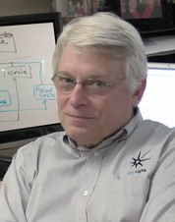
Essence of software
Computer are programmed with software
  Software is easily replaceable unlike hardware
Are we able to modify our code easily?
  Do we need to rewrite from scratch for any little changes
Our guideline from now
  How to make software easily/effectively modifiable?
The SOLID principles
Robert C. Martin
(Uncle Bob)

Slide 12
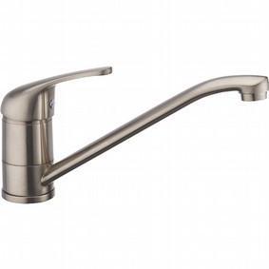

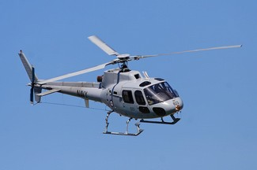
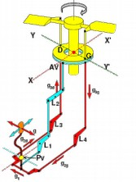
Orthogonality
Which is the easiest tap to use ?
An aircraft uneasy to pilot

Slide 13
Single Responsibility Principle
A component should have only one reason to change
  Responsibility = axis/reason of change
Responsibilities (across components) should be independent
  No impact of changes to one another
  Orthogonal system
Simple concept but hard to get it right
Notes:
Software easy to change:
Master your axis of changes

Slide 14
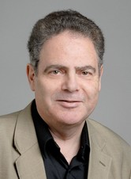
Open-Close Principle (1/2)
Easy to change software
  Must be designed for it
  Must be based upon a stable design
    Contrary of: one change ⇒ cascade of changes
      Code fragile, rigid, unpredictable and unreusable
Software entities (classes, modules, functions, etc.) should be open for extension, but closed for modification.
  Modules that never change
  Changes done by adding new code
  ??? How to get changes, if we avoid it
Bertrand Meyer
Notes:
Software easy to change:
Shall be design for it
Also need for stability to build on

Slide 15
Open-Close Principle (2/2)
Abstraction are the stable elements
  Interface in java
Extending code done thanks to implementation
  Class in java
Choose strategic closure (abstraction)
  Impossible to be 100% close
  If new abstraction required
    Refactor at iso features (check the tests still pass)
    Then extend for new behavior

Slide 16
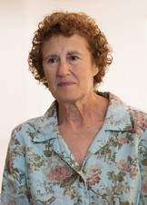
Liskov substitution principle
(1/2)
Extend is the key of OCP
  How to do it well ?
FUNCTIONS THAT USE POINTERS OR REFERENCES TO BASE CLASSES MUST BE ABLE TO USE OBJECTS OF DERIVED CLASSES WITHOUT KNOWING IT.
Barbara Liskov

Slide 17
Liskov substitution principle (2/2)
Design by contract
  An API is not only a set of method signatures
    Method signature
    Preconditions
    Postconditions
    Invariants
If the contract is broken OCP no longer works

Slide 18
Interface segregation principle (1/2)
Services should not have too many responsibilities (SRP)
Client should not depend on unnecessary things
  CLIENTS SHOULD NOT BE FORCED TO DEPEND UPON INTERFACES THAT THEY DO NOT USE
Notes:
Software easy to change:
SRP and OCP focus and building services well.
ISP is more focused on relationship between client and services

Slide 19
Interface segregation principle (2/2)
Avoid fat interface: split into “role interface” focused and dedicated
  Interface pollution
  Minimize coupling with client
    If services change, clients are impacted but inverse is true
    Role interfaces minimize those impacts
  Ease refactoring (malleable software) of service that implements many role interfaces (shared same data)
    Information hidding (Parnas 1971)
  Prefer polyadic form vs monadic
Notes:
Parnas keyword search:
hid…
decision
Page 24
Information hidding != encapsulation

Slide 20
Dependency inversion principle (1/2)
  A. HIGH LEVEL MODULES SHOULD NOT DEPEND UPON LOW LEVEL MODULES. BOTH SHOULD DEPEND UPON ABSTRACTIONS.
  B. ABSTRACTIONS SHOULD NOT DEPEND UPON DETAILS. DETAILS SHOULD DEPEND UPON ABSTRACTIONS.
Related to IoC (inversion of control) and DI (Dependency injection)
DIP is the structural implication of OCP and LSP
High level module
Business knowledge
(client)
Low level module
(service)
use
Abstraction
(interface)
implements

Slide 21
Dependency inversion principle (2/2)
Depending on low level modules makes high level modules unreusable
  However they holds
    Higher business value
    High level policy
    Strategic decision
  Changes in low level modules shall not affect high level modules

Slide 22
Bad design signs
Rigidity
  Change some part affect many other parts (interdependencies ⇒ high coupling, hard evaluate cost for changes)
Fragility
  Change some part break the system (not closed to modification hard to be reliable)
Immobility
  Hard to reuse / extract some part, everything is coupled. Cheaper to redevelop a module

Slide 23
Software is aimed for changes
Software shall do what has been specified
  Expected by the client
  No bugs
Computer behavior are defined by programs
  Expected to be softly modified
  From the beginning of software science

Slide 24
Next objective
Design patterns are SOLID

Slide 25
Reference
SOLID principles
  Uncle Bob books
The Pragmatic Programmer - Andrew Hunt, David Thomas
Charles Petzold – The Annotated Turing
Thomas Petrachi
  https://www.youtube.com/channel/UCSeroUKYavGiiMu-Zhwbg7w
Search: Babbage, Difference Machine and Analytical Engine
  Computer History Museum (YouTube)
    Ada Lovelace: The Making of a Computer Scientist
      https://www.youtube.com/watch?v=2UxjkGePZ48
  Dartmouth (YouTube)
    Mission Impossible: Constructing Charles Babbage's Analytical Engine
      https://www.youtube.com/watch?v=lnFe4UUE4KM

