Slide 1
Covariance and contravariance of parameterized types
Jean-Luc Delarbre

Slide 2
Definition
A generic type is a type with formal type parameters. A parameterized type is an instantiation of a generic type with actual type arguments.
[Angelika Langer – Java Generics FAQs]
Also called parametric polymorphism
Generic type | Parameterized type
// E is the (formal) type parameter interface List<E> { public void add(E e); E get(int I); //... } | // String is the type argument (or Actual type parameter) List<String>
Raw type = List

Slide 3
Generic purpose
Objects handling
  Collection API
  WeakReference, SoftReference…
Type safety
  Early error detection and avoid cast exception without visible cast
  List<String> myList = new ArrayList<>();
  myList.add(“aString”);
  String str = myList.get(0); // Hidden cast to String

Slide 4
Generic type creation
Class MyGenericType<T, U> { // At least one parameter
private T t;
private U u;
public MyGeneric(T t, U u) {
this.t = t;
this.u = u;
}
public T getT() {return t;}
public U getU() {return u;}
// ...
}
MyGenericType<String, Double> mgt = new MyGenericType<>(“a”, 1.0);
Not possible with anonymous class, exceptions or enum. Not usable to define arrays.
Primitive types not usable with generics

Slide 5
Bounded type parameter
Restrict the type of a parameter type
  class MyType<T extends Number> {
  T t;
  int getNearestInt() {
  return t.intValue(); // Can use “t” as a Number
  }
  }
  MyType<Double> d = new MyType<>();
  MyType<Integer> i = new MyType<>();
  MyType<String> s = new MyType<>(); // Error
Multiple bounds allowed
  <T extends A & B & C & ...>
  ComparableCollectionBox<T, C extends Collection<T> & Comparable<C>> {
  //…
  }

Slide 6
Type erasure
Type erasure
  Less type information on runtime than compile time
Reification
  Same type information on runtime than compile time
Reified type | (Generic) Type erasure
// .Upcast done on compile time Object o = new String(“”); // .Type information available on // runtime (o.getClass()) // .Downcast done at runtime String s = (String) o; | // .Upcast done on compile time Object o = new ArrayList<String>(); // .Generic type argument information // NOT available on runtime // .Downcast only done at runtime // towards RAW type List l = (List) o; // .Downcast not fully checked List<String> ls = (List<String>) o;

Slide 7
Inheritance and parameterized type (1/4)
Generic type
Parameterized type
Raw type
assignable to
Collection<E>
Collection<String>
Collection
List<E>
List<String>
List
ArrayList<E>
ArrayList<String>
ArrayList
// Safe but not safely reversible
List<String> stringList;
@SuppressWarnings("rawtypes")
List rawList = stringList;

Slide 8
Inheritance and parameterized type (2/4)
Number
Double
Integer
List<Number>
List<Double>
List<Integer>

Slide 9
Inheritance and parameterized type (2/4)
Number
Double
Integer
List<Number>
Generics are invariant
List<Double>
List<Integer>

Slide 10
Inheritance and parameterized type (3/4)
Number
Double
Integer
Object
List<Number>
List<Double>
List<Integer>

Slide 11
Inheritance and parameterized type (4/4)
Object
Collection
Assignable (upcast) but not safely downcastable
Loose type safety
List
List<Number>
List<Double>
List<Integer>

Slide 12
Wildcard
“?” is a special type parameter that ensure/control type safety of the use of generic/parameterized type.
  Different instantiations of generic type (List<String>, List<Double>, List<Number>) are never compatible. No inheritance relationship.
  Wildcard “?” allows a certain amount of compatibility between various generic type instantiations.
    Kind of inheritance with restrictions.
    Definition of an abstract super type for any parameterized type of a given generic type.

Slide 13
A difficult topic
Joshua Bloch criticized wildcard as being too hard to understand and use.
Scala (language on JVM) first uses declaration-site (“concurrent of wildcard”).
  Martin Odersky adds wildcard (used-site) only for Java compatibility.

Slide 14
Inheritance and super type with wildcard
Object
Collection<?>
Super type with restrictions on
methods that uses type argument
as input or output
List<?>
List<Number>
List<Double>
List<Integer>
List<String>
List<?> list = new ArrayList<Double>();
list.add(null);
list.add(5.0); // Error
Object x = list.get(0); // Only get Object
// Methods that does not use type argument (Double)
// Wildcard super types are less capable
list.remove(3);
list.clear();
int size = list.size();

Slide 15
Wildcard with upper bound
Inheritance in same direction
Number
List<? extends Number>
Covariance of types
Double
List<Double>
List<? Extends Number> list = new ArrayList<Double>();
list.add(null);
list.add(5.0); // Error still not usable
Number x = list.get(0); // Known as Number
// Methods that are still usable
list.remove(3);
list.clear();
int size = list.size();

Slide 16
Reason of wildcard limitation (covariant case)
Inheritance in same direction
Number
List<Number>
Wrong but assume that covariance holds
Double
List<Double>
List<Double> doubleList = new ArrayList<Double>();
List<Number> numberList = doubleList; // Forbidden by compiler
// Possible this way but with an unchecked cast (heap pollution)
@SuppressWarnings("unchecked")
List<Number> numberList = (List<Number>) (List<?>) doubleList;
numberList.add(Integer.valueOf(3)); // Work
Double x = doubleList.get(0); // Cast error since doubleList contains an Integer

Slide 17
Wildcard with lower bound
Inheritance in opposite direction
Number
List<? super Double>
Contravariance of types
Double
List<Number>
List<Number> nList = new ArrayList<Number>();
List<? super Double> dList = nList;
dList.add(5.0); // Only possible to add Double in Number List
dList.add(3); // Error do not know the real List type
Object x = dList.get(0); // Only known as Object
Double d = dList.get(0); // Not necessarily a Double
// nList.add(3);
// Methods that are still usable
list.remove(3);
list.clear();
int size = list.size();

Slide 18
Reason of wildcard limitation (contravariant case)
Inheritance in opposite direction
Number
List<Double>
Wrong but assume that contravariance holds
Double
List<Number>
List<Number> numberList = new ArrayList<Number>();
List<Double> doubleList = numberList; // Forbidden by compiler
// Possible this way but with an unchecked cast (heap pollution)
@SuppressWarnings("unchecked")
List<Double> doubleList = (List<Double>) (List<?>) numberList;
numberList.add(Integer.valueOf(3)); // Normally work as expected
doubleList.add(Double.valueOf(2.0)); // Normally work as expected
Double x = doubleList.get(0); // Cast error since doubleList is a number List that contains an
// Integer

Slide 19
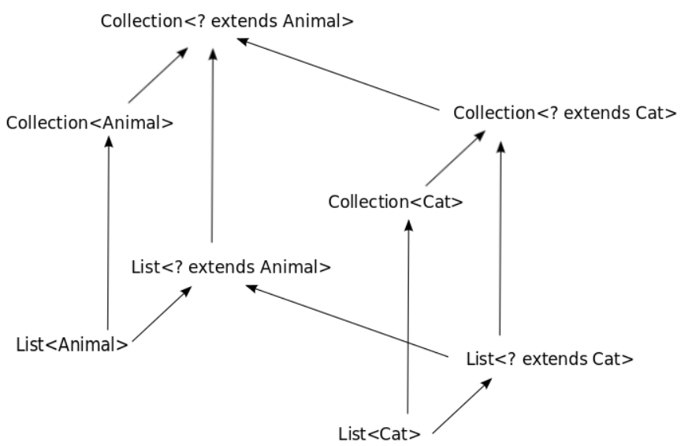
Wildcard subtyping in Java can be visualized as a cube (covariant)
Abstract super type
Source: wikipedia

Slide 20
Wildcard subtyping in Java can be visualized as a cube (contravariant)
Collection<? super Cat>
Abstract super type
Collection<Cat>
Collection<? super Animal>
Collection<Animal>
List<? super Cat>
List<Cat>
List<? super Animal>
List<Animal>

Slide 21
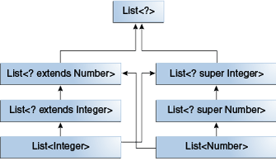
A hierarchy of several generic List class declarations
Source: Oracle

Slide 22
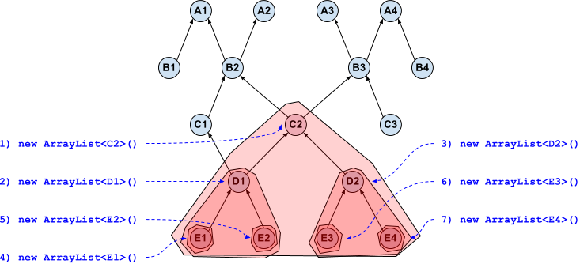
Hierarchy for “? extends” super type
Possible concrete types for List<? extends C2>:
1) new ArrayList<C2>(): can store C2 D1 D2 E1 E2 E3 E4
2) new ArrayList<D1>(): can store D1 E1 E2
3) new ArrayList<D2>(): can store D2 E3 E4
4) new ArrayList<E1>(): can store E1
5) new ArrayList<E2>(): can store E2
6) new ArrayList<E3>(): can store E3
7) new ArrayList<E4>(): can store E4
No common parameter type:
Impossible to write
Only common super type: C2
  Could only be read as C2

Slide 23
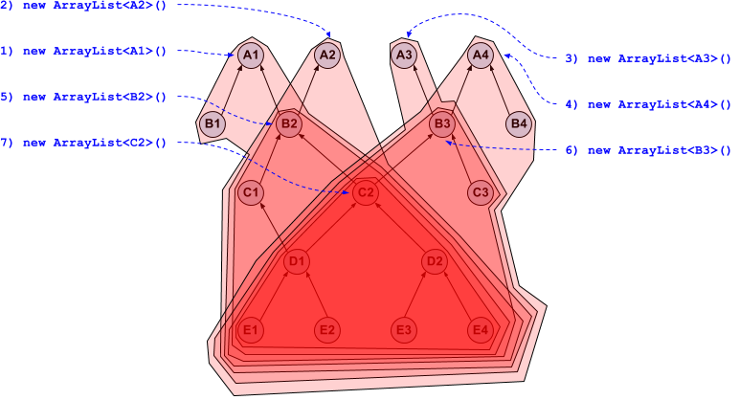
Hierarchy for “? super” super type
Common parameter types:
C2, D1, D2, E1, E2, E3, E4
Can write safely all common parameter types
No common super type
  Could only be read as Object
Possible concrete types for List<? super C2>:
1) new ArrayList<A1>(): can store A1 B1 B2 C1 C2 D1 D2 E1 E2 E3 E4
2) new ArrayList<A2>(): can store A2 B2 C1 C2 D1 D2 E1 E2 E3 E4
3) new ArrayList<A3>(): can store A3 B3 C2 C3 D1 D2 E1 E2 E3 E4
4) new ArrayList<A4>(): can store A4 B3 B4 C2 C3 D1 D2 E1 E2 E3 E4
5) new ArrayList<B2>(): can store B2 C1 C2 D1 D2 E1 E2 E3 E4
6) new ArrayList<B3>(): can store B3 C2 C3 D1 D2 E1 E2 E3 E4
7) new ArrayList<C2>(): can store C2 D1 D2 E1 E2 E3 E4

Slide 24
Usage of abstract super types
class Triangle implements Ishape {…}
class Circle implements Ishape {…}
class Canvas {
List<IShape> shapes;
void addShape(IShape shape) {
shapes.add(shape);
}
void draw() {
for (Ishape shape : Shapes) {
shape.draw();
}
}
}
Writing code that depends on abstraction and is independent of concrete things

Slide 25
Usage of generic abstract super type
(covariant case)
interface IBlinkingShape extends IShape {...}
class Canvas {
List<IShape> shapes;
//…
void addAll(List<? Extends IShape> shapes) {
this.shapes.addAll(shapes);
}
}
List<IBlinkingShape> blinkingShapes = …
List<IShape> shapes = …
canvas.addAll(blinkingShapes);
canvas.addAll(shapes);
Writing code that depends on abstraction and is independent of concrete things
  List<? extends IShape> is an abstraction of IShape provider/producer
  List<IShape>, List<IBlinkingShape> are concrete IShape provider/producer

Slide 26
Usage of generic abstract super type
(contravariant case)
interface IShape extends IDrawable // Image, text, shape...
interface ITransformer<T> {
void transform(T t) {// Translation, rotation…}
}
class Canvas {
List<IShape> shapes;
//…
void transformShapes(ITransformer<? super IShape> transformer) {
this.shapes.foreach(transformer::transform);
}
}
ITransformer<IDrawable> drawableTransformer = …
ITransformer<IShape> shapeTransformer = …
canvas.transformShapes(drawableTransformer);
canvas.transformShapes(shapeTransformer);
Writing code that depends on abstraction and is independent of concrete things
  ITransformer<? super IShape> is an abstraction of IShape consumer
  ITransformer<IShape>, ITransformer<IDrawable> are concrete IShape consumer
Notes:
Transformer::transform
This is not a functional way of applying transformation
But with
T transform(T t);
You no longer can use wildcard.

Slide 27
Usage of wildcards
For maximum flexibility, use wildcard types on input parameters that represent producers (output) or consumers (input parameter).
PECS stands for producer-extends, consumer-super.
For both producer and consumer
  Use exact type (no wildcard)
Do not use bounded wildcard as return types.

Slide 28
Generic methods
Not seen here, but easy to find information in reference

Slide 29
Another approach to generic types: C#
IEnumerator<T>
T get(); Bool MoveNext();
IComparable<T>
int compareTo(T other);
public interface IEnumerable<out T>
“out” keyword means:
T will only be used as return value
⇨
Covariant type
So:
public interface IComparable<in T>
‘in’ keyword means:
T will only be used as input parameter
⇨
Contravariant type
So:
IEnumerator<Animal>
IComparable<Cat>
IEnumerator<Cat>
IComparable<Animal>
Declaration-site (vs used-site in Java): Easier to use a component but harder to write its API

Slide 30
Generic programming implementations
C++ Template | Java Generics type erasure | C# Generics reification
template <typename T> class MyClass { T get() {...} } MyClass<A> ma; MyClass<B> mb; A a = ma.get(); | class MyClass<T> { T get() {...} } MyClass<A> ma; MyClass<B> mb; // Compiler implicitly add cast A a = (A) ma.get(); | class MyClass<T> { T get() {...} } MyClass<A> ma; MyClass<B> mb; A a = ma.get();
Generated at compile time | Only one class compiled | Generated at runtime Different binaries with primitive types
bin
MyClass<A>
bin
MyClass
bin
MyClass
Type T
bin
MyClass<B>
Type descriptor
VTable A
Type descriptor
VTable B

Slide 31
Reference
http://www.angelikalanger.com/GenericsFAQ/FAQSections/ParameterizedTypes.html
A Conversation with Anders Hejlsberg (part VII)
by Bill Venners with Bruce Eckel
https://www.artima.com/intv/anders.html
https://docs.oracle.com/javase/tutorial/java/generics/index.html
Effective Java - Joshua Bloch
https://stackoverflow.com/questions/4343202/difference-between-super-t-and-extends-t-in-java

