Slide 1
Answering public health questions through National Health Surveys
A case study of primary hypertension in NHANES 2013-2014

Slide 2
Some context…

Slide 3
NHANES 2013-2014 National Health and Nutrition Examination Survey
Cross-sectional survey
Observational study from a sample of the population at a specific time
Target population: Resident population of the United States
Sample for the interview: 10,176 persons from 30 different survey locations
Data collected:
Demographics, Questionnaire, Lab Results, Examination, Medication

Slide 4
Why ’hypertension’?
Notes:
For statistical significance!

Slide 5
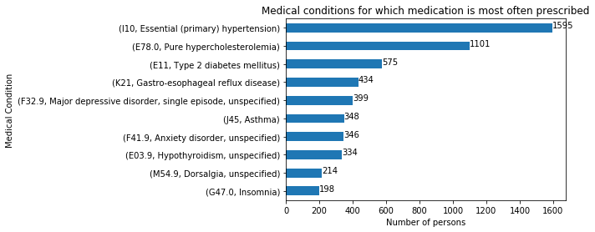
A case study of primary hypertension in NHANES 2013-2014

