Slide 1
Answering public health questions with National Health Surveys
A case study of primary hypertension in NHANES 2013-2014

Slide 2
Some context…

Slide 3
NHANES 2013-2014 National Health and Nutrition Examination Survey
Cross-sectional survey
Observational study from a sample of the population at a specific time
Target population: Resident population of the United States
Sample for the interview: 10,176 persons from 30 different survey locations
Data collected:
Demographics, Questionnaire, Lab Results, Examination, Medication

Slide 4
Why ’hypertension’?
Notes:
For statistical significance!

Slide 5
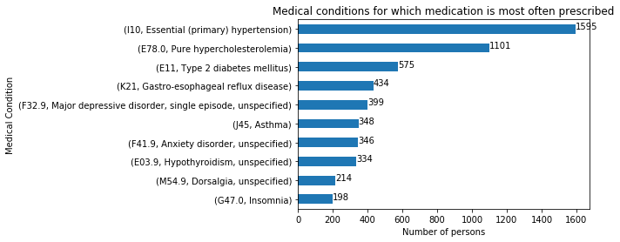
A case study of primary hypertension in NHANES 2013-2014

Slide 6
QUESTIONS
Q: What are the determinants of hypertension?
Or what are the associated complications? => Simple correlation
(way too many missing values in each column for feature selection!)
Q: Can we identify individuals with hypertension in this dataset? => CLASSIFICATION
Q: Can we predict the age of onset of hypertension? => REGRESSION
Notes:
DETERMINANTS vs COMPLICATIONS => inferring causality is out of the scope of this project

Slide 7
Data Acquisition
Through Kaggle
https://www.kaggle.com/cdc/national-health-and-nutrition-examination-survey
All participants are identified by a unique sequence number ‘SEQN’
The scope of this project is limited to the following files and variables
demographics.csv
Age, Gender (M/F), Total Annual Household income ($), Family or Individual income ($)
medications.csv
Reason for use of the medication (ICD10 medical condition code)
questionnaire.csv
All questions!! => 952 variables!

Slide 8
Data Cleaning
Text values
those variables were removed from the dataset because they were out of the scope of the project (i.e. ‘brand of cigarettes’)
all the relevant variables were already coded as numeric values
Values [7, 77, 9, 99]: missing values or continuous values?
‘Refused to answer’ [value: 7, 77, 777]
‘Don’t know’ [value: 9, 99, 999]
Missing values [value: (blank) or . ]
Statistically significant enough variables
Columns where count > 310 (confidence=0.95, n=1595)
Variables with std() = 0 (variance is 0)
i.e. ‘Do you speak English at home?’ (yes: 1, missing value otherwise)

Slide 9
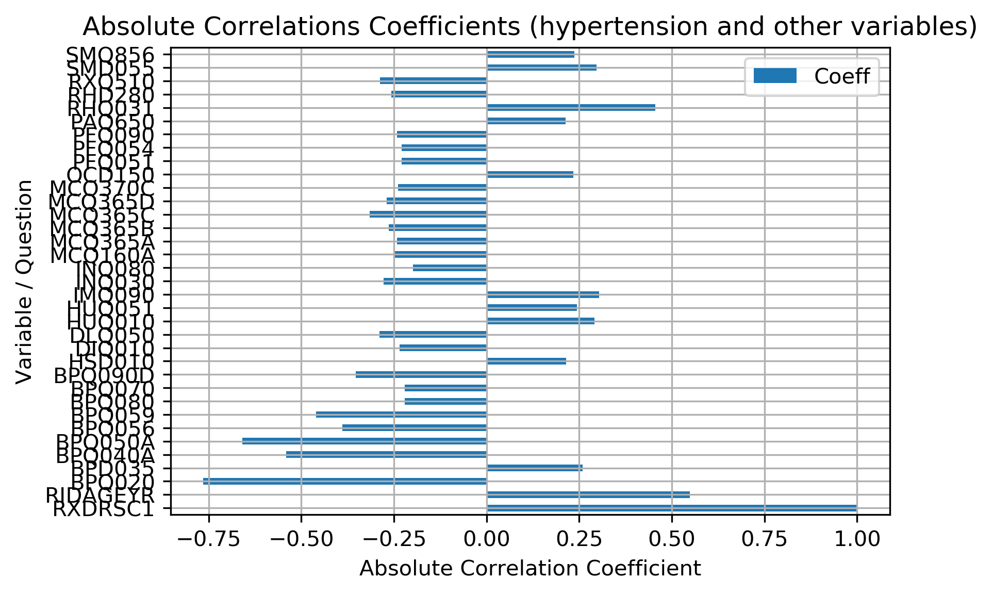
Q: What are the questionnaire variables associated with hypertension?
Variables with absolute correlation coeff > 0.2 with hypertension
Notes:
This type of graphic (bar chart) was chosen to present all the variables in a condensed format, even though correlations are usually depicted with linear graphics

Slide 10
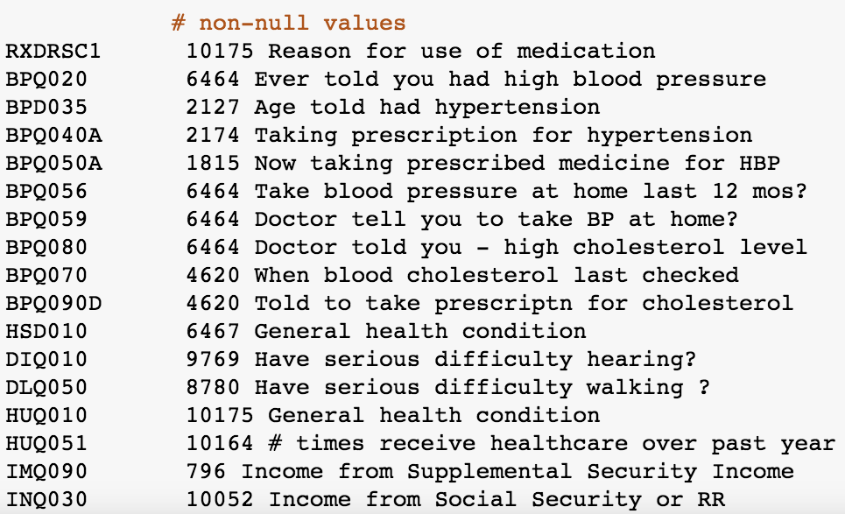
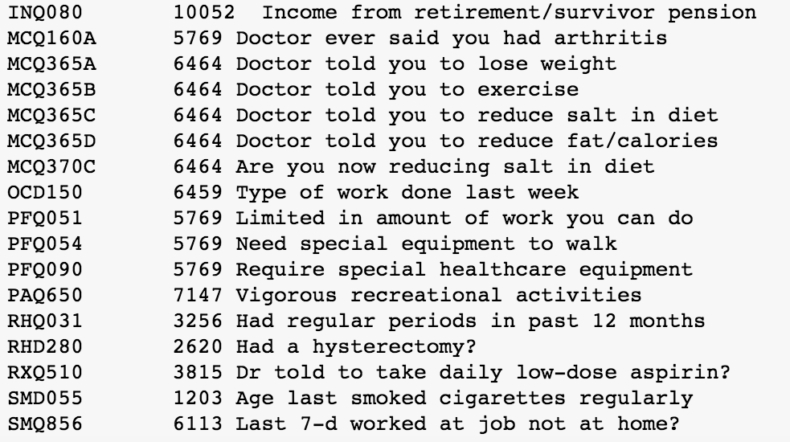
Q: What are the questionnaire variables associated with hypertension?
Notes:
Even with simple correlation, selected variables are still very relevant!

Slide 11
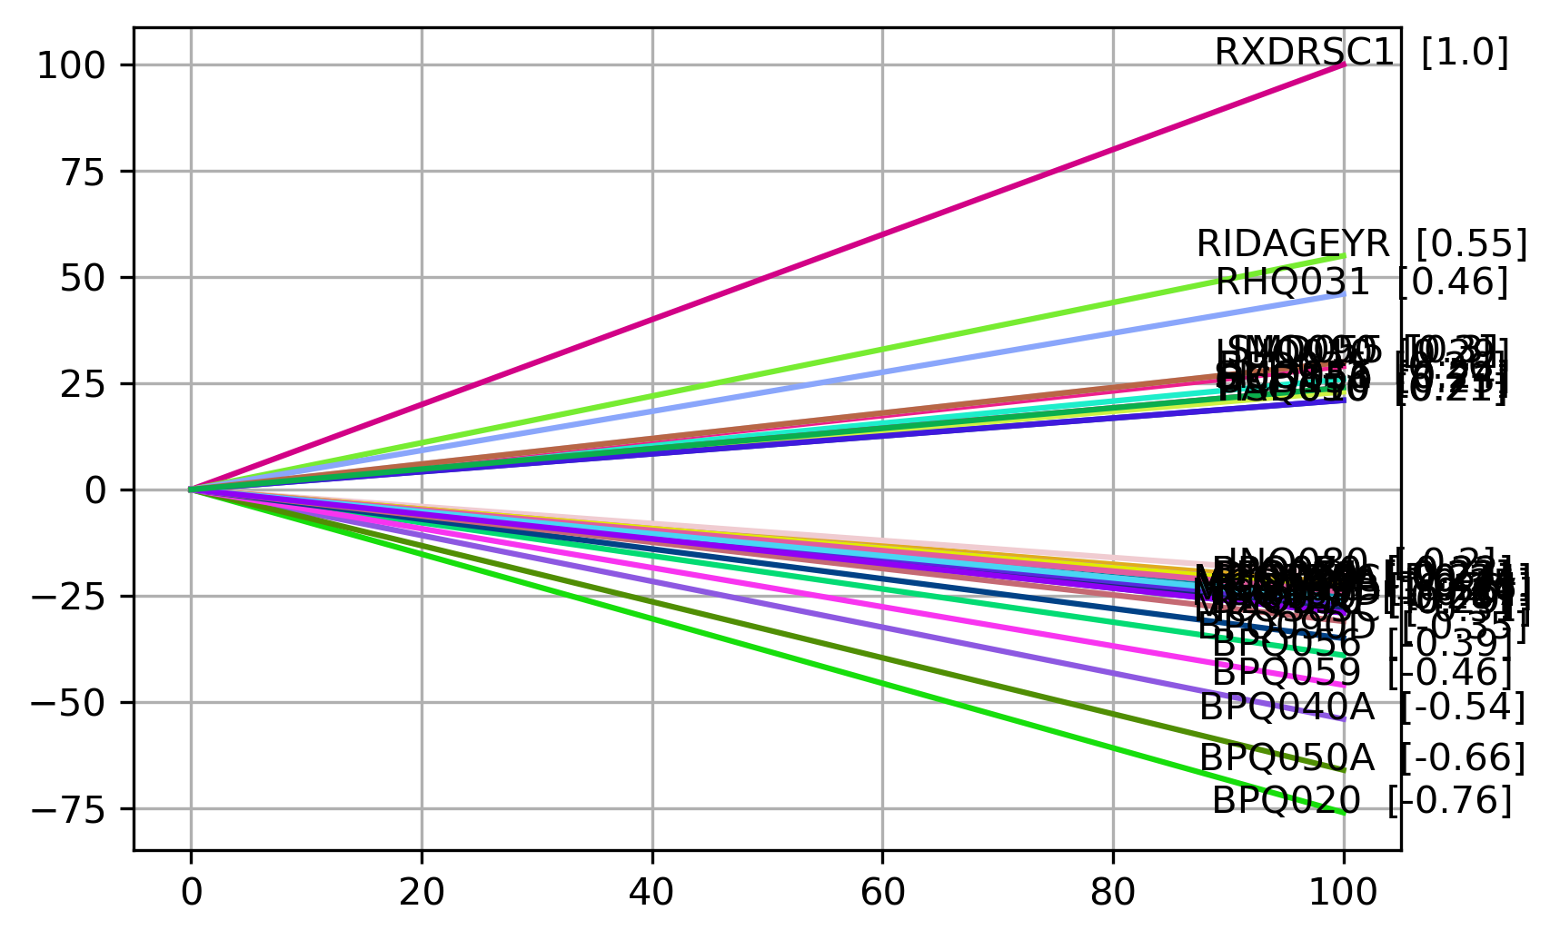
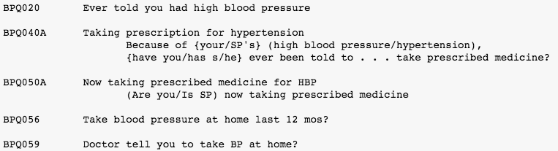
Items related to blood pressure…
Notes:
Unsurprisingly, some of the most correlated items are related to blood pressure.. However, take note of the formulation of some of the questionnaire variables

Slide 12
Issues related to health questionnaires
Compliance
Self-reported items

Slide 14
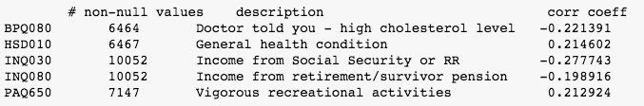
Q: Can we identify individuals with hypertension in this dataset?
Assuming we do classify an individual as having/not having hypertension only based on
We built our model on these arbitrary variables
These questionnaire variables are not too obviously related to blood pressure, and they are broad enough
Notes:
-would be too easy to build a model out of the previous blood pressure-related variables
-those selected variables are broad enough

