Slide 1
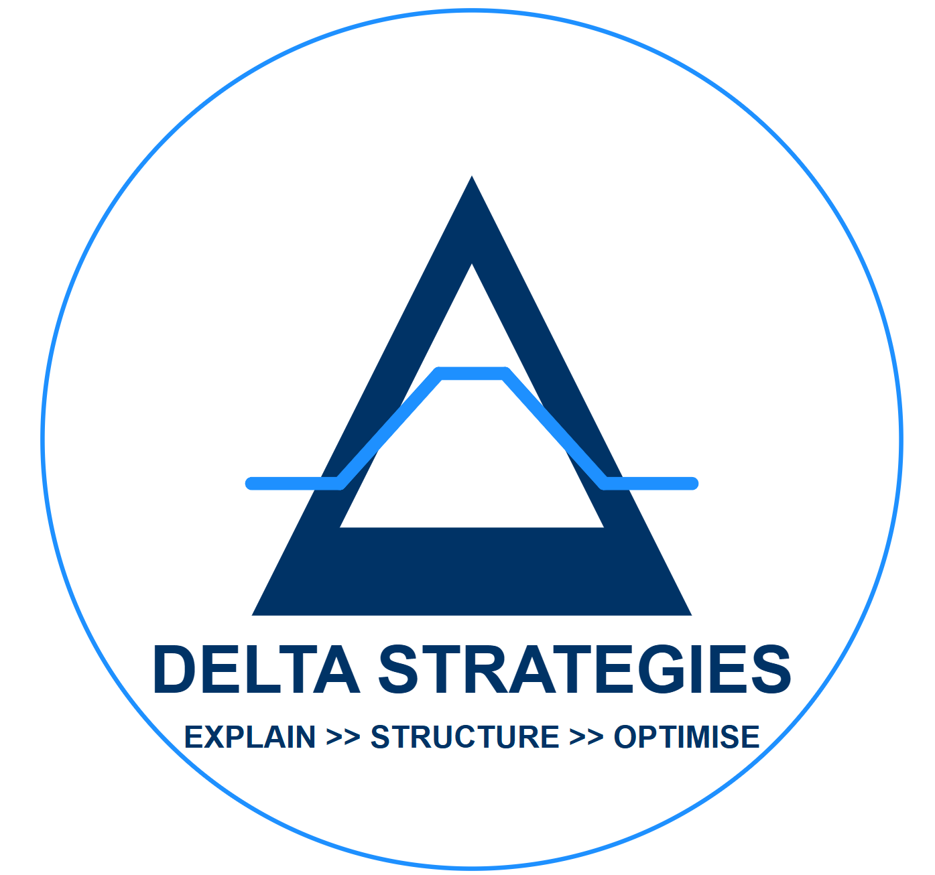
MercadoLibre (MELI)
Commentary Digest — YouTube & Podcast Sources
July 2026
Delta Capital Research

Slide 2
Scope: YouTube and podcast sources only — Reddit and X not yet available
• Target: MercadoLibre (MELI); window: recent commentary (2025–2026)
• Sources queried: YouTube (3 targeted searches), podcast RSS (Business Breakdowns feed)
• Reddit: API access requested 2026-07-06, pending Reddit's manual review
• X: on hold — no free API tier since Feb 2026 (pay-per-use only)
Full source-level detail: MELI_commentary_digest_2026-07-06.md

Slide 3
Leadership transition just completed: Galperin to Szarfsztejn
• Marcos Galperin stepped down as CEO Jan 1, 2026 after ~25 years; became Executive Chairman
• Ariel Szarfsztejn (joined 2017; built logistics org from 60 to 70,000+ employees) is now CEO
• Galperin gave up his salary and title specifically to force full commitment onto the new CEO

Slide 4
Galperin engineered the succession as a forcing function, not a retirement
• "I’m giving up my salary, I’m giving up my job, I’m giving up the position because whoever leads this company cannot be focused on Mercado Libre and other things." — Galperin
• Szarfsztejn calls it Galperin’s "visionary move ... a generational change" — says he was already acting as CEO before the official date
• Watch item: Galperin says he remains involved ‘24/7, 365’ as Executive Chairman — worth tracking whether Szarfsztejn has real autonomy
Bain & Company, “Founder’s Mentality: The CEO Sessions” (2026-02-24) · Americas Society/COA, “BRAVO Leadership Conversation” (2025-10-16)

Slide 5
Amazon's 2015 entry gets credit for sharpening MELI; Chinese rivals seen as a tougher fight
• Galperin: "we would not be the Mercado Libre that we are today if it were not because of Amazon coming into Mexico [in 2015]"
• Chinese competitors (Temu/Shein) described as less price-disciplined than Amazon — “a long and tough battle”
• Szarfsztejn: Brazil is "probably the most competitive scenario in e-commerce in the world"
• Independent analyst (Sven Carlin, June 2026) flags Wall Street concern over margin suppression tied to competitive pressure

Slide 6
AI is already capping developer headcount growth, not just an efficiency story
• Szarfsztejn's four pillars: efficiency, developer productivity, product improvements, early-stage agentic experience (piloted inside Mercado Pago)
• Galperin: "this is the first year ever that we won’t grow our developers" — projects 20,000 to ~10,000 over five years via attrition, not layoffs
• Platform risk flagged by the founder directly: an AI-native device/partnership could mean "our app doesn’t show up anymore"
• Gap: no independent pushback found yet on this narrative — check once Reddit/X access is available

Slide 7
Management frames fintech, not e-commerce, as the bigger growth lever
• Mexico: ~6% loan-to-GDP ratio; ~85% of Mexicans lack a credit card — framed as the scale of the opportunity
• MELI credit is often cited as a small business's first-ever access to credit
• Argentina's remunerated-deposit product grew from ~400K to 18 million investors on-platform

Slide 8
Independent analyst sees fair value near current levels, not a clear mispricing
• Sven Carlin (independent, YouTube, 2026-06-07): 42% revenue growth, 47% growth in items sold last quarter
• His own DCF-style estimate: ~$1,000/share conservative intrinsic value; implies 10–15% expected return depending on growth assumptions
• Claims Michael Burry holds a position and "is waiting for lower prices" — [UNSOURCED], the analyst's own claim, not independently verified

Slide 9
Two sources still closed; one podcast transcript blocked
• Reddit — application submitted 2026-07-06; approval odds uncertain for a private research use case under the new Responsible Builder Policy
• X — on hold; pay-per-use only since Feb 2026 (no free tier)
• Business Breakdowns podcast episode on MELI (Sept 2025): show notes retrieved; full transcript blocked by source site (403), no transcription key configured
• Two Spanish-language YouTube videos returned no transcript (caption-language gap)

