Slide 1
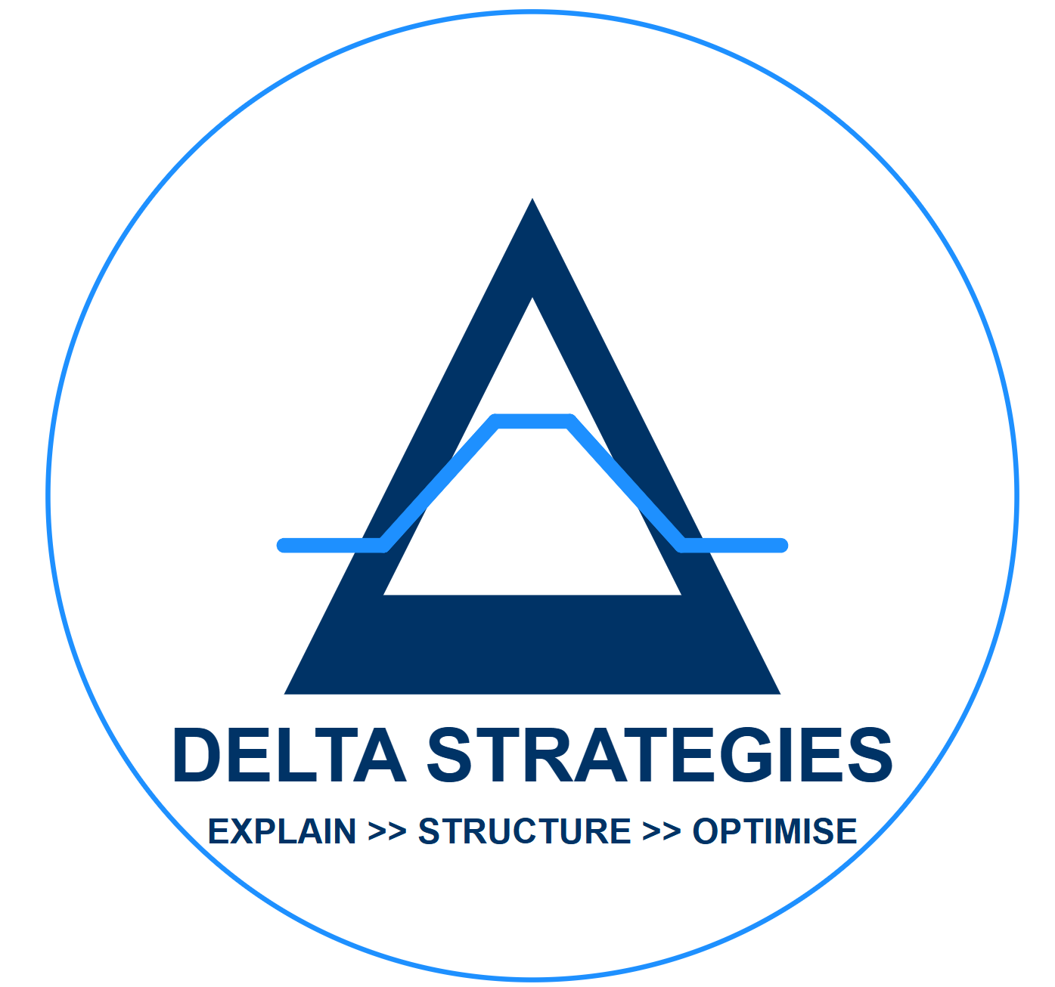
Delta Strategies Introduction
June 2026
Sadat Mannan
[ s.mannan@deltacapitalresearch.com ; +44 7876 558 440 ]

Slide 2
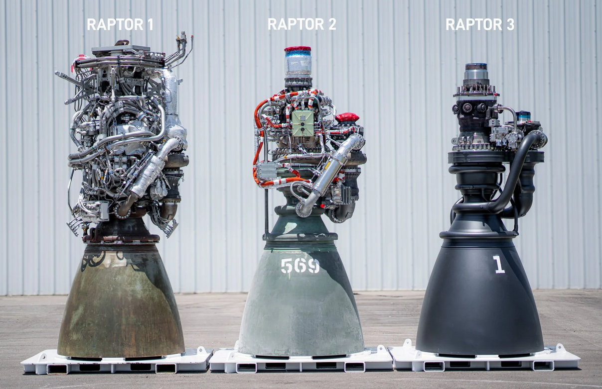
Optimisation viewed as higher output with lower inputs
Incremental efficiency gains in practice at SpaceX
 | Raptor 1 | Raptor 2 | Raptor 3 | Raptor X
Mass | 2,000 kg | 1,600 kg | 1,400 kg | 1,100 kg
Thrust | 185 tons | 230 tons | 269 tons | 320 tons
Chamber Pressure | 250 bar | 300 bar | 350 bar | 450 bar
TW Ratio engine Only | 93 | 144 | 192 | 267
https://www.nextbigfuture.com/2024/08/spacex-reveals-raptor-3-engine-and-specifications.html

Slide 3
Delta Strategies – Example Services
Creation of a Trade level, incremental, view of cash, collateral, margin, carry, risk and risk Greeks. This view then rolls up to Position, Issuer, Strategy, Portfolio Manager, Fund, CIO and Investor levels.
Replication of counterparty / exchange margin methodologies to verify margin calls and generate margin forecasts (T+0 look ahead).
Explanation of the difference between management Value at Risk (VaR) and Expected Shhortfall vs. actual margins being posted to identify areas of inefficiency and frictions.
Implementation of unencumbered cash / High Quality Liquid Assets (HQLA) management and investment and risk management policies leading to improved returns on Liquid Assets and cash.
Reduction of excess initial margin postings by identifying nettings and offsets.
Reduction of financing spreads on repos, prime brokerage and optimisation on the yield of reverse repos.
Negotiations with Prime Brokers and ISDA counterparties on commercial (balance sheet, specials, resources), treasury, liquidity and risk terms.
Tracking and publishing the dollar value of enhancements vs the baseline ex-ante run rates.

Slide 4
What is our overall goal?
Tighter control over repo financing, treasury investment functions, margin, capital, risk and P&L explains.
Maximize repo carry P&L at an ISIN / position level.
Add 50-100 bps extra return on Fund AuM while diversifying risk and reducing VaR.
Target [80]%-[95]% Unencumbered Cash Level. Dependent on Underlying Position liquidity and portfolio directionality and concentration.
Create a Return on Invested Capital (“RoIC”) view for daily, week to date, month to date, quarter to date, year to date view. Explain at a granular level the margin usage and P&L.

Slide 5
7 Pathways to Margin Relief
No | Type | Examples | Costs to Fund | Value to Fund | Pot Size in USD M
1 | Data Quality / Model Improvements | Faulty Time Series Data, Stale Data | 0 | 50-100 bps
2 | Parameter Renegotiations | VaR Mulitpilers, Minimum Term Commitments, MPOR, spreads | 0 | 50-100 bps
3 | Nettings | Butterfly 01 netting | 0 | 50-100 bps
4 | Offsets | Low Strike vs High Strike in Calls / Puts | minimal | 50-100 bps
5 | Rebalancing | Between Prime Brokers and Dealers | minimal | 50-100 bps
6 | Structures driven by CIO / PMs | Replace uncapped outright Linear positions and options with capped Call Spreads / Put Spreads | 5-15 bps carry cost | 50-100 bps
7 | Treasury Overlay Structures | Prime Broker / Dealer bespoke structures to finance the difference between House and Regulatory Margin | 100-200 bps carry cost | 600-700 bps

Slide 6
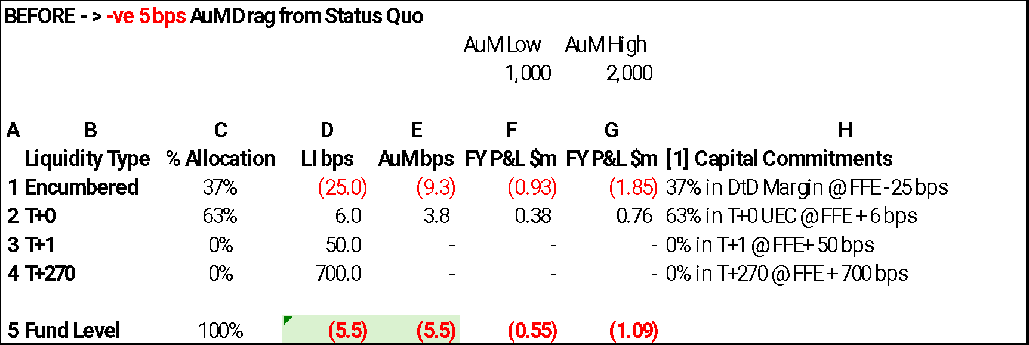
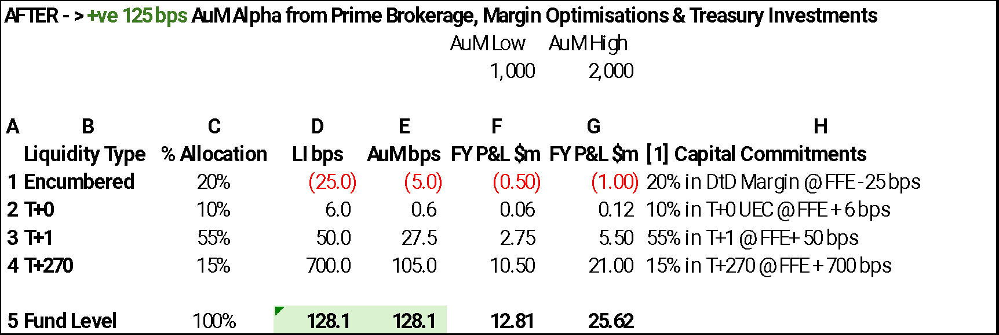
Case Study: Alpha Available from Prime Brokerage, Treasury and Liquidity Optimisations

Slide 7
Delta Strategies – An S Curves Approach to Optimisations
Set-up
Philosophy
Outcomes
1
2
3
(a) Specify > (b) Measure > (c) Standardise > (d) Normalise > (e) Scale-Up
Data Security
Data Extraction and coding
Investment Returns
Netting / Optimisation
Sharpe / Sortino
Initial Margin
Costs / Unsecured Funding charges
... Actionable Insights
Delta Strategies offers Integrated Skills Sets to Clients
Quintile 1
Quintile 5
Reduce and minimize
–ve Selections
Legal/ Compliance
Netting/ Offset
Outcomes
‘What if’ restructuring and trading
Increase and Scale Up
+ve Selections
Granular Events
Trade/ Client View
Client Co-location and integration to focus on Outcomes
Marginal Valuation Approach, scale up positive selections, avoid negative selections
Create both Trade Views and portfolio/ Entity Views of Financial Resource Usage

Slide 8
Delta Strategies - Background
Delta Strategies provides asset managers and investment firms with a consultancy service that covers risk analytics, treasury, margin, cash, collateral and secured / unsecured financing related enhancements as well as trade, structure and portfolio optimisation ideas and actionable steps.
Delta Strategies’ clients invest across the full spectrum of investment strategies - Equity (Long/Short), Fixed Income (Relative Value / Systematic, Discretionary / Macro, Nominal / Real), Foreign Exchange, Commodities and Credit (Illiquid / Emerging Markets) as well as the full spectrum of instruments (over the counter and exchange traded derivatives, listed and unlisted securities, cash and illiquid investments).
Delta Strategies’ trading and technology driven applications and processes allow granular risk, margin and cash forecasting on a T-1 basis and attribute explains on a T+1 basis.
Founded in 2020, Delta Strategies has clients in 4 continents (North America, Europe, Asia and Australia).
Current core team of 5 with deep expertise in trading, structuring, data analytics and coding. The core team is further supported by an external talent pool of industry veterans in areas of client origination, regulatory policy, legal and compliance.

Slide 9
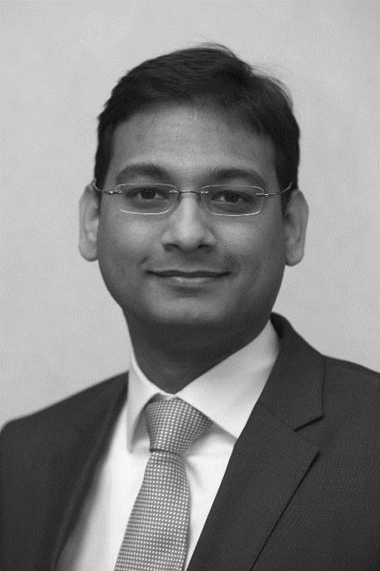
Delta Strategies - Founder - Sadat Mannan
25+ years in the finance industry
19 years with Barclays - 9 years as a Managing Director / global trading business head in London and New York. Built from scratch new business with annual revenue run rate >$400m with >300 clients and managed a team of >60 located in 4 locations.
Previously served as the EMEA Head of Prime Brokerage business during 2007-2010 period and as Head of Collateral Optimisation Trading 2010-2012.
3 years as a Treasurer / Portfolio Manager at a Global Macro Investment Firm in Switzerland.
Built multiple Technology focused trading / banking applications.
Founder - Delta Strategies. Provides externally outsourced risk analytics, treasury, margin, cash and financing enhancements consultancy as well as optimisation ideas for portfolio and trade structures to Asset Managers located in 4 continents.
Education
BSc (Hons) in Econometrics and Mathematical Economics from the London School of Economics
GCE – A Levels , Collège du Léman, Switzerland
CFA® charterholder
General Securities Registered Representative (Series 7)
Securities and Financial Derivatives Representative (SFDR)
NFA registration qualified

Slide 10


Appendix 5 - Delta Strategies - Operating Principles

