Slide 1
camlogic: a CDCL SAT solver for OCaml
By Jay LeCavalier

Slide 2
Implementation Details
Managed the project using oasis
Parsed the specification files using ocamllex and ocamlyacc.
Specify a problem as follows:
List number of variables and clauses at top of file.
Each clause is a sequence of integers terminated by a zero.

Slide 3
Interesting Part of the CDCL Algorithm
The most interesting part of CDCL is when we learn new information from a conflict in the form of a conflict clause.
There are multiple correct ways to generate a conflict clause (some lead to more efficient solvers than others)
Allow me to walk you through the procedure I used to find a conflict clause on the board.

Slide 4
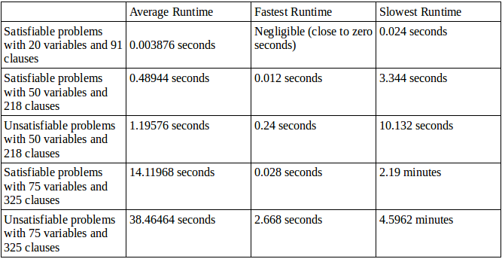
Results

Slide 5
Future Work
Implement random restarts, and compare the results to the solver as it is now.
Look into different methods for generating conflict clauses.
I already have a tool that solves SAT using DPLL without conflict clauses. I could compare that tool to this one.

Slide 6
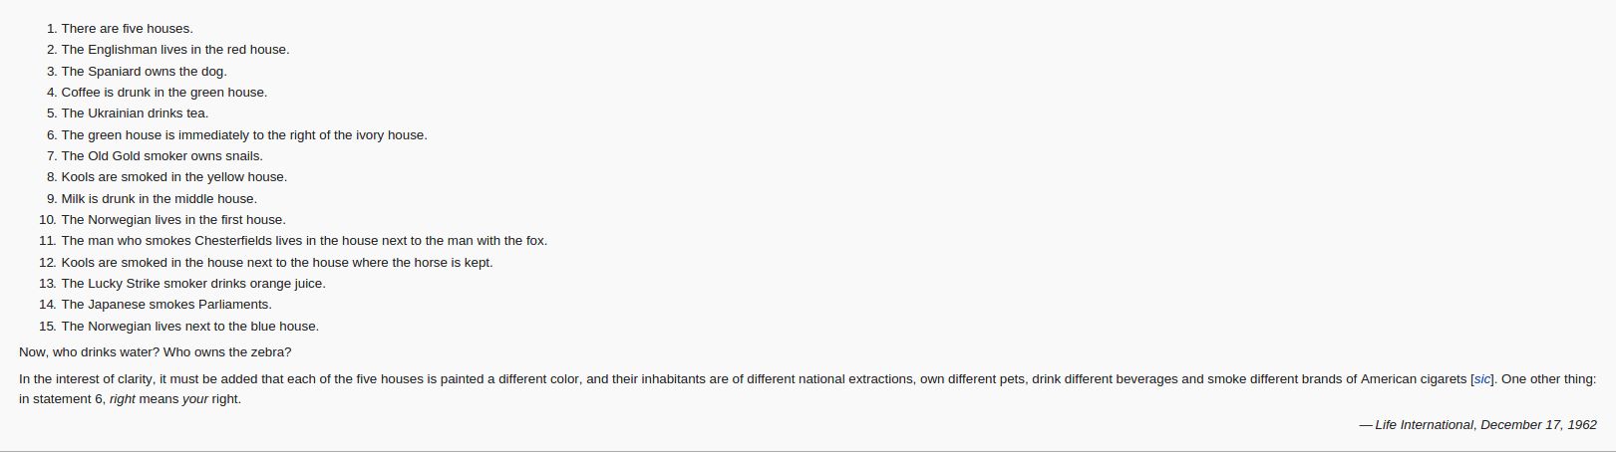
Now, for a quick demo!

