Slide 1
YUI 3 Loading Strategies
Yahoo! Search
Julien Lecomte
F2E Summit 2011

Slide 2
Terminology
SRP = Search Results Page
RTB = Round Trip Beacon (aka Boomerang)
YUI w/o version number will refer to YUI 3

Slide 3
What makes a good search results page?
Relevant results
Easy to scan quickly
Fast!

Slide 4
The SRP, a very special page
Performance is a business issue:
If your web site is not responsive enough,
you will lose revenue and customer loyalty!

Slide 5
The SRP, a very special page
Web Search is an extremely competitive arena, and it brings a significant amount of revenue to Yahoo! and its direct competitors.

Slide 6
The SRP, a very special page
Every millisecond and every byte counts!

Slide 7
The SRP, a very special page
Not only does the page need to be fast, it must feel fast → Perceived performance is critical!

Slide 8
The SRP, a very special page
Spinners and loading indicators are evil!

Slide 9
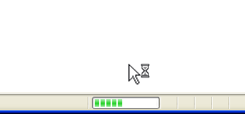
The SRP, a very special page
THIS IS EVIL!

Slide 10
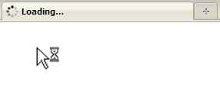
The SRP, a very special page
THIS IS EVIL!

Slide 11
The SRP, a very special page
Reducing time to window.onload
(without using dirty tricks*) is critical!
(*) Don’t even think about lazy-loading the entire page!

Slide 12
The SRP, a very special page
Q: What does the overwhelming majority of users look for in a search results page?

Slide 13
The SRP, a very special page
A: The search results!

Slide 14
The SRP, a very special page
Although “fancy” features are a differentiating factor, they should not get in the way!

Slide 15
The SRP, a very special page
Well-designed “fancy” SRP features should:
either occupy minimal real estate footprint,
or appear only when the user needs it / wants it,
or appear towards the bottom of the page,
unless it is highly relevant,
and never slow down the page!

Slide 16

Example of a “fancy” feature: “Super Wow”

Slide 17
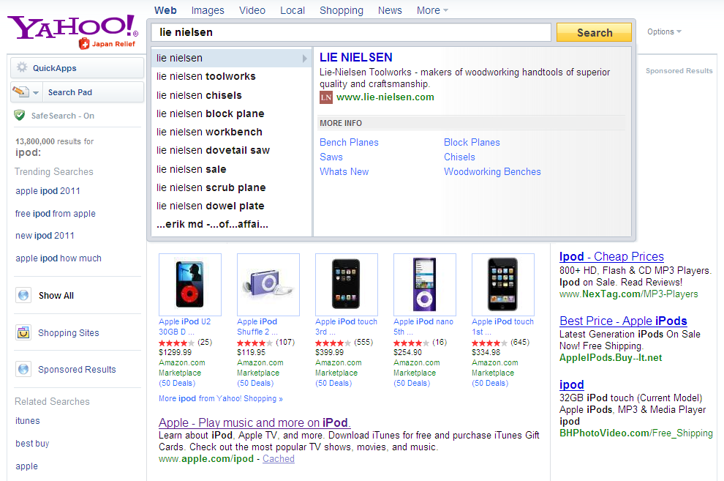
Example of a “fancy” feature: “Search Direct”

Slide 18
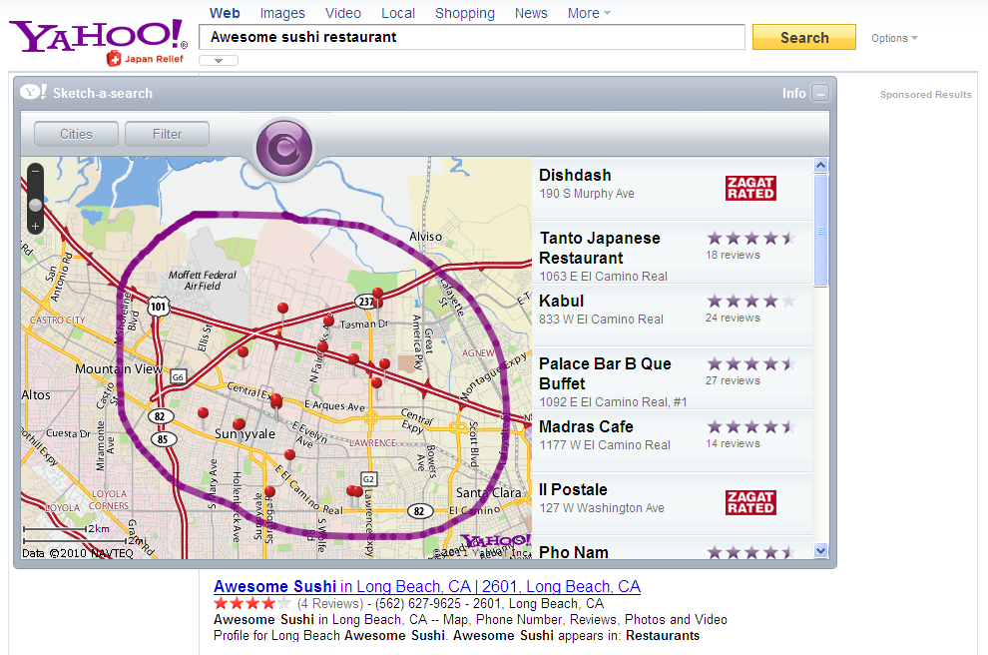
Example of a “fancy” feature: “Quick Apps”

Slide 19

Example of a “fancy” feature: “Slide shows”

Slide 20
The SRP, a very special page
Dynamic features require JavaScript.

Slide 21
The SRP, a very special page
It is unrealistic to develop complex features without a library nowadays…

Slide 22
The SRP, a very special page
YUI is the standard at Yahoo!

Slide 23
The SRP, a very special page
YUI is awesome…

Slide 24
The SRP, a very special page
…but it’s big!*
(*) when compared to the amount of JavaScript we used to load on the SRP with YUI 2

Slide 25
The SRP, a very special page
We load 70 KB compressed (gzip) / 210 KB uncompressed of JavaScript, most of which is YUI.

Slide 26
The SRP, a very special page
Advanced bootstrapping strategies mitigate the performance impact of loading a large library.

Slide 27
Common YUI bootstrapping strategies

Slide 28
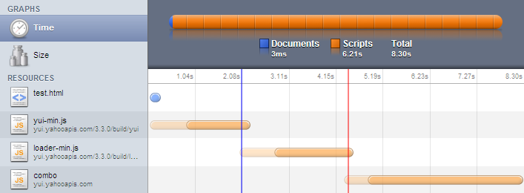
Bootstrap: YUI seed
<script src="http://yui.yahooapis.com/3.3.0/build/yui/yui-min.js"></script>
<script>
YUI().use('node', function (Y) {...});
</script>
YUI seed
YUI loader
“node” and dependencies…
→ 8.30 seconds on a modem! (total time for the page to load + download of each JS file)

Slide 29
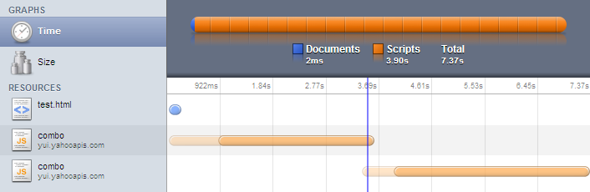
Bootstrap: YUI seed + loader
<script src="http://yui.yahooapis.com/combo?3.3.0/build/yui/yui-min.js&3.3.0/build/loader/loader-min.js"></script>
<script>
YUI().use('node', function (Y) {...});
</script>
YUI seed + loader
“node” and dependencies…
→ 7.37 seconds on a modem! (total time for the page to load + download of each JS file)

Slide 30
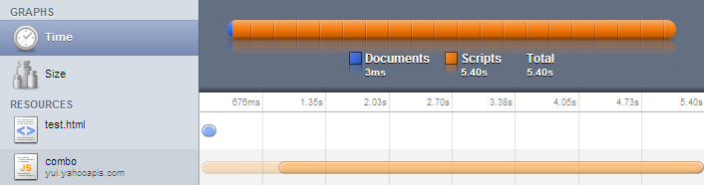
No bootstrap
<script src="http://yui.yahooapis.com/combo?3.3.0/build/yui/yui-base-min.js&3.3.0/build/oop/oop-min.js&3.3.0/build/dom/dom-base-min.js&3.3.0/build/dom/selector-native-min.js&3.3.0/build/dom/selector-css2-min.js&3.3.0/build/event-custom/event-custom-base-min.js&3.3.0/build/event/event-base-min.js&3.3.0/build/pluginhost/pluginhost-min.js&3.3.0/build/dom/dom-style-min.js&3.3.0/build/dom/dom-style-ie-min.js&3.3.0/build/dom/dom-screen-min.js&3.3.0/build/node/node-min.js&3.3.0/build/event/event-base-ie-min.js&3.3.0/build/event/event-delegate-min.js"></script>
<script>
YUI().use('features', 'node', function (Y) {...});
</script>
YUI seed + “node” and dependencies…
→ 5.40 seconds on a modem! (total time for the page to load + download of each JS file)

Slide 31
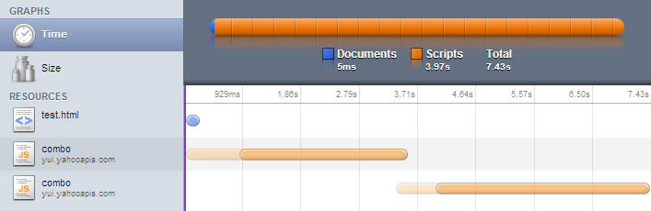
Lazy-load the YUI seed + loader
YUI seed + loader
“node” and dependencies…
7.43 seconds on a modem (total time for the page to load + download of each JS file)
“artificially” lower RTB but no overall improvement.

Slide 32
Lazy-load all of the code…
YUI seed + “node” and dependencies…
5.40 seconds on a modem (total time for the page to load + download of each JS file)
Same deal: “artificially” lower RTB but no overall improvement.

Slide 33
Lazy-loading, the nitty gritty…
window.onload = function () {
var d = document,
h = d.getElementsByTagName("head")[0],
s = d.createElement("script");
function init () {
YUI().use('node', function (Y) {...});
}
s.src = '...';
s.async = 'true';
if (s.addEventListener) {
s.addEventListener('load', init, false);
} else {
s.onreadystatechange = function () {
if (s.readyState === 'loaded' || s.readyState === 'complete') {
s.onreadystatechange = null;
init();
}
};
}
h.appendChild(s);
};

Slide 34
The problem we’re trying to solve
The YUI loader does not yet support parallel loading (it’s coming very soon!)

Slide 35
The problem we’re trying to solve
Even once the YUI loader supports parallel loading, we will still need to first load the seed, the loader and its meta-data…

Slide 36
The problem we’re trying to solve
That’s 16KB minified and compressed (gzip)…

Slide 37
The problem we’re trying to solve
…or 50KB uncompressed (15% of our traffic!)

Slide 38
The problem we’re trying to solve
We could lazy-load it…

Slide 39
The problem we’re trying to solve
…but we’re still stuck with sequentially loading seed + loader first, and then have the loader take care of the remainder of the code!

Slide 40
The problem we’re trying to solve
Sequential loading is evil!

Slide 41
What we’re shooting for…
Lazy-load the YUI seed in parallel with standard YUI modules and SRP-specific YUI modules*.
(*) SRP features are implemented as YUI modules.
These modules are “Y.use()’d” mostly from code output inline in the SRP.

Slide 42
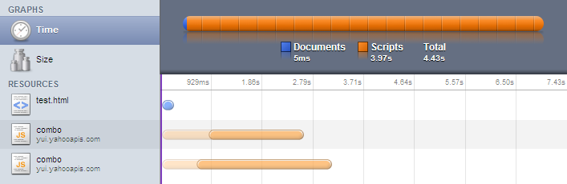
What we’re shooting for…
YUI seed + standard YUI modules
Standard YUI modules + SRP-specific YUI modules
3.17 seconds on a modem! (total time for the page to load + download of each JS file)
lower RTB because everything is lazy loaded
large overall improvement thanks to parallel download

Slide 43

A word of warning…

Slide 44
A word of warning…
The tricks you are about to witness are not recommended practice!

Slide 45
A word of warning…
The YUI team does not support this
(i.e. you’re pretty much on your own…)

Slide 46
How to do this?
Split code in “bundles” of roughly similar size.
The YUI seed is included in one of these bundles.
A bundle contains several YUI modules (either standard or SRP-specific), and therefore is just a series of calls to YUI.add()
Lazy-load the bundles from onload handler.

Slide 47
Huh, will that work?
NO! The order in which the bundles are downloaded cannot be guaranteed i.e. 'YUI' may be undefined when the code inside a bundle is evaluated.

Slide 48
What about inline scripts?
We want to make the loading process transparent to developers!

Slide 49
Old SRP skeleton
<!doctype html>
<html>
...
<body>
...
<script src="seed.js"></script>
<script>
Y.use('foo', function () { ... feature init code ... });
Y.use('bar', function () { ... feature init code ... });
...
</script>
</body>
</html>

Slide 50
What about inline scripts?
Developers should be able to safely output the following code inline:
Y.use('foo', function () {
... feature init code ...
});
Note: we’re using a single global YUI instance (Y)

Slide 51
Huh, will that work?
NO! Since we want to lazy-load the YUI seed, we cannot have a YUI instance created at that point i.e. 'Y' will be undefined.

Slide 52
Our solution

Slide 53
New SRP skeleton
<!doctype html>
<html>
...
<body>
...
<script>
YUI = ...;
Y = ...;
window.onload = function () { ... Lazy load bundles ... };
Y.use('foo', function () { ... feature init code ... });
Y.use('bar', function () { ... feature init code ... });
...
</script>
</body>
</html>

Slide 54
The fake YUI object (output inline in the SRP)
YUI = {
Env: {
mods: {}
},
add: function (name, fn, version, details) {
YUI.Env.mods[name] = {
name: name,
fn: fn,
version: version,
details: details || {}
};
}
};

Slide 55
The fake Y instance (output inline in the SRP)
Y = {
pending: [],
use: function () {
Y.pending.push(arguments);
}
};

Slide 56
The bundle containing the YUI seed
search/yui-override.js
yui-3.3.0/yui/yui-base.js
yui-3.3.0/yui/yui-later.js
yui-3.3.0/collection/array-extras.js
yui-3.3.0/yui/get.js
yui-3.3.0/yui/features.js
yui-3.3.0/oop/oop.js
yui-3.3.0/loader/loader.js
...
search/srp-core.js

Slide 57
yui-override.js
if (typeof YUI !== 'undefined') {
fakeYUI = YUI;
YUI = undefined;
}

Slide 58
The real YUI instance
Once the YUI seed has been downloaded,
we create a real YUI instance.

Slide 59
The real YUI instance (pseudo code)
YUI({
bootstrap: false
}).use('yui-base', function (Y) {
1) Save a local reference to the fake YUI instance (global 'Y')
2) Add the modules that may have been registered with the
fake YUI object (fakeYUI) to the real YUI object (YUI)
3) Replace global 'Y' variable by the real YUI instance
passed to this function.
4) Process any pending calls to Y.use()
});

Slide 60
The real YUI instance (pseudo code)
YUI({
bootstrap: false
}).use('yui-base', function (Y) {
1) Save a local reference to the fake YUI instance (global 'Y')
2) Add the modules that may have been registered with the
fake YUI object (fakeYUI) to the real YUI object (YUI)
3) Replace global 'Y' variable by the real YUI instance
passed to this function.
4) Process any pending calls to Y.use()
});

Slide 61
The real YUI instance (pseudo code)
YUI({
bootstrap: false
}).use('yui-base', function (Y) {
1) Save a local reference to the fake YUI instance (global 'Y')
2) Add the modules that may have been registered with the
fake YUI object (fakeYUI) to the real YUI object (YUI)
3) Replace global 'Y' variable by the real YUI instance
passed to this function.
4) Process any pending calls to Y.use()
});

Slide 62
The real YUI instance (pseudo code)
YUI({
bootstrap: false
}).use('yui-base', function (Y) {
1) Save a local reference to the fake YUI instance (global 'Y')
2) Add the modules that may have been registered with the
fake YUI object (fakeYUI) to the real YUI object (YUI)
3) Replace global 'Y' variable by the real YUI instance
passed to this function.
4) Process any pending calls to Y.use()
});

Slide 63
The real YUI instance (pseudo code)
YUI({
bootstrap: false
}).use('yui-base', function (Y) {
1) Save a local reference to the fake YUI instance (global 'Y')
2) Add the modules that may have been registered with the
fake YUI object (fakeYUI) to the real YUI object (YUI)
3) Replace global 'Y' variable by the real YUI instance
passed to this function.
4) Process any pending calls to Y.use()
});

Slide 64
Huh, will that work?
NO! When the loader is disabled, the callback function passed to Y.use() is invoked, whether or not the dependencies are available (a bad design decision IMHO)

Slide 65
Modifying the behavior of Y.use()
YUI({
bootstrap: false
}).use('yui-base', 'event-custom-base', function (Y) {
var pending = [];
...
Y.before(function () {
If a dependency is missing, do:
pending.push(arguments);
return new Y.Do.Prevent();
}, Y, 'use');
...
});

Slide 66
Unblocking a pending call to Y.use()
The availability of a new module may unblock a pending call to Y.use()

Slide 67
Modifying the behavior of YUI.add()
YUI({
bootstrap: false
}).use('yui-base', 'event-custom-base', function (Y) {
...
Y.after(function () {
Process pending queue to see if this newly added
module may unblock a pending call to Y.use()
}, YUI, 'add');
...
});

Slide 68
Loading/execution flow (1/2)
Y.use() invoked
Compute dependency tree.
Missing
dependency?
Yes
Append call to pending queue.
No
Execute standard Y.use()

Slide 69
Loading/execution flow (1/2)
Y.use() invoked
Compute dependency tree.
Missing
dependency?
Yes
Append call to pending queue.
No
Execute standard Y.use()

Slide 70
Loading/execution flow (1/2)
Y.use() invoked
Compute dependency tree.
Missing
dependency?
Yes
Append call to pending queue.
No
Execute standard Y.use()

Slide 71
Loading/execution flow (1/2)
Y.use() invoked
Compute dependency tree.
Missing
dependency?
Yes
Append call to pending queue.
No
Execute standard Y.use()

Slide 72
Loading/execution flow (1/2)
Y.use() invoked
Compute dependency tree.
Missing
dependency?
Yes
Append call to pending queue.
No
Execute standard Y.use()

Slide 73
Loading/execution flow (2/2)
JS bundle downloaded
YUI.add()
Is a call to Y.use()
pending?
Yes
Execute pending call.

Slide 74
Loading/execution flow (2/2)
JS bundle downloaded
YUI.add()
Is a call to Y.use()
pending?
Yes
Execute pending call.

Slide 75
Loading/execution flow (2/2)
JS bundle downloaded
YUI.add()
Is a call to Y.use()
pending?
Yes
Execute pending call.

Slide 76
Loading/execution flow (2/2)
JS bundle downloaded
YUI.add()
Is a call to Y.use()
pending?
Yes
Execute pending call.

Slide 77
The code…
Putting it together…
SVN: yahoo/searchfe/projects/web/trunk/src/webdev/js/intl/all/metro_yui3/srp-core.js

Slide 78
srp-core.js (1/8)
YUI({
bootstrap: false
}).use('yui-base', 'event-custom-base', function (Y) {
var fakeY = Y.config.win.Y, pending = [];
Y.mix(YUI.Env, fakeYUI.Env, false, null, 0, true);
Y.before(function () {
If a dependency (direct or indirect) is missing, do:
pending.push(arguments);
return new Y.Do.Prevent();
}, Y, 'use');
Y.after(function () {
Process queue to see if this newly added module
unblocks a pending call to Y.use()
}, YUI, 'add');
Y.config.win.Y = Y;
Y.each(fakeY.pending, function (args) {
Y.use.apply(Y, args);
});
fakeYUI = undefined;
});

Slide 79
srp-core.js (2/8)
YUI({
bootstrap: false
}).use('yui-base', 'event-custom-base', function (Y) {
var fakeY = Y.config.win.Y, pending = [];
Y.mix(YUI.Env, fakeYUI.Env, false, null, 0, true);
Y.before(function () {
If a dependency (direct or indirect) is missing, do:
pending.push(arguments);
return new Y.Do.Prevent();
}, Y, 'use');
Y.after(function () {
Process queue to see if this newly added module
unblocks a pending call to Y.use()
}, YUI, 'add');
Y.config.win.Y = Y;
Y.each(fakeY.pending, function (args) {
Y.use.apply(Y, args);
});
fakeYUI = undefined;
});

Slide 80
srp-core.js (3/8)
YUI({
bootstrap: false
}).use('yui-base', 'event-custom-base', function (Y) {
var fakeY = Y.config.win.Y, pending = [];
Y.mix(YUI.Env, fakeYUI.Env, false, null, 0, true);
Y.before(function () {
If a dependency (direct or indirect) is missing, do:
pending.push(arguments);
return new Y.Do.Prevent();
}, Y, 'use');
Y.after(function () {
Process queue to see if this newly added module
unblocks a pending call to Y.use()
}, YUI, 'add');
Y.config.win.Y = Y;
Y.each(fakeY.pending, function (args) {
Y.use.apply(Y, args);
});
fakeYUI = undefined;
});

Slide 81
srp-core.js (4/8)
YUI({
bootstrap: false
}).use('yui-base', 'event-custom-base', function (Y) {
var fakeY = Y.config.win.Y, pending = [];
Y.mix(YUI.Env, fakeYUI.Env, false, null, 0, true);
Y.before(function () {
If a dependency is missing, do:
pending.push(arguments);
return new Y.Do.Prevent();
}, Y, 'use');
Y.after(function () {
Process queue to see if this newly added module
unblocks a pending call to Y.use()
}, YUI, 'add');
Y.config.win.Y = Y;
Y.each(fakeY.pending, function (args) {
Y.use.apply(Y, args);
});
fakeYUI = undefined;
});

Slide 82
srp-core.js (5/8)
YUI({
bootstrap: false
}).use('yui-base', 'event-custom-base', function (Y) {
var fakeY = Y.config.win.Y, pending = [];
Y.mix(YUI.Env, fakeYUI.Env, false, null, 0, true);
Y.before(function () {
If a dependency (direct or indirect) is missing, do:
pending.push(arguments);
return new Y.Do.Prevent();
}, Y, 'use');
Y.after(function () {
Process queue to see if this newly added module
unblocks a pending call to Y.use()
}, YUI, 'add');
Y.config.win.Y = Y;
Y.each(fakeY.pending, function (args) {
Y.use.apply(Y, args);
});
fakeYUI = undefined;
});

Slide 83
srp-core.js (6/8)
YUI({
bootstrap: false
}).use('yui-base', 'event-custom-base', function (Y) {
var fakeY = Y.config.win.Y, pending = [];
Y.mix(YUI.Env, fakeYUI.Env, false, null, 0, true);
Y.before(function () {
If a dependency (direct or indirect) is missing, do:
pending.push(arguments);
return new Y.Do.Prevent();
}, Y, 'use');
Y.after(function () {
Process queue to see if this newly added module
unblocks a pending call to Y.use()
}, YUI, 'add');
Y.config.win.Y = Y;
Y.each(fakeY.pending, function (args) {
Y.use.apply(Y, args);
});
fakeYUI = undefined;
});

Slide 84
srp-core.js (7/8)
YUI({
bootstrap: false
}).use('yui-base', 'event-custom-base', function (Y) {
var fakeY = Y.config.win.Y, pending = [];
Y.mix(YUI.Env, fakeYUI.Env, false, null, 0, true);
Y.before(function () {
If a dependency (direct or indirect) is missing, do:
pending.push(arguments);
return new Y.Do.Prevent();
}, Y, 'use');
Y.after(function () {
Process queue to see if this newly added module
unblocks a pending call to Y.use()
}, YUI, 'add');
Y.config.win.Y = Y;
Y.each(fakeY.pending, function (args) {
Y.use.apply(Y, args);
});
fakeYUI = undefined;
});

Slide 85
srp-core.js (8/8)
YUI({
bootstrap: false
}).use('yui-base', 'event-custom-base', function (Y) {
var fakeY = Y.config.win.Y, pending = [];
Y.mix(YUI.Env, fakeYUI.Env, false, null, 0, true);
Y.before(function () {
If a dependency (direct or indirect) is missing, do:
pending.push(arguments);
return new Y.Do.Prevent();
}, Y, 'use');
Y.after(function () {
Process queue to see if this newly added module
unblocks a pending call to Y.use()
}, YUI, 'add');
Y.config.win.Y = Y;
Y.each(fakeY.pending, function (args) {
Y.use.apply(Y, args);
});
fakeYUI = undefined;
});

Slide 86
The results

Slide 87
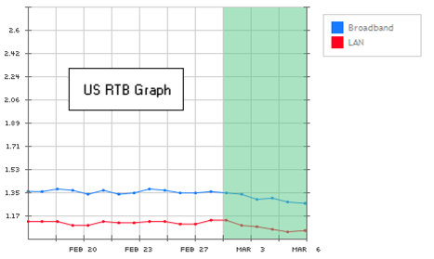
The results…
RTB times lower by 40 to 50 msec on broadband
(that’s considered a significant improvement :)
Over 1 second better on dialup connections!

Slide 88
The holy grail of JavaScript loading on the SRP…
Adapt the number of bundles lazy-loaded in parallel to the user agent’s capabilities.
Reduce the amount of JavaScript we load for all page views by moving more of it to on-demand loading.

Slide 89
Questions?
jlecomte@yahoo-inc.com
http://www.julienlecomte.net/
Twitter: @powersander
Y!IM: julien.lecomte

