Slide 1
YUI3 Loading Strategies
Yahoo! Search
Julien Lecomte
F2E Summit 2011

Slide 2
High level goals / Problem statement
Lower RTB times by lazy-loading the YUI seed.
Avoid sequential loading: load the bulk of the YUI library and the SRP core JS files in parallel with the seed!
Make the loading process transparent to web developers
(as long as they stick to a specific API)
Problem: As you will see, the YUI 3 library is not able to do that “out of the box”. Thankfully, it is amazingly flexible and beautifully designed, so we can modify it to do what we want.
Note: SRP = Search Results Page
Note: RTB = Round Trip Beacon: measures time between onunload and onload

Slide 3
YUI bootstrapping strategies

Slide 4
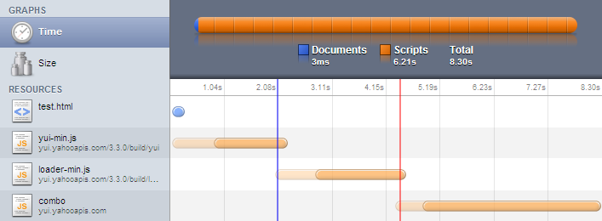
Bootstrap: YUI seed
<script src="http://yui.yahooapis.com/3.3.0/build/yui/yui-min.js"></script>
<script>
YUI().use('node', function (Y) {...});
</script>
→ 8.30 seconds on a modem! (total time for the page to load + download of each JS file)

Slide 5
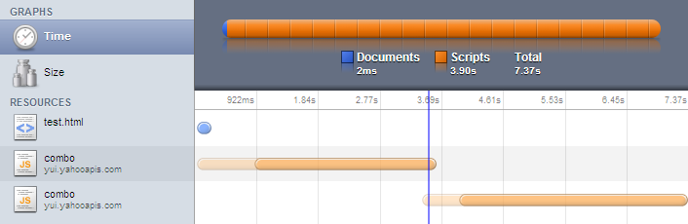
Bootstrap: YUI seed + loader
<script src="http://yui.yahooapis.com/combo?3.3.0/build/yui/yui-min.js&3.3.0/build/loader/loader-min.js"></script>
<script>
YUI().use('node', function (Y) {...});
</script>
→ 7.37 seconds on a modem! (total time for the page to load + download of each JS file)

Slide 6
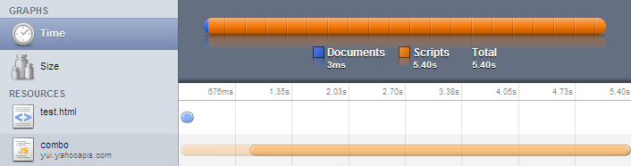
No bootstrap
<script src="http://yui.yahooapis.com/combo?3.3.0/build/yui/yui-base-min.js&3.3.0/build/oop/oop-min.js&3.3.0/build/dom/dom-base-min.js&3.3.0/build/dom/selector-native-min.js&3.3.0/build/dom/selector-css2-min.js&3.3.0/build/event-custom/event-custom-base-min.js&3.3.0/build/event/event-base-min.js&3.3.0/build/pluginhost/pluginhost-min.js&3.3.0/build/dom/dom-style-min.js&3.3.0/build/dom/dom-style-ie-min.js&3.3.0/build/dom/dom-screen-min.js&3.3.0/build/node/node-min.js&3.3.0/build/event/event-base-ie-min.js&3.3.0/build/event/event-delegate-min.js"></script>
<script>
YUI().use('features', 'node', function (Y) {...});
</script>
→ 5.40 seconds on a modem! (total time for the page to load + download of each JS file)

Slide 7
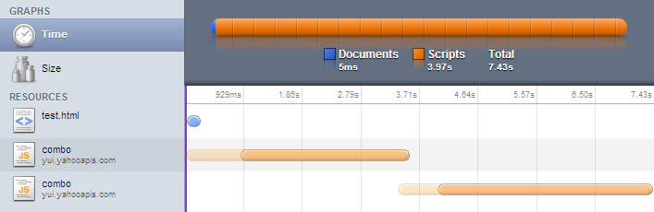
Lazy-load the YUI seed + loader
7.43 seconds on a modem (total time for the page to load + download of each JS file)
“artificially” lower RTB but no overall improvement compared to similar technique w/o lazy loading.

Slide 8
Lazy-load all of the code…
5.40 seconds on a modem (total time for the page to load + download of each JS file)
Same deal: “artificially” lower RTB but no overall improvement compared to similar technique w/o lazy loading.

Slide 9
Lazy-loading, the nitty gritty…
window.onload = function () {
var d = document,
h = d.getElementsByTagName("head")[0],
s = d.createElement("script");
function init () {
YUI().use('node', function (Y) {...});
}
s.src = '...';
s.async = 'true';
if (s.addEventListener) {
s.addEventListener('load', init, false);
} else {
s.onreadystatechange = function () {
if (s.readyState === 'loaded' || s.readyState === 'complete') {
s.onreadystatechange = null;
init();
}
};
}
h.appendChild(s);
};

Slide 10
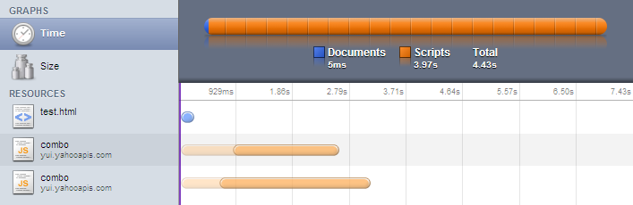
What we’re shooting for…
3.17 seconds on a modem! (total time for the page to load + download of each JS file)
lower RTB and large overall improvement
Note: the number of chunks loaded in parallel can be increased (and can even be tailored to the user agent requesting the page). However, the chunks should be similar in size!

Slide 11
How to do this?
Split code in chunks of roughly similar size
  The YUI seed is included in one of these chunks.
  A chunk contains several YUI3 modules, and therefore is a series of calls to YUI.add()
  The dependencies are fully resolved at build time.
→ Problem: the order in which chunks are downloaded cannot be guaranteed i.e. 'YUI' may be undefined when the code inside a module is evaluated.

Slide 12
YUI loader limitations

Slide 13
SRP skeleton
<!doctype html>
<html>
...
<body>
...
<script src="..."></script>
<script>
Y.use(..., function () { ... feature init code ... });
Y.use(..., function () { ... feature init code ... });
Y.use(..., function () { ... feature init code ... });
...
</script>
</body>
</html>

Slide 14
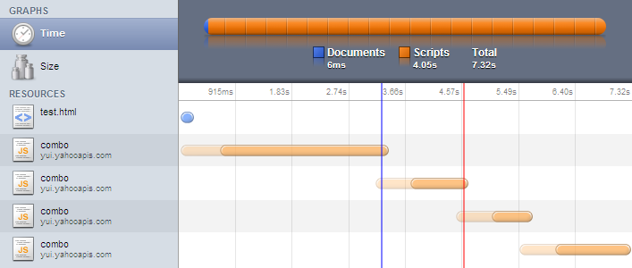
YUI Loader behavior
→ multiple sequential requests

Slide 15
What we’re shooting for…
Calling Y.use() should not invoke the loader.
We will take care of the loading ourselves.
The callback passed to Y.use() should not be invoked until all the (direct and indirect) dependencies are available.

Slide 16
How to do this?
Create a YUI instance and disable the loader for that instance:
Y = YUI({
bootstrap: false
});
→ Problem: when the loader is disabled, the callback function passed to Y.use() is invoked, whether or not the dependencies are available (a bad design decision IMHO)
→ Problem: the instance must be created *before* it can be used (duh!), but this inherently conflicts with our desire to lazy-load the YUI seed…

Slide 17
Our solution

Slide 18
New SRP skeleton
<!doctype html>
<html>
...
<body>
...
<script>
YUI = ...;
Y = ...;
Y.use(..., function () { ... feature init code ... });
Y.use(..., function () { ... feature init code ... });
Y.use(..., function () { ... feature init code ... });
...
</script>
</body>
</html>

Slide 19
The fake YUI object (output inline in the SRP)
YUI = {
Env: {
mods: {}
},
add: function (name, fn, version, details) {
YUI.Env.mods[name] = {
name: name,
fn: fn,
version: version,
details: details || {}
};
}
};

Slide 20
The fake Y instance (output inline in the SRP)
Y = {
pending: [],
use: function () {
Y.pending.push(arguments);
}
};

Slide 21
The real YUI instance
Here is the content of one of our lazy-loaded chunks:
search/yui-override.js
yui-3.3.0/yui/yui-base.js
yui-3.3.0/yui/yui-later.js
yui-3.3.0/collection/array-extras.js
yui-3.3.0/yui/get.js
yui-3.3.0/yui/features.js
yui-3.3.0/oop/oop.js
yui-3.3.0/loader/loader.js
...
search/srp-core.js

Slide 22
yui-override.js
if (typeof YUI !== 'undefined') {
fakeYUI = YUI;
YUI = undefined;
}

Slide 23
Loading/execution flow (1/2)
Y.use() was invoked, either directly or because
it was queued and a YUI 3 module was added.
Compute dependency tree.
Is a dependency missing?
Append call to pending queue and prevent
the standard Y.use() function from executing:
return new Y.Do.Prevent();
Yes
No
The standard Y.use() function
is automatically executed.
yahoo/searchfe/projects/web/trunk/src/webdev/js/intl/all/metro_yui3/srp-core.js

Slide 24
Loading/execution flow (2/2)
A file containing at least one YUI 3 module
is loaded, parsed and executed in the browser.
YUI.add() is invoked, adding
the module to the YUI object.
Is there a pending call to
Y.use() in the queue?
Pick a pending call to Y.use()
from the queue and execute it.
[the newly added module might
have solved a missing dependency
blocking a call to Y.use()…]
Yes
yahoo/searchfe/projects/web/trunk/src/webdev/js/intl/all/metro_yui3/srp-core.js

Slide 25
srp-core.js (1/8)
YUI({
bootstrap: false
}).use('yui-base', 'event-custom-base', function (Y) {
var fakeY = Y.config.win.Y, pending = [];
Y.mix(YUI.Env, fakeYUI.Env, false, null, 0, true);
Y.before(function () {
If a dependency (direct or indirect) is missing, do:
pending.push(arguments);
return new Y.Do.Prevent();
}, Y, 'use');
Y.after(function () {
Process queue to see if this newly added module
unblocks a pending call to Y.use()
}, YUI, 'add');
Y.config.win.Y = Y;
Y.each(fakeY.pending, function (args) {
Y.use.apply(Y, args);
});
fakeYUI = undefined;
});
yahoo/searchfe/projects/web/trunk/src/webdev/js/intl/all/metro_yui3/srp-core.js

Slide 26
srp-core.js (2/8)
YUI({
bootstrap: false
}).use('yui-base', 'event-custom-base', function (Y) {
var fakeY = Y.config.win.Y, pending = [];
Y.mix(YUI.Env, fakeYUI.Env, false, null, 0, true);
Y.before(function () {
If a dependency (direct or indirect) is missing, do:
pending.push(arguments);
return new Y.Do.Prevent();
}, Y, 'use');
Y.after(function () {
Process queue to see if this newly added module
unblocks a pending call to Y.use()
}, YUI, 'add');
Y.config.win.Y = Y;
Y.each(fakeY.pending, function (args) {
Y.use.apply(Y, args);
});
fakeYUI = undefined;
});
yahoo/searchfe/projects/web/trunk/src/webdev/js/intl/all/metro_yui3/srp-core.js

Slide 27
srp-core.js (3/8)
YUI({
bootstrap: false
}).use('yui-base', 'event-custom-base', function (Y) {
var fakeY = Y.config.win.Y, pending = [];
Y.mix(YUI.Env, fakeYUI.Env, false, null, 0, true);
Y.before(function () {
If a dependency (direct or indirect) is missing, do:
pending.push(arguments);
return new Y.Do.Prevent();
}, Y, 'use');
Y.after(function () {
Process queue to see if this newly added module
unblocks a pending call to Y.use()
}, YUI, 'add');
Y.config.win.Y = Y;
Y.each(fakeY.pending, function (args) {
Y.use.apply(Y, args);
});
fakeYUI = undefined;
});
yahoo/searchfe/projects/web/trunk/src/webdev/js/intl/all/metro_yui3/srp-core.js

Slide 28
srp-core.js (4/8)
YUI({
bootstrap: false
}).use('yui-base', 'event-custom-base', function (Y) {
var fakeY = Y.config.win.Y, pending = [];
Y.mix(YUI.Env, fakeYUI.Env, false, null, 0, true);
Y.before(function () {
If a dependency is missing, do:
pending.push(arguments);
return new Y.Do.Prevent();
}, Y, 'use');
Y.after(function () {
Process queue to see if this newly added module
unblocks a pending call to Y.use()
}, YUI, 'add');
Y.config.win.Y = Y;
Y.each(fakeY.pending, function (args) {
Y.use.apply(Y, args);
});
fakeYUI = undefined;
});
yahoo/searchfe/projects/web/trunk/src/webdev/js/intl/all/metro_yui3/srp-core.js

Slide 29
srp-core.js (5/8)
YUI({
bootstrap: false
}).use('yui-base', 'event-custom-base', function (Y) {
var fakeY = Y.config.win.Y, pending = [];
Y.mix(YUI.Env, fakeYUI.Env, false, null, 0, true);
Y.before(function () {
If a dependency (direct or indirect) is missing, do:
pending.push(arguments);
return new Y.Do.Prevent();
}, Y, 'use');
Y.after(function () {
Process queue to see if this newly added module
unblocks a pending call to Y.use()
}, YUI, 'add');
Y.config.win.Y = Y;
Y.each(fakeY.pending, function (args) {
Y.use.apply(Y, args);
});
fakeYUI = undefined;
});
yahoo/searchfe/projects/web/trunk/src/webdev/js/intl/all/metro_yui3/srp-core.js

Slide 30
srp-core.js (6/8)
YUI({
bootstrap: false
}).use('yui-base', 'event-custom-base', function (Y) {
var fakeY = Y.config.win.Y, pending = [];
Y.mix(YUI.Env, fakeYUI.Env, false, null, 0, true);
Y.before(function () {
If a dependency (direct or indirect) is missing, do:
pending.push(arguments);
return new Y.Do.Prevent();
}, Y, 'use');
Y.after(function () {
Process queue to see if this newly added module
unblocks a pending call to Y.use()
}, YUI, 'add');
Y.config.win.Y = Y;
Y.each(fakeY.pending, function (args) {
Y.use.apply(Y, args);
});
fakeYUI = undefined;
});
yahoo/searchfe/projects/web/trunk/src/webdev/js/intl/all/metro_yui3/srp-core.js

Slide 31
srp-core.js (7/8)
YUI({
bootstrap: false
}).use('yui-base', 'event-custom-base', function (Y) {
var fakeY = Y.config.win.Y, pending = [];
Y.mix(YUI.Env, fakeYUI.Env, false, null, 0, true);
Y.before(function () {
If a dependency (direct or indirect) is missing, do:
pending.push(arguments);
return new Y.Do.Prevent();
}, Y, 'use');
Y.after(function () {
Process queue to see if this newly added module
unblocks a pending call to Y.use()
}, YUI, 'add');
Y.config.win.Y = Y;
Y.each(fakeY.pending, function (args) {
Y.use.apply(Y, args);
});
fakeYUI = undefined;
});
yahoo/searchfe/projects/web/trunk/src/webdev/js/intl/all/metro_yui3/srp-core.js

Slide 32
srp-core.js (8/8)
YUI({
bootstrap: false
}).use('yui-base', 'event-custom-base', function (Y) {
var fakeY = Y.config.win.Y, pending = [];
Y.mix(YUI.Env, fakeYUI.Env, false, null, 0, true);
Y.before(function () {
If a dependency (direct or indirect) is missing, do:
pending.push(arguments);
return new Y.Do.Prevent();
}, Y, 'use');
Y.after(function () {
Process queue to see if this newly added module
unblocks a pending call to Y.use()
}, YUI, 'add');
Y.config.win.Y = Y;
Y.each(fakeY.pending, function (args) {
Y.use.apply(Y, args);
});
fakeYUI = undefined;
});
yahoo/searchfe/projects/web/trunk/src/webdev/js/intl/all/metro_yui3/srp-core.js

Slide 33
Low coverage features

Slide 34
YUI Loader
Y.use('loader', 'srp', function () {
Y.config = Y.mix(Y.config, {
bootstrap: true,
combine: true,
comboBase: 'http://a.l.yimg.com/a/combo?',
root: 'yui/3.3.0/build/',
... modules info goes here ...
}, true, null, 0, true);
Y.Search.use(..., function () { ← invokes the YUI loader
...
});
});

Slide 35
R3 template code…
$data = ...;
$config = json_encode($data);
$js = 'new Y.Search.Shortcut.CelebWow(' . $config . ');';
ComboRegistry::requires('shortcut-celeb-wow');
ComboRegistry::script($js);

Slide 36
Additional considerations

Slide 37
Early features
Reset the search forms post-onload
Send beacon to Bing
Clean up ULT craziness on algo links
Lazy-load images
→ implemented using native browser APIs

Slide 38
Degradation / Capturing early user interactions
Core features must work with or without JavaScript anyway!
Features that rely on JavaScript should not be reachable until the code is available (which may be never if JavaScript is disabled…)
Early user interactions may be captured using the event-binder Gallery utility.

Slide 39
The results

Slide 40
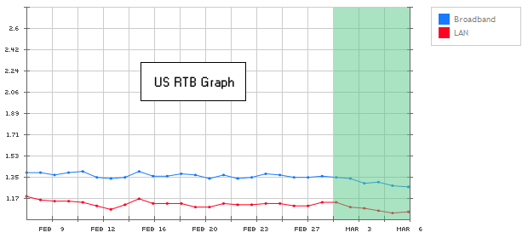
The results…
RTB times lower by 20 to 30 msec on broadband,
and over 1 second better on dialup connections!
User and business metrics mostly neutral to very slightly positive.

Slide 41
Questions?
jlecomte@yahoo-inc.com
http://www.julienlecomte.net/
Twitter: @powersander
Y!IM: julien.lecomte

