Slide 1

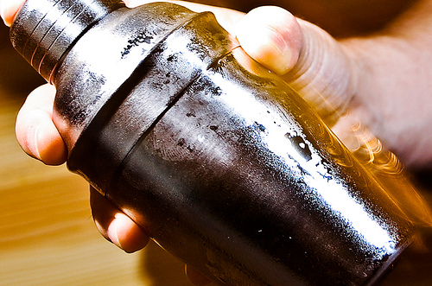
Shaker
Julien Lecomte – @powersander – Paypal 5/17/2012
Notes:
Before starting the presentation:
* Describe who I am, describe the team and what we do
* Explain that Yahoo! Search is in the process of rewriting its runtime stack
* Explain that we chose Mojito for the frontend and why…
* Explain that we run in 50+ markets, 30+ languages, that we have numerous partners -> huge number of contexts
* Each one of those dimensions may require customizations of CSS or JavaScript
* To keep things optimized, we use rollups!
* Explain what Fuse is and why it’s not optimal (crazy config files, bugs when files are updated, etc.)
* Explain that while switching to Mojito, we looked for a better solution, but…
* We had to create it, and we want to share what we’ve done with the community

Slide 2
What is Shaker?
Static Asset Management for Mojito Apps
`mojito compile rollups` evolved
Convention over configuration
Set and forget
Notes:
* Do NOT explain right now why Shaker is better than mojito compile rollups…
Two goals for Shaker:
* Convention over configuration -> lowers barrier of entry
* Set and forget -> no long term maintenance costs (no need to refuse…)

Slide 3
mojito compile rollups
Mojito’s current asset rollup tool
JavaScript only – No CSS support
All or nothing – No control over rollup content
No CDN support – served directly from app
Notes:
* mojito compile rollups [--app] combines:
- mojito core
- YUI modules in mojits (not just binders)
- Any dependencies
* Reduces the number of script tags.
* No support for dimensions
* No CDN support, although the FE server can be used as an origin

Slide 4
mojito shake
JavaScript and CSS support
Convention over configuration
Advanced configuration available
Deploy to & serve from CDN
Supports context dimensions
Supports multiple environments (dev, staging, prod, …)
Notes:
* mojito shake is a new command that is not available currently in mojito
* Advanced configuration allows you to surgically modify your rollups if needed

Slide 5
Installation
$ npm install mojito-shaker -g
$ cd myMojitoApp
$ mojito-shake
Notes:
Explain why we need to install it globally.
You may install shaker locally but you have to npm link it.
Finally, explain that “mojito shake” will be available soon (same as npm, git, svn, etc.)

Slide 6
JavaScript: shaken, not stirred
Shaker creates JavaScript rollups based on Mojit controller actions (binders).
Binder dependency calculations (YUI modules) are done at build time.
Binder rollups contain the binder and all its dependencies.
Notes:
* Explain what binders are!
* The action is part of the context
* Explain how we do the dependency calculation at build time

Slide 7
Convention over Configuration
Directory structure maps to dimensions
Advanced Configuration when needed
Surgical rollups via include/exclude/replace
App level rollups
Notes:
* For most people, convention should be enough
-> just place your files in the right place, and voila!
* For more advanced cases, you can customize the rollups
and override the defaults -> super powerful!
* In this talk, we won’t cover any of the advanced configuration

Slide 8
Directory Structure (CSS)
<mojit>/
assets/
common/
device/
desktop/
smartphone/
tablet/
region/
CA/
US/
Notes:
Explain the mojito/mojit directory structure with the assets directory for CSS files.
The directories below that map to context dimensions.
JS files are in binders directory + autoload…

Slide 9
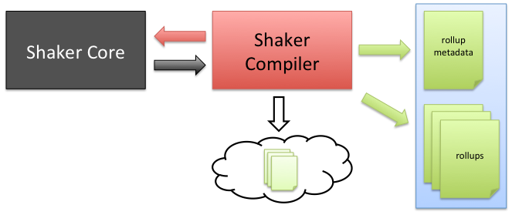
Shaker Architecture Build Process
Notes:
This is the build time architecture (next slide is on runtime)
* Shaker has a modular architecture
* The compiler:
- uses shaker core
- generates the rollup meta-data
- deploys the rollups to CDN
- it can also create files which can be served by the app itself (cloud)
- is easy to integrate in any CI system (they’re just UNIX commands)

Slide 10

Shaker Architecture Mojito Runtime
Notes:
This is the runtime architecture (previous slide was on build time)
When Mojito receives a request, it:
* evaluates its context
* invokes the shaker html frame mojit
The shaker html frame mojit invokes the shaker addon.
The Shaker addon consumes the rollup meta data generated at build time to figure out which rollup to serve
The shaker html frame generates an HTML document with the correct link and script tags

Slide 11
Project info
Only 1 CDN supported: Amazon S3
Shaker is 100% open source!
https://github.com/yahoo/mojito-shaker
BSD License
Pull requests are welcome!

Slide 12
Roadmap
Integration with more CDNs
Generate sprites/data URIs
Support inline CSS and JS
Split rollups for parallel download
Notes:
Explain that sprites have the same issue as JS/CSS rollups
Explain that rollups may be inlined!
Explain the need for split rollups/balancing

Slide 13



Shaker Team
Diego Ferreiro - @diervo
diegof@yahoo-inc.com
Stephen Murphy - @hypernaut
murphys@yahoo-inc.com
Brett Stimmerman - @bretts
brettstimmerman@gmail.com

Slide 14
Are you ready to shake it?
Notes:
Tell people they can come talk to me at the mojito bar until 5pm
Encourage folks to contribute to mojito and shaker.

