Slide 1
Forms and CSS
Rich Sonnenblick
11 October 2011

Slide 2
Basics
Code for Firefox and IE—remember that IE will look different unless you turn grids off in the form (nogrid="true")
Code for a 1024x768 browser window size
  Minimize the need for scroll bars in the window
  Put a buttonset at the top and the bottom, left justified
  Avoid fixed-width elements (width:XXXpx) if at all possible
  Never create fixed-width elements greater than 600px

Slide 3
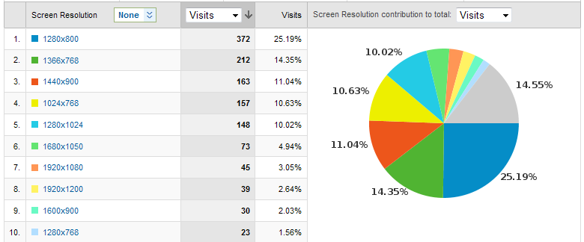
Screen resolution of visitors to enrichconsulting.com
48% at 1280x1024
or less!

Slide 4
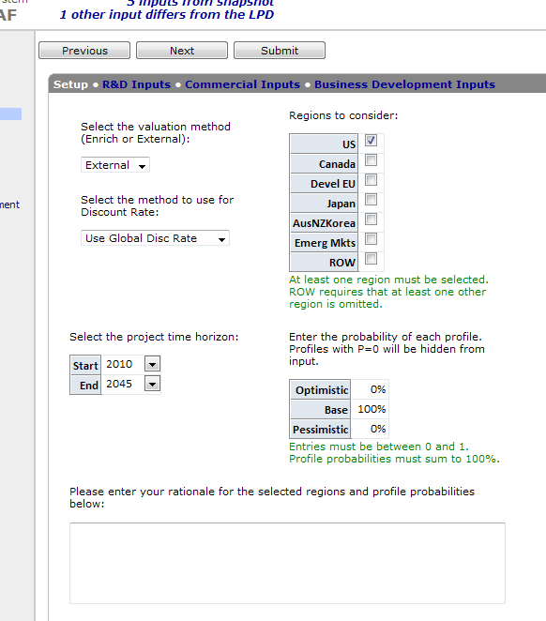
Avoid wide lines of text
Newspapers keep text to 2-3 inches wide because the eye cannot easily track horizontally
Two column layouts work well for smaller tables

Slide 5
Don’t Use Nifty Corners
Use Fieldsets and legends instead
  You can style these with jquery ui styles

Slide 6
Show Hide with Fieldsets
$(document).ready(function(){
$('fieldset legend').each(function() {
var initState = getSubCookie('dock', this.parentNode.id);
$('.fsbody', this.parentNode).toggle(initState==null || initState=='itemshow');
$(this).click(function() {
$('.fsbody', this.parentNode).toggle(setDockCookie);
return false;
});
});
});
function setDockCookie() {
setSubCookie('dock',this.parentNode.id,$(this).css('display')=='none' ? 'itemhide': 'itemshow');
}
------------- later in the html body:
<fieldset>
<legend>My legend</legend>
<div class=“fsbody”>
</div>
</fieldset>

Slide 7
Hints in Forms
Use hints to include CSS and JS in your form. It is better to the old method of <link> and <script> because these will be loaded in the proper order when inserted in a <hint> directive, and because the system will ensure that column alignment and resizing will occur AFTER the directives in the files you include.
See the wiki for more information about <hints>
<cost_projection nogrid="true" tempid="2">
<hints>
<include>
<jsfile>tablesplicing_generic.js</jsfile>
<jsfile>jquery.cost_projection.js</jsfile>
<jsfile>jquery.dimensions.js</jsfile>
<cssfile>lum_forms.css</cssfile>
</include>
<colresize>
<checklimit>18</checklimit> <!-- min number of chars in a cell before checking size -->
<mincolwidth>1425</mincolwidth> <!-- min column width (in twips) if checklimit has not been met -->
</colresize>
</hints>
…rest of form goes here…
</cost_projection>

Slide 8
CSS Basics
Inline
    <td style=“font-size: 12pt; color:#FEFEFE”>blah</td>
Style definition
    <style> .snowblind {
    font-size: 12pt;
    color:#FEFEFE
    }
    </style>
    …
    <td class=“snowblind”>blah</td>
Selector: defines what html objects are assigned the style
Style: defines the style elements

Slide 9
Scary CSS vs. Elegant CSS
Always define styles in your .css file rather than inline, or at the top of your form (never use inline styles)
Simplify your CSS
  Leverage inheritance: http://coding.smashingmagazine.com/2010/04/07/css-specificity-and-inheritance/
  Avoid duplication, using commas instead: http://webdesign.about.com/od/cssselectors/f/comma-in-css-selectors.htm
Only use jquery to assign css when the css selectors are not sufficiently precise or aren’t cross-browser compatible

Slide 10
Common CSS Selectors
Use a comma to delimit multiple selectors
Selector | Element | Example
.string | All elements with class string | .happy matches all elements with class happy
#string | The element with id string | #happy matches the element with id happy
string | All elements of type string | div matches all div elements on the page
string1.string2 | All elements of type string1 with class string2 | div.happy matches all div elements of class happy
string1 string2 | All elements that match string2 that are descendants of string1 | div .sad matches all elements with class sad under a div in the hierarchy
string1 > string2 | All elements that match string2 that are immediate descendants of string1 | span > b matches all <b> elements that are direct children of a <span>
string:active string:hover string:focus | Matches string and is involved in a user action (for link behaviors)
There are other selectors, but they don’t work in all browsers (yikes!)

Slide 11
CSS Classes in tables
(without class attribute)
<variable name=“Revenue” mode=“input”/>
<table id=“Revenue” class=“epsgrid gridtbl”>
Top-left corner id=Revenue_, class=corner
First row of table cells r1
First column of table cells c1
Table cells
  Inputs cell
  Outputs ocell

Slide 12
CSS Classes in tables
(with class attribute)
No longer recommended… use an id/class combination to reference the table components instead:
#Revenue .r1 {color:blue}
-RSS May 2013
<variable name=“Revenue” class=“myclass” mode=“input”/>
<table id=“Revenue” class=“myclass”>
Top-left corner id=Revenue_, class=myclass_corner
First row of table cells class=myclass_r1
First column of table cells class=myclass_c1
Table cells
  Inputs class=myclass_td
  Outputs class=myclass_td
Note: If you specify a class, you now have to define all the styles for this table, since the table will no longer use styles defined for r1, c1, corner, ocell, and cell

Slide 13
Spiffy Jquery Selectors
In addition to the regular CSS selectors! Plus, cross-browser support is tops!
Selector | Element | Example
string:first string:last string:even string:odd string:eq(int) string:gt(int) string:lt(int) string:slice(int,int) | All elements matching string that are the right rank | .happy:odd matches the odd numbered elements in the list of all elements with class happy
string:has(selector) string:not(selector) string:empty | All elements matching string that have/don’t have children that match selector | table#Revenue tr:has(td) matches all tr elements in the table with id Revenue that have td children
string[attribute] string[attribute=value] string[attribute!=value] string[attribute^=value] string[attribute$=value] string[attribute*=value] | All elements matching string that have an attribute, or an attribute set to/beginning with/ending with/not equal/containing a value | td[align=center] matches the td elements with an align=“center” attribute
http://www.javascriptworkshop.com/wp-content/uploads/pdf/jquery_selectors.pdf

Slide 14
Jquery CSS assignment
$ = jquery
<script>
$(document).ready(function(){
$("#Clin_cost_table tr:even").addClass("alt");
$("td.happy[align=left]").css(“background-color", “red");
});
</script>
ready() is a special function that fires on page load
This is the jquery selector
This is how you add a class assignment
This is how you “inline” css onto matching elements

Slide 15
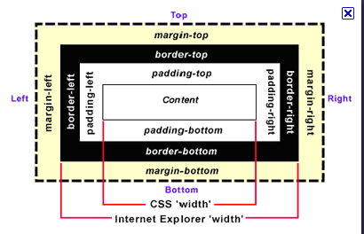
What CSS Property do I need?
Google it
  CSS font size
  CSS padding
  CSS color
  CSS background color
  CSS text alignment
  etc.
Border allows you to specify color size and linetype in several shorthand notations
  border:5px solid red; all four borders solid red lines of 5px in width
  border-style:dotted solid; top and bottom borders are dotted & right and left borders are solid
  etc.
Many other shorthand notations you’ll need to google
Know your box model (and shorthand)
  margin:25px 50px 75px 100px;
    top margin is 25px
    right margin is 50px
    bottom margin is 75px
    left margin is 100px
  margin:25px 50px 75px;
    top margin is 25px
    right and left margins are 50px
    bottom margin is 75px
  margin:25px 50px;
    top and bottom margins are 25px
    right and left margins are 50px
  margin:25px;
    all four margins are 25px

Slide 16

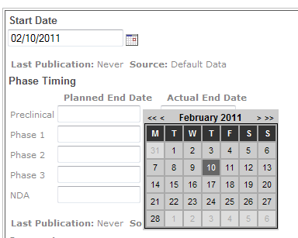
Datepickers
The Jquery UI (User Interface) library has one
Can be used for mon/year (without day)
Has useful keyboard shortcuts
Integrates with other Jquery UI components we are integrating into EPS
We can also use the one we’ve always used by Kevin Luck
Either can be used with a mask to allow structured manual entry

Slide 17
Tweaking and Inspecting with the DOM Inspector (FF) and Developer Tools (IE)
Use the Document Object Model (DOM) Inspector to browse the object hierarchy of your form
Locate your tables, td, and other elements in the document
Inspect their styles and explore inheritance
Change styles and css on the fly and view the changes in the browser immediately.
Find an introduction here:
  https://developer.mozilla.org/en/DOM_Inspector/Introduction_to_DOM_Inspector

