Slide 1
MECA 482: Control Systems Design
Austin Mahannah
Jerome Lee Craig Parks
Melania Raygoza

Slide 2

Background
Design and Simulate a physical system with the use of Matlab, Simulink and CoppeliaSim.
Physical System: Inertia Wheel Pendulum (IWP).
Implementation:
Mathematical Model
State-space representation
Negative loop feedback control
CoppeliaSim Simulation

Slide 3
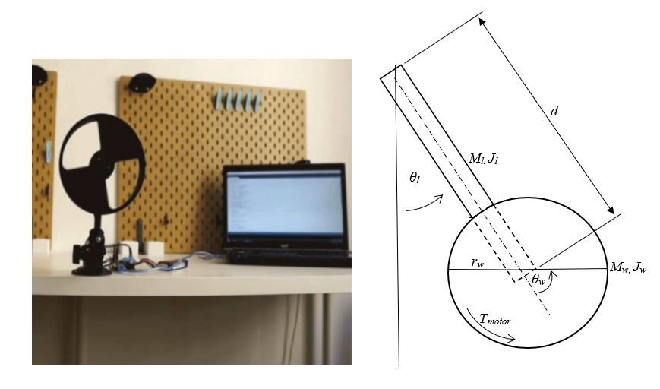
Physical system
Rigidly mounted to a support.
Link (pendulum arm) with an encoder.
Inertia Wheel with encoder and motor.

Slide 4

Mathematical Model
$\frac{d}{dt}\frac{∂L}{∂\dot{θ_{w}}}−\frac{d}{dt}\frac{∂L}{∂θ_{w}}=0$ Eq.1
$\frac{d}{dt}\frac{∂L}{∂\dot{θ_{l}}}−\frac{d}{dt}\frac{∂L}{∂θ_{l}}=T_{motor}$ Eq.2
$L=K_{l+w}−P_{l+w}$ Eq.3
$K_{l}=\frac{1}{2}M_{l}({\frac{d}{2})}^{2}{\dot{θ}}_{l}^{2}+\frac{1}{2}J_{l}{\dot{θ}}_{l}^{2}$ Eq.4
$K_{w}=\frac{1}{2}M_{w}d^{2}{\dot{θ}}_{l}^{2}+\frac{1}{2}J_{w}{(\dot{θ_{l}}+{\dot{θ}}_{w})}^{2}$ Eq.5
$P_{l}=M_{l}g(\frac{d}{2})(1−cos⁡(θ_{l}$)) Eq.6
$P_{w}=M_{w}g(d)(1−cos⁡(θ_{l}$)) Eq.7
$L=\frac{1}{2}M_{l}({\frac{d}{2})}^{2}{\dot{θ}}_{l}^{2}+\frac{1}{2}J_{l}{\dot{θ}}_{l}^{2}+\frac{1}{2}M_{w}d^{2}{\dot{θ}}_{l}^{2}+\frac{1}{2}J_{w}{\left(\dot{θ_{l}}+{\dot{θ}}_{w}\right)}^{2}−(g∗d(\frac{M_{l}}{2}+M_{w})(1−cos⁡(θ_{l}$)) Eq.8
$D\left[\begin{matrix}{\ddot{θ}}_{l} \\ {\ddot{θ}}_{w}\end{matrix}\right]+\left[\begin{matrix}(g∗d\left(\frac{M_{l}}{2}+M_{w}\right)\sin\left(θ_{l}\right)) \\ 0\end{matrix}\right]=\left[\begin{matrix}0 \\ T_{motor}\end{matrix}\right]$ Eq.9
$D=\left[\begin{matrix}d_{11} & d_{12} \\ d_{21} & d_{22}\end{matrix}\right]=\left[\begin{matrix}M_{l}{\left(\frac{d}{2}\right)}^{2}+M_{w}{\left(d\right)}^{2}+J_{l}+J_{w} & J_{w} \\ J_{w} & J_{w}\end{matrix}\right]$ Eq.10

Slide 5

State-Space
$\dot{x}=Ax+Bu$ Eq.1
$y=C_{x}+D_{u}$ Eq.2
$A=\frac{∂f\left(z, T_{motor}\right)}{∂z}=\left[\begin{matrix}0 & 1 & 0 \\ d_{011}∗g∗d\left(\frac{M_{l}}{2}+M_{w}\right) & 0 & 0 \\ d_{021}∗g∗d\left(\frac{M_{l}}{2}+M_{w}\right) & 0 & 0\end{matrix}\right]$ Eq.3
$B=\frac{∂f\left(z, T_{motor}\right)}{∂T_{motor}}=\left[\begin{matrix}0 \\ d_{012} \\ d_{022}\end{matrix}\right]\frac{k_{m}}{R}$ Eq.4
$C=\left[\begin{matrix}1 & 0 & 0 \\ 0 & 1 & 0 \\ 0 & 0 & 1\end{matrix}\right]$ Eq.5

Slide 6
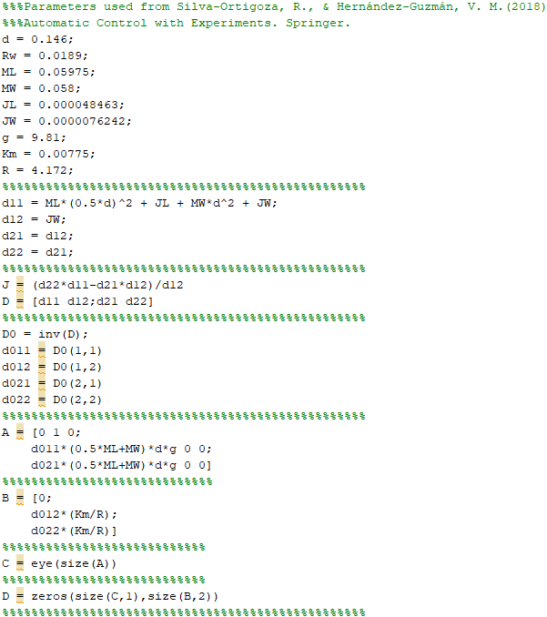
Matlab
The guts behind the control system.
Parametric values sampled from the book.
Implements our State-space representation.

Slide 7
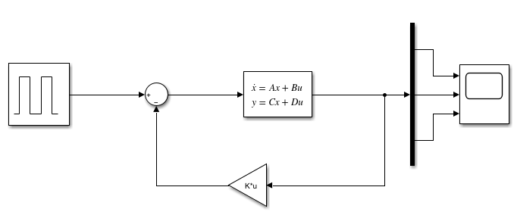
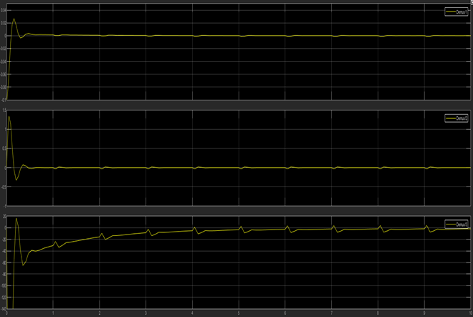
Simulink
Pulse into the system.
State-space representation of the Mathematical Model determines behavior of output.
Negative-loop feedback with gain to adjust next input.
Results

Slide 8
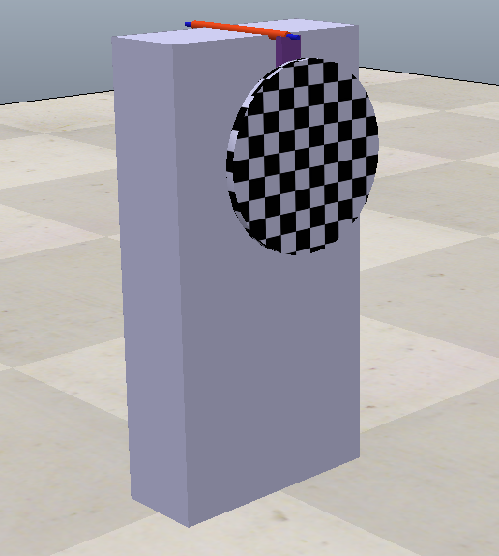
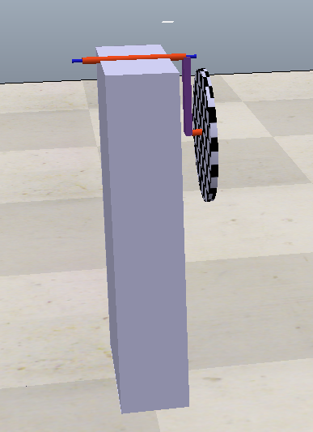
CoppeliaSim

Slide 9
Final Result
Chose a physical system to model.
Derived the mathematical model for that system.
Represented the mathematical model in state-space representation.
Designed a controller using the SSR.
Attempted to simulate the action in CoppeliaSim.

