Slide 1
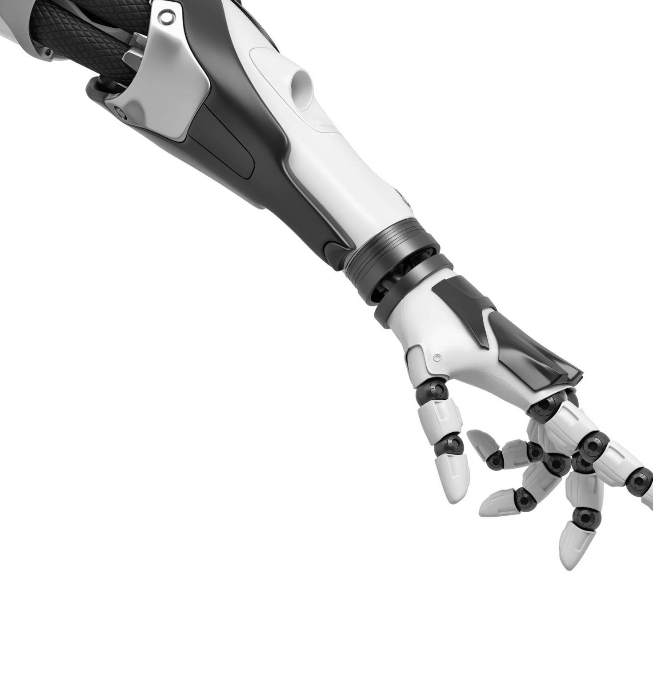
iControBot:
An Intuitive Robot Arm Controller
Jeffrey Lee

Slide 2
Background
Problem Background:
According to the Bureau of Labour Statistics in the United States, there are over 300 work-related fatalities each year in manufacturing.
Implementing robotics in industrial workplaces allows for a 17.71% cost deduction.
“Contacting interfaces, such as (...) joysticks, (...) require operator motions that may be unnatural and must be learned.”
Benefits of an Intuitive Controller:
Minimizes costs
Reduces training time
Automation
Safety
Increase accessibility to manufacturing jobs
More dynamic manuverability

Slide 3
Background
Problem Statement:
The current control of robotic arms using keyboards and joysticks do not provide an intuitive interface for users to navigate in a 3D space.
Need:
A need exists for an intuitive control interface for humans to easily manipulate a robot arm’s movement to improve human-robot interaction and automation.

Slide 4
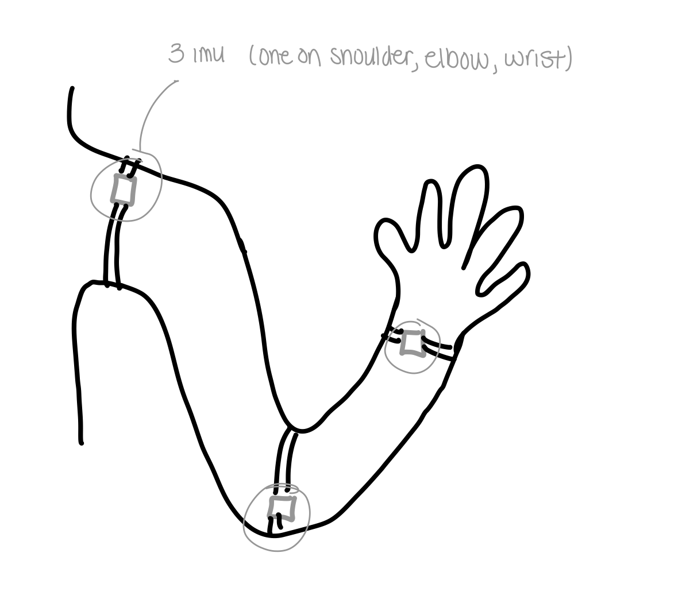
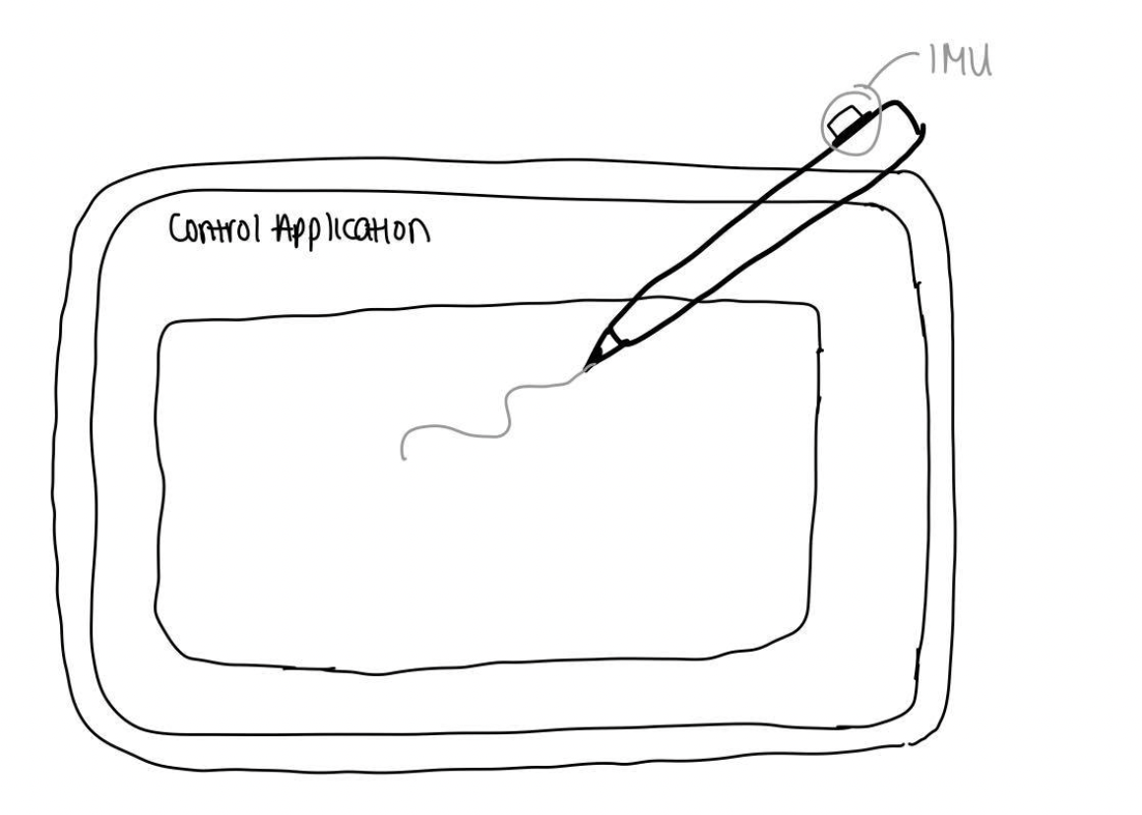
Alternative Solutions
IMU Sleeve
Stylus/Tablet Controller
+ Low cost
+ Robust in different environments
- Invasive (body attachment)
- Calibration required
- Decreased accuracy due to IMU noises sensitivity
+ Precise control in X-Y plane
+ No calibration required
- High cost
- Unintuitive in Z plane

Slide 5
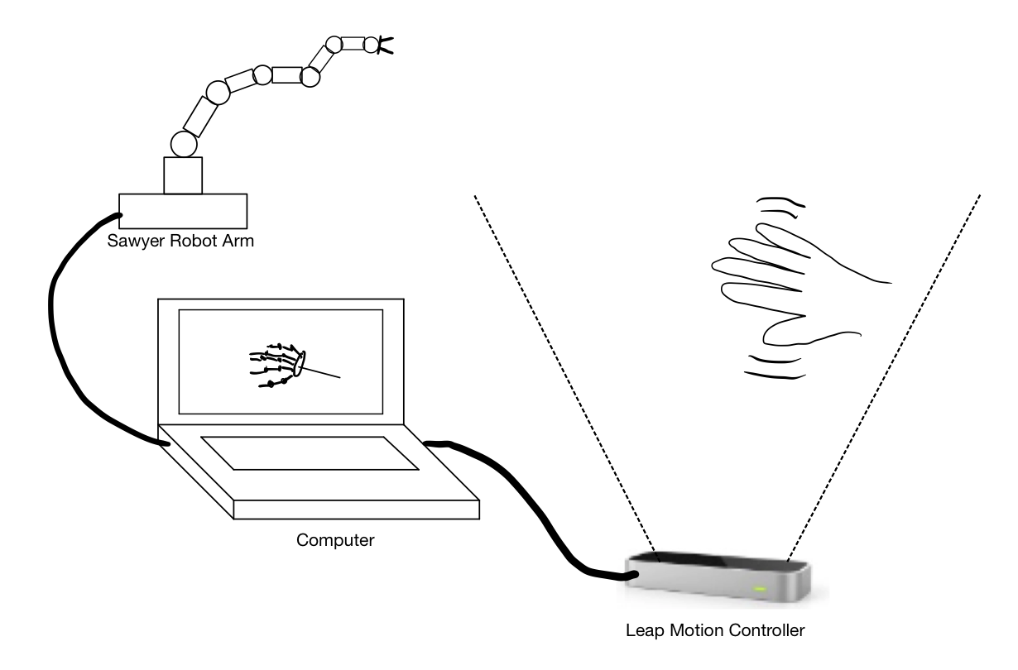
Our Solution
Advantages with this design:
+ Ability to move in all 3 planes
+ Most intuitive
+ Accuracy
+ Simple to use
+ Minimal setup/calibration
+ Non-Invasive

Slide 6
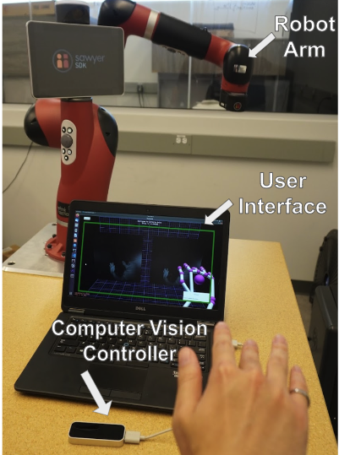
Solution
3 Components
Robot Arm
User Interface
Computer Vision Controller
These 3 components each are designed with their own ROS node

Slide 7
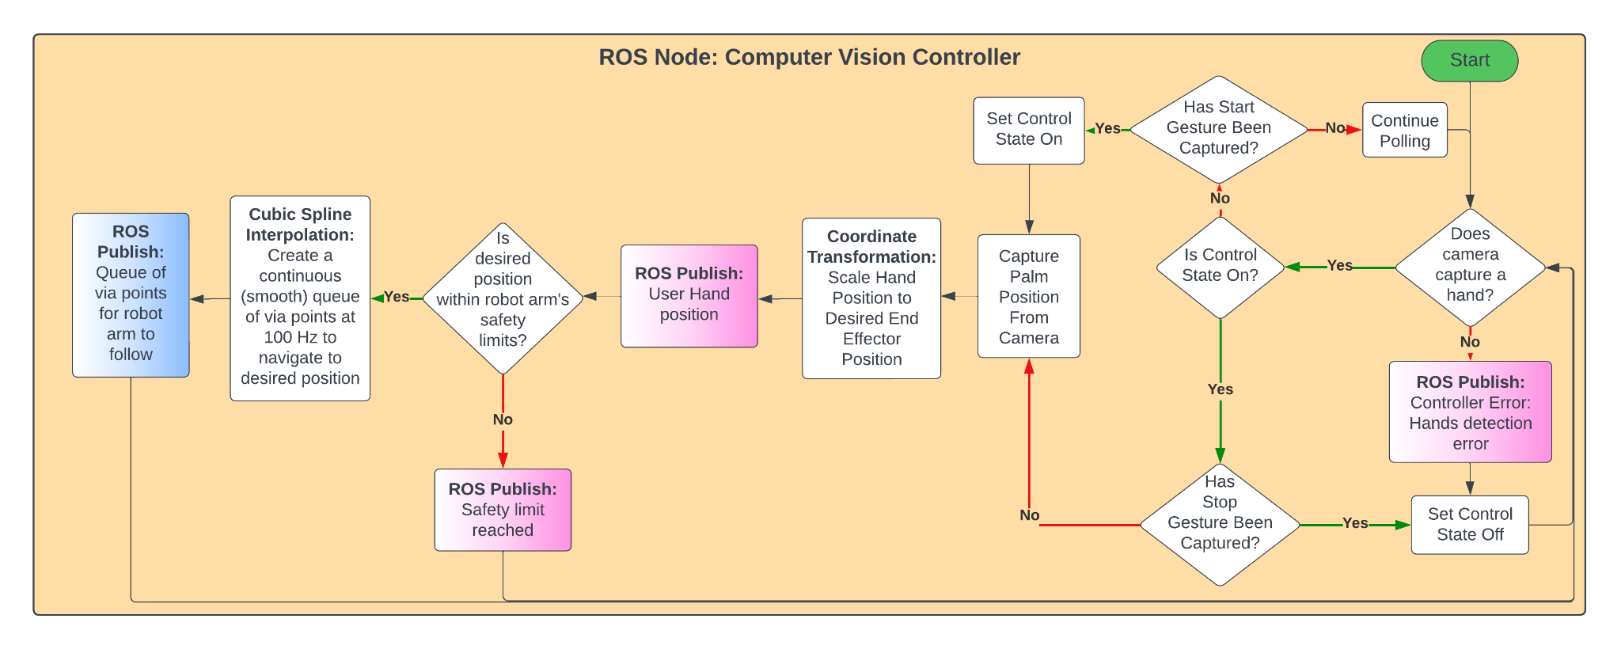
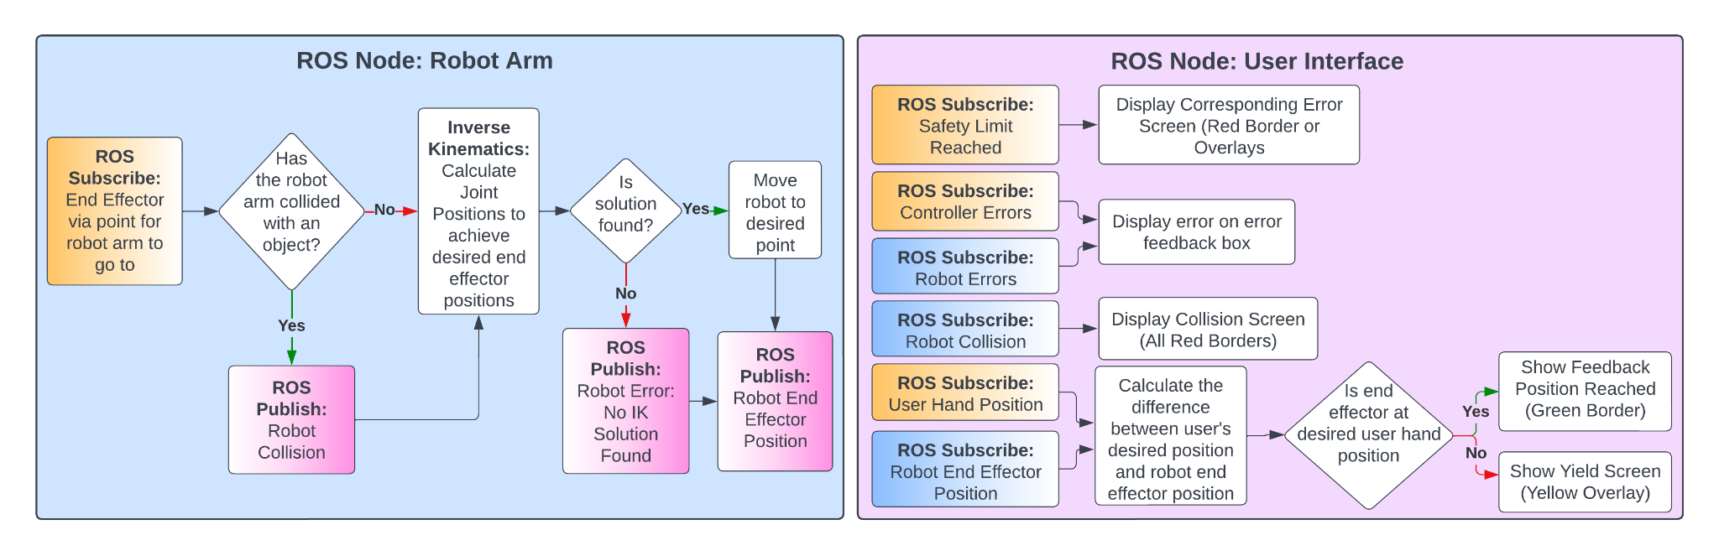
System Architecture

Slide 8
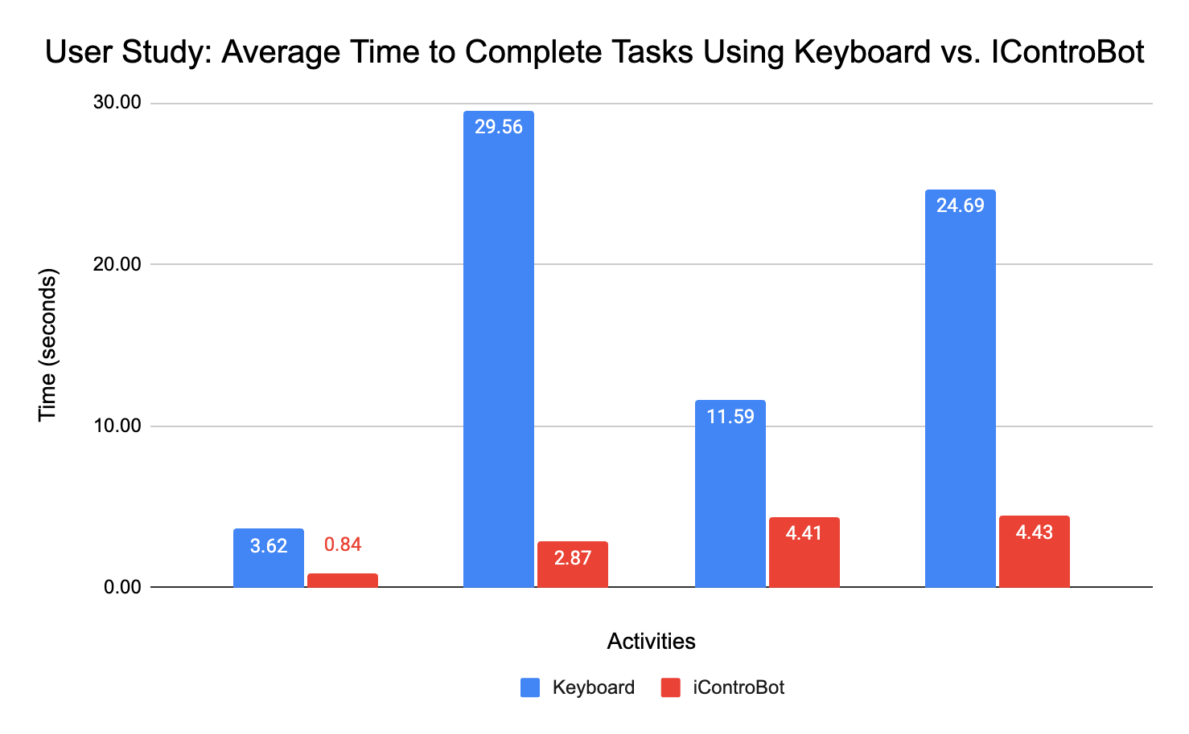
Testing and Verification: User Study on Intuitiveness
66.7% of users found iControBot to be 5/5 in intuitiveness
100% of users found iControBot to be more intuitive than traditional keyboard interfaces
Simple Movements
Make a Rainbow
Move a Box
Hit Target

Slide 9
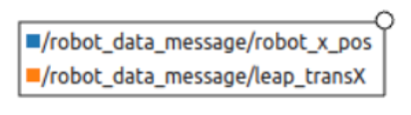
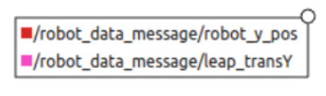
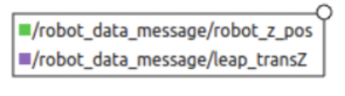
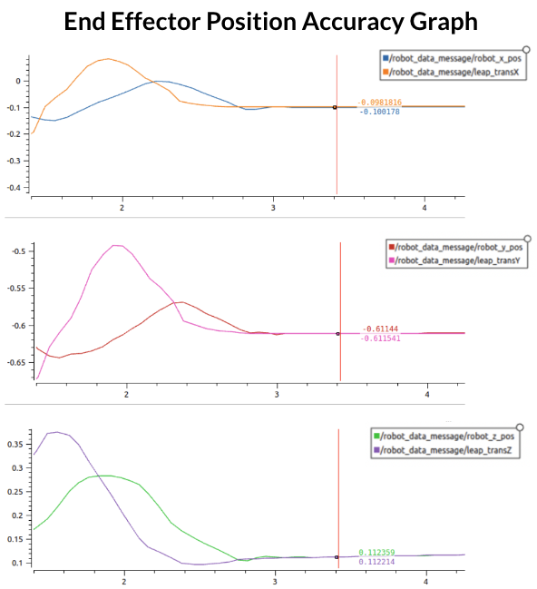
Testing and Verification: Accuracy
The robot was able to perform with a 2mm accuracy after settling

Slide 10
Future Improvements
Display an overlay of the robot arm visuals in the UI
End-Effector Rotation Control (additional camera needed to point horizontally)
Wider range of control (mainly in the x-y plane)
Addition of End-effector Controls (Proof of concept provided with gestures)
Additional Filtering (Low-pass Filter)
More joint constraints through arm position detection

Slide 11
QUESTIONS?

