Slide 1
Snakemake – how-to, tips & tricks
Originally by Breeshey Roskams-Heiter
Updated by Aaron Doe for Comp Hub Meeting 6/5/23

Slide 2
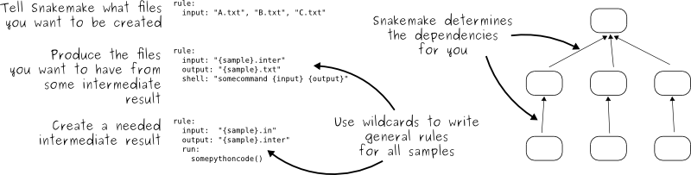
General structure of snakemake
Snakemake is a workflow management system that builds its workflow tree from the “top-down” by looking at defined input/output files, and how those are linked to upstream input files (Generates a DAG)
Allows uniform data processing of large datasets in parallel
Python-based, but is configured to implement many languages, such as bash, R and python

Slide 3
Working directory
Snakefile → Define wildcards, define functions/variables, specify rules to be included and rule all
Cluster.json → Define allocation of CPUs and memory for each command (“rule”)
Config.yaml → Define paths to files used in your workflow that may be variable (ex: star index/gtf or specific comparisons you might run)
Submit_snakemake.sh → bash script to submit snakemake workflow to the cluster
Rules directory
Scripts directory
Envs directory
Rule files (.smk) which contain the individual rules, each pertaining to a specific step of data processing in your workflow
Scripts (R, python, bash), which can be executed via the rules, written either in standard format, or snakemake format
Conda environment files in .yaml format which include the software used in specific rules, and are pointed to there

Slide 4
How do you define wildcards, what are they, and how do you make sure your ”rules” are running on the correct ones?
What?
They are essentially a list of strings which you want to pass iteratively through a rule (like a list of sample IDs)
How?
You define your wildcards in your Snakefile
1. You can define your wildcards by matching a pattern in a specific directory
SAMPLES, = glob_wildcards(“samples/raw/{sample}_R1.fastq.gz”)
2. You can define your wildcards by explicitly writing out each element in the list
CONTRASTS = [‘Treatment1-vs-Control’, ‘Treatment2-vs-Control’, ‘Treatment3-vs-Control’]
How do you reference them correctly?
You specify them in your ”rule all”, which pieces together your workflow by mapping backwards from the terminal nodes of your workflow tree
There are some cases where you specify them in your rule, and we will go over this later

Slide 5
How do rules relate to each other and to the rule all?
rule RULE1
input:
input1 = “path/to/input/{sample}.fastq”
output:
“path/to/{sample}_output_rule1”
shell:
“somecommand {input} {output}
rule RULE2
input:
“path/to/{sample}_output_rule1
output:
“path/to/{sample}_output_rule2”
shell:
“somecommand {input} {output}
Snakemake generates your workflow tree like:
Then your Snakefile might look something like this…
“path/to/input/{sample}_R1.fastq”
SAMPLES, = glob_wildcards(“path/to/input/{sample}_R1.fastq”)
rule all:
input:
expand(“path/to/{sample}_output_rule2”, sample = SAMPLES)
“path/to/{sample}_output_rule1”
“path/to/{sample}_output_rule2”
**If a rule has MULTIPLE outputs, you do not need to list all of these in your rule all, only the one that is created last

Slide 6
Structure of a snakemake rule
Define your input file(s)
rule STAR:
input:
”samples/raw/{sample}.fastq”
output:
“samples/aligned/{sample}.aligned.bam”
params:
gtf = “/path/to/gtf_file.gtf”
conda:
“../envs/STAR.yaml”
shell/run/script:
”STAR {input} {output} –gtf {params.gtf}"
Define your output file(s)
Define paths to any files/directories which are used in this rule
Gtf file, star index, etc.
Define path to any conda environments with software used in this rule
This is where you define your code. There are a few options here.

Slide 7
1. input/output
Run rule once with one input file and one output file
Run rule in parallel across many samples (ie. wildcards)
Run rule with multiple input files and one output file
Run rule with variable input – write a function to define this input
Run a rule that will output a directory
Run a sequence of rules, whose intermediate files are temporary
Rule is dependent on the output of the previous rule

Slide 8
1A) Run rule once with one input file and one output file
rule filter_counts:
input:
“path/to/counts_file.txt”
output:
“path/to/filtered_counts_file.txt”
script:
“../scripts/filter_counts.R”
“path/to/filtered_counts_file.txt” is written in rule all
https://github.com/ohsu-cedar-comp-hub/Bulk-RNA-seq-pipeline-PE/blob/master/rules/align_rmdp.smk

Slide 9
1B) Run rule in parallel across many samples (ie. wildcards)
If you want to reference the wildcard string in your shell command, you must reference it by {wildcards.sample}, rather than just {sample}
rule fastqc:
input:
“path/to/{sample}.fastq”
output:
“path/to/output_directory/{sample}_fastqc.zip”
shell:
“fastqc {input} path/to/output_directory/{wildcards.sample}
expand(“path/to/output_directory/{sample}_fastqc.zip”, sample = SAMPLES) is written in rule all
https://github.com/ohsu-cedar-comp-hub/Bulk-RNA-seq-pipeline-PE/blob/master/rules/align_rmdp.smk

Slide 10
Setting wildcards
Wildcards can be set in a number of ways, but most commonly through the Snakefile or config file.
Snakefile example:
SAMPLES, = glob_wildcards("samples/raw/{sample}_R1.fastq.gz")
This takes all files matching the string _R1.fastq.gz in the samples/raw/ directory and sets all of the strings that fall in the {sample} part of the filename as the wildcards
E.g. samples/raw/cell1_R1.fastq.gz and samples/raw/cell2_R1.fastq.gz would set cell1 and cell2 as wildcards to iterate over throughout the pipeline.
Config example:
win_sizes:
- 100
- 200
- 500
Sets 100, 200, and 500 as wildcards to iterate over throughout pipeline

Slide 11
Calling wildcards
How to call wildcards set in the Snakefile:
SAMPLES, = glob_wildcards(“path/to/input/{sample}_R1.fastq”)
rule all:
input:
expand(“path/to/{sample}_output_rule2”, sample = SAMPLES)
How to call wildcards set in the config:
rule all:
input:
expand("vocab/CLRNormT_{win_size}kb_2000Feats_Model/vocab_matrix.rds",
win_size = config["win_sizes"])

Slide 12
1C) Run rule with multiple input files and one output file
rule compile_counts:
input:
expand(“path/to/{sample}_htseq_count.txt”, sample = SAMPLES)
output:
“results/compiled_counts.txt”
script:
“../scripts/compile_counts.py”
“results/compiled_counts.txt” is written in rule all
https://github.com/ohsu-cedar-comp-hub/cfRNA-seq-pipeline/blob/master/rules/align_rmdp.smk

Slide 13
1D) Run rule with variable input – write a function to define this input
def get_contrast(wildcards):
"""Return each contrast provided in the configuration file"""
return config["diffexp"]["contrasts"][wildcards.contrast]
rule deseq2_pairwise:
input:
get_contrast
output:
”path/to/deseq2_results/DEG.{contrast}.txt"
script:
”../scripts/run_deseq2_pairwise.R”
How it’s written in the config file:
diffexp:
contrasts:
wt-vs-mut:
- wt
- mut
expand(“someoutput.{contrast}.txt”, contrast = config[“diffexp”][“contrast”]) is written in rule all
https://github.com/ohsu-cedar-comp-hub/Bulk-RNA-seq-pipeline-PE/blob/master/rules/deseq.smk

Slide 14
1E) Run a rule that will output a directory
rule DIR:
input:
“path/to/{sample}_input_file”
output:
directory(“path/to/directory/”)
shell:
“somecommand {input} {output}”
“path/to/directory” is written in rule all

Slide 15
1F) Run a sequence of rules, whose intermediate files are temporary
rule TMP:
input:
“path/to/{sample}_input_file”
output:
temp(“path/to/{sample}_output_file”)
shell:
“somecommand {input} {output}”
Nothing is written in rule all, because these files will never be on the terminal nodes of your workflow tree

Slide 16
1E) Rule is dependent on the output of the previous rule
rule a:
input:
“path/to/{sample}_input_file”
output:
“path/to/{sample}_output_file”
shell:
“somecommand {input} {output}”
rule b:
input:
rules.a.output
output:
“path/to/{sample}_output_rule_b”
shell:
“somecommand {input} {output}”
“path/to/{sample}_output_rule_b” is written in rule all

Slide 17
Structure of a snakemake rule
Define your input file(s)
rule STAR:
input:
”samples/raw/{sample}.fastq”
output:
“samples/aligned/{sample}.aligned.bam”
params:
gtf = “/path/to/gtf_file.gtf”
conda:
“../envs/STAR.yaml”
shell/run/script:
”STAR {input} {output} –gtf {params.gtf}"
Define your output file(s)
Define paths to any files/directories which are used in this rule
Gtf file, star index, etc.
Define path to any conda environments with software used in this rule
This is where you define your code. There are a few options here.

Slide 18
2. params
The params portion of a rule is designed to reference things like the path to a file needed in that rule or a string that might be variable from project-to-project (can also be constant)
Examples:
The path to a gtf file used for gene counting
The path to a built index for alignment
The column name in your metadata file of which to run DE analysis on (“Condition”, “Genotype”)
The biotypes you would like to include in your final counts table (passed to a script that filters your counts table to include only genes of a specific biotype)
Generally points to a variable in your config.yaml file

Slide 19
How to reference things in the config file
config.yaml:
In snakemake rule:
gtf_file:
/path/to/gtf_file
params:
gtf = config[“gtf_file”]
diffexp:
contrasts:
wt-vs-mut:
- wt
- mut
params:
contrast = config[“diffexp”][“contrast”]
** The config.yaml file is read in as a key-value dictionary pairing

Slide 20
Structure of a snakemake rule
Define your input file(s)
rule STAR:
input:
”samples/raw/{sample}.fastq”
output:
“samples/aligned/{sample}.aligned.bam”
params:
gtf = “/path/to/gtf_file.gtf”
conda:
“../envs/STAR.yaml”
shell/run/script:
”STAR {input} {output} –gtf {params.gtf}"
Define your output file(s)
Define paths to any files/directories which are used in this rule
Gtf file, star index, etc.
Define path to any conda environments with software used in this rule
This is where you define your code. There are a few options here.

Slide 21
3. conda
Like “containers” for the software used in a given rule
Pre-build your environments and export them to a .yaml file can be referenced in a rule
All environments are built before a workflow is executed
TIP: Build your environments first and use those while you’re writing your workflow

Slide 22
Conda cheat sheet
Best practices:
Install only essentials in your base environment
Try to keep your environments relatively small, this will reduce the chance of creating environments with conflicts in them
Create an environment
conda create --name name_of_env
Activate environment
Conda activate name_of_env
Install packages into that environment (while activated)
conda install –c name_of_channel name_of_package
Export environment to a .yaml file (while activated)
conda env export --no-builds > name_of_env.yaml
Deactivate an environment
conda deactivate name_of_env
Remove an environment
conda env remove --name name_of_env
Best way (Thanks Joey!) to create a new environment without any conflicts
conda create --name name_of_env name_of_package1 name_of_package2 name_of_package3

Slide 23
My .condarc file (in same directory as conda installation)
channels:
- bioconda
- conda-forge
- defaults

Slide 24
What if conda doesn’t have your package?
required.packages <- "data.table" new.packages <- required.packages[!(required.packages %in% installed.packages()[,"Package"])] if(length(new.packages)){ install.packages(new.packages, repos='http://cran.us.r-project.org') }else{ library(data.table) }
Thanks Ashley!

Slide 25
Structure of a snakemake rule
Define your input file(s)
rule STAR:
input:
”samples/raw/{sample}.fastq”
output:
“samples/aligned/{sample}.aligned.bam”
params:
gtf = “/path/to/gtf_file.gtf”
conda:
“../envs/STAR.yaml”
shell/run/script:
”STAR {input} {output} –gtf {params.gtf}"
Define your output file(s)
Define paths to any files/directories which are used in this rule
Gtf file, star index, etc.
Define path to any conda environments with software used in this rule
This is where you define your code. There are a few options here.

Slide 26
4. shell / script / run
run parameter will allow for python scripting
shell parameter will allow for bash scripting
Can be multi-line, just use triple quotes
script parameter
Will run a script that is in snakemake format – either python or R

Slide 27
4A) run
rule star:
input:
fwd = "samples/trimmed/{sample}_R1_t.fq",
rev = "samples/trimmed/{sample}_R2_t.fq"
output:
"samples/star/{sample}_bam/Aligned.sortedByCoord.out.bam
params:
gtf=config["gtf_file"]
run:
STAR=config["star_tool"],
pathToGenomeIndex = config["star_index"]
shell("""
{STAR} --runThreadN {threads} --runMode alignReads --genomeDir {pathToGenomeIndex} \
--readFilesIn {input.fwd} {input.rev} \
--outFileNamePrefix samples/star/{wildcards.sample}_bam/ \
--sjdbGTFfile {params.gtf} --quantMode GeneCounts \
--sjdbGTFtagExonParentGene gene_name \
--outSAMtype BAM SortedByCoordinate \
--twopassMode Basic
""")
Can run shell() for linux commands in a ”run”
** Cannot have “run” and “conda” in the same rule

Slide 28
4B) shell (most common)
rule genecount:
input:
"samples/star/{sample}_bam/Aligned.sortedByCoord.out.bam”
output:
"samples/htseq_count/{sample}_htseq_gene_count.txt",
params:
gtf = config["gtf_file"]
conda:
"../envs/omic_qc_wf.yaml"
shell:
"""htseq-count \
-f bam \
-r name \
-s reverse \
-m intersection-strict \
{input} \
{params.gtf} > {output}"""

Slide 29
4C) script
”Snakemake” script:
References input/output/params of a rule
Syntax is dependent on the language of the script
Python scripts:
snakemake.input[0]
R scripts:
snakemake@input[[1]]
rule compile_counts:
input:
expand("samples/htseq_count/{sample}_htseq_gene_count.txt", sample=SAMPLES)
output:
"data/{project_id}_counts.txt".format(project_id=config["project_id"])
script:
"../scripts/compile_counts_table.py"
import pandas as pd
tables = [pd.read_csv(fh, sep='\t', index_col=0, names=[fh.split('/')[-1].split('_')[0]]) for fh in snakemake.input]
joined_table = pd.concat(tables, axis=1)
filtered_joined = joined_table.iloc[:-5, :]
filtered_joined_sorted = filtered_joined.reindex(sorted(filtered_joined.columns), axis = 1)
filtered_joined_sorted.to_csv(snakemake.output[0], sep='\t')
https://snakemake.readthedocs.io/en/stable/snakefiles/rules.html#external-scripts

Slide 30
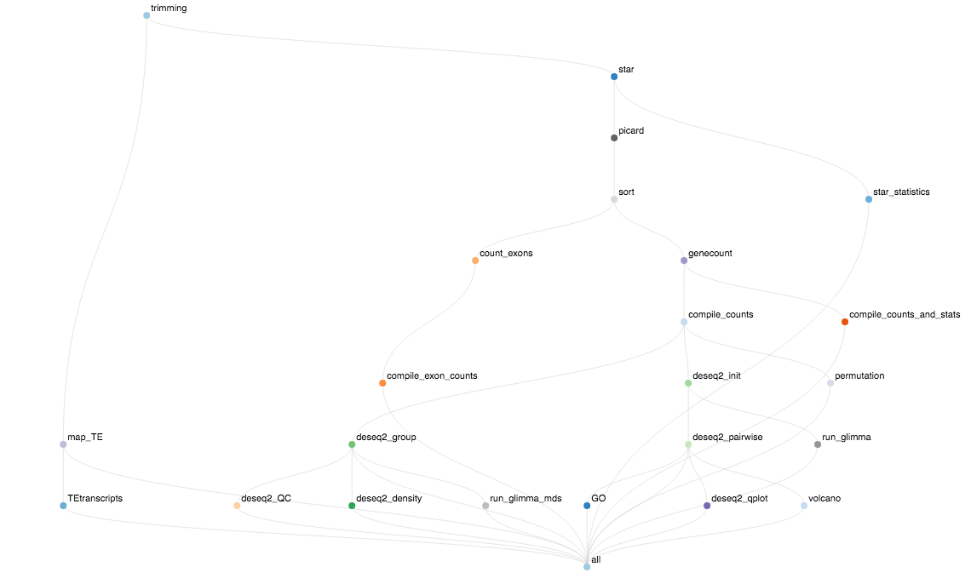
Example workflow for cfRNA-seq-pipeline
**The outputs of these rules are the only things that need to be in your rule all

Slide 31
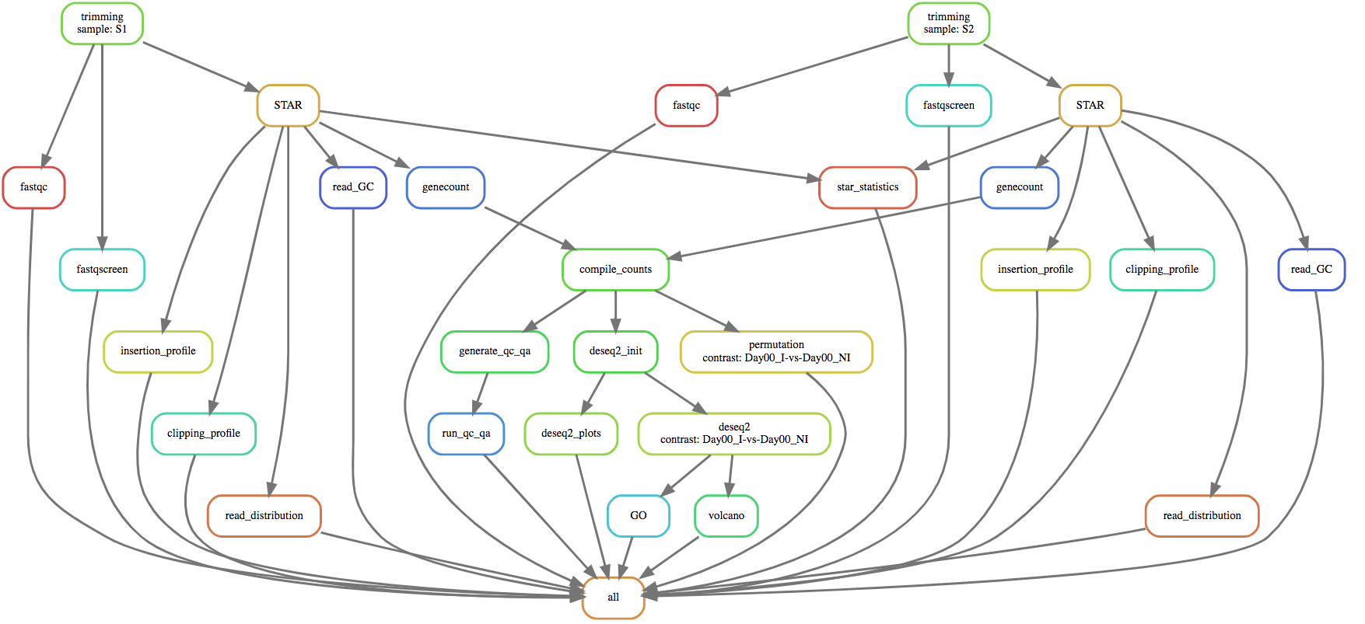
Example DAG
**A node for every job that will be launched

Slide 32
Other files used in these workflows and their format
config.yaml
Spacing defines your “blocks” of code
cluster.json
Name must exactly match the name of your rule
Include this in your Snakefile, and it will loop through your cluster.json file and create a directory for each rules log files
Import json
with open('cluster.json') as json_file:
json_dict = json.load(json_file)
rule_dirs = list(json_dict.keys())
for rule in rule_dirs:
if not os.path.exists(os.path.join(os.getcwd(),'logs',rule)):
log_out = os.path.join(os.getcwd(), 'logs', rule)
os.makedirs(log_out)
print(log_out)

Slide 33
Your best friend
The “dry-run”
snakemake will build your DAG, ensure all your syntax is correct, and report the number of jobs it is expecting to launch for each rule
Easiest way to debug surface-level errors
This does not mean your workflow will run without errors, but it will help you to debug the majority of the issues you will run into
snakemake -np --verbose

Slide 34
Common errors you will run into
Missing input files for rule all
There is a mismatch between how the input / output is specified in your rule all vs. your rule
Cannot resolve wildcards
There is a mismatch between the input for a rule and your wildcard definition
Jobs hanging and never finishing OR jobs saying they are “submitted” in your workflow_submission.log file, but do not show up running on exacloud
The proper logs directory is not getting created for that rule
Increase latency-wait time
Sometimes there is a lag between exacloud and snakemake, and snakemake thinks that some rules have not created the proper output, but they are there. Just re-submit your workflow if your output files are there.
Multi-line EOF statement OR syntax error
Missing commas

Slide 35
How to track down your errors
logs/workflow_submission.log
This tracks the launching of your jobs and the success/failure of your overall snakemake workflow, not individual jobs
Will tell you if a job fails → once ONE job fails, the workflow stops launching new jobs, but will let currently running jobs finish
logs/{rule}/{rule}_{jobID}.err
For each rule, there will be a unique standard error and standard out file (marked by the job submission ID)
This tracks the error for a given node on the DAG of a workflow

Slide 36
Unique scenarios
You want to run a rule only after a certain output has been created, but you don’t necessarily need that input in your shell command
If you forcibly cancel your workflow (via scancel) or you are kicked off of the node it is launched on, your snakemake workflow will be “locked”
snakemake --unlock (before re-submitting)
You want to define your wildcards in the config file
https://snakemake.readthedocs.io/en/stable/tutorial/advanced.html#step-2-config-files
Debugging a snakemake script
Every time snakemake launches a rule with a snakemake script, it creates a temporary script, but this is deleted once the rule is finished / errors out
Run snakemake interactively in one window (with --verbose specification), copy over the tmp script in another window, and run that with your environment activated to debug

Slide 37
Tips and tricks
Visualizing the DAG
snakemake --dag | dot -Tsvg > dag.svg
Generating a report to summarize your successful ”run”
snakemake --report report.html
https://snakemake.readthedocs.io/en/stable/snakefiles/reporting.html
You can use your environments built by snakemake
snakemake --list-conda-envs
Resources
https://snakemake.readthedocs.io/en/stable/
https://github.com/ohsu-cedar-comp-hub
Example report: report.html

