Slide 1
CCAR
Presented by: James Lee
Danjun Lu
Soumya Bhmidipaty

Slide 2
Agenda
Project Objective
CCAR Overview
Expected Credit Loss(ECL)
Exposure at Default(EAD)
Loss Given default(LGD)
Probability of default(PD)
Methods and Estimations
EAD
LGD
PD
Final Results
Implications and Notes

Slide 3
Project Objective
Forecasting the expected credit loss for 9 quarters on Fannie Mae mortgage loan datasets under three macroeconomic scenarios.

Slide 4
CCAR Overview
Comprehensive Capital Analysis Review
Who is required?
Stress test for large bank holding companies in the US with total assets larger than $50M
What is the goal?
Banks set aside provisions to absorb future losses
What are the requirements?
Evaluate and report capital position under three supervisory scenarios (Baseline / Adverse / Severe)
Where do we look for?
Expected Credit Loss in financial statements

Slide 5
Expected Credit Loss(ECL)
Dismantling ECL
E[L] = P(Loss)*Loss
= PD*Loss
= PD*LGD*EAD, where LGD = Loss/EAD
Result from possible default events over the life of loan.

Slide 6
Exposure at Default (EAD)
Definition
The maximum total amount bank might lose if all of borrowers default.
Often calculated for each loan. (Loan-Level)
Properties
EAD = Current outstanding amount for fixed loans
For mortgage loans, EAD = Unpaid Balance (UPB)

Slide 7
Loss Given Default (LGD)
Dismantling LGD
LGD = Loss/EAD
Loss = EAD + Costs – Proceeds
Model
Linear Regression--
Costs = b₀ + b₁ *FICO + b₂ *DTI + b₃ *LTV + … + b_{n} *HPI + b_{n+1} *MR + b_{n+2} *UR
Proceeds = b₀ + b₁ *FICO + b₂ *DTI + b₃ *LTV + … + b_{n} *HPI + b_{n+1} *MR + b_{n+2} *UR

Slide 8
Probability of Default (PD)
Purpose
Estimating the likelihood of a default over a particular time horizon
→ Understanding the effect of different macroeconomics scenarios
Model
Logistic Regression

Slide 9
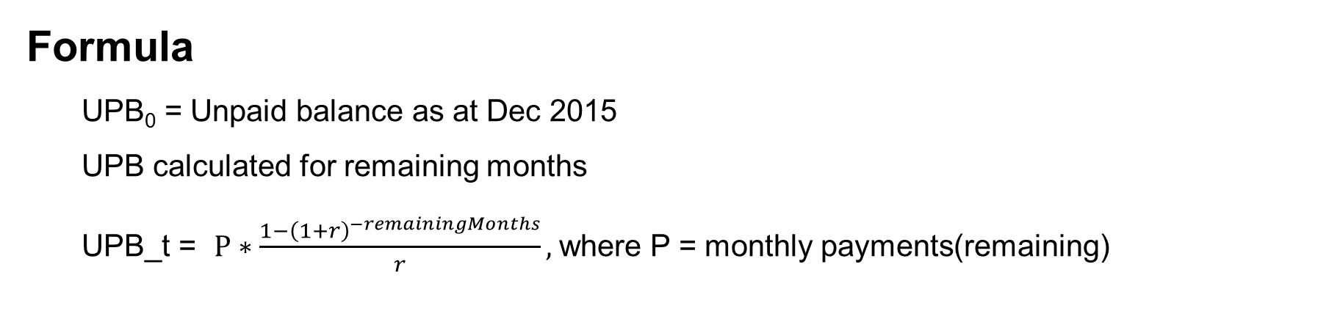
Method: EAD
Formula
UPB₀ = Unpaid balance as at Dec 2015
UPB calculated for remaining months
UPB_t = $P∗\frac{1−{\left(1+r\right)}^{−remainingMonths}}{r},$where P = monthly payments(remaining)
Notes
Fixed-rate mortgage
Rate changes over period, current rate goes up, EAD goes down

Slide 10
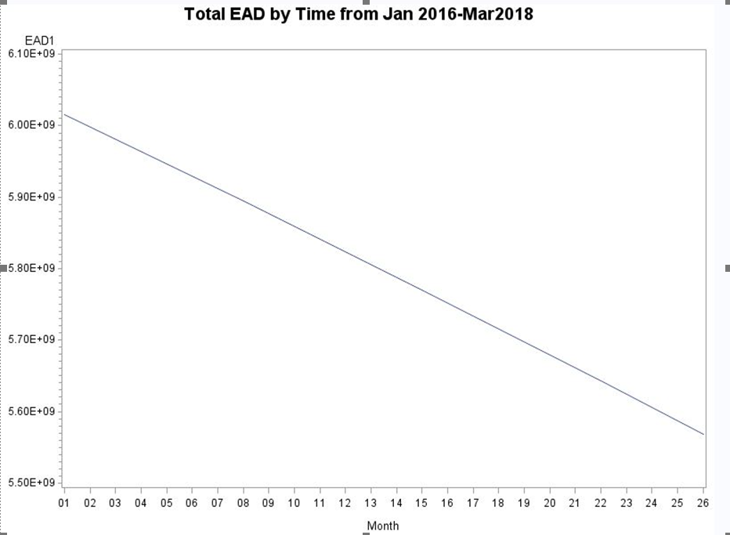
Results: EAD
Decreasing linearly over time…

Slide 11
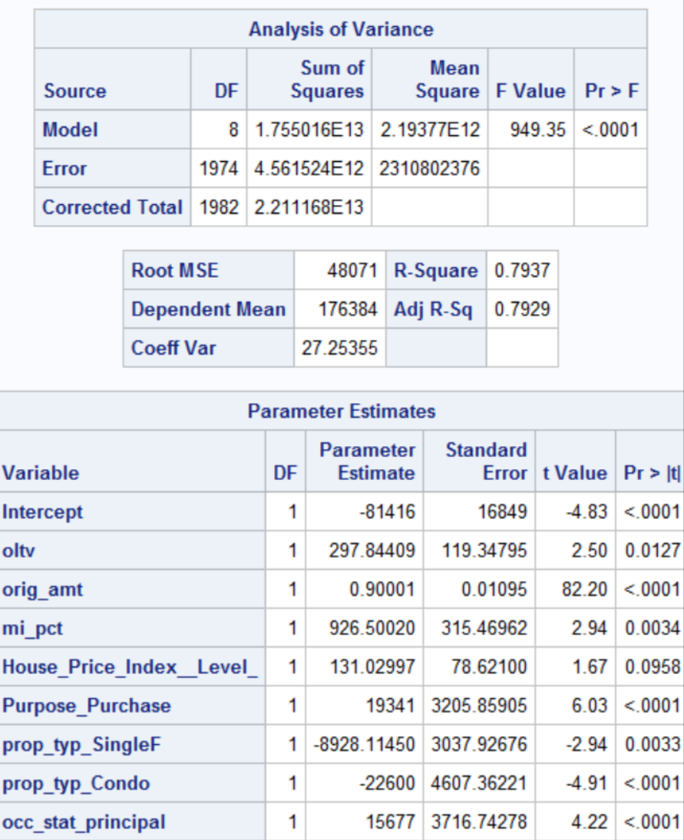
Method: LGD/Cost Regression
Notes
Costs = 4046.61 + 159.26*HPI + 0.039*orig_amount - 2159.37*Unemployment + 7367.74*cluster1 + 1920.48*cluster2
HPI: House Price Index
Cluster ‘State’ using K-means, 0-1 value.

Slide 12
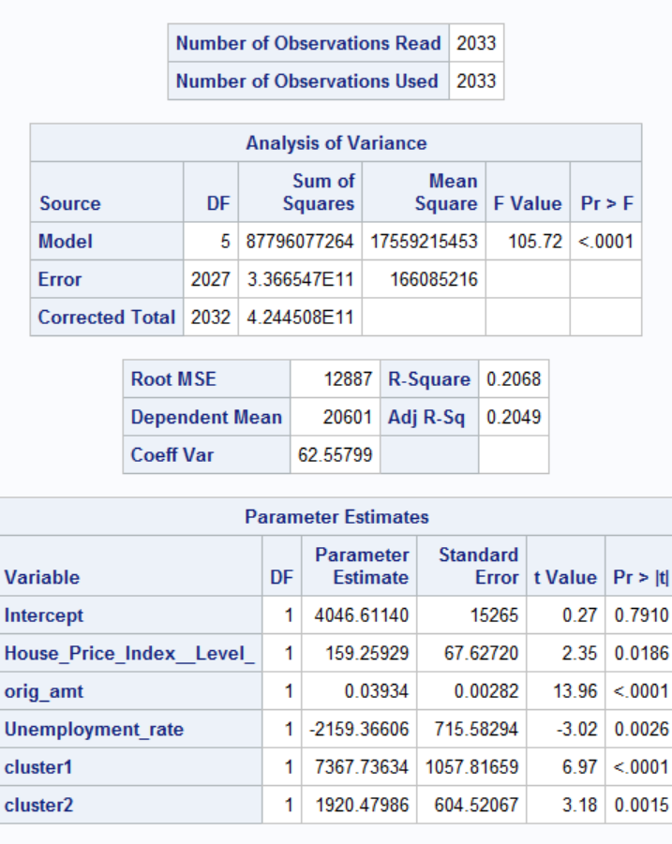
Method: LGD/Proceeds Regression
Notes
Proceeds = -81416 + 297.84*oltv + 0.9*orig_amount + 926.5*mi_pct + 131.03*HPI + 19341*Purpose_Purchase – 8928.11*prop_typ_SingleF – 22600*prop_typ_Condo + 15677*occ_stat_principal
Oltv: original loan to value
Mi_pct: mortgage insurance percentage
Purpose_Purchase: 0-1 value
prop_typ_SingleF: property type - Single Family, 0-1 value
prop_typ_Condo: property type – Condo, 0-1 value
Occ_stat_principal: occupancy stastus – Principal, 0-1 value

Slide 13
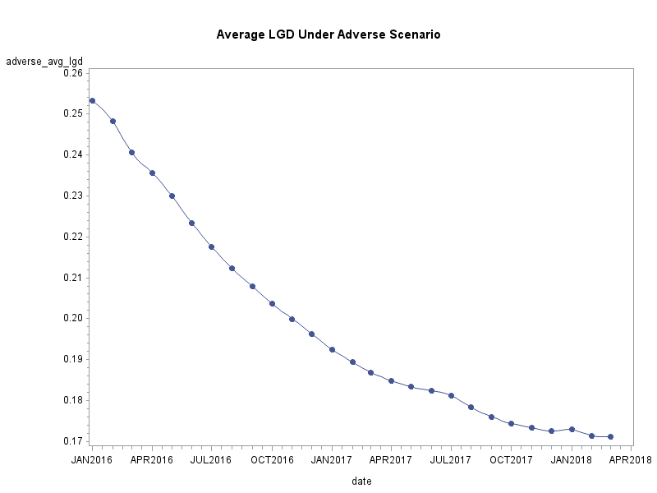
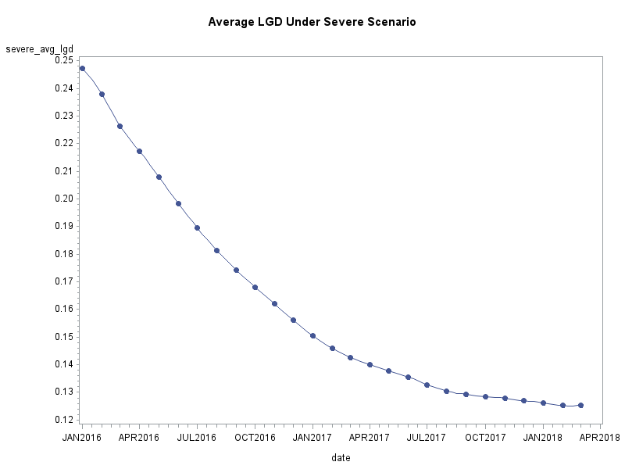
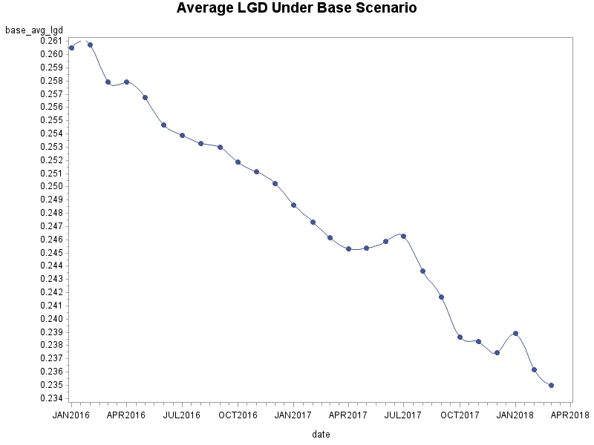
Results: LGD
Revise needed. /James

Slide 14
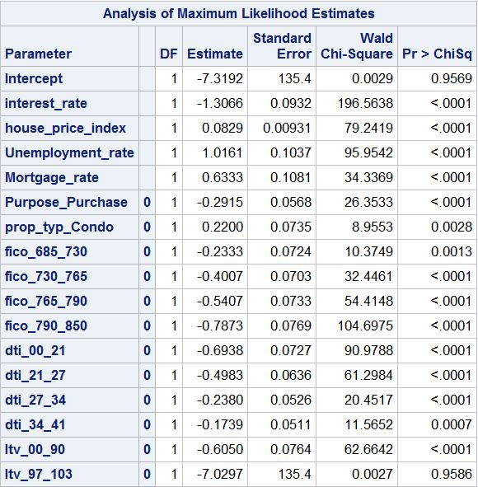
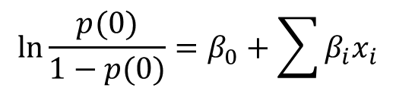
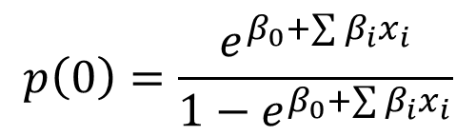
Method: PD/Logistic Regression
Notes
$$\ln{\frac{p(0)}{1−p(0)}=β_{0}+\sum{β_{i}x_{i}}}$$
$$p\left(0\right)=\frac{e^{β_{0}+\sum{β_{i}x_{i}}}}{1−e^{β_{0}+\sum{β_{i}x_{i}}}}$$

Slide 15
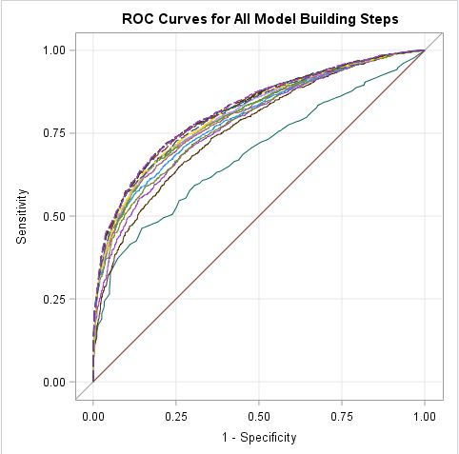
Method: PD/ROC Curve
Notes
False Positive Rate=25%
False Negative Rate=26.3%

Slide 16
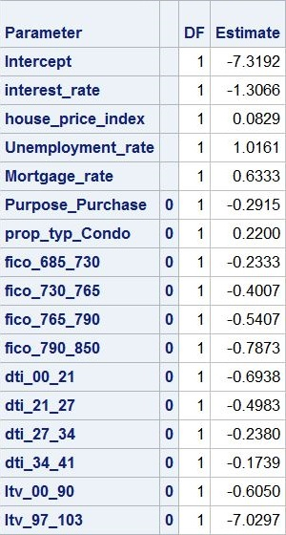
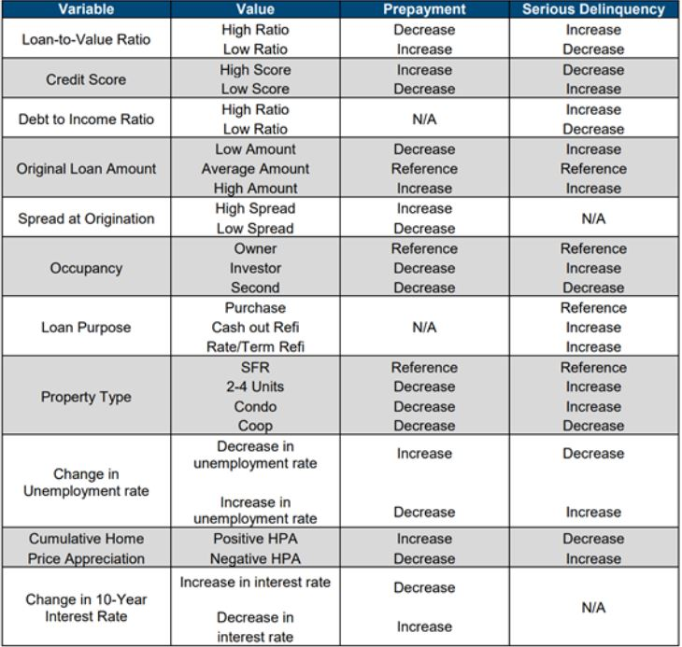
Comparison: PD Parameters

Slide 17
Results: PD/ROC Curve
Notes
False Positive Rate=25%
False Negative Rate=26.3%

Slide 18
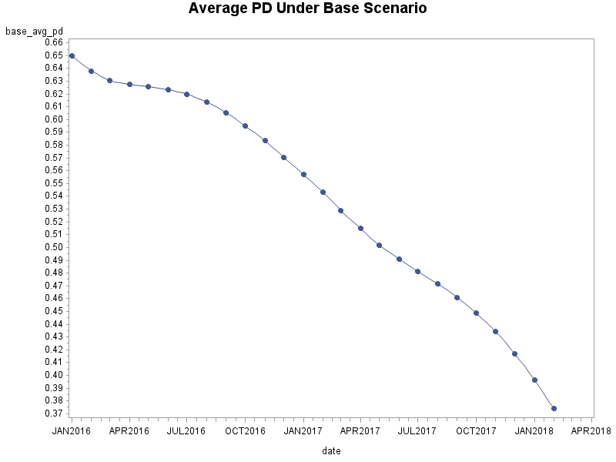
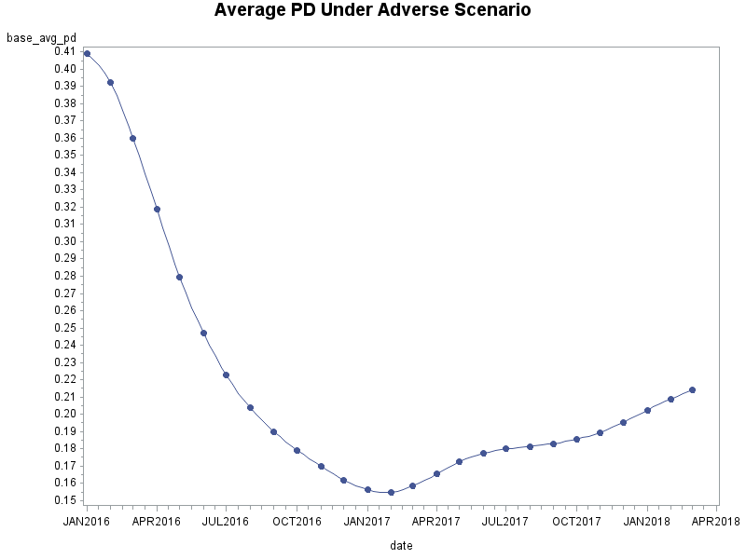
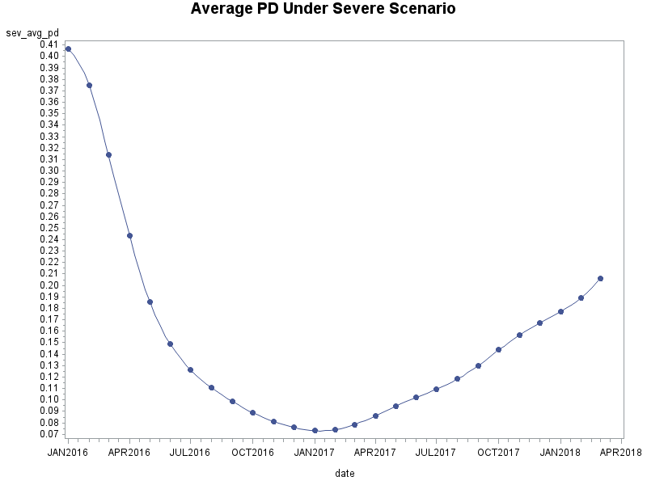
Results: PD
Revise needed. /James

Slide 19
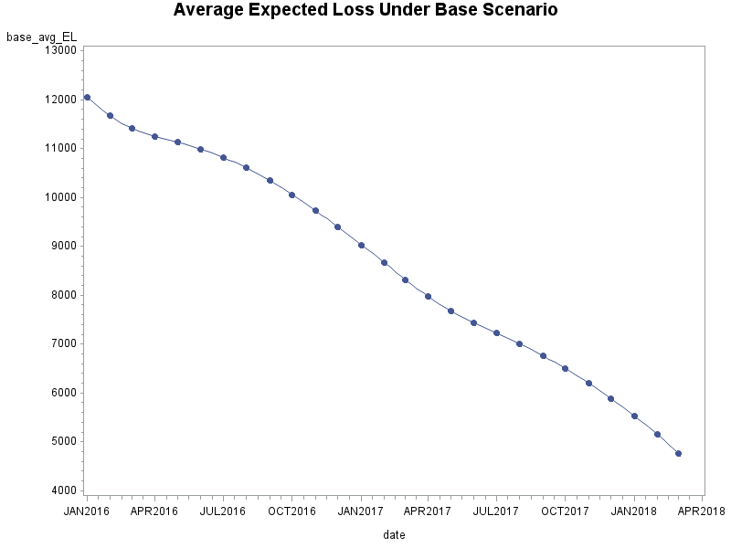
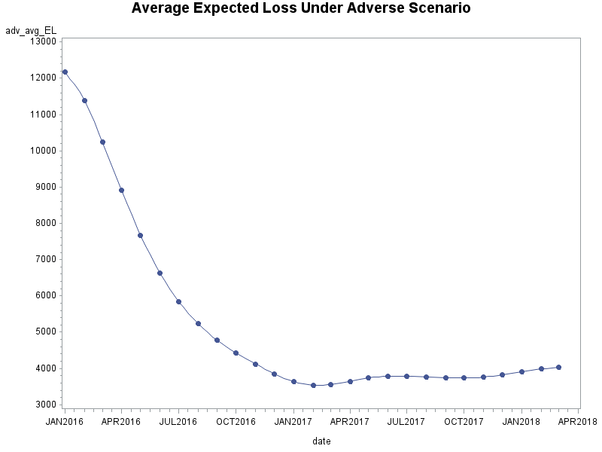
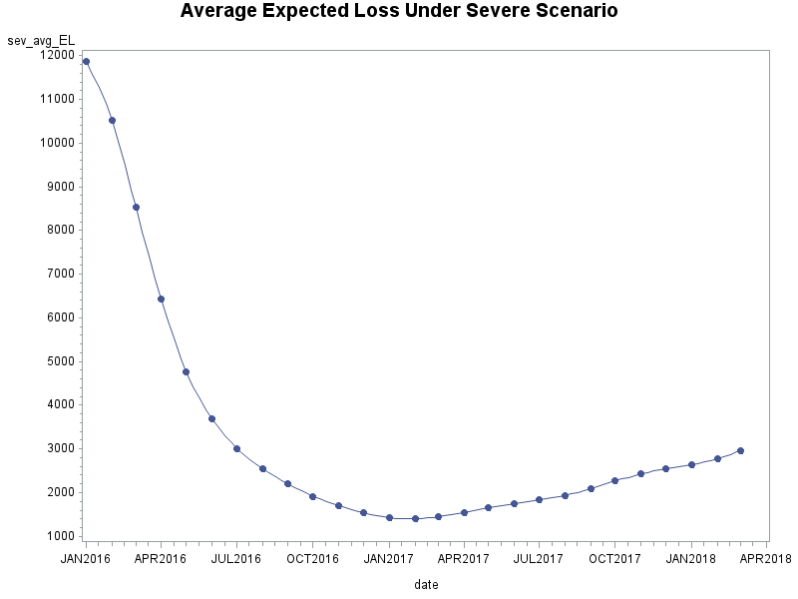
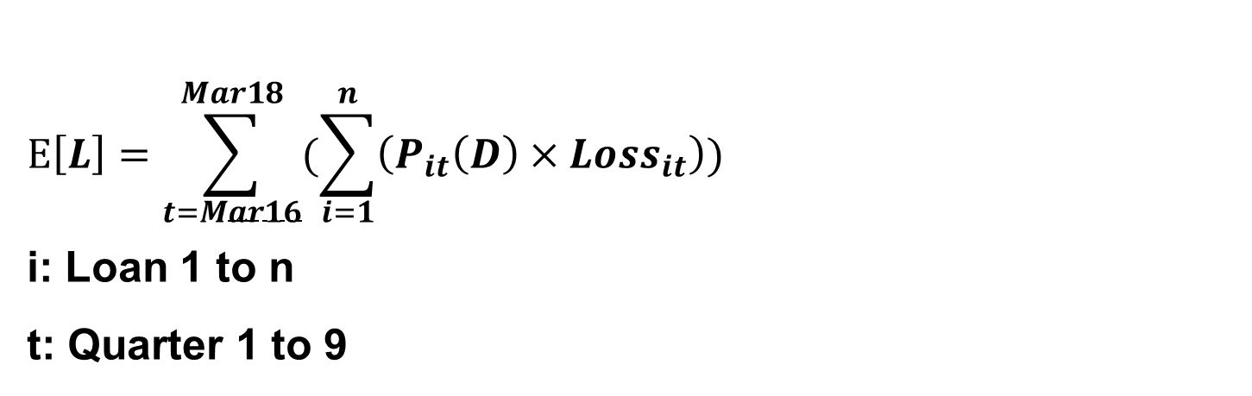
Final Results
$$E\left[L\right]=\sum_{t=Mar16}^{Mar18}{(\sum_{i=1}^{n}{\left(P_{it}\left(D\right)×{Loss}_{it}\right)})}$$
i: Loan 1 to n
t: Quarter 1 to 9
Revise needed. /James

Slide 20
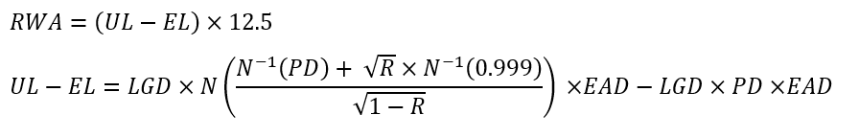
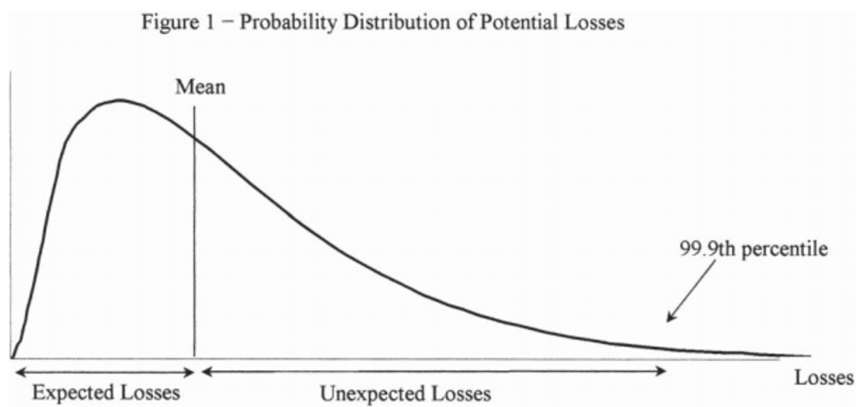
Implications
Risk weighted asset(RWA)
RWA = Risk Weighted Asset = Risk weighted according to its risk

Slide 21
Implications
Tier 1 Capital Ratio
Tier 1 Capital Ratio=Equity/RWA

Slide 22
THE END
Presented by: James Lee
Danjun Lu
Soumya Bhmidipaty
Any Questions?

Slide 23
