Slide 1
CCAR PROJECT
Group 4
James Lee , Soumya Bhamidipaty & Danjun Lu

Slide 2
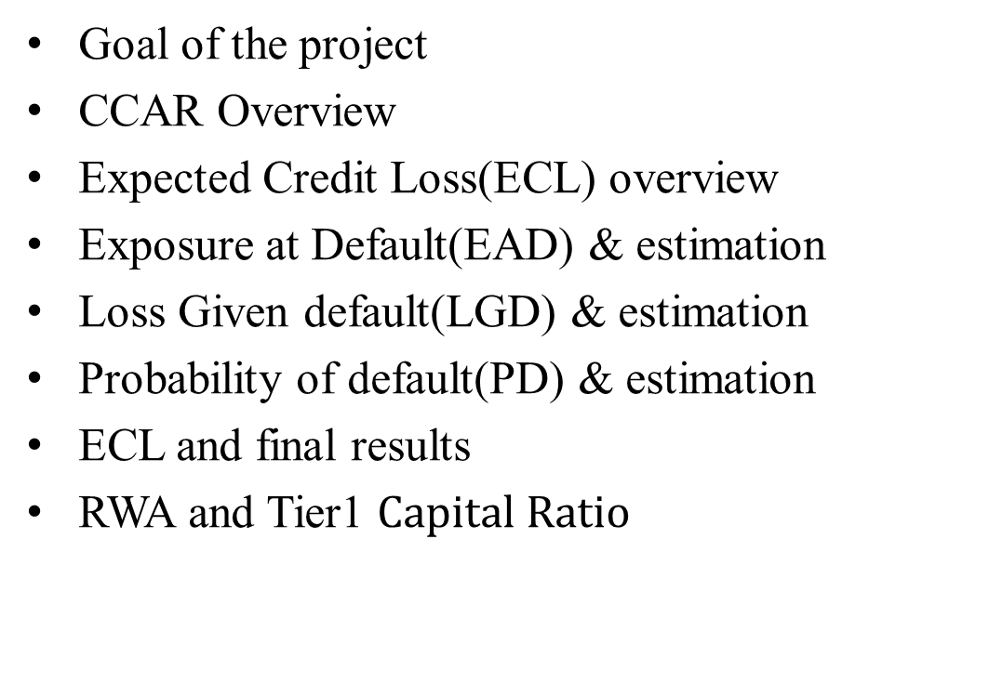
AGENDA
Goal of the project
CCAR Overview
Expected Credit Loss(ECL) overview
Exposure at Default(EAD) & estimation
Loss Given default(LGD) & estimation
Probability of default(PD) & estimation
ECL and final results
RWA and Tier1 $Capital Ratio$

Slide 3
Goal of the Project
Forecast nine-quarter Expected Loss for a portfolio of mortgage loans from Freddie and Fannie Mae(2009Q1) under three CCAR economic scenarios – Baseline, Adverse and Severely adverse.

Slide 4

CCAR Overview
Comprehensive Capital Analysis Review
Stress test for large Bank Holding Companies in the US
Total assets>$50M
Banks set aside provisions to absorb future losses
Evaluate and report capital position under three supervisory scenarios
Baseline, adverse, and severely adverse scenarios

Slide 5
Where do we look for ?
Financial Statements
Which metric in financial statement ?
Expected Credit Loss

Slide 6
Expected Credit Loss(ECL)
Result from possible default events over the life of loan.
Weighted average credit losses with probability of default(PD) as weight
E[L] = P(Loss)*Loss
ECL = PD*Loss
ECL = PD*LGD*EAD (as per industry standards defined by regulators)
where LGD = Loss/EAD

Slide 7
Exposure at Default (EAD)
Total max amount bank might lose
If all borrowers default
Often calculated for each loan
EAD – current outstanding amount for fixed loans
EAD = UPB(for mortgage loans)

Slide 8

EAD Estimation
UPB_0 = Unpaid balance as at Dec 2015
UPB calculated for remaining months
UPB_t = $P∗\frac{1−{\left(1+r\right)}^{\begin{aligned}−remainingMonths \\ \end{aligned}}}{r}$
where P = monthly payments(remaining)
Fixed-rate mortgages considered
But rates change over a period- several factors
EAD = UPB is a Future Value
As current rates go up, EAD goes down

Slide 9
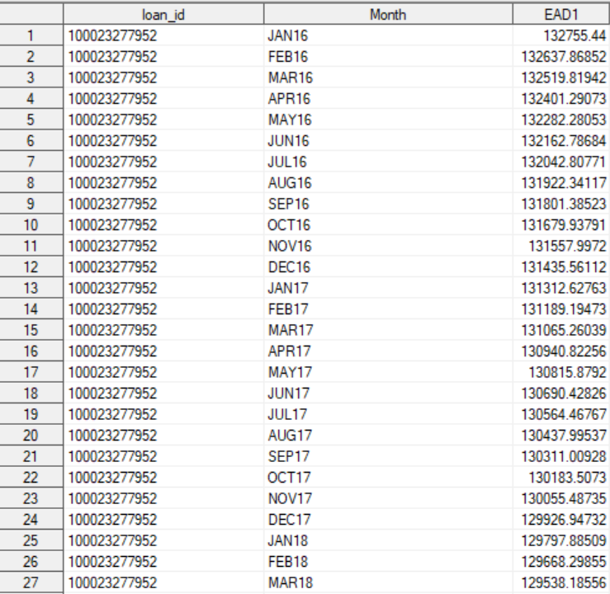
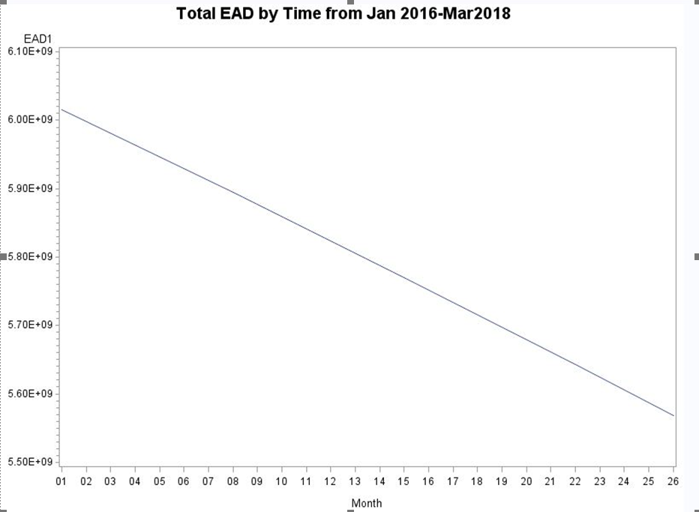
EAD Results

Slide 10
Loss Given default (LGD)
LGD = Loss/EAD
Loss = EAD + Costs – Proceeds
Liner regression:
Costs = b0 + b1 FICO + b2 DTI + b3 LTV + … + bn HPI + bn+1 MR + bn+2 UR
proceeds = b0 + b1 FICO + b2 DTI + b3 LTV + … + bn HPI + bn+1 MR + bn+2 UR

Slide 11
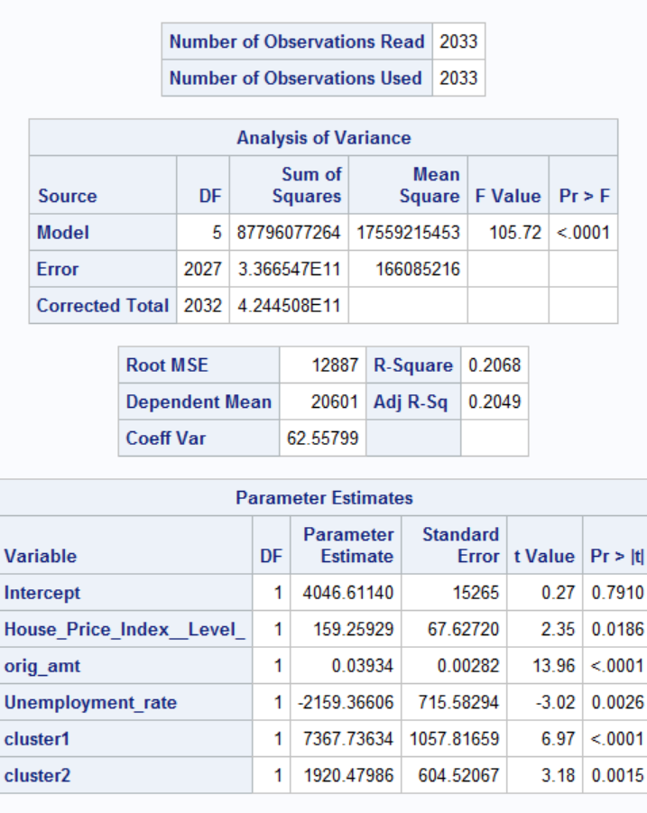
Costs regression
Costs = 4046.61 + 159.26*HPI + 0.039*orig_amount - 2159.37*Unemployment + 7367.74*cluster1 + 1920.48*cluster2
HPI: House price index
Cluster1 & cluster2: Cluster ‘State’ by Kmeans, 0-1 value.

Slide 12
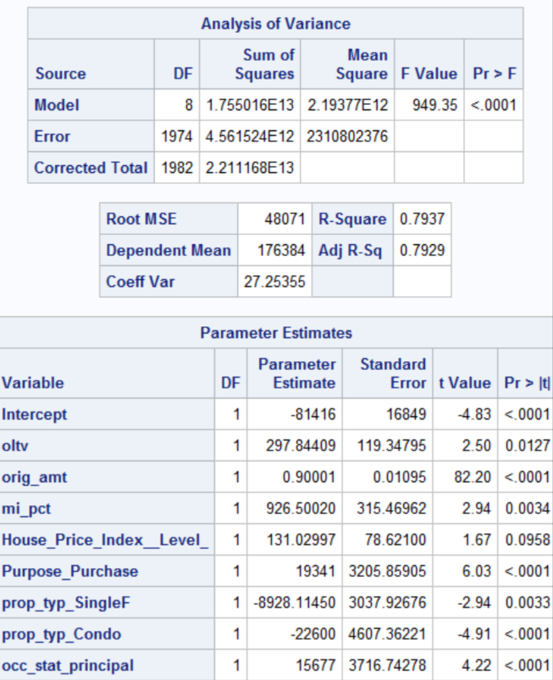
Proceeds regression
Proceeds = -81416 + 297.84*oltv + 0.9*orig_amount + 926.5*mi_pct + 131.03*HPI + 19341*Purpose_Purchase – 8928.11*prop_typ_SingleF – 22600*prop_typ_Condo + 15677*occ_stat_principal
Oltv: Original loan to value
Mi_pct: mortgage insurance percentage
Purpose_Purchase: 0-1 value
prop_typ_SingleF: property type - Single Family, 0-1 value
prop_typ_Condo: property type – Condo, 0-1 value
Occ_stat_principal: occupancy stastus – Principal, 0-1 value

Slide 13
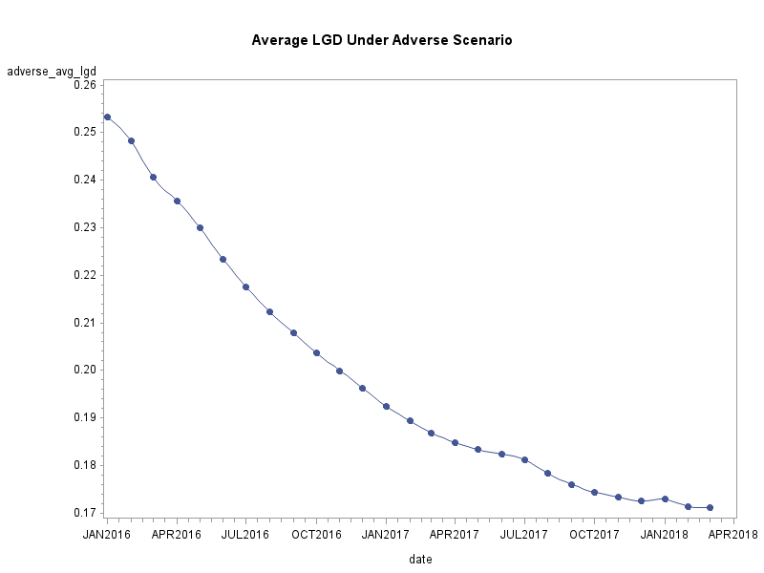
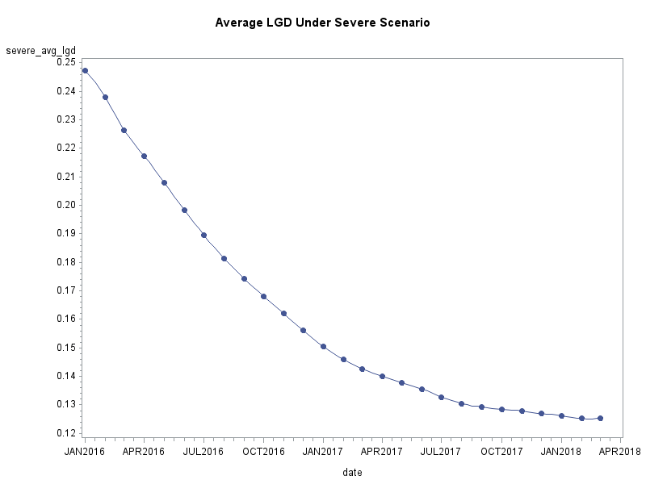
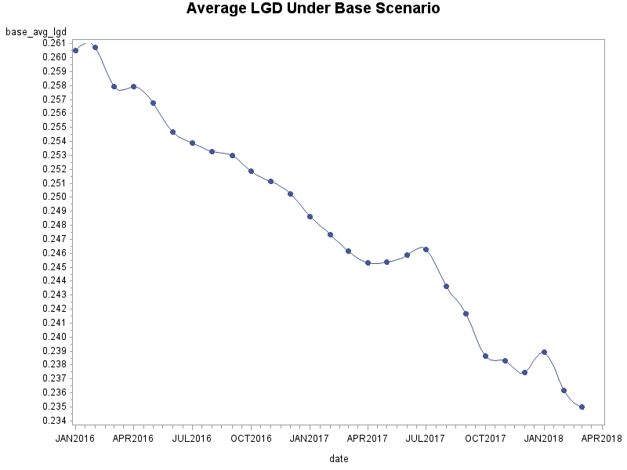
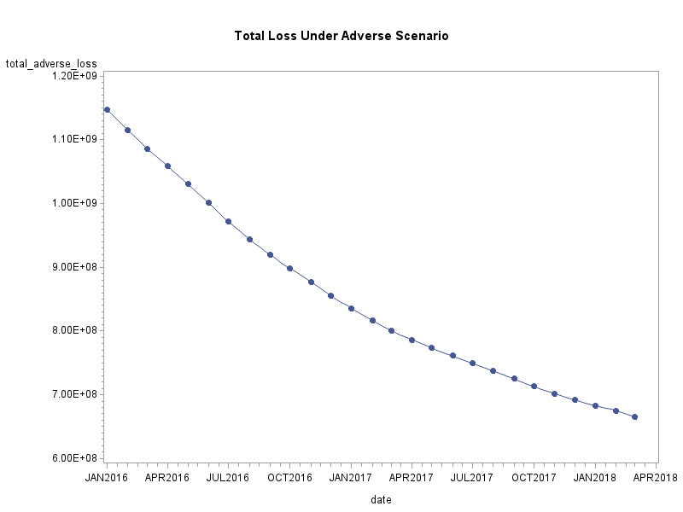
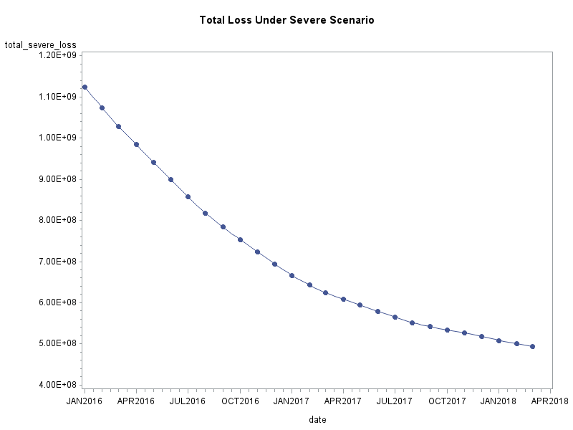
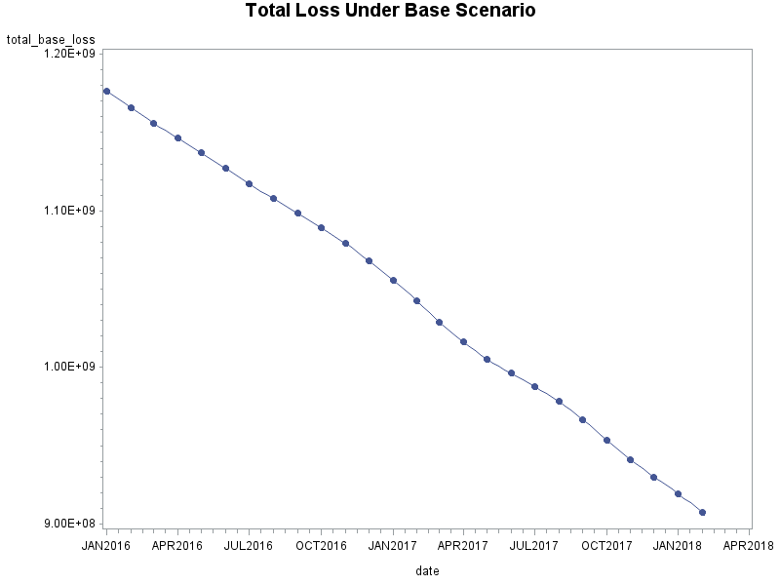

Slide 14




Probability of Default Modeling(PD)
Purpose
Modeling
Discussion
Improvements

Slide 15
Estimating the likelihood of a default over a particular time horizon
→Logistic model
Understanding the effect of different macroeconomics scanarios
→Different MEVs set(Base.Adverse.Severe)
Purpose

Slide 16
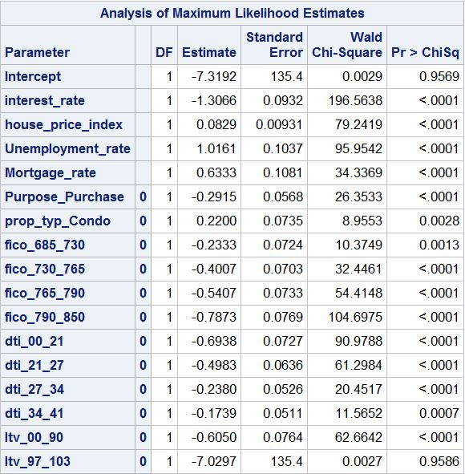
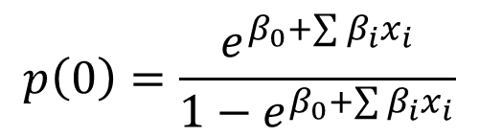
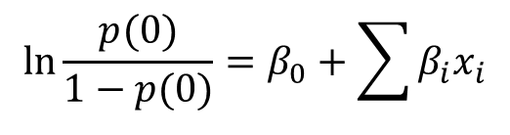
Modeling
$$\ln{\frac{p(0)}{1−p(0)}=β_{0}+\sum{β_{i}x_{i}}}$$
$$p\left(0\right)=\frac{e^{β_{0}+\sum{β_{i}x_{i}}}}{1−e^{β_{0}+\sum{β_{i}x_{i}}}}$$
Notes:
Millian’s Report // Technical Notes: 1/-1 contrast: 0->1 1->-1 threshold=0.5(after balancing! Note the unbalanced data)

Slide 17
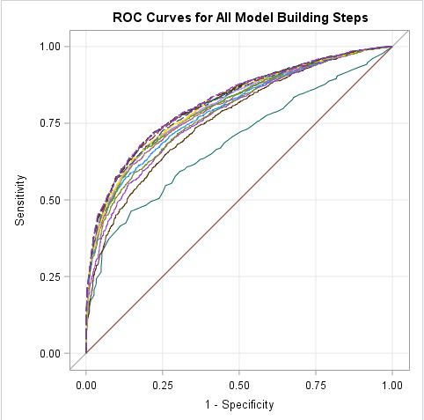
Modeling
False Positive Rate=25%
False Negative Rate=26.3%

Slide 18
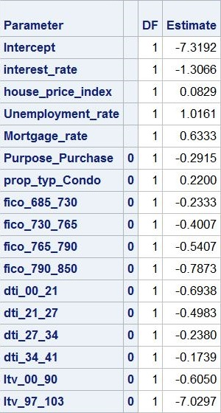
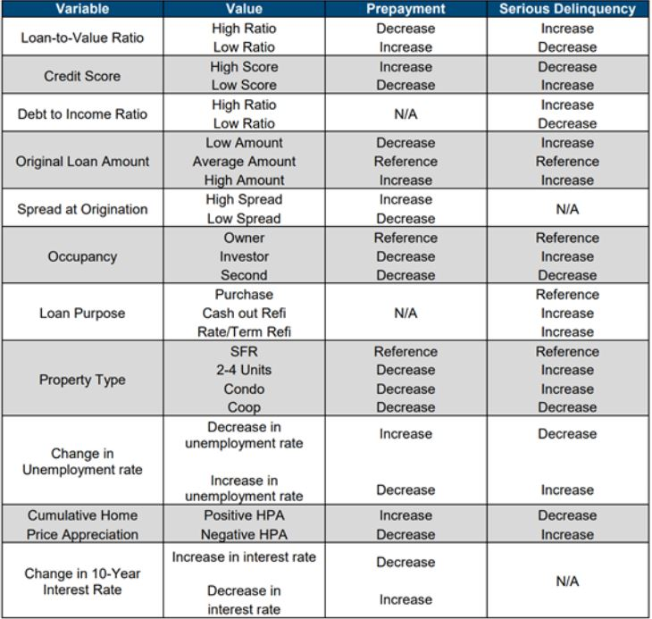
Discussion

Slide 19
Validation on the Model
Low R^2
→Alternative Method?
→”Obscure” estimate on probability of default
Improvements

Slide 20
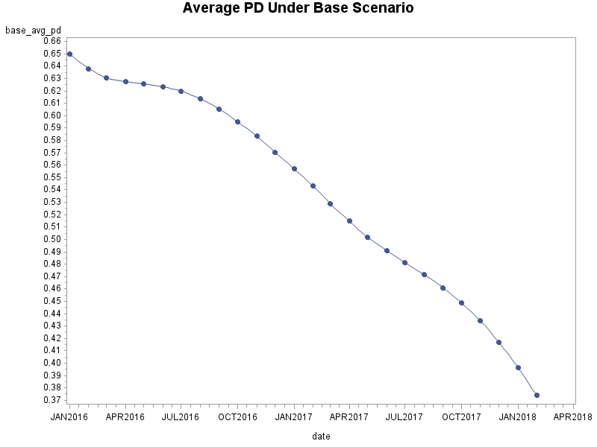
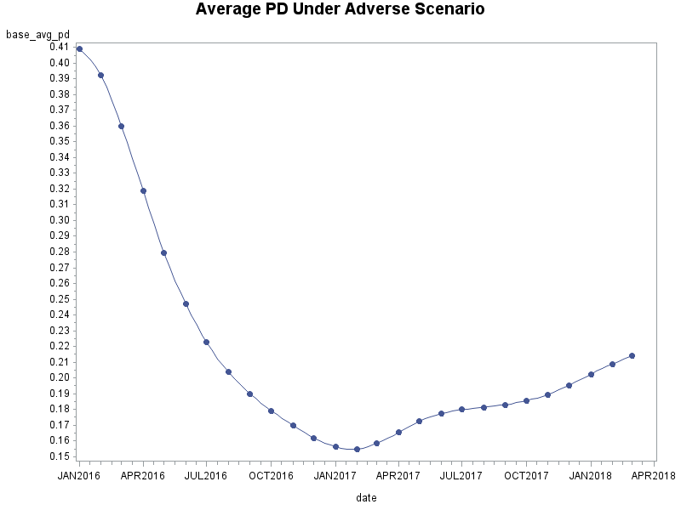
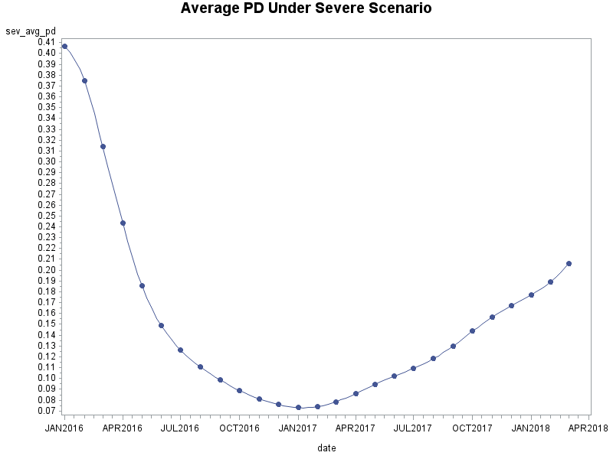
Average Probability default

Slide 21
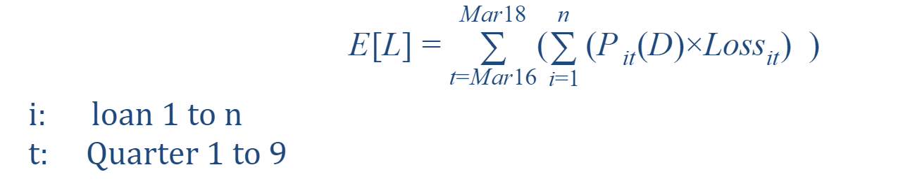
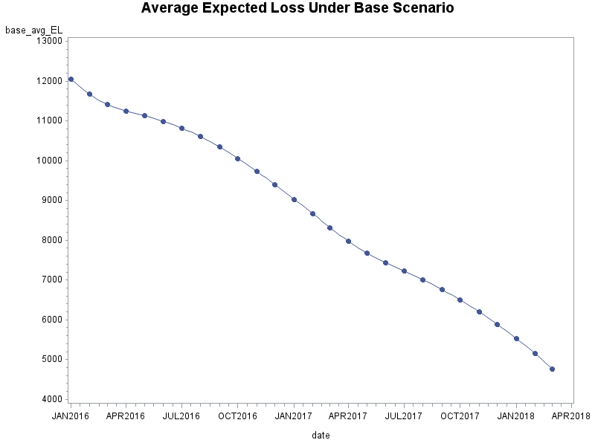
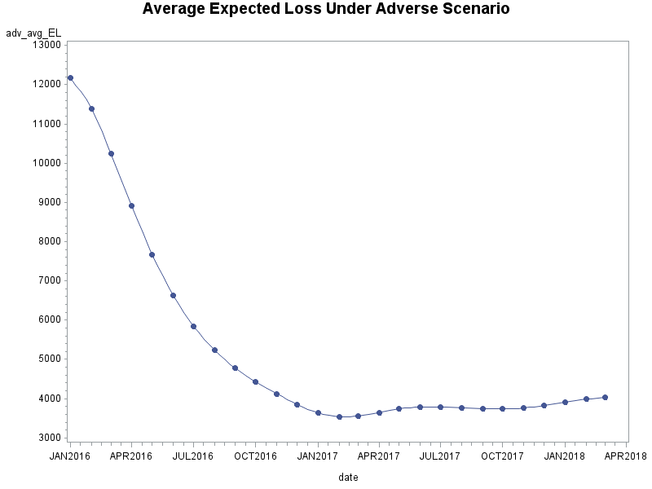
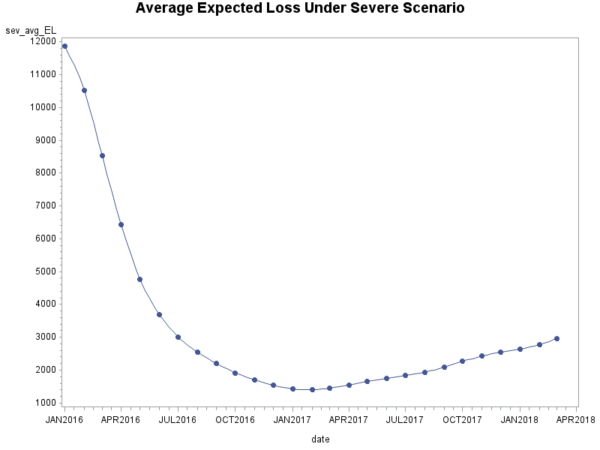
Expected Credit Loss (ECL)

Slide 22
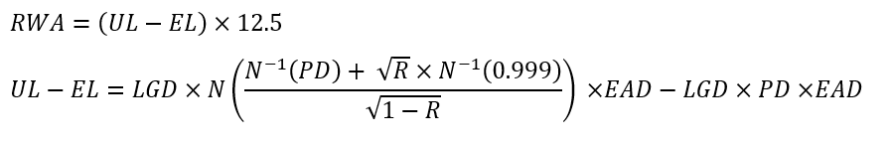
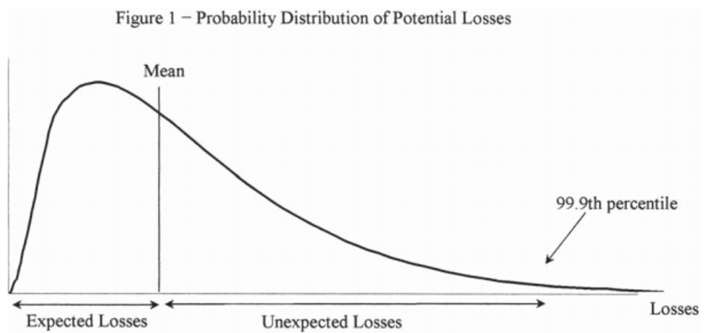
Risk Weighted Asset (RWA)
RWA = Risk Weighted Asset = Risk weighted according to its risk
Where,
R: Correlation factor for Residential Mortgages=0.15

Slide 23


$$Tier 1 Capital Ratio$$
$$Tier 1 Capital Ratio=\frac{Equity}{RWA}$$

Slide 24
Thank you

