Slide 1
GUN
VIOLENCE
JAMES LEE
INCIDENTS
09-07-2022

Slide 2
TABLE OF
01
INTRODUCTION
02
DATA
03
DATA PIPELINE
04
WEB APPLICATION
CONTENTS
Objective
Motivation
Data Information
Data Requirement
Flowchart
Methodology
Streamlit
Demonstration

Slide 3
TABLE OF
05
CONCLUSION
06
FUTURE WORKS
CONTENTS
Insights
Summary
Improvements
New Opportunity

Slide 4
01
INTRODUCTION
Motivation:
There have been increase in gun violence recently. Unfortunately, the outcome of gun violence is horrifying.
How can we help general public be more informed and aware of incidents?
Objective:
Provide an app that summarizes the gun violence statistics and locations.

Slide 5

02
DATA
DATA INFORMATION
DATA REQUIREMENTS
Raw data downloaded from Kaggle. - 239,677 rows & 29 columns - Numeric and string data types - 2013~2018 USA
Cleaned and reduced data have: - 231,754 rows - 8 columns - Numeric and string data types
https://www.kaggle.com/datasets/jameslko/gun-violence-data

Slide 6







03
DATA PIPELINE
DATA INGESTION
PROCESSING I
PROCESSING II
DATA PREPROCESSING
DATA STORAGE
Deployment

Slide 7
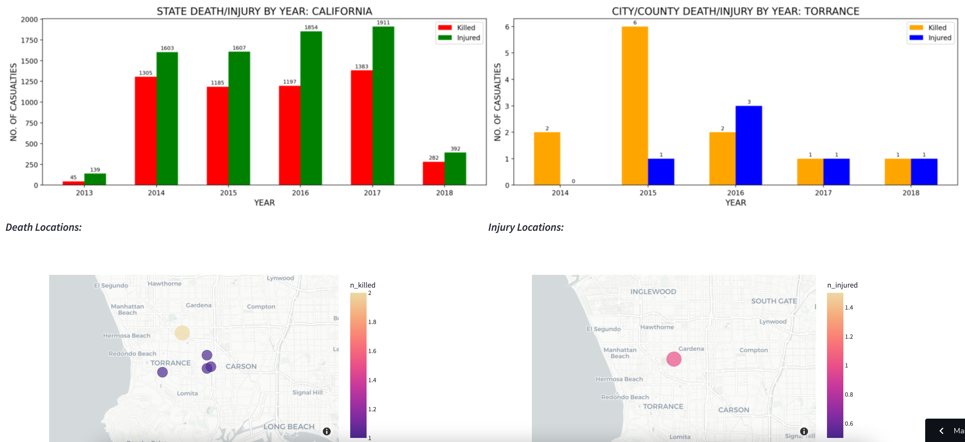
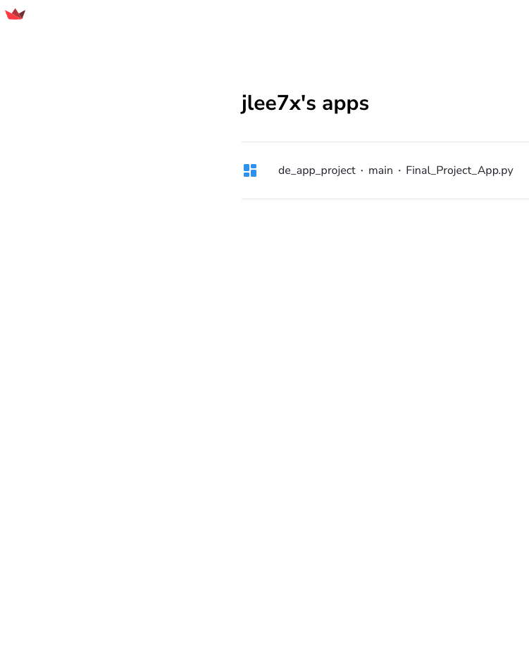
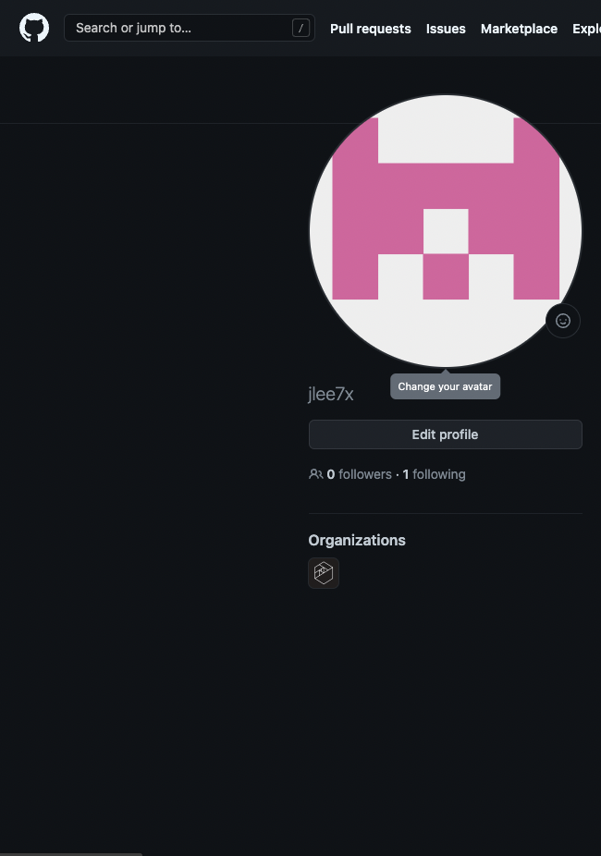
04
WEB APPLICATION DEMONSTRATION
https://jlee7x-de-app-project-final-project-app-tn2wv3.streamlitapp.com/

Slide 8
05
Conclusion #01
Conclusion #02
Conclusion #03
Conclusion #04
CONCLUSIONS
More injuries than death from gun violence.
Big jump in gun violence number in 2014.
Big reduction in gun violence from 2017 to 2018, due to data ending at March in 2018.

Slide 9
06
#01
#02
#03
FUTURE WORK
Add more visualization that displays more metrics, such as age, gender, etc., to users.
Automate the data pipeline to obtain daily data and update the app.
Implement Natural Language Processing to get insights and trends of behaviors of perpetrator from article data in the original data.

Slide 10


Slide 11
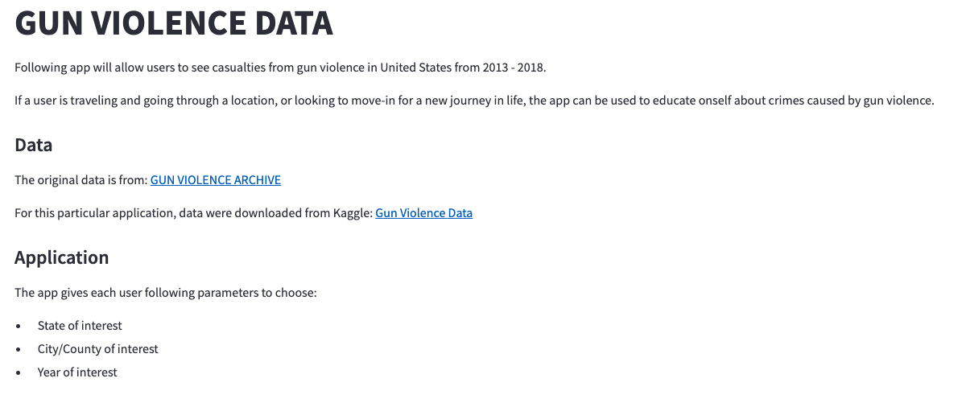
04
WEB APPLICATION INTRODUCTION (BACK-UP)

Slide 12
04
WEB APPLICATION PARAMETERS (BACK-UP)
-First parameter to choose.
-Drop-down
-Second parameter to choose.
-Drop-down
-Third parameter to choose.
-Slidebar

Slide 13
04
WEB APPLICATION DEMONSTRATION (BACK-UP)

