Slide 1

MIPSRAY: A Ray Tracer
  Josh Lee, Gary Doran
  EECS 314: Computer Architecture

Slide 2
Ray Tracer Overview
Camera Ray
Ray Tracer
Color

Slide 3
The Camera Ray
Image
Plane
Current
Pixel
Camera

Slide 4

The Ray Tracing Algorithm
^{Reflection}
^{Normal}
Hit
^{Shadow Test}
^{From Camera}

Slide 5
The Ray Tracing Algorithm
Start with a ray…
Recursive call
for reflect/refract
For each shape,
Compute the hit
Take the
closest hit
Illuminate
and shade
…and return a color

Slide 6
Implementation Challenges
Repeated vector arithmetic
  Module (add, subtract, scalar, cross, dot, norm)
Root solvers (linear, quadratic)
Shape solvers (sphere, plane)
BMP file format
Debugging

Slide 7
Pretty pictures!

Slide 8
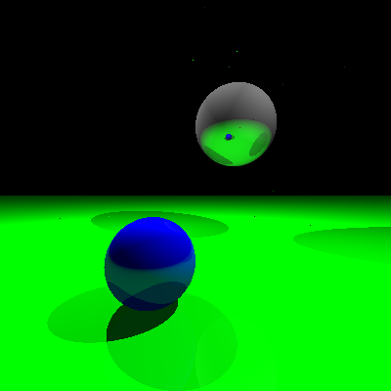

Slide 9
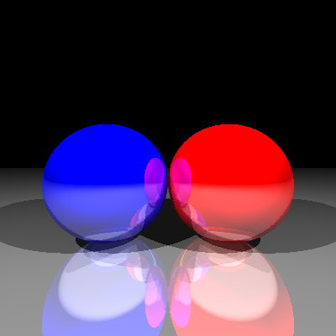

Slide 10
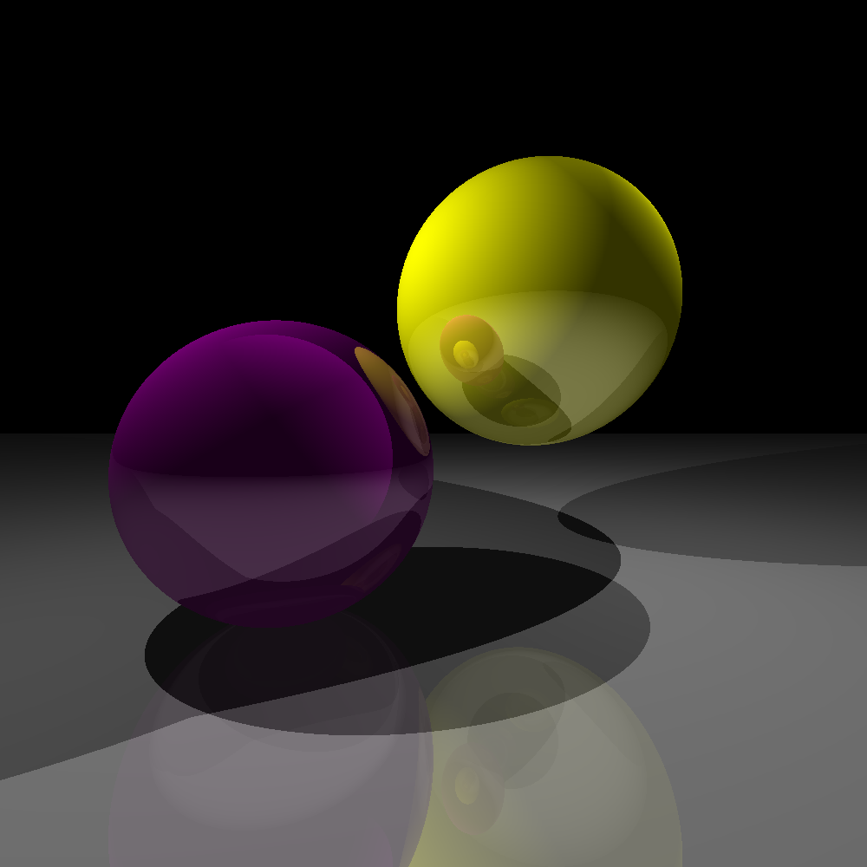

Slide 11
